Slide 1
PHYS 3313 – Section 001 Lecture #13
Wednesday, Oct. 23, 2013
Dr. Jaehoon Yu
Wave Function Normalization
Time-Independent Schrödinger Wave Equation
Expectation Values
Operators – Position, Momentum and Energy
Infinite Square Well Potential

Slide 2
Announcements
Mid-term grade discussion Monday, Oct. 28
In Dr. Yu’s office, CPB 342
Last name begins with A – C: 12:50 – 1:20pm
Last name begins with D – L: 1:20 – 1:50pm
Last name begins with M – Z: 1:50 – 2:20pm
Colloquium today
4pm today, SH101, Dr. X. Chu, U. of Colorado
Double extra credit for this colloquium

Slide 3
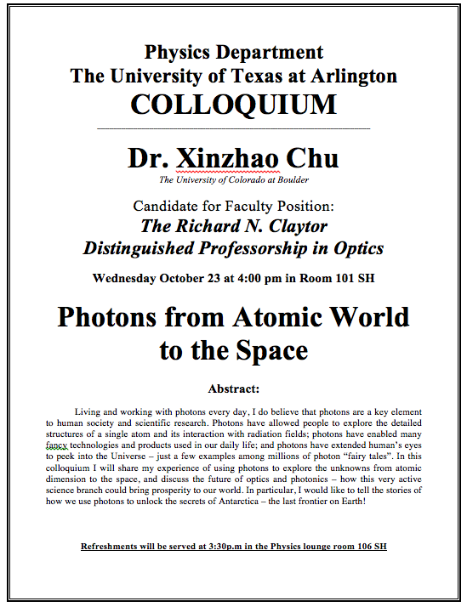

Slide 4
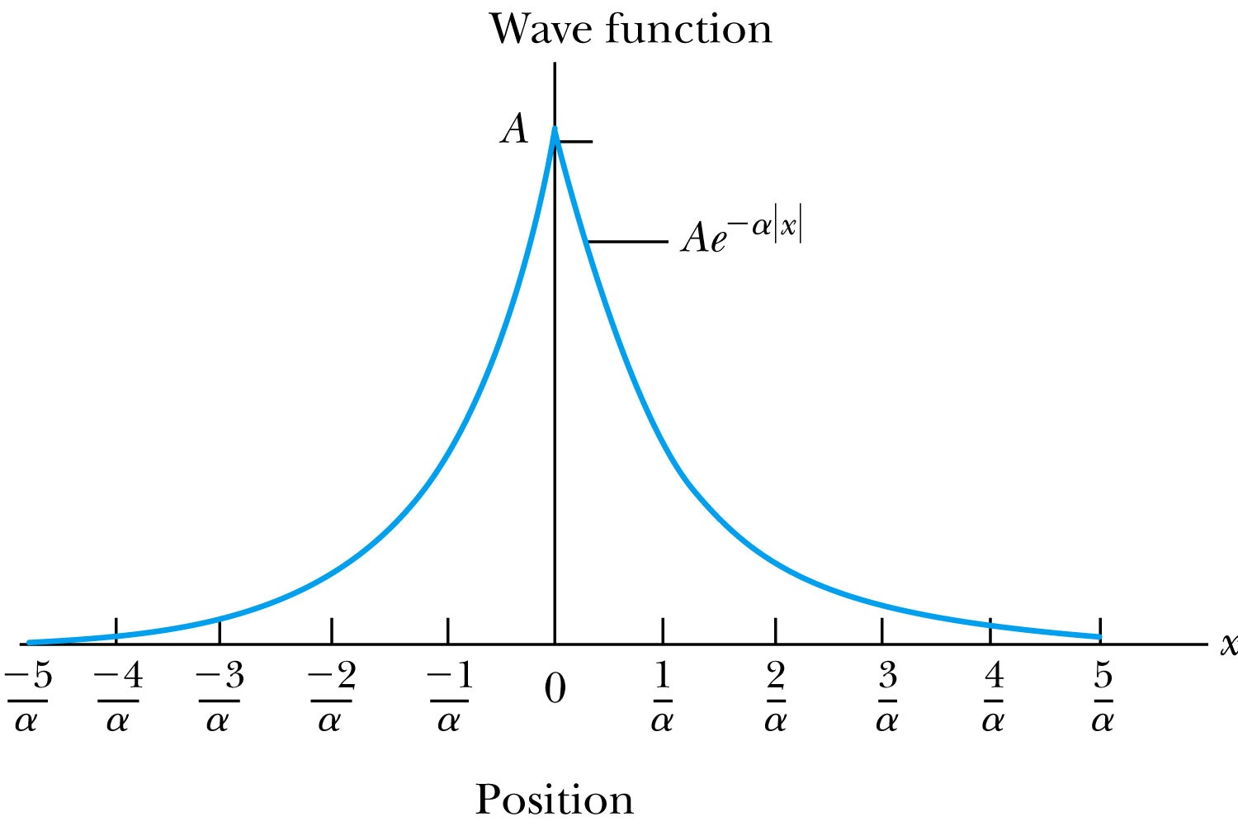
Ex 6.4: Normalization
Consider a wave packet formed by using the wave function that Ae^{-α|ξ|}, where A is a constant to be determined by normalization. Normalize this wave function and find the probabilities of the particle being between 0 and 1/α, and between 1/α and 2/α.
Probability density
Normalized Wave Function

Slide 5
Ex 6.4: Normalization, cont’d
Using the wave function, we can compute the probability for a particle to be with 0 to 1/α and 1/α to 2/α.
For 0 to 1/α:
For 1/α to 2/α:
How about 2/α:to ∞?

Slide 6
Properties of Valid Wave Functions
Boundary conditions
To avoid infinite probabilities, the wave function must be finite everywhere.
To avoid multiple values of the probability, the wave function must be single valued.
For finite potentials, the wave function and its derivatives must be continuous. This is required because the second-order derivative term in the wave equation must be single valued. (There are exceptions to this rule when V is infinite.)
In order to normalize the wave functions, they must approach zero as x approaches infinity.
Solutions that do not satisfy these properties do not generally correspond to physically realizable circumstances.

Slide 7
Time-Independent Schrödinger Wave Equation
The potential in many cases will not depend explicitly on time.
The dependence on time and position can then be separated in the Schrödinger wave equation. Let,
which yields:
Now divide by the wave function:
The left side of this last equation depends only on time, and the right side depends only on spatial coordinates. Hence each side must be equal to a constant. The time dependent side is

Slide 8
Time-Independent Schrödinger Wave Equation(con’t)
We integrate both sides and find:
where C is an integration constant that we may choose to be 0. Therefore
This determines f to be by comparing it to the wave function of a free particle
This is known as the time-independent Schrödinger wave equation, and it is a fundamental equation in quantum mechanics.

Slide 9
Stationary State
Recalling the separation of variables:
and with f(t) = the wave function can be written as:
The probability density becomes:
The probability distributions are constant in time. This is a standing wave phenomena that is called the stationary state.

Slide 10
Comparison of Classical and Quantum Mechanics
Newton’s second law and Schrödinger’s wave equation are both differential equations.
Newton’s second law can be derived from the Schrödinger wave equation, so the latter is the more fundamental.
Classical mechanics only appears to be more precise because it deals with macroscopic phenomena. The underlying uncertainties in macroscopic measurements are just too small to be significant due to the small size of the Planck’s constant

Slide 11
Expectation Values
In quantum mechanics, measurements can only be expressed in terms of average behaviors since precision measurement of each event is impossible (what principle is this?)
The expectation value is the expected result of the average of many measurements of a given quantity. The expectation value of x is denoted by <x>.
Any measurable quantity for which we can calculate the expectation value is called a physical observable. The expectation values of physical observables (for example, position, linear momentum, angular momentum, and energy) must be real, because the experimental results of measurements are real.
The average value of x is

Slide 12
Continuous Expectation Values
We can change from discrete to continuous variables by using the probability P(x,t) of observing the particle at a particular x.
Using the wave function, the expectation value is:
The expectation value of any function g(x) for a normalized wave function:

Slide 13
Momentum Operator
To find the expectation value of p, we first need to represent p in terms of x and t. Consider the derivative of the wave function of a free particle with respect to x:
With k = p / ħ we have
This yields
This suggests we define the momentum operator as .
The expectation value of the momentum is

Slide 14
Position and Energy Operators
The position x is its own operator as seen above.
The time derivative of the free-particle wave function is
Substituting ω = E / ħ yields
The energy operator is
The expectation value of the energy is

