Slide 1
PHYS 3313 – Section 001 Lecture #14
Wednesday, Oct. 30, 2013
Dr. Jaehoon Yu
Infinite Square Well Potential
Finite Potential Well
Penetration Depth
Degeneracy
Simple Harmonic Oscillator

Slide 2
Announcements
Homework #5
CH6 end of chapter problems: 3, 5, 11, 14, 22, and 26
Due on Wednesday, Nov. 6 in class
Quiz #3
At the beginning of the class Wed., Nov. 6
Covers CH5.6 to what we cover Monday, Nov. 4
Prepare your own formula sheet
Research paper template is posted onto the research link
Deadline for research paper submission is Monday, Nov. 25!!
Colloquium today
4pm today, SH101, Dr. O. Auciello, UTD
Colloquium coming week
4pm Monday, Nov. 4, SH101, Dr. Yujie Ding of Lehigh Univ.: Double extra credit
4pm Wednesday, Nov. 6, SH101, Dr. David Nygren of Lorentz Berkeley National Laboratory, Triple extra credit

Slide 3
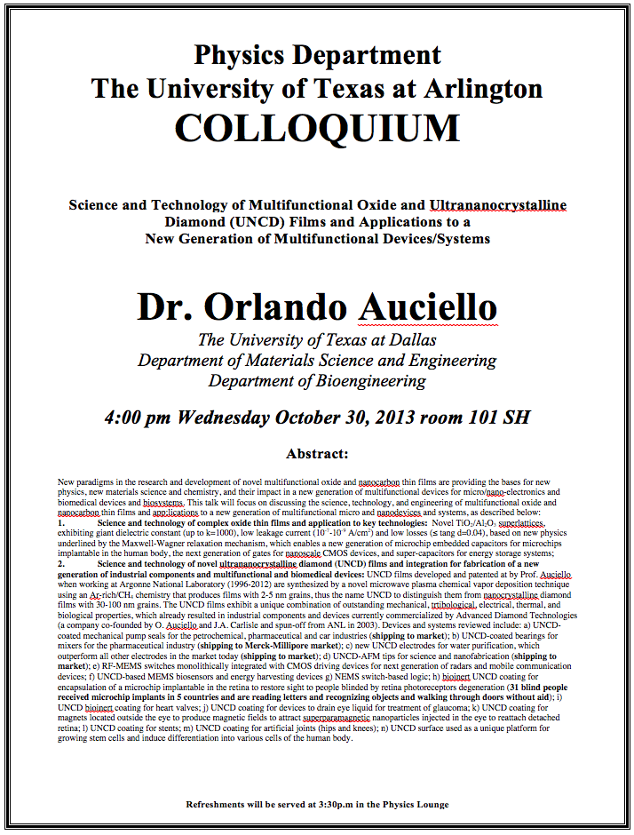

Slide 4
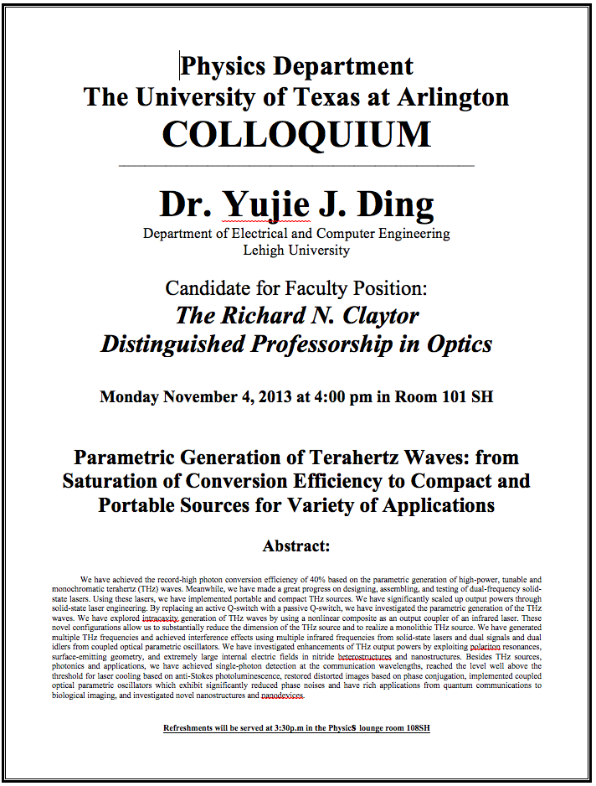

Slide 5
Special project #5
Show that the Schrodinger equation becomes Newton’s second law. (15 points)
Deadline Monday, Nov. 11, 2013
You MUST have your own answers!

Slide 6
Properties of Valid Wave Functions
Boundary conditions
To avoid infinite probabilities, the wave function must be finite everywhere.
To avoid multiple values of the probability, the wave function must be single valued.
For finite potentials, the wave function and its derivative must be continuous. This is required because the second-order derivative term in the wave equation must be single valued. (There are exceptions to this rule when V is infinite.)
In order to normalize the wave functions, they must approach zero as x approaches infinity.
Solutions that do not satisfy these properties do not generally correspond to physically realizable circumstances.

Slide 7
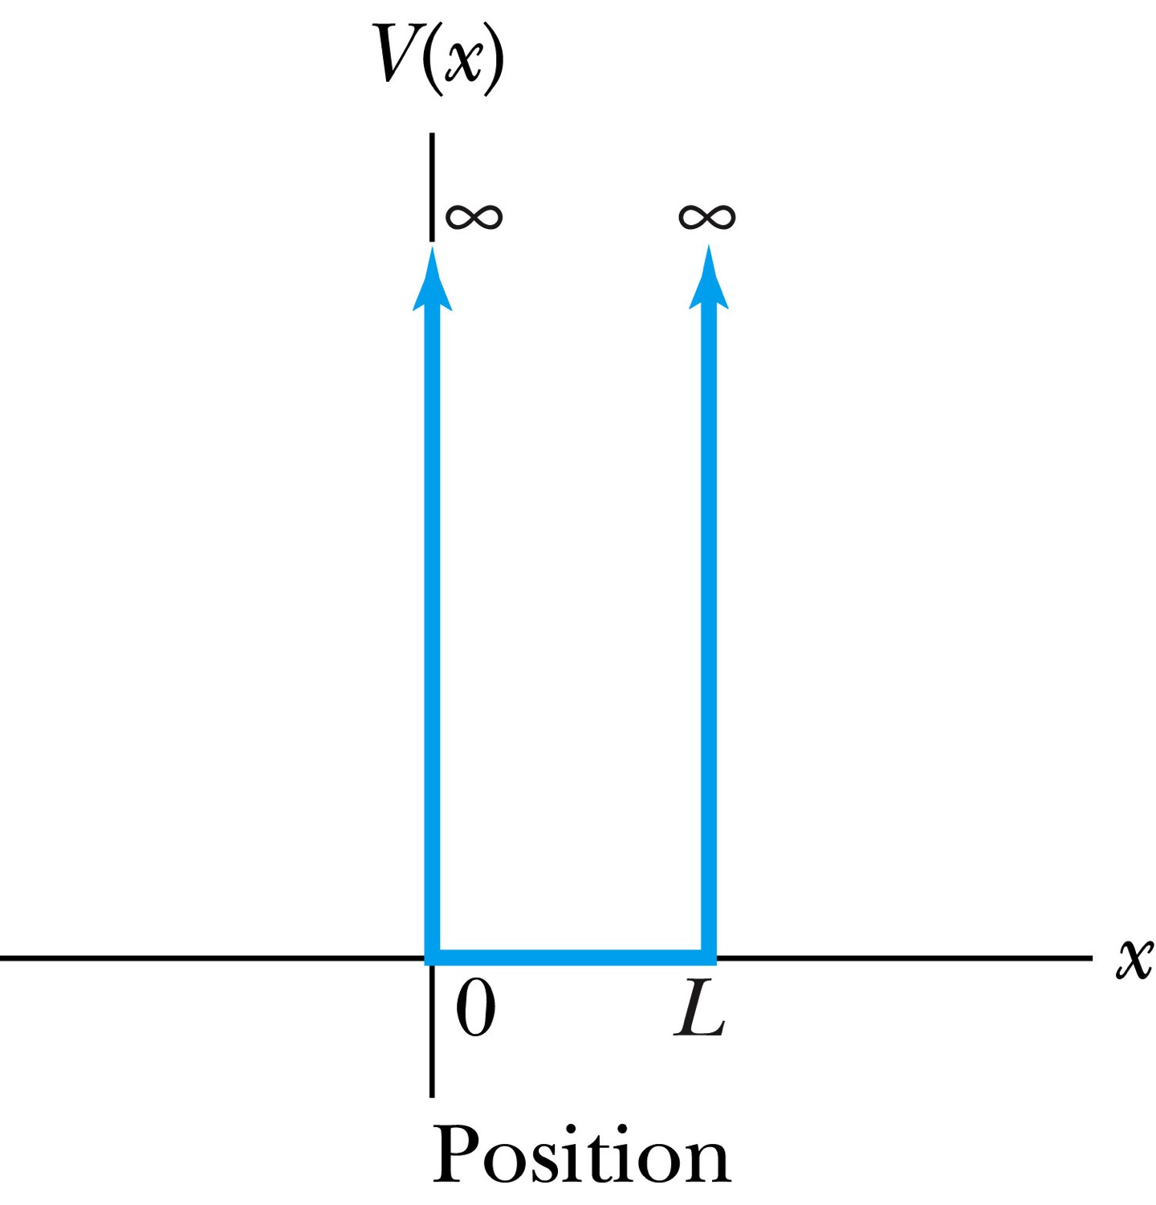
Infinite Square-Well Potential
The simplest such system is that of a particle trapped in a box with infinitely hard walls that the particle cannot penetrate. This potential is called an infinite square well and is given by
The wave function must be zero where the potential is infinite.
Where the potential is zero inside the box, the time independent Schrödinger wave equation becomes where .
The general solution is .

Slide 8
Quantization
Since the wave function must be continuous, the boundary conditions of the potential dictate that the wave function must be zero at x = 0 and x = L. These yield valid solutions for B=0, and for integer values of n such that kL = nπ ➔ k=nπ/L
The wave function is now
We normalize the wave function
The normalized wave function becomes
These functions are identical to those obtained for a vibrating string with fixed ends.

Slide 9
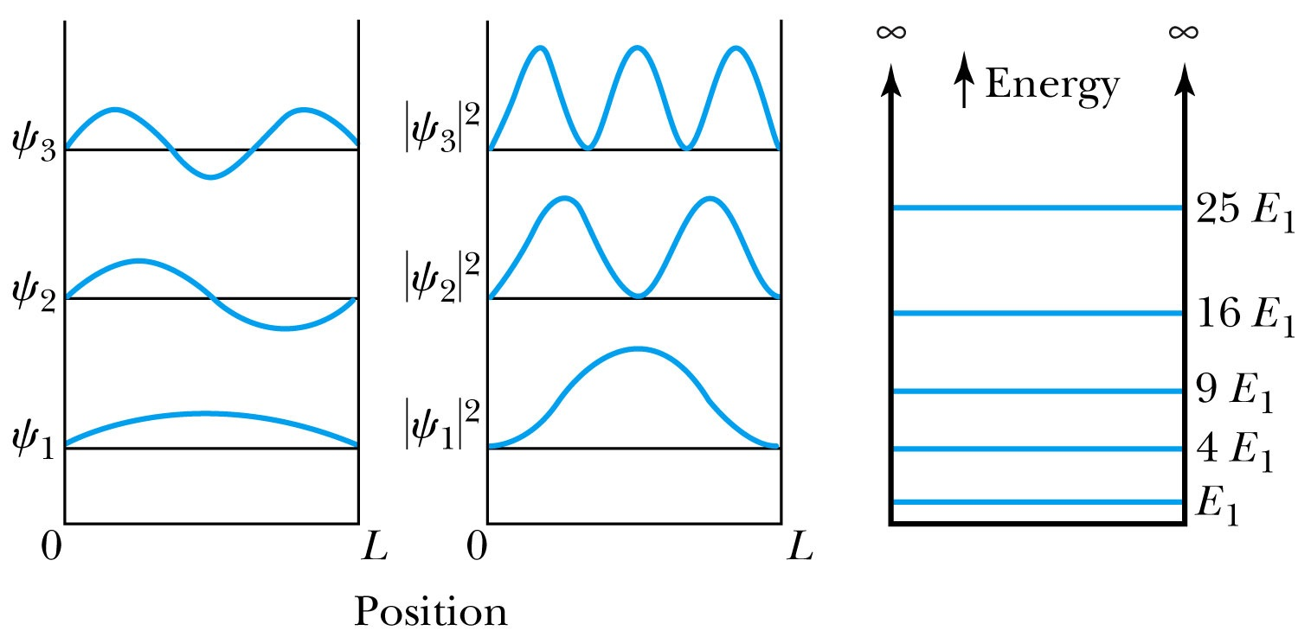
Quantized Energy
The quantized wave number now becomes
Solving for the energy yields
Note that the energy depends on the integer values of n. Hence the energy is quantized and nonzero.
The special case of n = 1 is called the ground state energy.

Slide 10
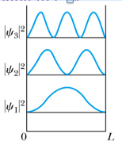
How does this correspond to Classical Mech.?
What is the probability of finding a particle in a box of length L?
Bohr’s correspondence principle says that QM and CM must correspond to each other! When?
When n becomes large, the QM approaches to CM
So when n→∞, the probability of finding a particle in a box of length L is
Which is identical to the CM probability!!
One can also see this from the plot of P!

Slide 11
Ex 6.8: Expectation values inside a box
Determine the expectation values for x, x², p and p² of a particle in an infinite square well for the first excited state.
What is the wave function of the first excited state?
n=?
2

Slide 12
Ex 6.9: Proton Transition Energy
A typical diameter of a nucleus is about 10⁻¹⁴m. Use the infinite square-well potential to calculate the transition energy from the first excited state to the ground state for a proton confined to the nucleus.
The energy of the state n is
What is n for the ground state?
n=1
What is n for the 1st excited state?
n=2
So the proton transition energy is

