Slide 1
PHYS 3313 – Section 001 Lecture #15
Monday, Nov. 4, 2013
Dr. Jaehoon Yu
Finite Potential Well
Penetration Depth
Degeneracy
Simple Harmonic Oscillator
Barriers and Tunneling

Slide 2
Announcements
Reminder: Homework #5
CH6 end of chapter problems: 3, 5, 11, 14, 22, and 26
Due on this Wednesday, Nov. 6 in class
Quiz #3
At the beginning of the class this Wed., Nov. 6
Covers CH5.6 to what we cover today (CH6.6?)
Prepare your own formula sheet
Research paper template is posted onto the research link
Deadline for research paper submission is Monday, Dec. 2!!
Colloquium coming week
4pm Monday, Nov. 4, SH101, Dr. Yujie Ding of Lehigh Univ., Double extra credit
4pm Wednesday, Nov. 6, SH101, Dr. David Nygren of Lorentz Berkeley National Laboratory, Triple extra credit

Slide 3
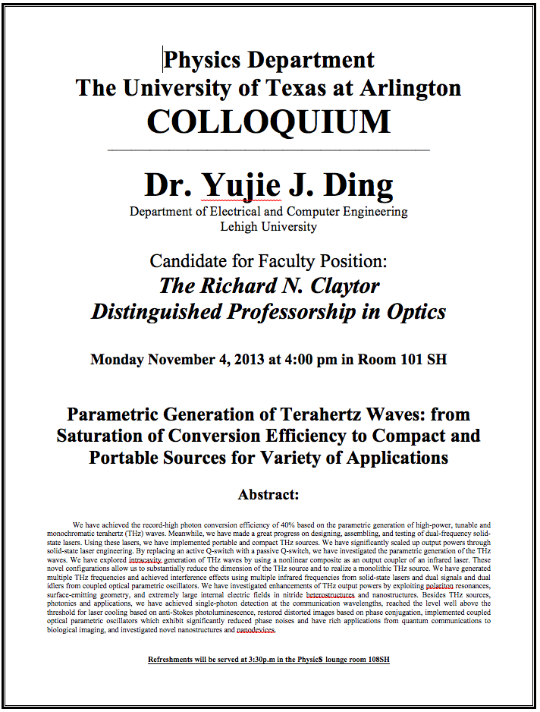

Slide 5
Reminder: Special project #5
Show that the Schrodinger equation becomes Newton’s second law. (15 points)
Deadline Monday, Nov. 11, 2013
You MUST have your own answers!

Slide 6
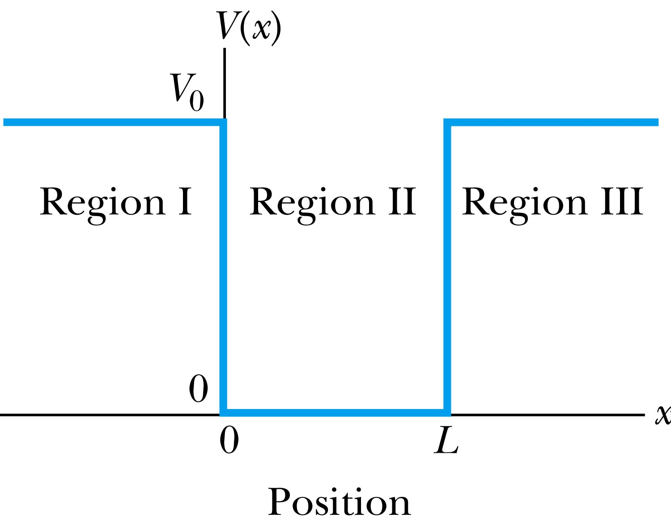
Finite Square-Well Potential
The finite square-well potential is
The Schrödinger equation outside the finite well in regions I and III is
for regions I and III, or using
yields . The solution to this differential has exponentials of the form e^{αx} and e^{-αx}. In the region x > L, we reject the positive exponential and in the region x < 0, we reject the negative exponential. Why?
This is because the wave function should be 0 as x→infinity.

Slide 7
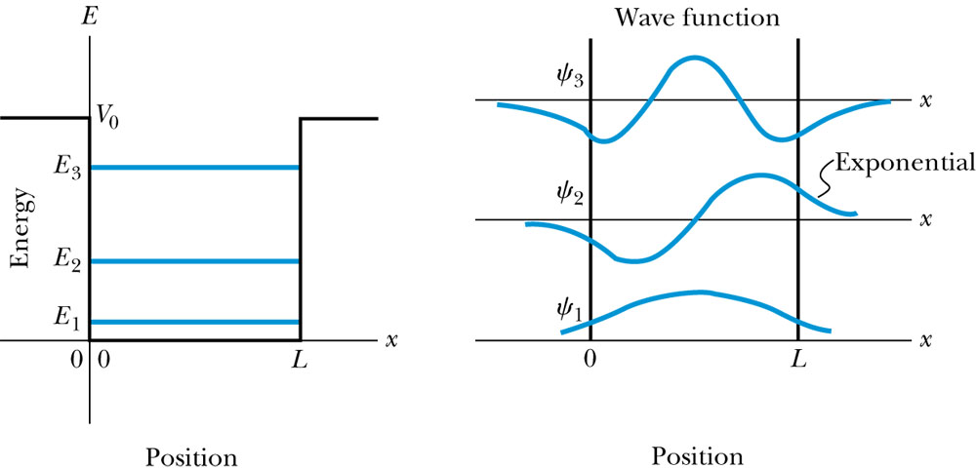
Finite Square-Well Solution
Inside the square well, where the potential V is zero and the particle is free, the wave equation becomes where
Instead of a sinusoidal solution we can write
The boundary conditions require that
and the wave function must be smooth where the regions meet.
Note that the wave function is nonzero outside of the box.
Non-zero at the boundary either..
What would the energy look like?

Slide 8
Penetration Depth
The penetration depth is the distance outside the potential well where the probability significantly decreases. It is given by
It should not be surprising to find that the penetration distance that violates classical physics is proportional to Planck’s constant.

Slide 9
Three-Dimensional Infinite-Potential Well
The wave function must be a function of all three spatial coordinates.
We begin with the conservation of energy
Multiply this by the wave function to get
Now consider momentum as an operator acting on the wave function. In this case, the operator must act twice on each dimension. Given:
The three dimensional Schrödinger wave equation is
Rewrite

Slide 10
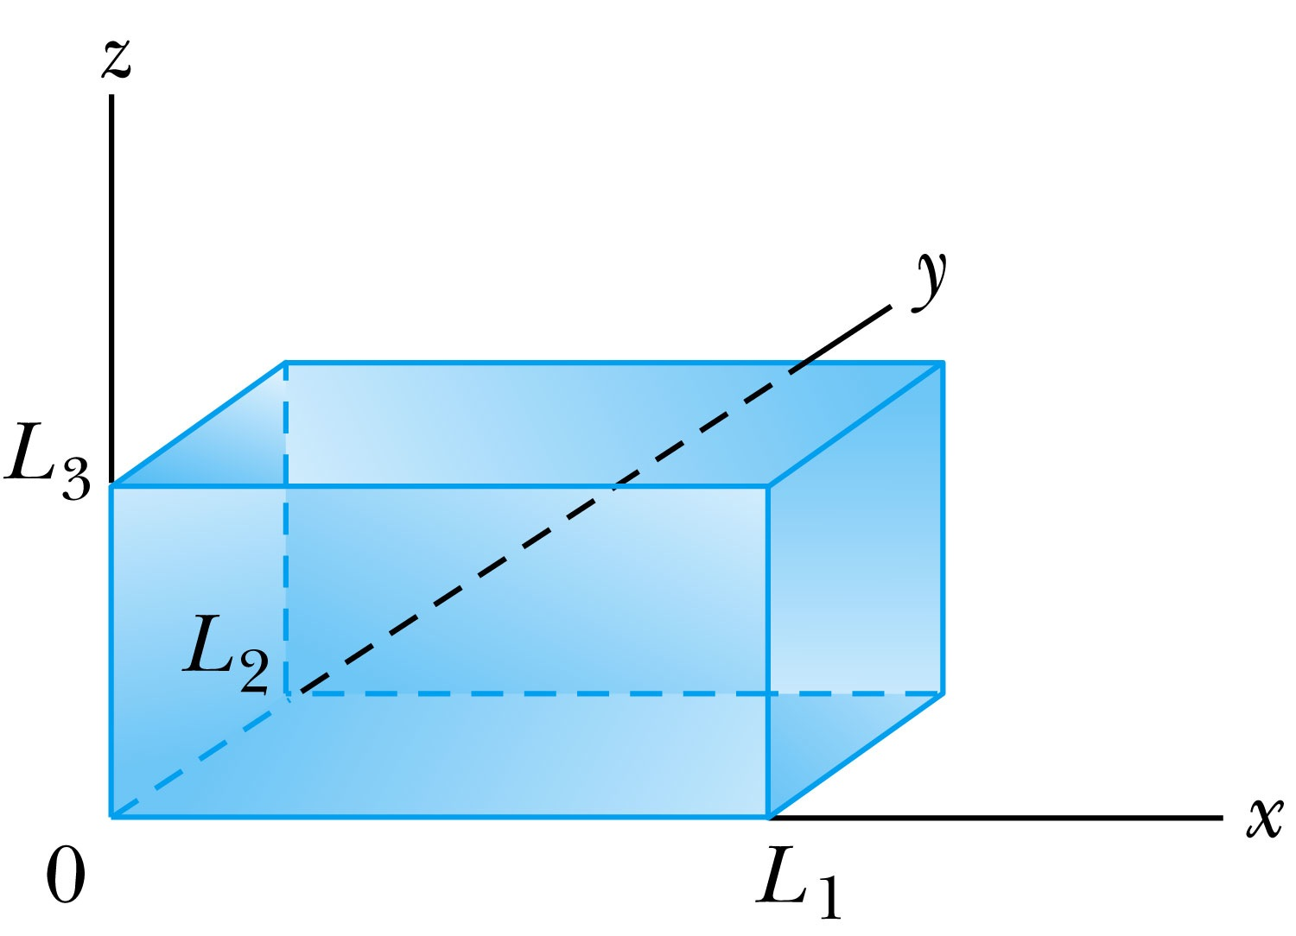
Ex 6.10: Expectation values inside a box
Consider a free particle inside a box with lengths L₁, L₂ and L₃ along the x, y, and z axes, respectively, as shown in the Figure. The particle is constrained to be inside the box. Find the wave functions and energies. Then find the ground energy and wave function and the energy of the first excited state for a cube of sides L.
What are the boundary conditions for this situation?
Particle is free, so x, y and z wave functions are independent from each other!
Each wave function must be 0 at the wall!
Inside the box, potential V is 0.
A reasonable solution is
Using the boundary condition
So the wave numbers are

Slide 11
Ex 6.10: Expectation values inside a box
Consider a free particle inside a box with lengths L₁, L₂ and L₃ along the x, y, and z axes, respectively, as shown in Fire. The particle is constrained to be inside the box. Find the wave functions and energies. Then find the round energy and wave function and the energy of the first excited state for a cube of sides L.
The energy can be obtained through the Schrödinger equation
What is the ground state energy?
E_{1,1,1} when n₁=n₂=n₃=1, how much?
When are the energies the same for different combinations of n_{i}?

Slide 12
Degeneracy*
Analysis of the Schrödinger wave equation in three dimensions introduces three quantum numbers that quantize the energy.
A quantum state is degenerate when there is more than one wave function for a given energy.
Degeneracy results from particular properties of the potential energy function that describes the system. A perturbation of the potential energy, such as the spin under a B field, can remove the degeneracy.
*Mirriam-webster: having two or more states or subdivisions having two or more states or subdivisions

Slide 13
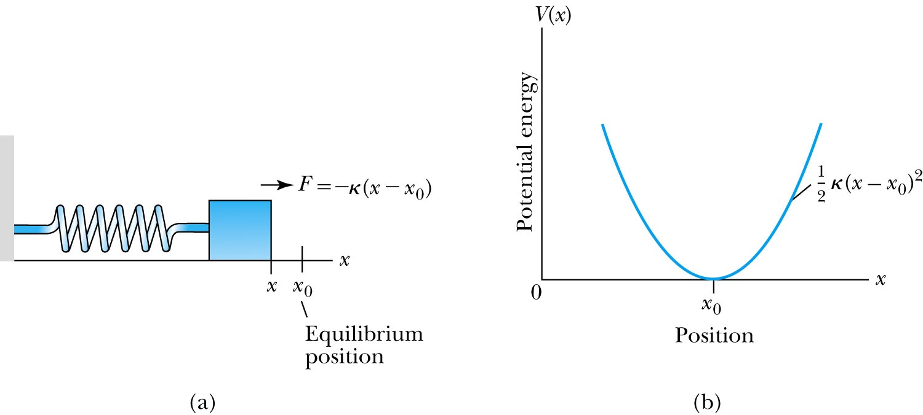
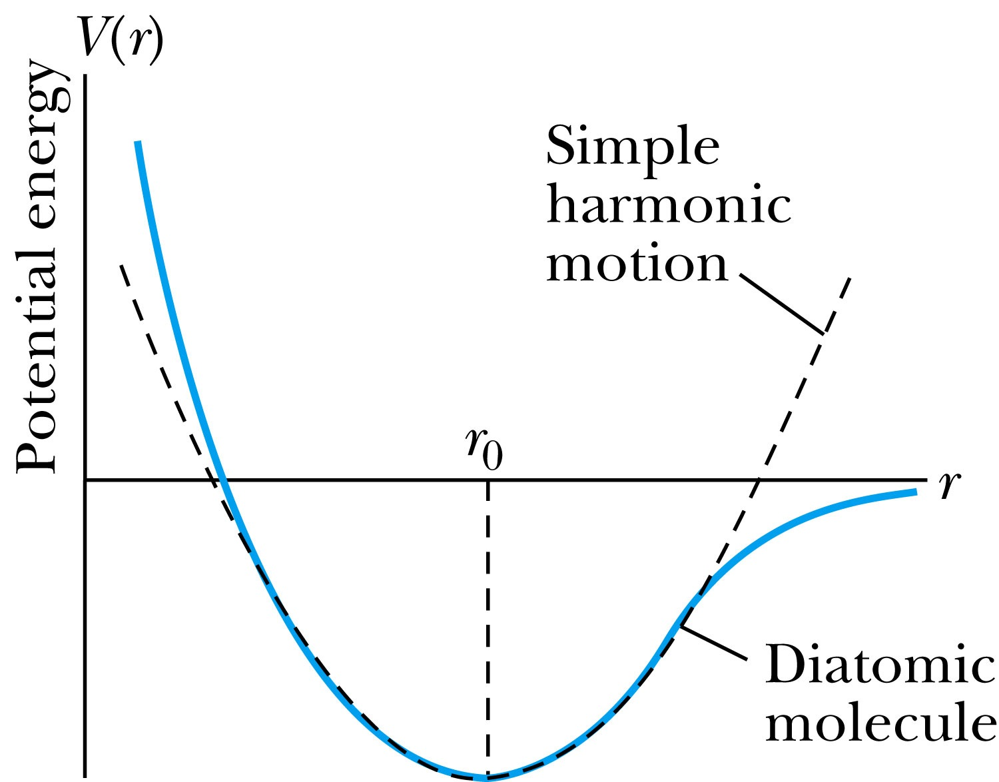
The Simple Harmonic Oscillator
Simple harmonic oscillators describe many physical situations: springs, diatomic molecules and atomic lattices.
Consider the Taylor expansion of a potential function:
The minimum potential at x=x₀, so dV/dx=0 and V₁=0; and the zero potential V₀=0, we have
Substituting this into the wave equation:
Let and which yields .

Slide 14
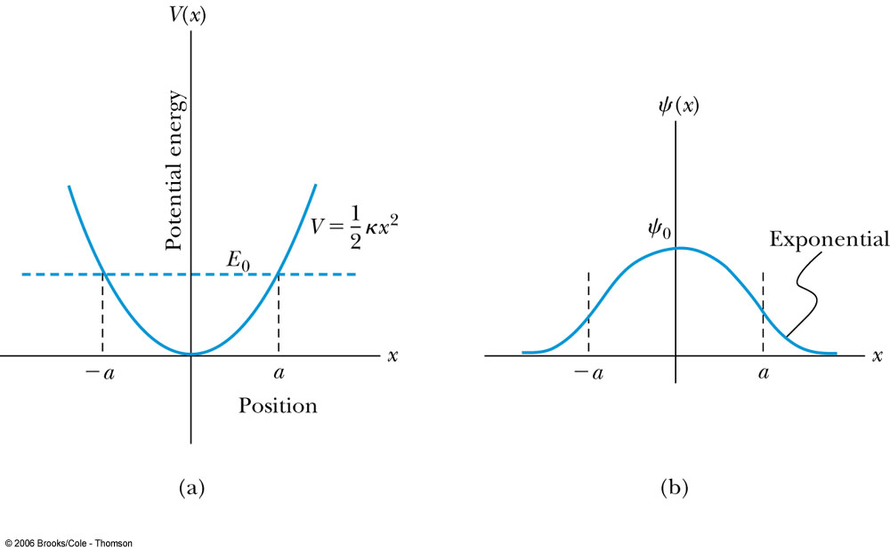
Parabolic Potential Well
If the lowest energy level is zero, this violates the uncertainty principle.
The wave function solutions are where H_{n}(x) are Hermite polynomials of order n.
In contrast to the particle in a box, where the oscillatory wave function is a sinusoidal curve, in this case the oscillatory behavior is due to the polynomial, which dominates at small x. The exponential tail is provided by the Gaussian function, which dominates at large x.

Slide 15
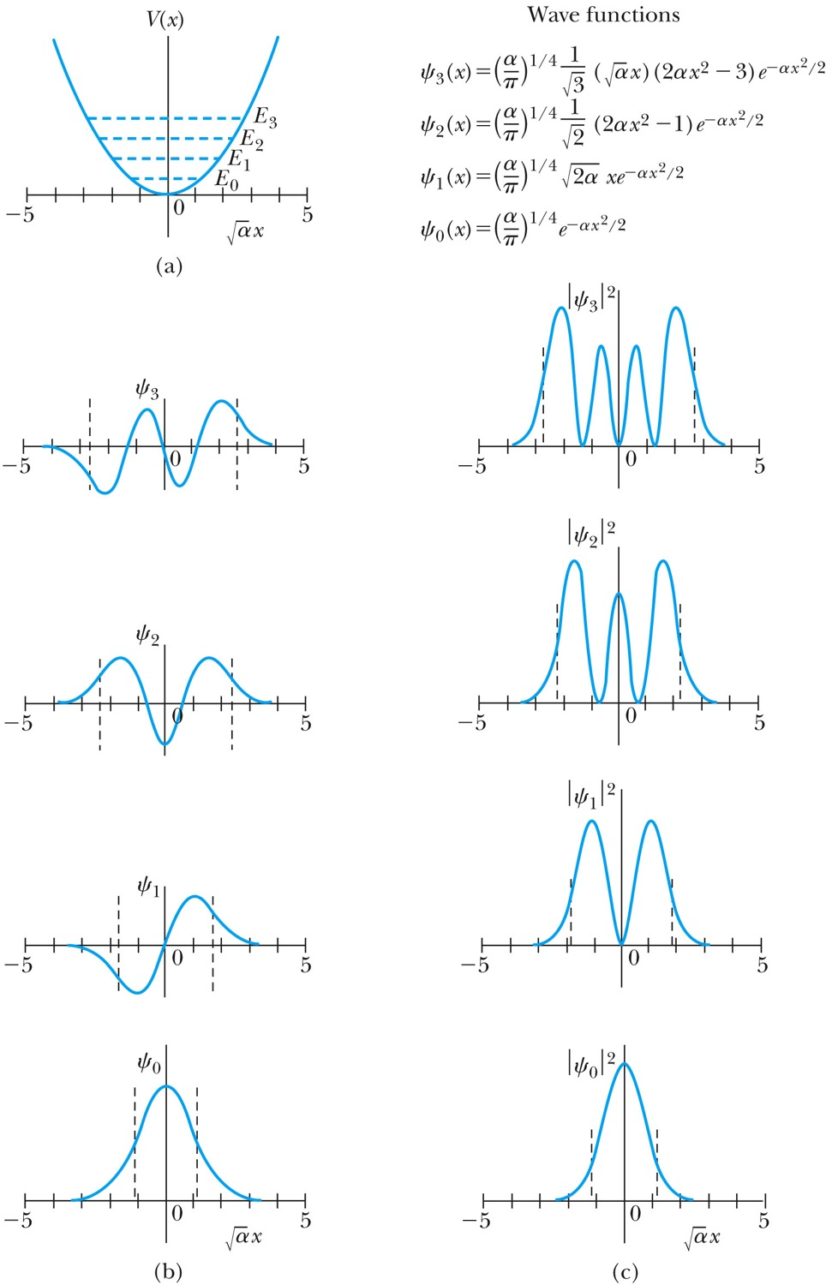
Analysis of the Parabolic Potential Well
The energy levels are given by
The zero point energy is called the Heisenberg limit:
Classically, the probability of finding the mass is greatest at the ends of motion’s range and smallest at the center (that is, proportional to the amount of time the mass spends at each position).
Contrary to the classical one, the largest probability for this lowest energy state is for the particle to be at the center.

