Slide 1
PHYS 3313 – Section 001
Lecture #16
Wednesday, Nov. 6, 2013
Dr. Jaehoon Yu
Barriers and Tunneling
Alpha Particle Decay
Use of Schrodinger Equation on Hydrogen Atom
Solutions for Schrodinger Equation for Hydrogen Atom
Quantum Numbers

Slide 2
Announcements
Research paper template is posted onto the research link
  Deadline for research paper submission is Monday, Dec. 2!!
Colloquium today
  4pm Wednesday, Nov. 6, SH101, Dr. David Nygren of Lorentz Berkeley National Laboratory, Triple extra credit
Bring homework #5 after the class

Slide 3
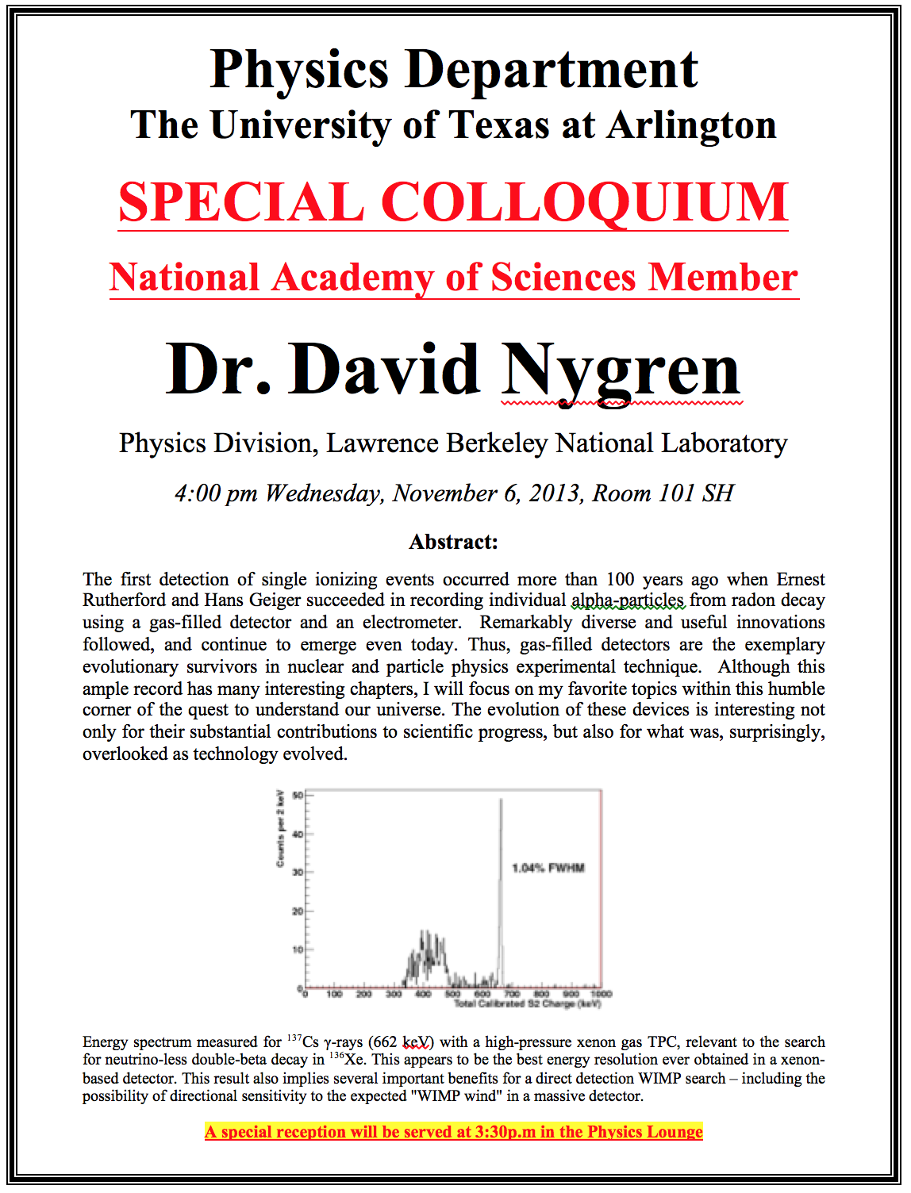

Slide 4
Reminder: Special project #5
Show that the Schrodinger equation becomes Newton’s second law. (15 points)
Deadline Monday, Nov. 11, 2013
You MUST have your own answers!

Slide 5
Research Presentations
Each of the 12 research groups makes a 10min presentation
  8min presentation + 2min Q&A
  All presentations must be in power point
  I must receive all final presentation files by 8pm, Sunday, Dec. 1
    No changes are allowed afterward
  The representative of the group makes the presentation with all group members participate in the Q&A session
Date and time: Determined by drawing
  In class Monday, Dec. 2 or in class Wednesday, Dec. 4
Important metrics
  Contents of the presentation: 60%
    Inclusion of all important points as mentioned in the report
    The quality of the research and making the right points
  Quality of the presentation itself: 15%
  Presentation manner: 10%
  Q&A handling: 10%
  Staying in the allotted presentation time: 5%
  Judging participation and sincerity: 5%

Slide 6
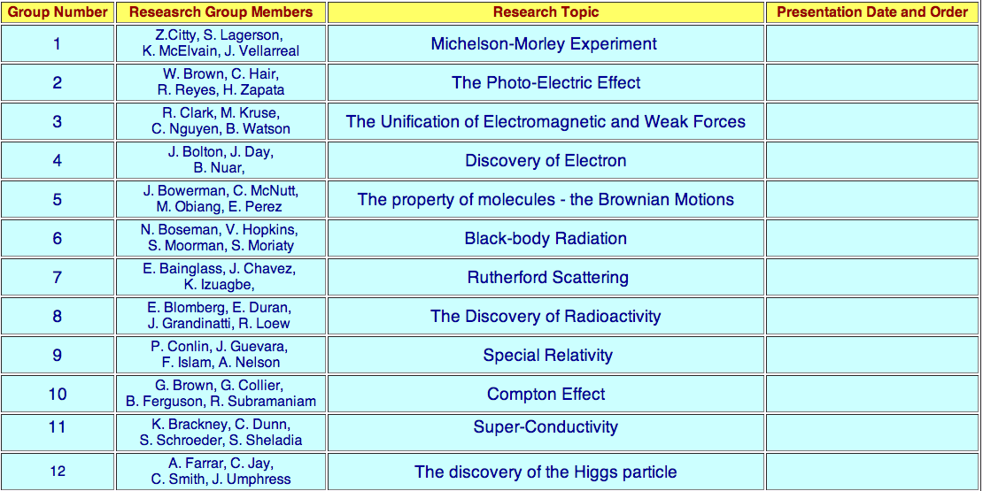

Slide 7
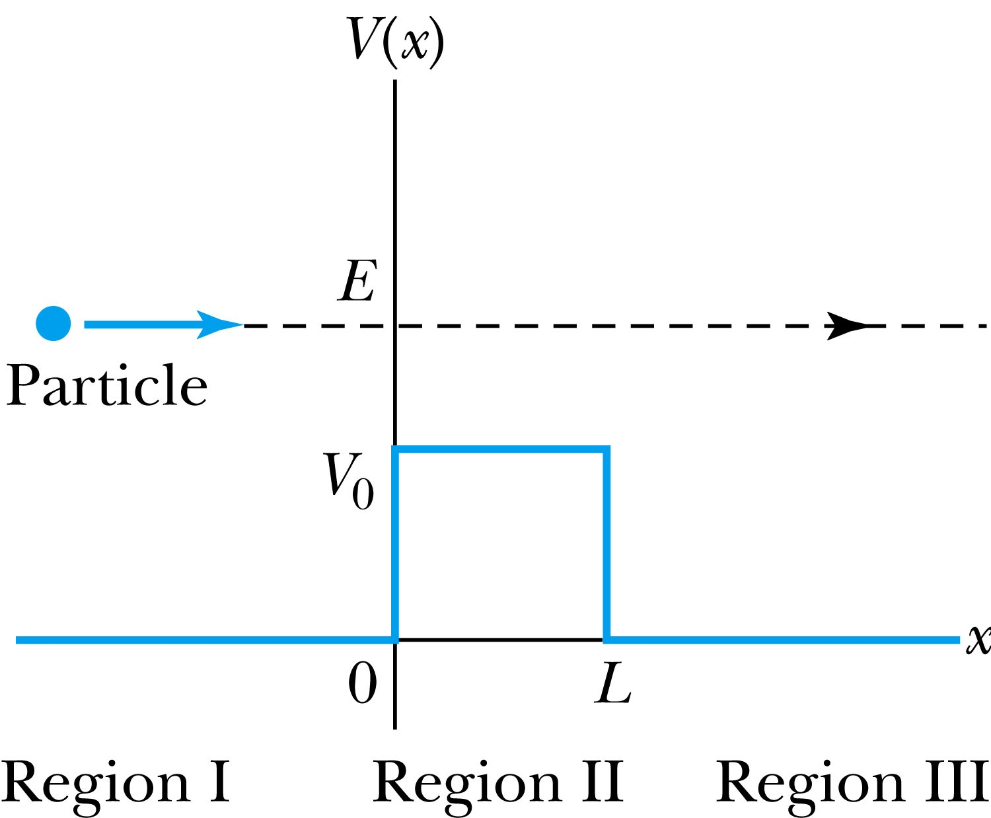
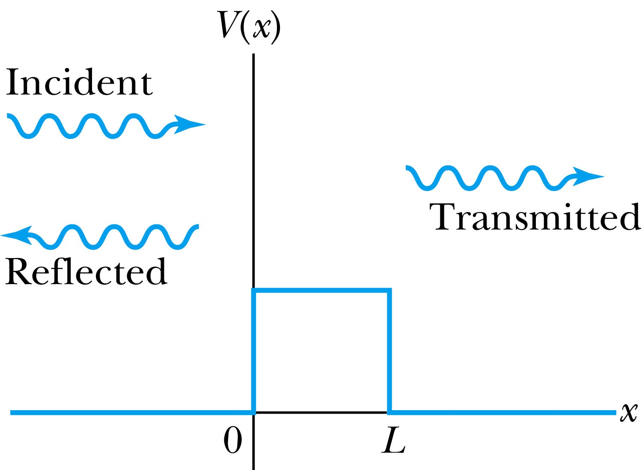
Barriers and Tunneling
Consider a particle of energy E approaching a potential barrier of height V₀ and the potential everywhere else is zero.
We will first consider the case when the energy is greater than the potential barrier.
In regions I and III the wave numbers are:
In the barrier region we have

Slide 8
Reflection and Transmission
The wave function will consist of an incident wave, a reflected wave, and a transmitted wave.
The potentials and the Schrödinger wave equation for the three regions are as follows:
The corresponding solutions are:
As the wave moves from left to right, we can simplify the wave functions to:

Slide 9
Probability of Reflection and Transmission
The probability of the particles being reflected R or transmitted T is:
The maximum kinetic energy of the photoelectrons depends on the value of the light frequency f and not on the intensity.
Because the particles must be either reflected or transmitted we have: R + T = 1
By applying the boundary conditions x → ±∞, x = 0, and x = L, we arrive at the transmission probability:
When does the transmission probability become 1?

Slide 10
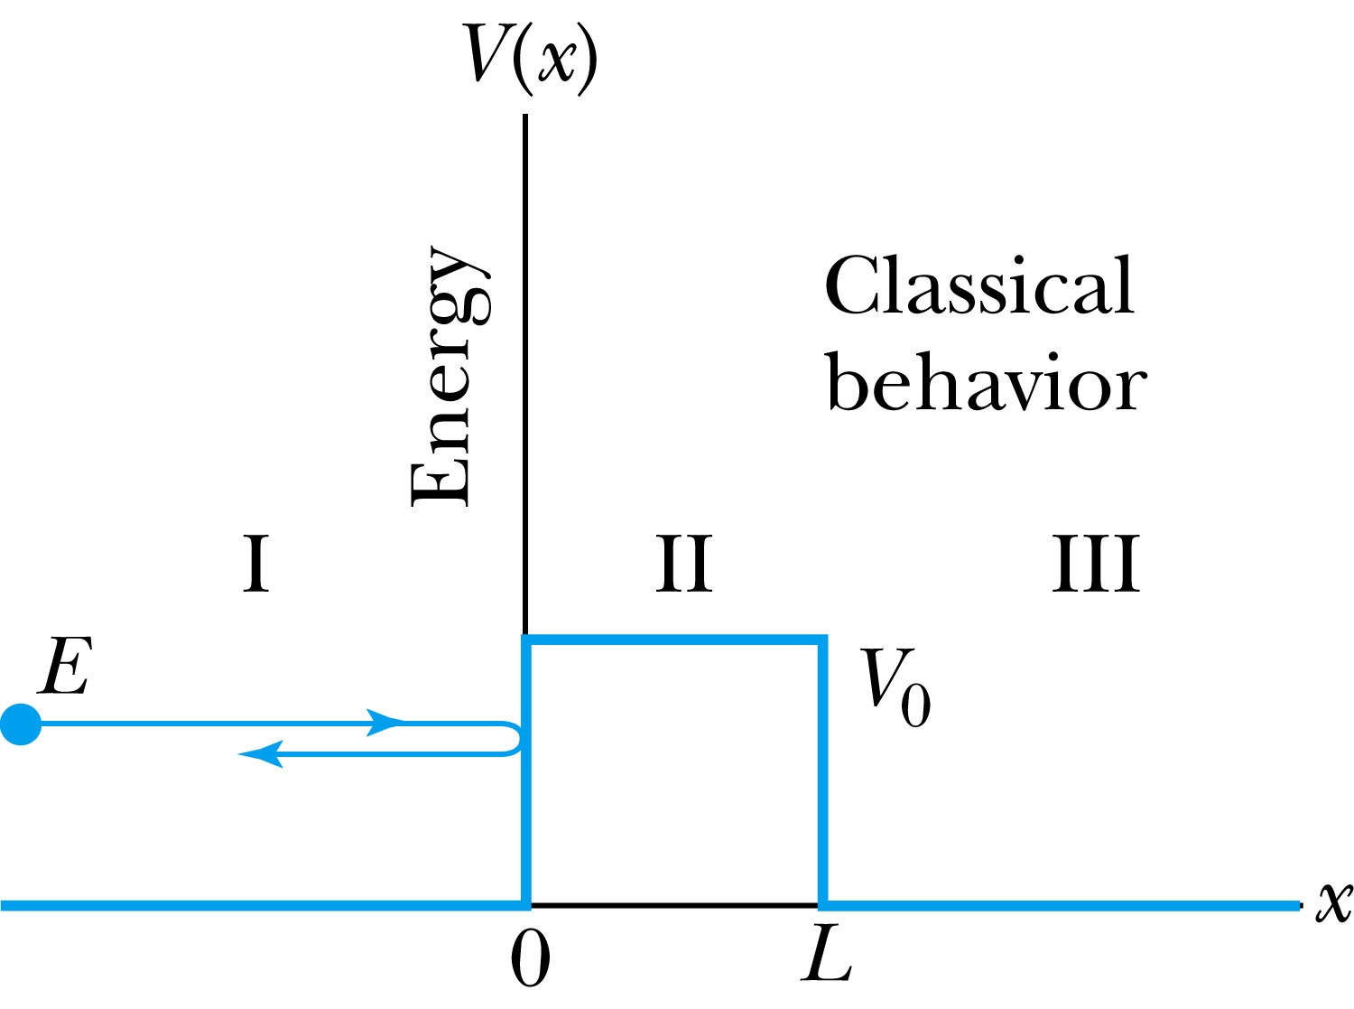
Tunneling
Now we consider the situation where classically the particle does not have enough energy to surmount the potential barrier, E < V₀.
The quantum mechanical result, however, is one of the most remarkable features of modern physics, and there is ample experimental proof of its existence. There is a small, but finite, probability that the particle can penetrate the barrier and even emerge on the other side.
The wave function in region II becomes
The transmission probability that
describes the phenomenon of tunneling is

Slide 11
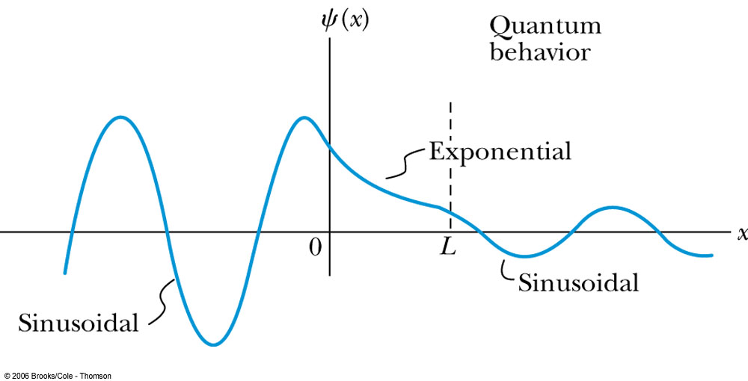
Uncertainty Explanation
Consider when κL >> 1 then the transmission probability becomes:
This violation allowed by the uncertainty principle is equal to the negative kinetic energy required! The particle is allowed by quantum mechanics and the uncertainty principle to penetrate into a classically forbidden region. The minimum such kinetic energy is:

Slide 12
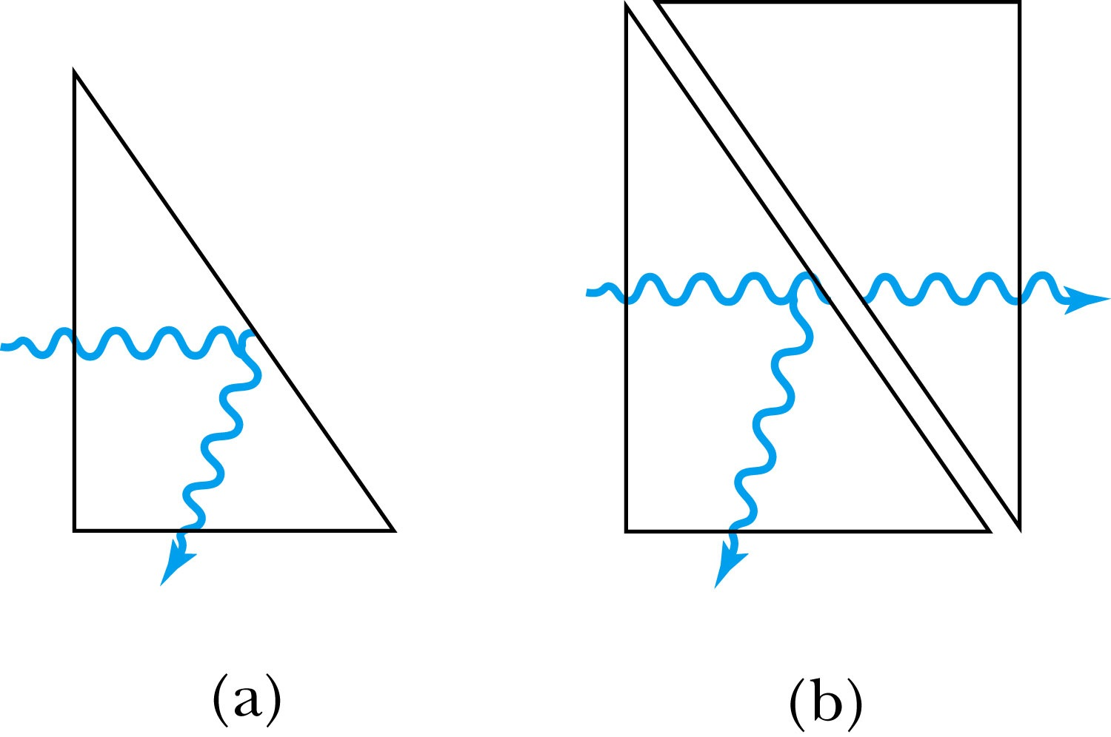
Analogy with Wave Optics
If light passing through a glass prism reflects from an internal surface with an angle greater than the critical angle, total internal reflection occurs. The electromagnetic field, however, is not exactly zero just outside the prism. Thus, if we bring another prism very close to the first one, experiments show that the electromagnetic wave (light) appears in the second prism.
The situation is analogous to the tunneling described here. This effect was observed by Newton and can be demonstrated with two prisms and a laser. The intensity of the second light beam decreases exponentially as the distance between the two prisms increases.

