Slide 1
PHYS 3313 – Section 001 Lecture #17
Monday, Nov. 11, 2013
Dr. Jaehoon Yu
Alpha Particle Decay
Use of Schrodinger Equation on Hydrogen Atom
Solutions for Schrodinger Equation for Hydrogen Atom
Quantum Numbers
Principal Quantum Number
Orbital Angular Momentum Quantum Number
Magnetic Quantum Number

Slide 2
Announcements
Reminder: homework #6
CH6 end of chapter problems: 34, 39, 46, 62 and 65
Due on Monday, Nov. 18, in class
Reading assignments
CH7.6 and the entire CH8

Slide 3
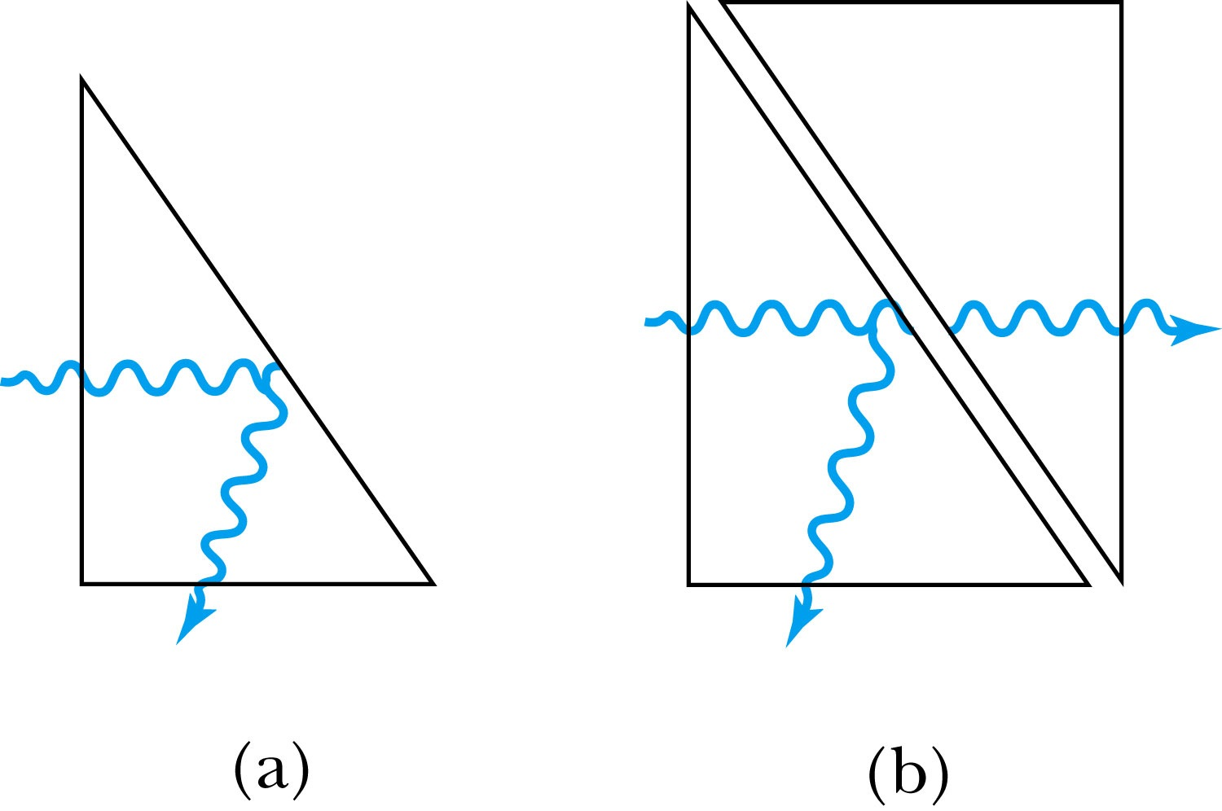
Analogy with Wave Optics
If light passing through a glass prism reflects from an internal surface with an angle greater than the critical angle, total internal reflection occurs. The electromagnetic field, however, is not exactly zero just outside the prism. Thus, if we bring another prism very close to the first one, experiments show that the electromagnetic wave (light) appears in the second prism.
The situation is analogous to the tunneling described here. This effect was observed by Newton and can be demonstrated with two prisms and a laser. The intensity of the second light beam decreases exponentially as the distance between the two prisms increases.

Slide 4
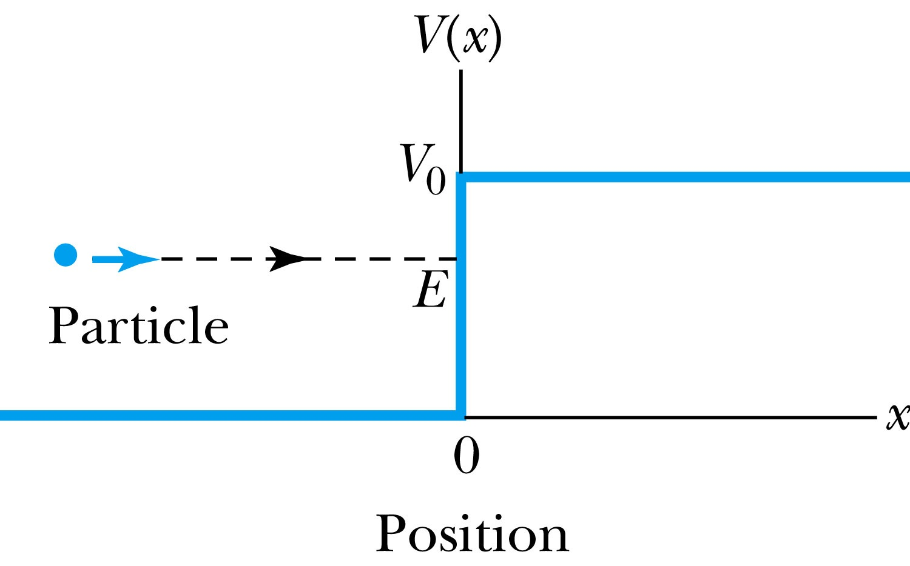
Potential Well
Consider a particle passing through a potential well region rather than through a potential barrier.
Classically, the particle would speed up passing the well region, because K = mv² / 2 = E - V₀.
According to quantum mechanics, reflection and transmission may occur, but the wavelength inside the potential well is shorter than outside. When the width of the potential well is precisely equal to half-integral or integral units of the wavelength, the reflected waves may be out of phase or in phase with the original wave, and cancellations or resonances may occur. The reflection/cancellation effects can lead to almost pure transmission or pure reflection for certain wavelengths. For example, at the second boundary (x = L) for a wave passing to the right, the wave may reflect and be out of phase with the incident wave. The effect would be a cancellation inside the well.

Slide 5
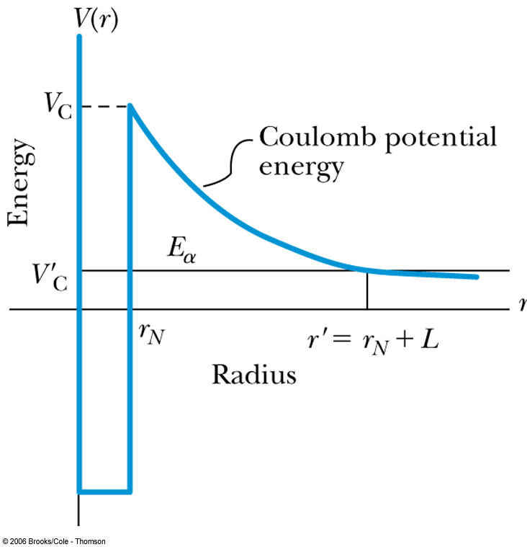
Alpha-Particle Decay
May nuclei heavier than Pb emits alpha particles (nucleus of He)! The phenomenon of tunneling explains the alpha-particle decay of heavy, radioactive nuclei.
Inside the nucleus, an alpha particle feels the strong, short-range attractive nuclear force as well as the repulsive Coulomb force.
The nuclear force dominates inside the nuclear radius where the potential is approximately a square well.
The Coulomb force dominates outside the nuclear radius.
The potential barrier at the nuclear radius is several times greater than the energy of an alpha particle (~5MeV).
According to quantum mechanics, however, the alpha particle can “tunnel” through the barrier. Hence this is observed as radioactive decay.

Slide 6
Application of the Schrödinger Equation to the Hydrogen Atom
The approximation of the potential energy of the electron-proton system is the Coulomb potential:
To solve this problem, we use the three-dimensional time-independent Schrödinger Equation.
For Hydrogen-like atoms with one electron (He⁺ or Li⁺⁺)
Replace e² with Ze² (Z is the atomic number)
Use appropriate reduced mass μ

Slide 7
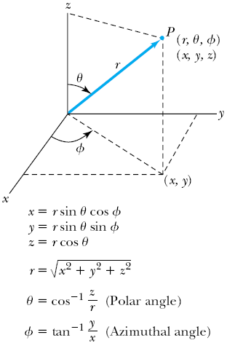
Application of the Schrödinger Equation
The potential (central force) V(r) depends on the distance r between the proton and electron.
Transform to spherical polar coordinates to exploit the radial symmetry.
Insert the Coulomb potential into the transformed Schrödinger equation.

Slide 8
Application of the Schrödinger Equation
The wave function ψ is a function of r, θ and φ .
The equation is separable into three equations of independent variables
The solution may be a product of three functions.
We can separate the Schrodinger equation in polar coordinate into three separate differential equations, each depending only on one coordinate: r, θ, or φ .

Slide 9
Solution of the Schrödinger Equation for Hydrogen
Substitute ψ into the polar Schrodinger equation and separate the resulting equation into three equations: R(r), f(θ), and g(φ).
Separation of Variables
The derivatives in Schrodinger eq. can be written as
Substituting them into the polar coord. Schrodinger Eq.
Multiply both sides by r² sin² θ / Rfg
Reorganize

Slide 10
Solution of the Schrödinger Equation
Only r and θ appear on the left-hand side and only φ appears on the right-hand side of the equation
The left-hand side of the equation cannot change as φ changes.
The right-hand side cannot change with either r or θ.
Each side needs to be equal to a constant for the equation to be true in all cases. Set the constant −m_{ℓ}² equal to the right-hand side of the reorganized equation
The sign in this equation must be negative for a valid solution
It is convenient to choose a solution to be .
-------- azimuthal equation

Slide 11
Solution of the Schrödinger Equation
satisfies the previous equation for any value of m_{ℓ}.
The solution be single valued in order to have a valid solution for any φ, which requires
m_{ℓ} must be zero or an integer (positive or negative) for this to work
Now, set the remaining equation equal to −m_{ℓ}² and divide either side with sin²θ and rearrange them as
Everything depends on r on the left side and θ on the right side of the equation.

