Slide 1
PHYS 3313 – Section 001 Lecture #18
Wednesday, Nov. 13, 2013
Dr. Jaehoon Yu
Solutions for Schrodinger Equation for Hydrogen Atom
Quantum Numbers
Principal Quantum Number
Orbital Angular Momentum Quantum Number
Magnetic Quantum Number
Intrinsic Spin

Slide 2
Announcements
Reminder: homework #6
CH6 end of chapter problems: 34, 39, 46, 62 and 65
Due on Monday, Nov. 18, in class
Reading assignments
CH7.6 and the entire CH8
Colloquium at 4pm in SH101

Slide 3
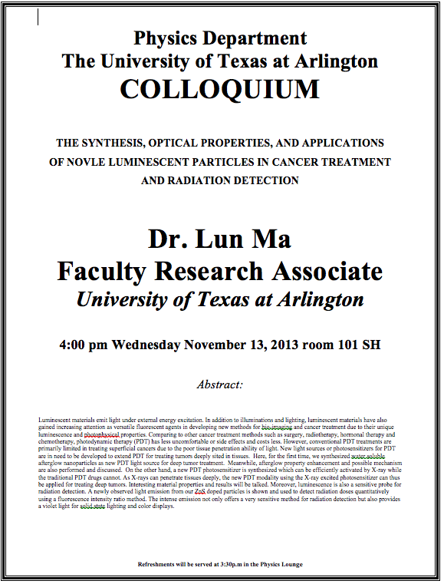

Slide 5
Solution of the Schrödinger Equation for Hydrogen
Substitute ψ into the polar Schrodinger equation and separate the resulting equation into three equations: R(r), f(θ), and g(φ).
Separation of Variables
The derivatives in Schrodinger eq. can be written as
Substituting them into the polar coord. Schrodinger Eq.
Multiply both sides by r² sin² θ / Rfg
Reorganize

Slide 6
Solution of the Schrödinger Equation
satisfies the previous equation for any value of m_{ℓ}.
The solution be single valued in order to have a valid solution for any φ, which requires
m_{ℓ} must be zero or an integer (positive or negative) for this to work
Now, set the remaining equation equal to −m_{ℓ}² and divide either side with sin²θ and rearrange them as
Everything depends on r on the left side and θ on the right side of the equation.

Slide 7
Solution of the Schrödinger Equation
Set each side of the equation equal to constant ℓ(ℓ + 1).
Radial Equation
Angular Equation
Schrödinger equation has been separated into three ordinary second-order differential equations, each containing only one variable.

Slide 8
Solution of the Radial Equation
The radial equation is called the associated Laguerre equation, and the solutions R that satisfies the appropriate boundary conditions are called associated Laguerre functions.
Assume the ground state has ℓ = 0, and this requires m_{ℓ} = 0.
We obtain
The derivative of yields two terms, and we obtain

Slide 9
Solution of the Radial Equation
Let’s try a solution where A is a normalization constant, and a₀ is a constant with the dimension of length.
Take derivatives of R, we obtain.
To satisfy this equation for any r, each of the two expressions in parentheses must be zero.
Set the second parentheses equal to zero and solve for a₀.
Set the first parentheses equal to zero and solve for E.
Both equal to the Bohr’s results
Bohr’s radius
Ground state energy of the hydrogen atom

Slide 10
Principal Quantum Number n
The principal quantum number, n, results from the solution of R(r) in the separate Schrodinger Eq. since R(r) includes the potential energy V(r).
The result for this quantized energy is
The negative sign of the energy E indicates that the electron and proton are bound together.

Slide 11
Quantum Numbers
The full solution of the radial equation requires an introduction of a quantum number, n, which is a non-zero positive integer.
The three quantum numbers:
n Principal quantum number
ℓ Orbital angular momentum quantum number
m_{ℓ} Magnetic quantum number
The boundary conditions put restrictions on these
n = 1, 2, 3, 4, . . . (n>0) Integer
ℓ = 0, 1, 2, 3, . . . , n − 1 (ℓ < n) Integer
m_{ℓ} = −ℓ, −ℓ + 1, . . . , 0, 1, . . . , ℓ − 1, ℓ (|m_{ℓ}| ≤ ℓ) Integer
The predicted energy level is

Slide 12
Ex 7.3: Quantum Numbers & Degeneracy
What are the possible quantum numbers for the state n=4 in atomic hydrogen? How many degenerate states are there?
n ℓ m_{ℓ}
4 0 0
4 1 -1, 0, +1
4 2 -2, -1, 0, +1, +2
4 3 -3, -2, -1, 0, +1, +2, +3
The energy of a atomic hydrogen state is determined only by the primary quantum number, thus, all these quantum states, 1+3+5+7 = 16, are in the same energy state.
Thus, there are 16 degenerate states for the state n=4.

Slide 13
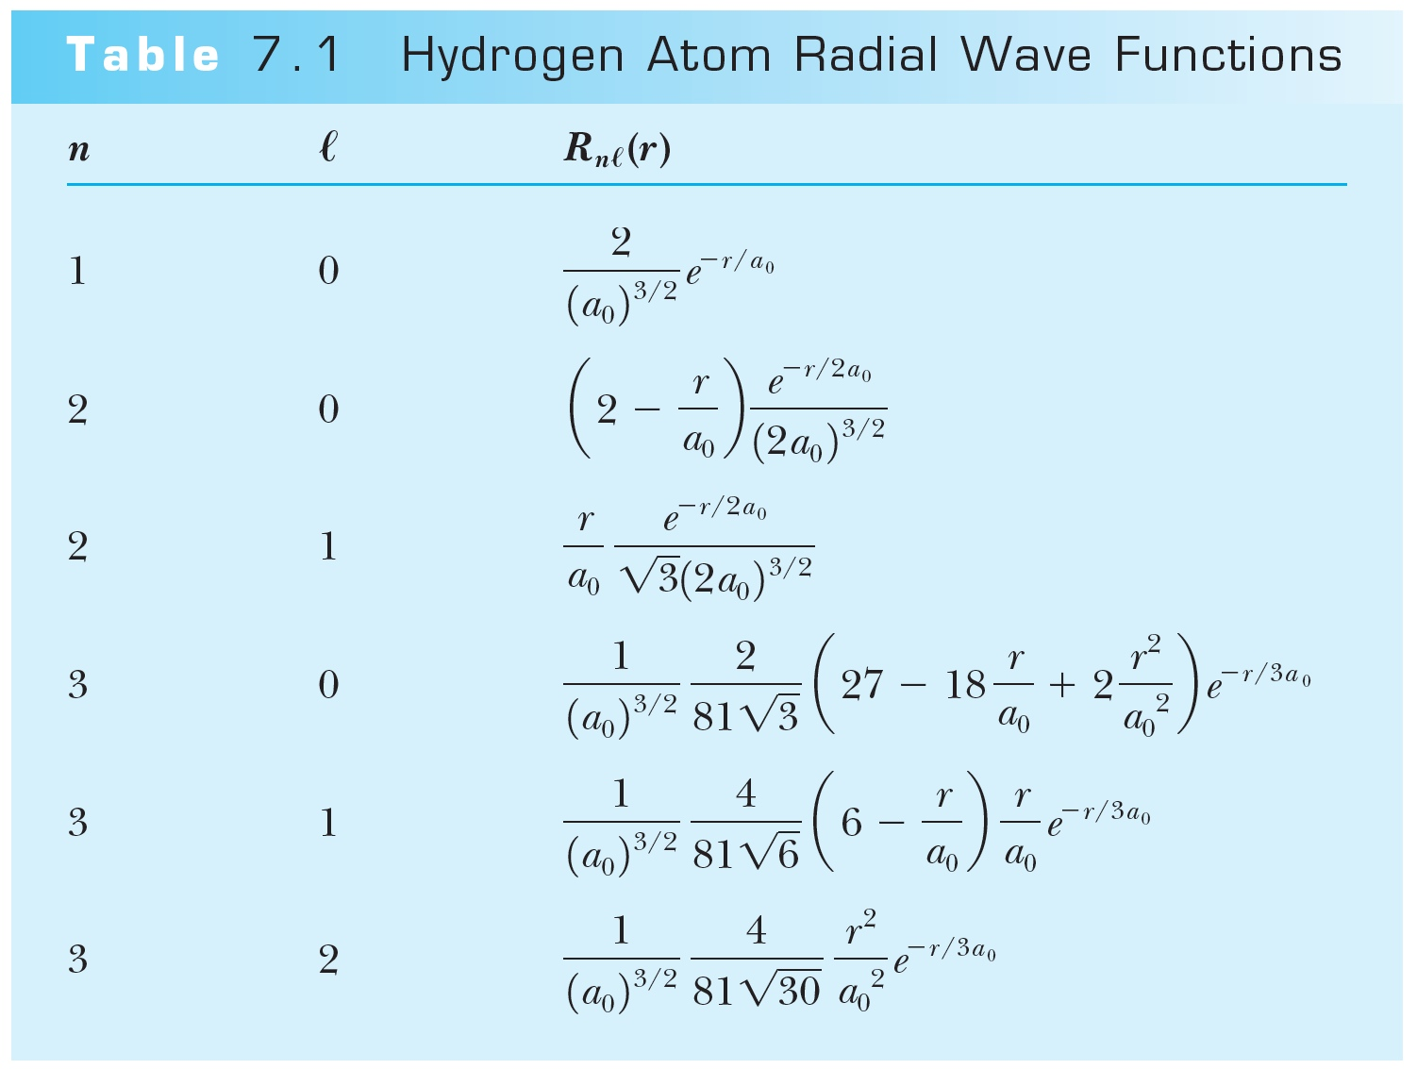
Hydrogen Atom Radial Wave Functions
The radial solution is specified by the values of n and ℓ
First few radial wave functions R_{nℓ}

Slide 14
Solution of the Angular and Azimuthal Equations
The solutions for azimuthal eq. are or
Solutions to the angular and azimuthal equations are linked because both have m_{ℓ}
Group these solutions together into functions
---- spherical harmonics

Slide 15
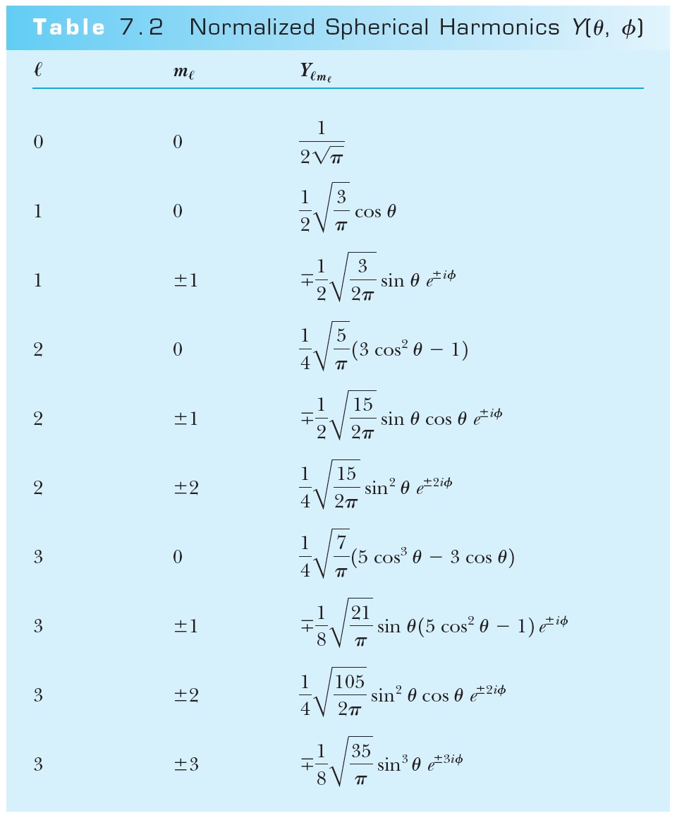
Normalized Spherical Harmonics

Slide 16
Ex 7.1: Spherical Harmonic Function
Show that the spherical harmonic function Y11(θ,φ) satisfies the angular Schrodinger equation.

Slide 17
Solution of the Angular and Azimuthal Equations
The radial wave function R and the spherical harmonics Y determine the probability density for the various quantum states.
Thus the total wave function ψ(r,θ,φ) depends on n, ℓ, and m_{ℓ}. The wave function can be written as

