Slide 1
PHYS 3313 – Section 001 Lecture #20
Wednesday, Nov. 20, 2013
Dr. Jaehoon Yu
Historical Overview
Maxwell Velocity Distribution
Equipartition Theorem

Slide 2
Announcements
Reminder: Homework #7
CH7 end of chapter problems: 7, 8, 9, 12, 17 and 29
Due coming Monday, Nov. 25, in class
Reminder: Quiz number 4
At the beginning of the class coming Monday, Nov. 25
Covers CH7 and what we finish today
Reminder: Research materials
Presentation submission via e-mail to Dr. Yu by 8pm Sunday, Dec. 1
Research papers due in class Monday, Dec. 2
Final exam:
Comprehensive exam covering CH1.1 to what we cover Monday, Nov. 25 + appendices 3 – 7
BYOF: one handwritten, letter size, front and back
Reading assignments
Entire CH8 (in particular CH8.1), CH9.4 and CH9.7
Class is cancelled next Wednesday, Nov. 27
Colloquium today: Dr. B. Franklin of Baylor U.

Slide 3
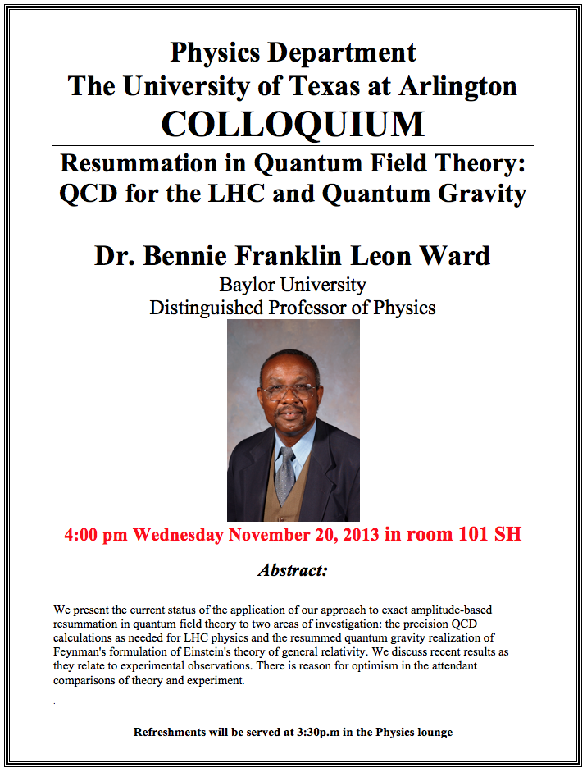

Slide 4
Why is statistical physics necessary?
Does physics perceive inherent uncertainty and indeterminism since everything is probabilistic?
Statistical physics is necessary since
As simple problems as computing probability of coin tosses is complex, so it is useful to reduce it to statistical terms
When the number of particles gets large, it is rather impractical to describe the motion of individual particle than describing the motion of a group of particles
Uncertainties are inherent as Heisenberg’s uncertainty principle showed and are of relatively large scale in atomic and subatomic level
Statistical physics necessary for atomic physics and the description of solid states which consists of many atoms

Slide 5
Historical Overview
Statistics and probability: New mathematical methods developed to understand the Newtonian physics through 18th and 19th centuries.
Lagrange around 1790 and Hamilton around 1840 added significantly to the computational power of Newtonian mechanics.
Pierre-Simon de Laplace (1749-1827)
Had a view that it is possible to have a perfect knowledge of the universe
Can predict the future and the past to the beginning of the universe
He told Napoleon that the hypothesis of God is not necessary
He made major contributions to the theory of probability
Benjamin Thompson (Count Rumford): Put forward the idea of heat as merely the motion of individual particles in a substance but not well accepted
James Prescott Joule: Demonstrated experimentally the mechanical equivalence of heat and energy

Slide 6
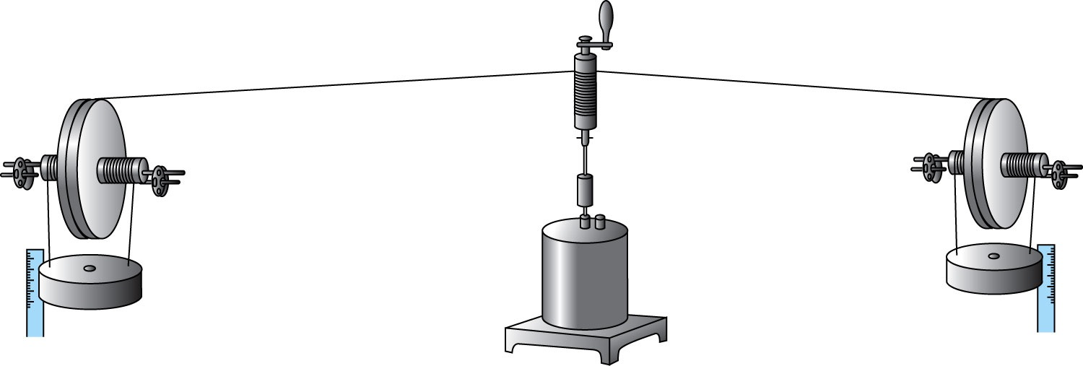
Joule’s experiment
Showed deterministically the equivalence of heat and energy
Dropping weights that turns the paddles in the water and measuring the change of water temperature

Slide 7
Historical Overview
James Clark Maxwell
Brought the mathematical theories of probability and statistics to bear on the physical thermodynamics problems
Showed that distributions of an ideal gas can be used to derive the observed macroscopic phenomena
His electromagnetic theory succeeded to the statistical view of thermodynamics
Einstein: Published a theory of Brownian motion, a theory that supported the view that atoms are real
Bohr: Developed atomic and quantum theory

Slide 8
Maxwell’s Velocity Distributions
Laplace claimed that it is possible to know everything about an ideal gas by knowing the position and velocity precisely
There are six parameters—the position (x, y, z) and the velocity (v_{x}, v_{y}, v_{z})—per molecule to know the position and instantaneous velocity of an ideal gas.
These parameters make up 6D phase space
The velocity components of the molecules are more important than positions because the energy of a gas should depend only on the velocities
Define a velocity distribution function = the probability of finding a particle with velocity between where

Slide 9
Maxwell’s Velocity Distributions
Maxwell proved that the probability distribution function is proportional to
Therefore .
where C is a proportionality constant and β ≡ (kT)⁻¹.
Since v² = v_{x}² + v_{y}² + v_{z}²,
Rewrite this as the product of three factors (i.e. probability density).

Slide 10
The solution
Since the probability is 1 when integrated over entire space, we obtain
Thus
The average velocity in x direction is
The average of the square of the velocity in x direction is
Where T is the absolute temperature (temp in C+273), m is the molecular mass and k is the Boltzman constant
Solve for C’

Slide 11
Maxwell Velocity Distribution
The results for the x, y, and z velocity components are identical.
The mean translational kinetic energy of a molecule:
Purely statistical consideration is a good evidence of the validity of this statistical approach to thermodynamics.
Note no dependence of the formula to the mass!!

Slide 12
Ex 9.1: Molecule Kinetic Energy
Compute the mean translational KE of (a) a single ideal gas molecule in eV and (b) a mol of ideal gas in J at room temperature 20ºC.
What is the mean translational KE of 1kg of steam at 1atm at 100ºC, assuming an ideal gas?
Water molecule is 18g/mol.

