Slide 1
PHYS 3313 – Section 001 Lecture #21
Monday, Nov. 25, 2013
Dr. Jaehoon Yu
Equipartition Theorem
Classical and Quantum Statistics
Fermi-Dirac Statistics
Liquid Helium

Slide 2
Announcements
Reminder: Research materials
Presentation submission via e-mail to Dr. Yu by 8pm this Sunday, Dec. 1
Research papers due in class Monday, Dec. 2
Final exam:
Date and time: 11am – 1:30pm, Monday, Dec. 9, in SH125
Comprehensive exam covering CH1.1 to CH9.7 + appendices 3 – 7
BYOF: one handwritten, letter size, front and back
No derivations or solutions of any problems allowed!
Reading assignments
CH9.6 and CH9.7
Class is cancelled this Wednesday, Nov. 27
Colloquium today at 4pm in SH101

Slide 3
Reminder: Research Project Report
Must contain the following at the minimum
Original theory or Original observation
Experimental proofs or Theoretical prediction + subsequent experimental proofs
Importance and the impact of the theory/experiment
Conclusions
Each member of the group writes a 10 (max) page report, including figures
10% of the total grade
Can share the theme and facts but you must write your own!
Text of the report must be your original!
Due Mon., Dec. 2, 2013

Slide 5
Research Presentations
Each of the 10 research groups makes a 10min presentation
8min presentation + 2min Q&A
All presentations must be in power point
I must receive all final presentation files by 8pm, Sunday, Dec. 1
No changes are allowed afterward
The representative of the group makes the presentation followed by all group members’ participation in the Q&A session
Date and time:
In class Monday, Dec. 2 or in class Wednesday, Dec. 4
Important metrics
Contents of the presentation: 60%
Inclusion of all important points as mentioned in the report
The quality of the research and making the right points
Quality of the presentation itself: 15%
Presentation manner: 10%
Q&A handling: 10%
Staying in the allotted presentation time: 5%
Judging participation and sincerity: 5%

Slide 6
Equipartition Theorem
The formula for average kinetic energy 3kT/2 works for monoatomic molecule what is it for diatomic molecule?
Consider oxygen molecule as two oxygen atoms connected by a massless rod ➔ This will have both translational and rotational energy
How much rotational energy is there and how is it related to temperature?
Equipartition Theorem:
In equilibrium a mean energy of ½ kT per molecule is associated with each independent quadratic term in the molecule’s energy.
Each independent phase space coordinate: degree of freedom
Essentially the mean energy of a molecule is ½ kT *NDoF

Slide 7
Equipartition Theorem
In a monoatomic ideal gas, each molecule has
There are three degrees of freedom.
Mean kinetic energy is
In a gas of N helium molecules, the total internal energy is
The heat capacity at constant volume is
For the heat capacity for 1 mole,
using the ideal gas constant R = 8.31 J/K.

Slide 8
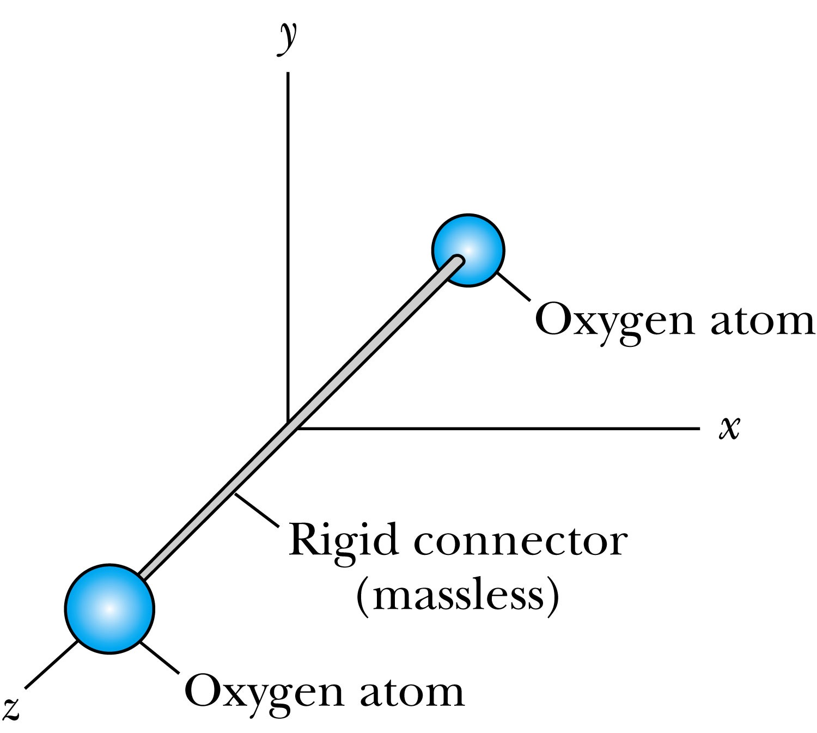
The Rigid Rotator Model
For diatomic gases, consider the rigid rotator model.
The molecule has rotational E only when it rotates about x or y axis.
The corresponding rotational energies are
There are five degrees of freedom (three translational and two rotational)➔ resulting in mean energy of 5kT/2 per molecule according to equi-partition principle (C_{V}=5R/2)

Slide 9
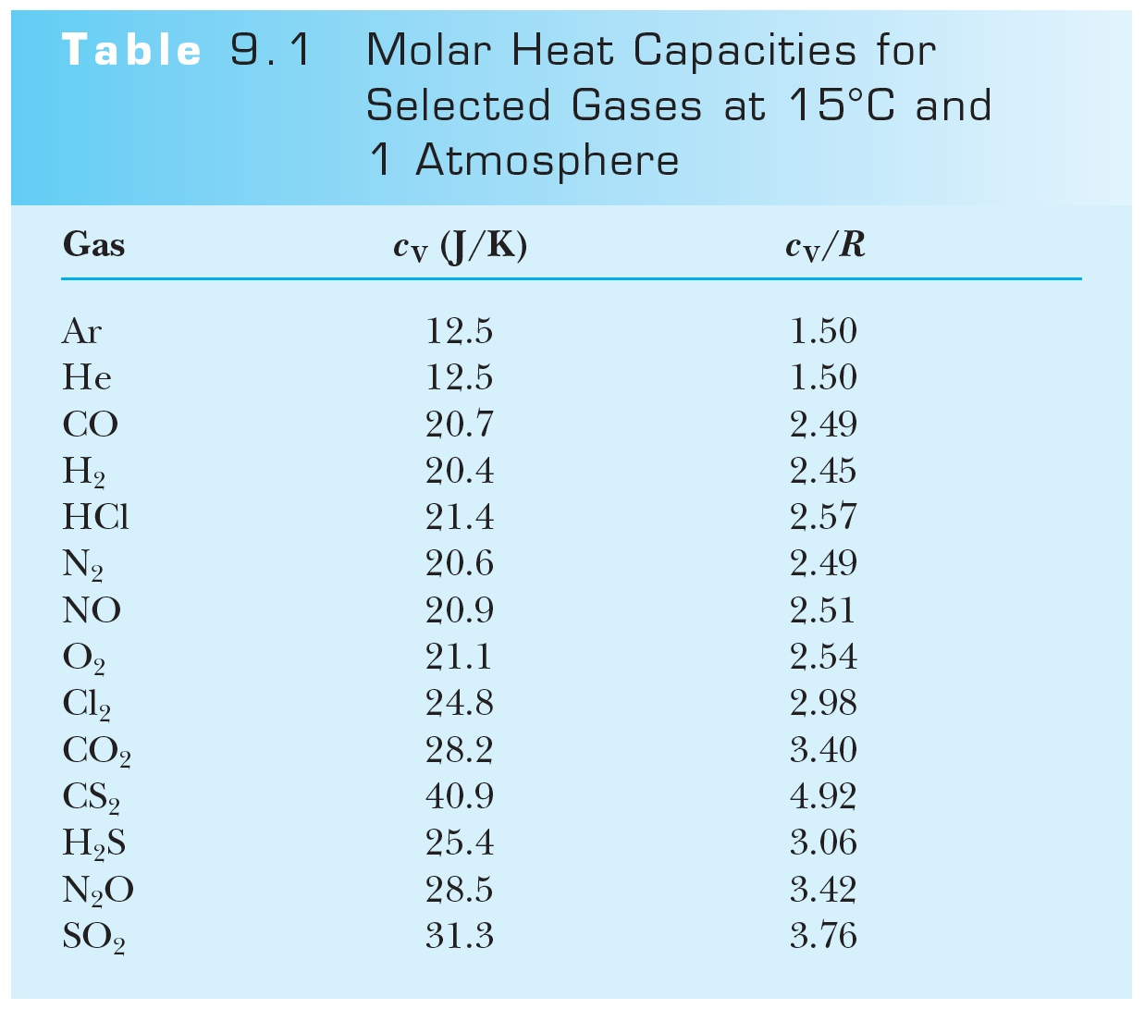
Table of Measured Gas Heat Capacities

Slide 10
Equipartition Theorem
Most the mass of an atom is confined to a nucleus whose magnitude is smaller than the whole atom.
I_{z} is smaller than I_{x} and I_{y}.
Only rotations about x and y contributes to the energy
In some circumstances it is better to think of atoms connected to each other by a massless spring.
The vibrational kinetic energy is
There are seven degrees of freedom (three translational, two rotational, and two vibrational). ➔ 7kT/2 per molecule
While it works pretty well, the simple assumptions made for equi-partition principle, such as massless connecting rod, is not quite sufficient for detailed molecular behaviors

Slide 11
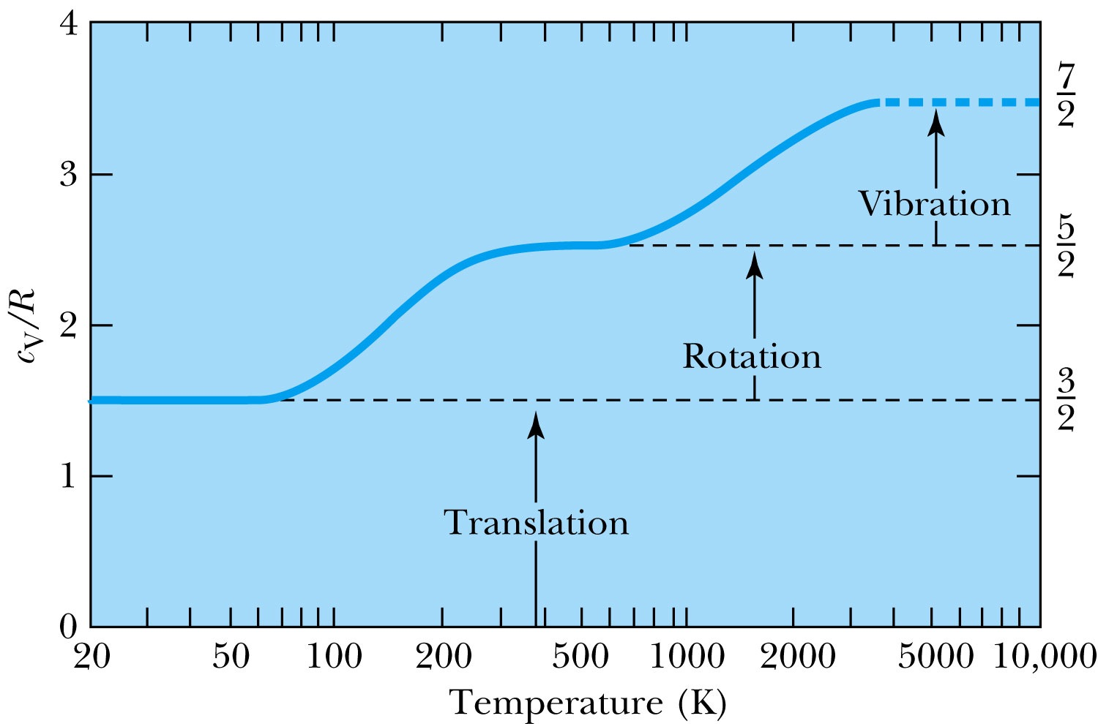
Molar Heat Capacity
The heat capacities of diatomic gases are also temperature dependent, indicating that the different degrees of freedom are “turned on” at different temperatures.
Example of H₂

Slide 12
Classical and Quantum Statistics
In gas, particles are so far apart, they do not interact substantially & are free➔ even if they collide, they can be considered as elastic and do not affect the mean values
If molecules, atoms, or subatomic particles are in the liquid or solid state, the Pauli exclusion principle* prevents two particles with identical quantum states from sharing the same space ➔ limits available energy states in quantum systems
Recall there is no restriction on particle energies in classical physics.
This affects the overall distribution of energies
*Pauli Exclusion Principle: No two electrons in an atom may have the same set of quantum numbers

Slide 13
Classical Distributions
Rewrite Maxwell speed distribution in terms of energy.
Probability for finding a particle between speed v and v+dv
For a monoatomic gas the energy is all translational kinetic energy.
where

Slide 14
Classical Distributions
Boltzmann showed that the statistical factor exp(−βE) is a characteristic of any classical system.
regardless of how quantities other than molecular speeds may affect the energy of a given state
Maxwell-Boltzmann factor for classical system:
The energy distribution for classical system:
n(E) dE: the number of particles with energies between E and E + dE
g(E), the density of states, is the number of states available per unit energy
F_{MB}: the relative probability that an energy state is occupied at a given temperature

Slide 15
Quantum Distributions
Identical particles cannot be distinguished if their wave functions overlap significantly
Characteristic of indistinguishability is what makes quantum statistics different from classical statistics.
Consider two distinguishable particles in two different energy states with the same probability (0.5 each)
The possible configurations are
Since the four states are equally likely, the probability of each state is one-fourth (0.25).
E1 | E2
A, B
A | B
B | A
 | A, B

Slide 16
Quantum Distributions
If the two particles are indistinguishable:
There are only three possible configurations
Thus the probability of each is one-third (~0.33).
Because some particles do not obey the Pauli exclusion principle, two kinds of quantum distributions are needed.
Fermions: Particles with half-spins (1/2) that obey the Pauli principle.
Examples?
Bosons: Particles with zero or integer spins that do NOT obey the Pauli principle.
Examples?
State 1 | State 2
XX
X | X
 | XX
Electron, proton, neutron, any atoms or molecules with odd number of fermions
Photon, force mediators, pions, any atoms or molecules with even number of fermions

Slide 17
Quantum Distributions
Fermi-Dirac distribution:
where
Bose-Einstein distribution:
where
B_{i} (i = FD or BE) is the normalization factor.
Both distributions reduce to the classical Maxwell-Boltzmann distribution when B_{i} exp(βE) is much greater than 1.
the Maxwell-Boltzmann factor A exp(−βE) is much less than 1.
In other words, the probability that a particular energy state will be occupied is much less than 1!

Slide 18
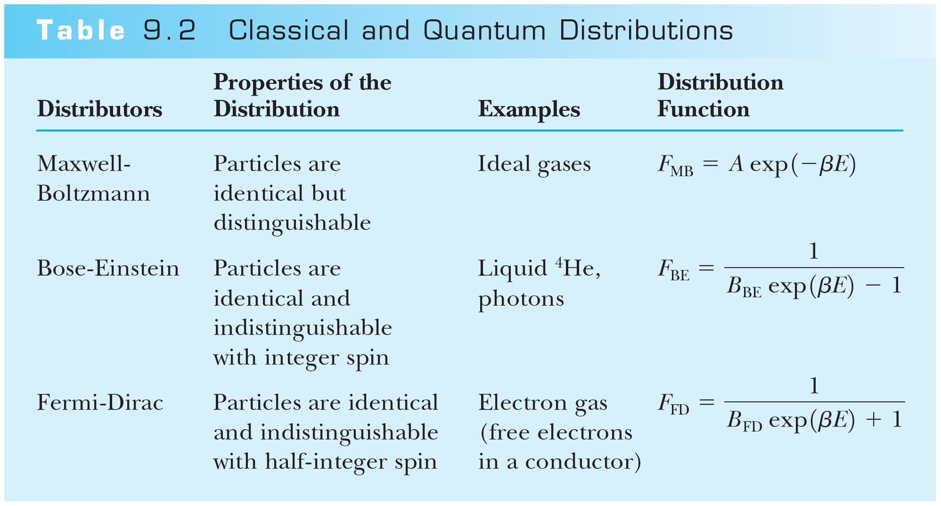
Summary of Classical and Quantum Distributions

Slide 19
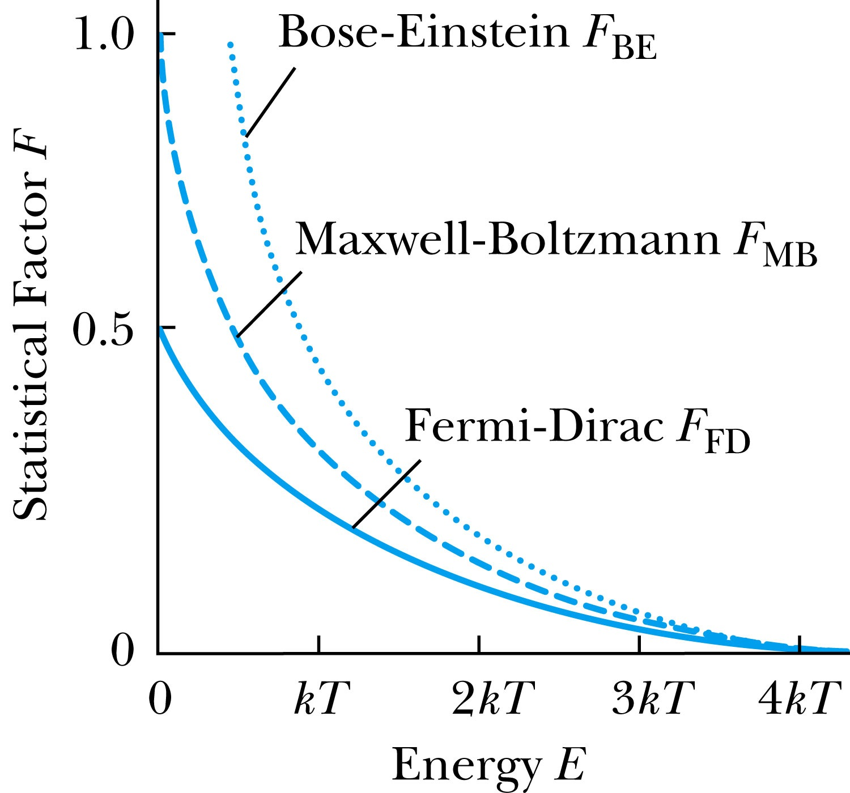
Quantum Distributions
The normalization constants for the distributions depend on the physical system being considered.
Because bosons do not obey the Pauli exclusion principle, more bosons can fill lower energy states.
Three graphs coincide at high energies – the classical limit.
Maxwell-Boltzmann statistics may be used in the classical limit.

Slide 20
Fermi-Dirac Statistics
This is most useful for electrical conduction
The normalization factor B_{FD}
Where E_{F} is called the Fermi energy.
The Fermi-Dirac Factor becomes
When E = E_{F}, the exponential term is 1. ➔F_{FD} =1/2
In the limit as T → 0,
At T = 0, fermions occupy the lowest energy levels available to them
Since they cannot all fill the same energy due to Pauli Exclusion principle, they will fill the energy states up to Fermi Energy
Near T = 0, there is little a chance that the thermal agitation will kick a fermion to an energy greater than E_{F}.

Slide 21
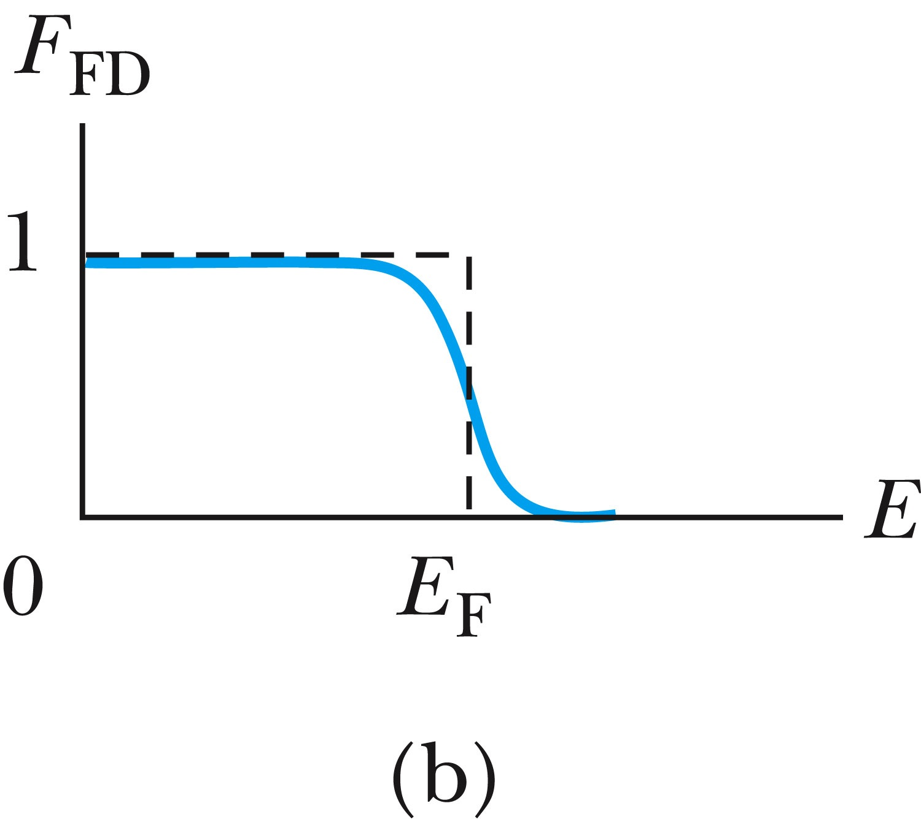
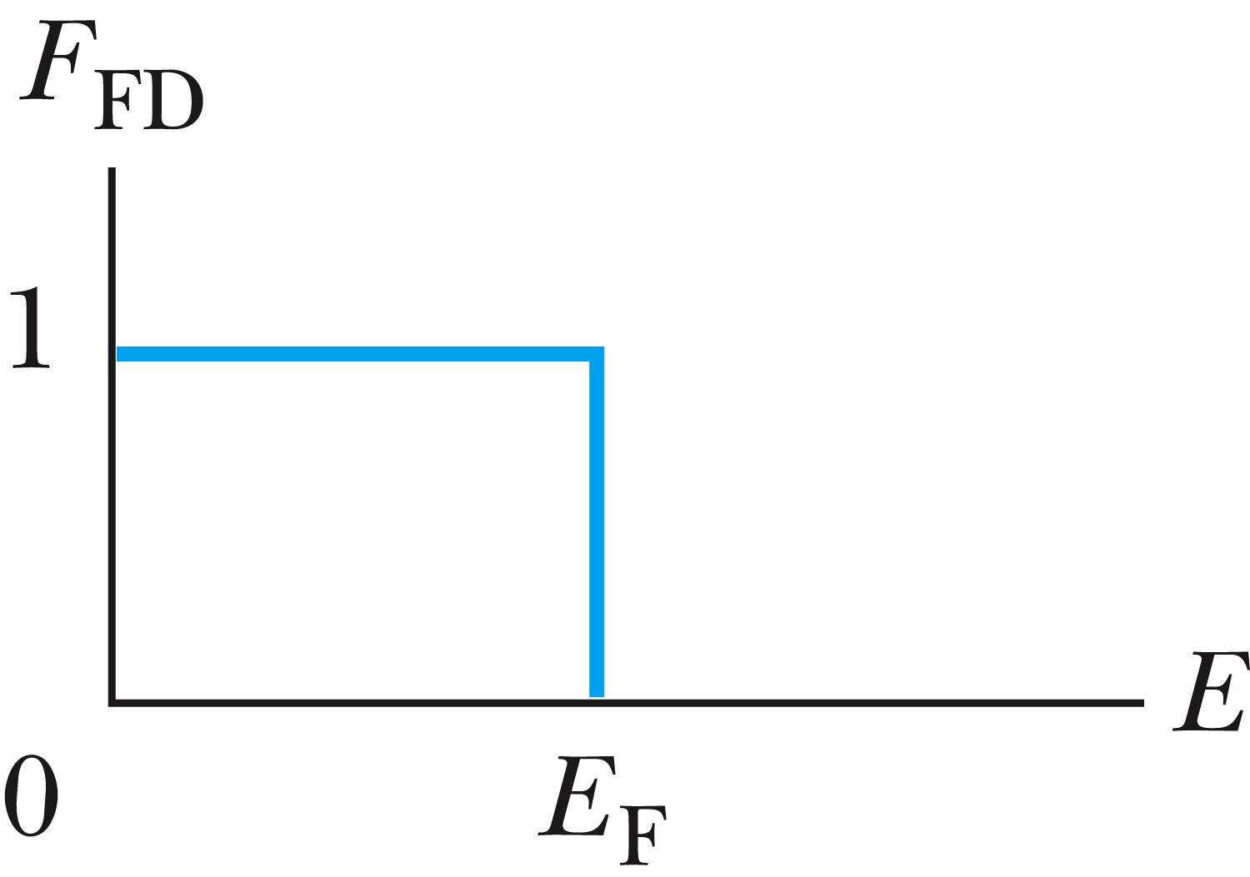
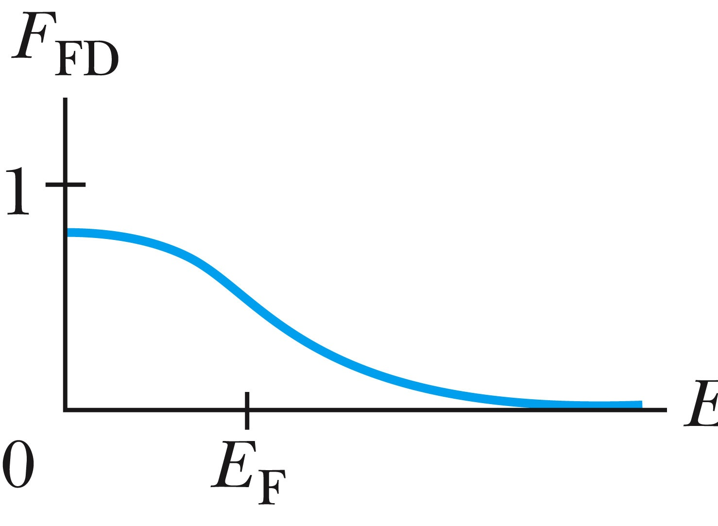
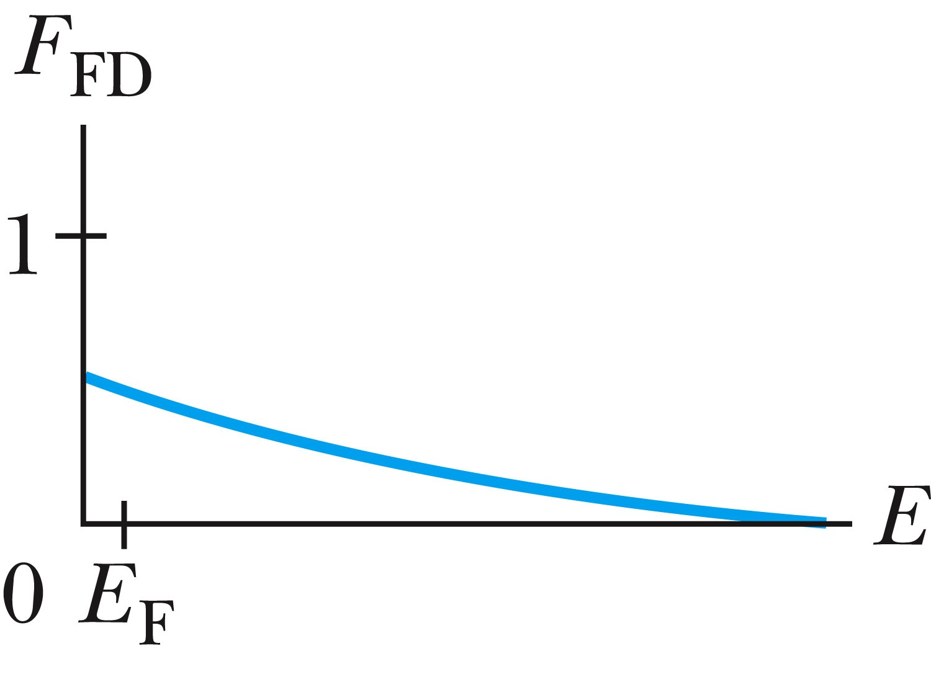
Fermi-Dirac Statistics
T > 0
T = 0
As the temperature increases from T = 0, the Fermi-Dirac factor “smears out”, and more fermions jump to higher energy level above Fermi energy
We can define Fermi temperature, defined as T_{F} ≡ E_{F} / k
T = T_{F}
T >> T_{F}
When T >> T_{F}, F_{FD} approaches a simple decaying exponential

Slide 22
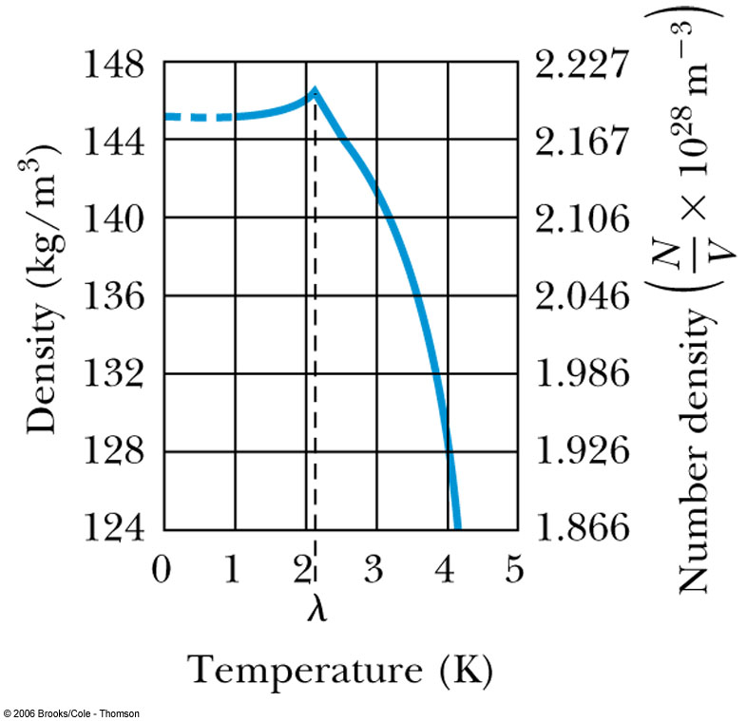
Liquid Helium
Has the lowest boiling point of any element (4.2 K at 1 atmosphere pressure) and has no solid phase at normal pressure
Helium is so light and has high speed and so escapes outside of the Earth atmosphere ➔ Must be captured from underground

Slide 23
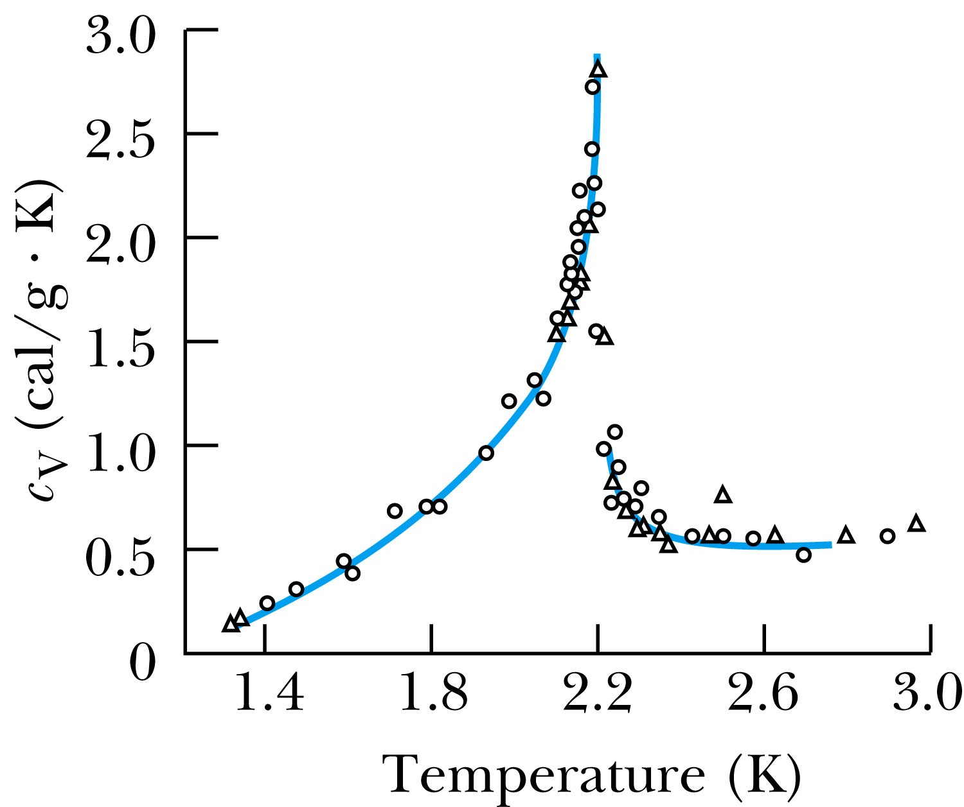
Liquid Helium
The specific heat of liquid helium as a function of temperature
The temperature at about 2.17 K is referred to as the critical temperature (T_{c}), transition temperature, or the lambda point.
As the temperature is reduced from 4.2 K toward the lambda point, the liquid boils vigorously. At 2.17 K the boiling suddenly stops.
What happens at 2.17 K is a transition from the normal phase to the superfluid phase.

Slide 24
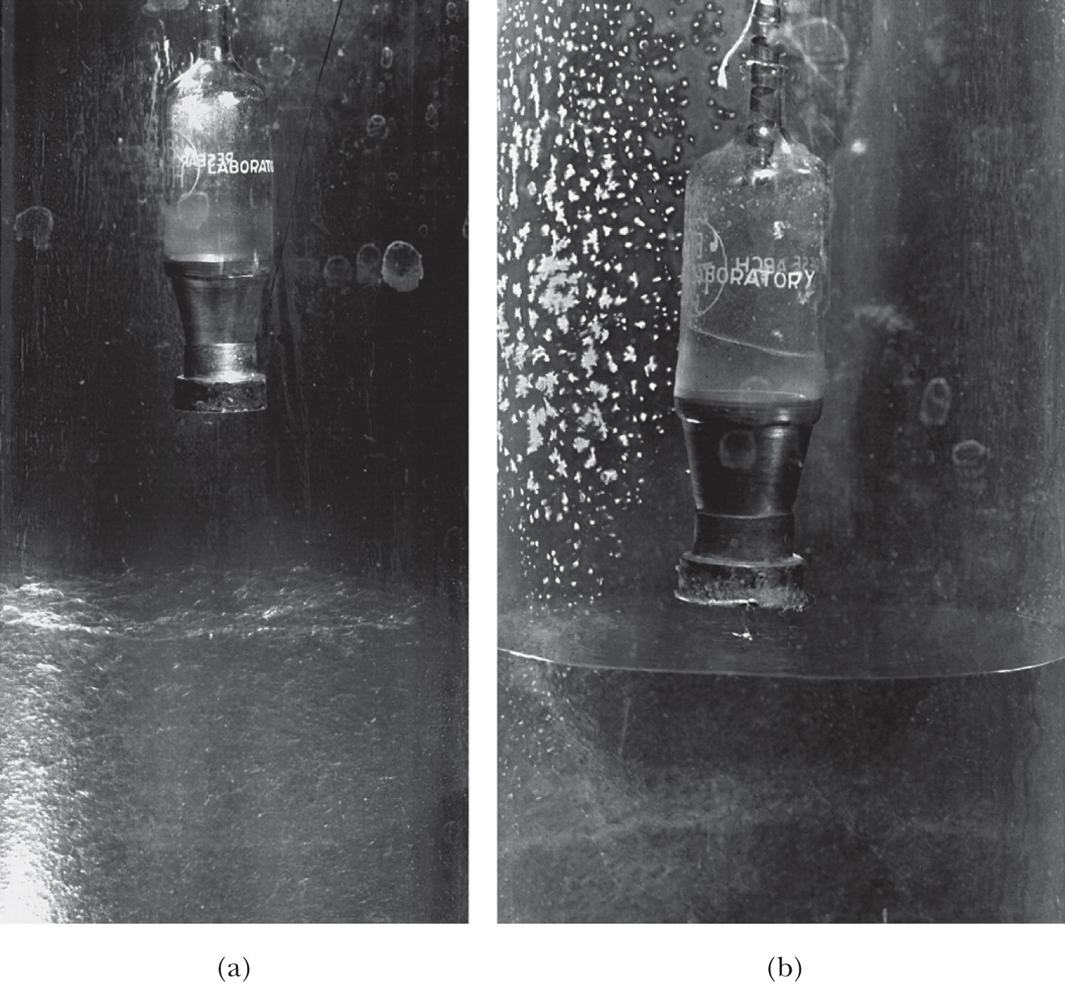
He Transition to Superfluid State
T>T_{c}
T<T_{c}
Vessel with very fine holes that do not allow passage of normal liquid
See the liquid here
Boiling surface
Calm surface below 2.17K

Slide 25
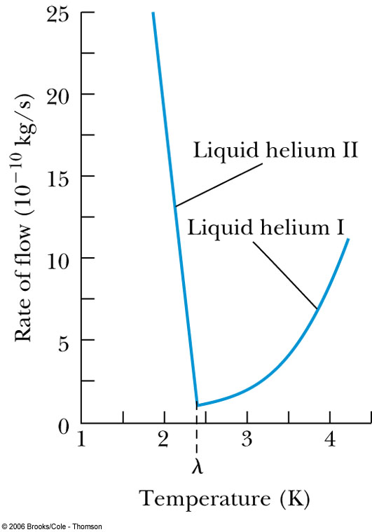
Liquid Helium
The rate of flow increases dramatically as the temperature is reduced because the superfluid has a low viscosity.
Creeping film – formed when the viscosity is very low
But when the viscosity is measured through the drag on a metal surface, He behaves like a normal fluid ➔ Contradiction!!

Slide 26
Liquid Helium
Fritz London claimed (1938) that liquid helium below the lambda point is a mixture of superfluid and normal fluid.
As the temperature approaches absolute zero, the superfluid approaches 100% superfluid.
The fraction of helium atoms in the superfluid state:
Superfluid liquid helium (⁴He) is referred to as a Bose-Einstein condensation.
⁴He is a boson thus it is not subject to the Pauli exclusion principle
all particles are in the same quantum state

Slide 27
Bose-Einstein Condensation in Gases
BE condensation in liquid has been accomplished but gas condensation state hadn’t been until 1995
The strong Coulomb interactions among gas particles made it difficult to obtain the low temperatures and high densities needed to produce the BE condensate.
Finally success was achieved by E. Cornell and C. Weiman in Boulder, CO, with Rb (at 20nK) and W. Kettle at MIT on Sodium (at 20μK) ➔ Awarded of Nobel prize in 2001
The procedure
Laser cool their gas of ⁸⁷Rb atoms to about 1 mK.
Used a magnetic trap to cool the gas to about 20 nK, driving away atoms with higher speeds and keeping only the low speed ones
At about 170 nK, Rb gas went through a transition, resulting in very cold and dense state of gas
Possible application of BEC is an atomic laser but it will take long time..

