Slide 1
PHYS 1443 – Section 004
Lecture #1
Tuesday, Aug. 26, 2014
Dr. Jaehoon Yu
Who am I?
How is this class organized?
What is Physics?
What do we want from this class?
Brief history of physics
Standards and units
Dimensional Analysis
Today’s homework is homework #1, due 11pm, this Thursday, Aug. 28 !!

Slide 2
Announcements
Plea to you: Please turn off your cell-phones, tablets and computers while class is in session
Reading assignment #1: Read and follow through all sections in appendix A – D for units and unit conversions and E on math refresher by Thursday, Aug. 28
  There will be a quiz next Thursday, Aug. 28, on this reading assignment

Slide 3
Who am I?
Name: Dr. Jaehoon Yu (You can call me Dr. Yu)
Office: Rm 342, Chemistry and Physics Building
Extension: x22814, E-mail: jaehoonyu@uta.edu
My profession: High Energy Particle Physics (HEP)
  Collide particles (protons on anti-protons or electrons on anti-electrons, positrons) at the energies equivalent to 10,000 Trillion degrees
  To understand
    Fundamental constituents of matter
    Forces between the constituents (gravitational, electro-magnetic, weak and strong forces)
    Origin of Mass
    Search for Dark Matter
    Creation of Universe (Big Bang Theory)
  A pure scientific research activity
    Direct use of the fundamental laws we find may take longer than we want but
    Indirect product of research contribute to every day lives; eg. WWW
  Why do we do with this?
    Make our everyday lives better to help us live well as an integral part of the universe

Slide 4
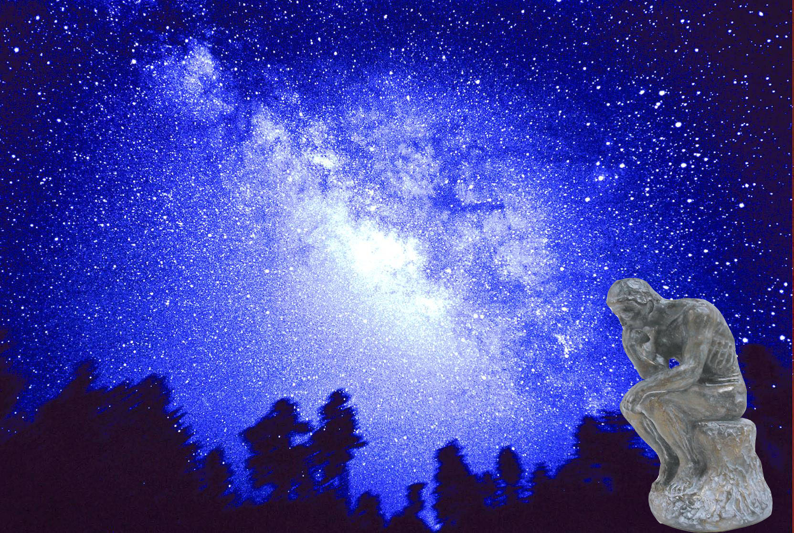

We always wonder…
What makes up the universe?
How does the universe work?
What holds the universe together?
How can we live in the universe well?
Where do we all come from?

Slide 5
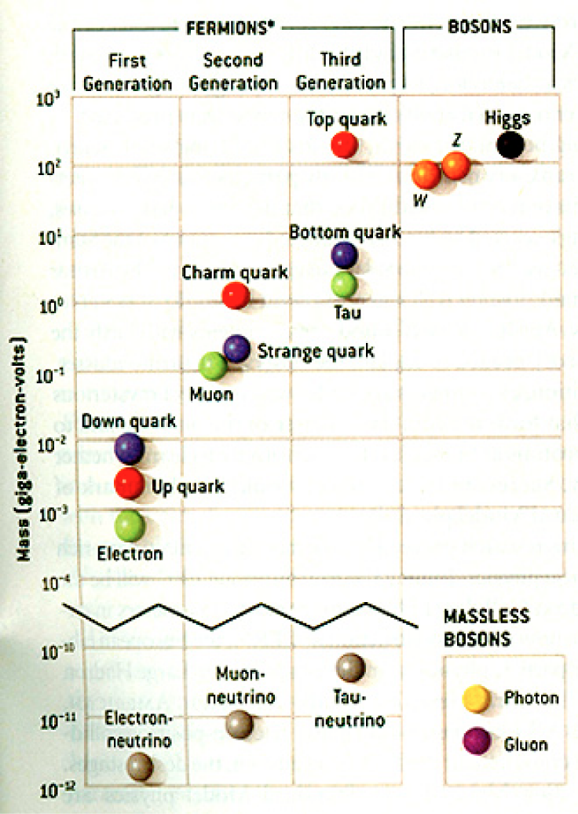
HEP and the Standard Model
HEP: A field of physics that studies the fundamental constituents of matter and basic principles of interactions between them.
Discovered in 1995, ~175m_{p}
Make up most ordinary matters ~0.1m_{p}
Total of 16 particles (12+4 force mediators) make up all the visible matter in the universe! ➔ Simple and elegant!!!
Tested to a precision of 1 part per million!

Slide 6
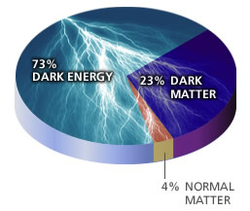
So what’s the problem?
Why is the mass range so large (0.1m_{p} – 175 m_{p})?
How do matters acquire mass?
  Higgs mechanism! Did we find the Higgs particle?
Why is the matter in the universe made only of particles?
Neutrinos have mass!! What are the mixing parameters, CP violations and mass ordering?
Why are there only three apparent forces?
  Can the forces be unified?
Is the picture we present the real thing?
  What makes up the 96% of the universe?
  What is the dark matter and dark energy?
Are there any other theories that describe the universe better?
  Does the super-symmetry exist?
How is the universe created, the Big Bang?

Slide 7
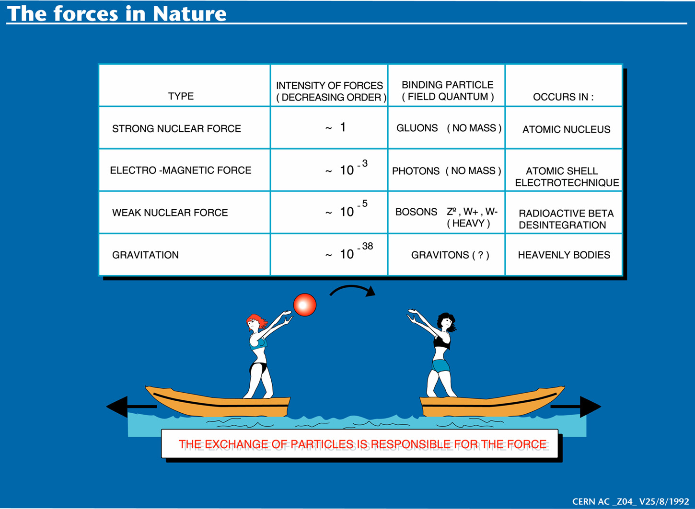

Slide 8
Accelerators are Powerful Microscopes.
They make high energy particle beams
that allow us to see small things.
seen by
low energy beam
(poorer resolution)
seen by
high energy beam
(better resolution)

Slide 9
Accelerators are also Time Machines.
They make particles last seen
in the earliest moments of the universe.
Energy
particle beam
energy
anti-particle beam
energy
Particle and anti-particle annihilate.
E = mc²

Slide 10
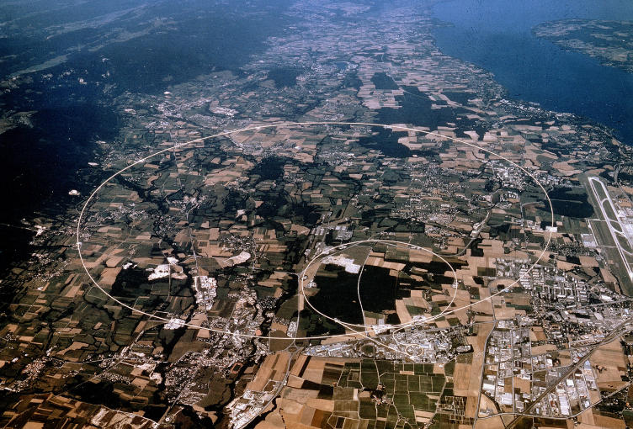


LHC @ CERN Aerial View
CMS
France
Geneva Airport
ATLAS
Swizerland

Slide 11
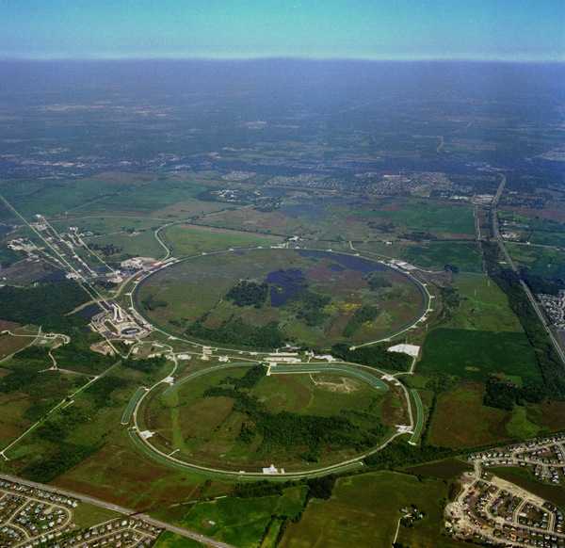
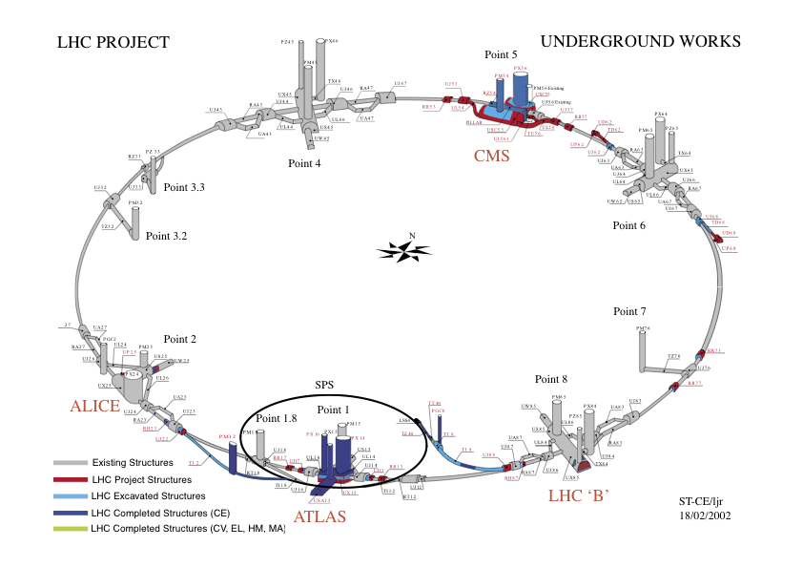
Fermilab Tevatron and LHC at CERN
World’s Highest Energy proton-anti-proton collider
  4km (2.5mi) circumference
  E_{cm}=1.96 TeV (=6.3x10⁻⁷J/p➔ 13M Joules on the area smaller than 10⁻⁴m²)
  Equivalent to the kinetic energy of a 20t truck at the speed 81mi/hr
    ~100,000 times the energy density at the ground 0 of the Hiroshima atom bomb
  Tevatron was shut down in 2011
  Vibrant other programs running, including the search for dark matter with beams!!
World’s Highest Energy p-p collider
  27km (17mi) circumference, 100m (300ft) underground
  Design E_{cm}=14 TeV (=44x10⁻⁷J/p➔ 362M Joules on the area smaller than 10⁻⁴m²)
  Equivalent to the kinetic energy of a B727 (80tons) at the speed 193mi/hr
    ~3M times the energy density at the ground 0 of the Hiroshima atom bomb
Large amount of data accumulated in 2010 – 2013
Shutdown in Feb. 2013 & on track to resume Mar. 2015
Chicago
CDF
p
DØ
Tevatron
p

Slide 12
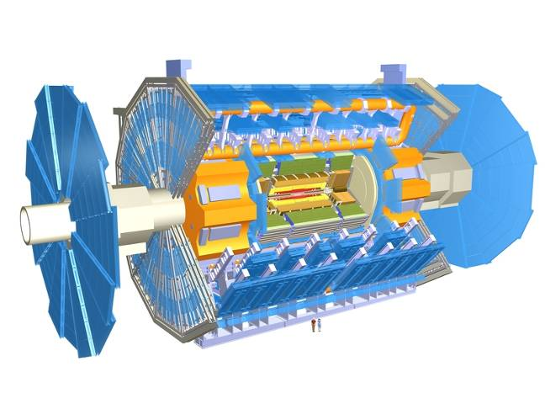
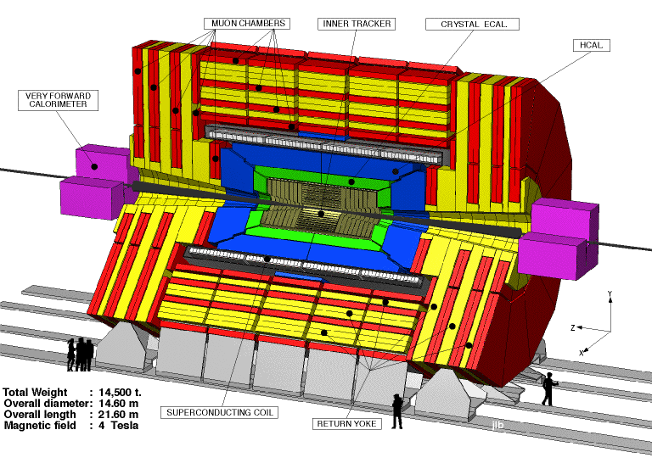

The ATLAS and CMS Detectors
Weighs 7000 tons and ~10 story tall
Records 200 – 400 collisions/second (out of 50million)
Records approximately 350 MB/second
Records ~2 PB per year ➔ 200*Printed material of the US Lib. of Congress
200x

Slide 13
What is the Higgs and What does it do?
When there is perfect symmetry, one cannot tell directions!

Slide 14

What? What’s the symmetry?
Where is the head of the table?
Without a broken symmetry, one cannot tell directional information!!

Slide 15
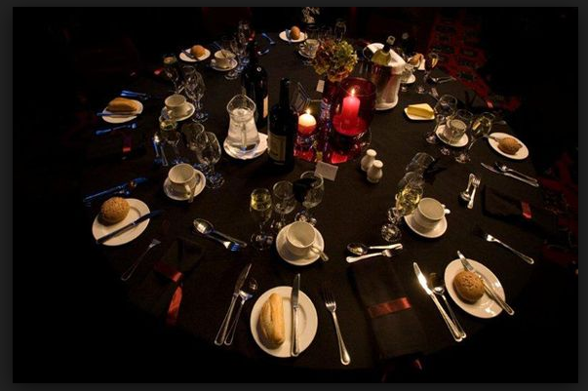
A broken symmetry

Slide 16
What is the Higgs and What does it do?
When there is perfect symmetry, one cannot tell directions!
Only when symmetry is broken, can one tell directions
Higgs field works to break the perfect symmetry and gives mass to all fundamental particles
Sometimes, this field spontaneously generates a particle, the Higgs particle
So the Higgs particle is the evidence of the existence of the Higgs field!

Slide 17



So how does Higgs Field work again?
Person in space ➔ no symmetry breaking
Person in air ➔ symmetry can be broken
Sometimes, you get
Just like a tornado is a piece of evidence of the existence of air, Higgs particle is a piece of evidence of Higgs mechanism

Slide 18
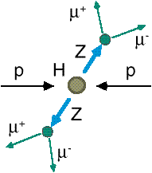
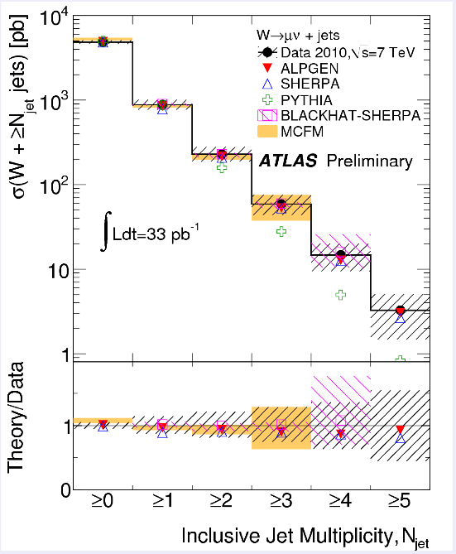
How do we look for the Higgs?
Identify Higgs candidate events
Understand fakes (backgrounds)
Look for a bump!!
  Large amount of data absolutely critical
e⁺ (μ⁺)
e⁻ (μ⁻)
e⁺
e⁻

Slide 19
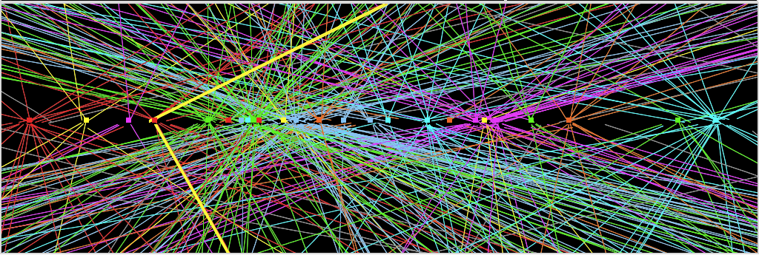
Challenges? No problem!
An interesting collision event with 25 collisions at once!!
Here it is!!

Slide 20
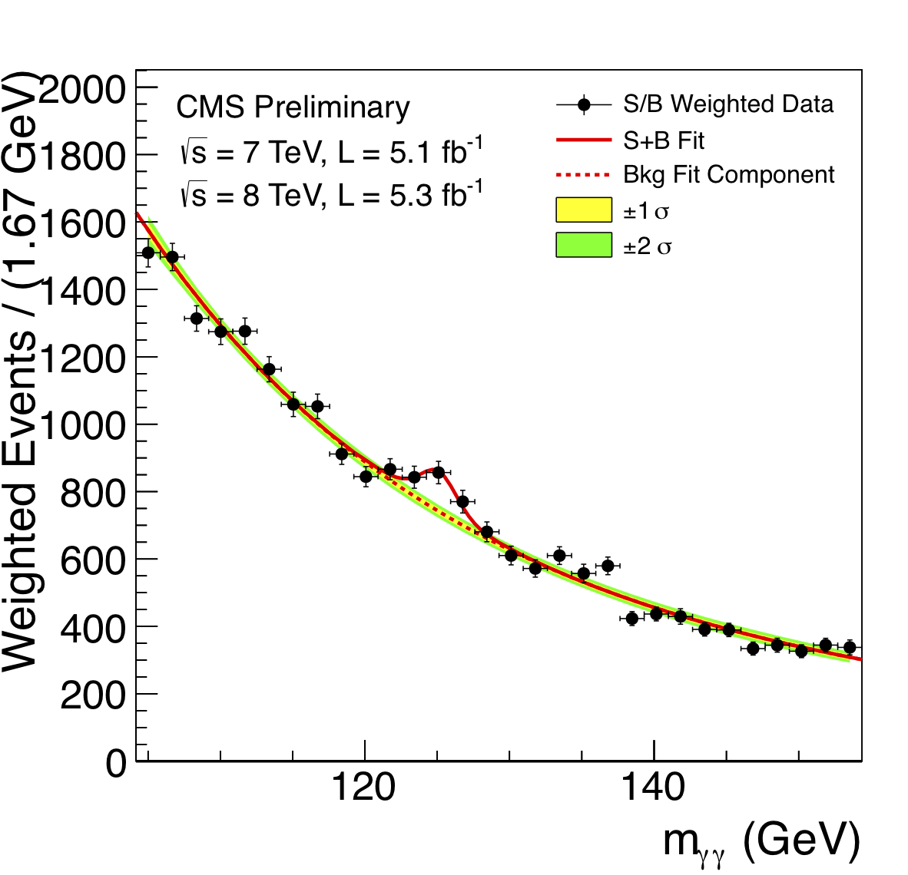
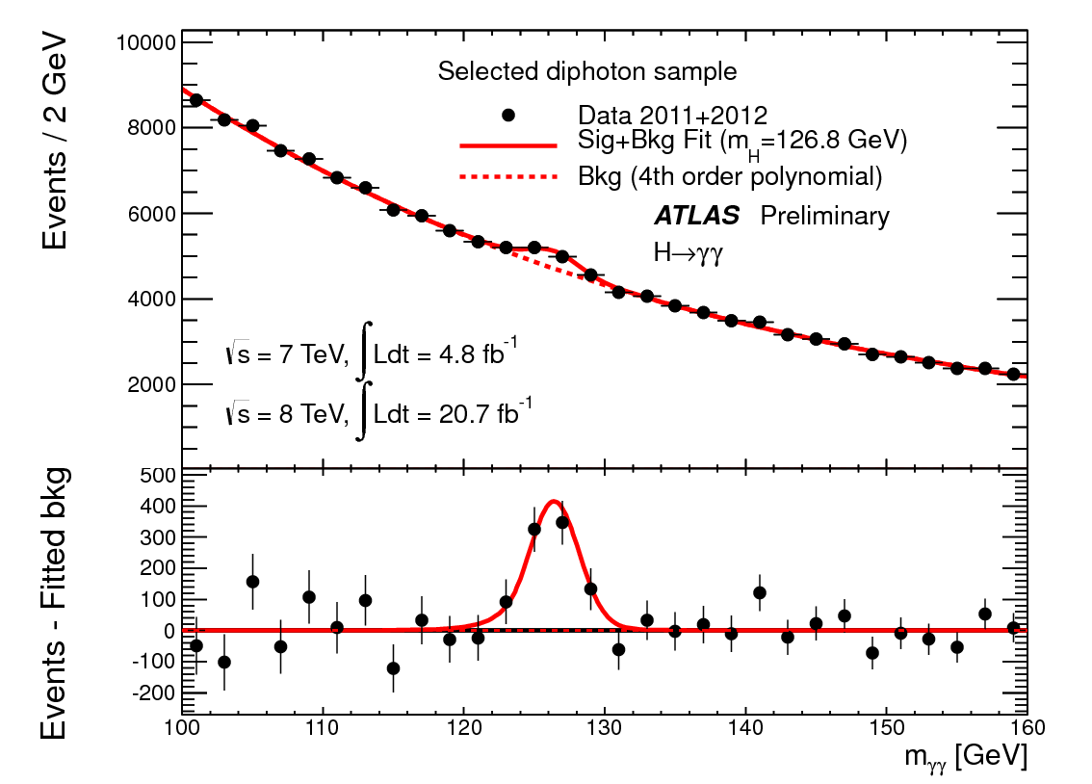
ATLAS and CMS Mass Bump Plots (H→γγ )
ATLAS
CMS
LOOK, Ma! Bumps!!

Slide 21

What did statistics do for Higgs?

Slide 22

How about this?

Slide 23
So have we seen the Higgs particle?
The statistical significance of the finding is way over 7 standard deviations

Slide 24
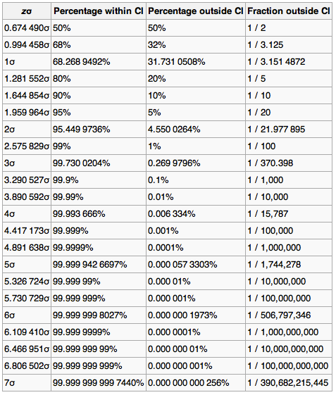
Statistical Significance Table

Slide 25
So have we seen the Higgs particle?
The statistical significance of the finding is much bigger than seven standard deviations
  Level of significance: much better than 99.999 999 999 7% (eleven 9s!!)
  We could be wrong once if we do the same experiment 391,000,000,000 times (will take ~13,000 years even if each experiment takes 1s!!)
So did we find the Higgs particle?
  We have discovered the heaviest new boson we’ve seen thus far
  It has many properties consistent with the Standard Model Higgs particle
    It quacks like a duck and walks like a duck but…
  We do not have enough data to precisely measure all the properties – mass, lifetime, the rate at which this particle decays to certain other particles, etc – to definitively determine its nature
Precision measurements and searches in new channels ongoing

Slide 26
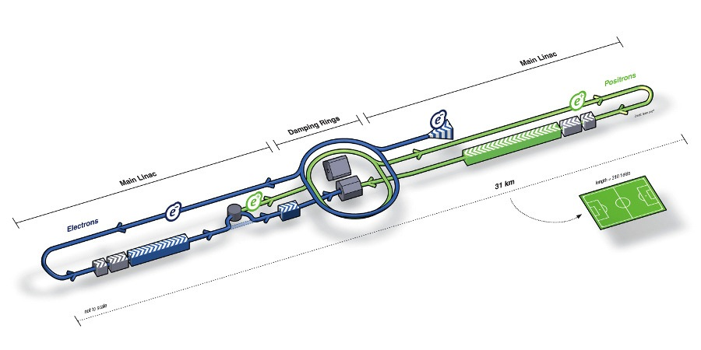
What’s next? Future Linear Collider
Now that we have found a new boson, precision measurement of the particle’s properties becomes important
An electron-positron collider on a straight line for precision measurements
10~15 years from now (In Dec. 2011, Japanese PM announced that they would bid for a LC in Japan and reaffirmed by the new PM in 2013)
  Our Japanese colleagues have declared that they will bid for building ILC
  Japan announced the selection of the site for the ILC in Aug. 2013!!
Takes 10 years to build a detector
Circumference ~6.6km
~300 soccer fields
L~31km (~20 mi)

Slide 27
Dark Matter Searches at Fermilab
Fermi National Accelerator Laboratory is turning into a lab with very high intensity accelerator program
UTA group is part of three experiments
  Long Baseline Neutrino Experiment (LBNE), an $850M flagship experiment, with data expected in 2025
    High flux secondary beam and a near detector enables searches for DM
    In addition to precision measurements of key neutrino param..
    UTA playing very significant role in this and other experiments at Fermilab in Chicago!
A rich physics program for the next 20 – 30 years!!
If we see DM, we could use this to make DM Beam??

Slide 28
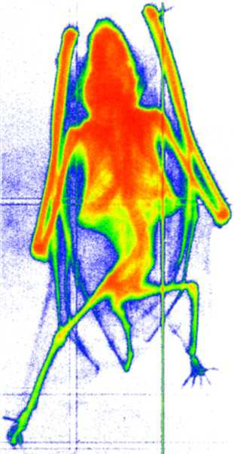
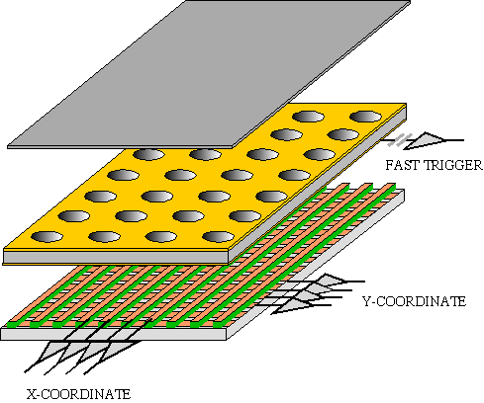
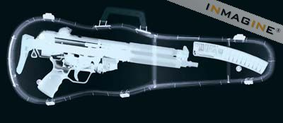
GEM Application Potential
FAST X-RAY IMAGING
Using the lower GEM signal, the readout can be self-triggered with energy discrimination:
9 keV absorption radiography of a small mammal (image size ~ 60 x 30 mm²)
A. Bressan et al,
Nucl. Instr. and Meth. A 425(1999)254
F. Sauli, Nucl. Instr. and Meth.A 461(2001)47

Slide 29
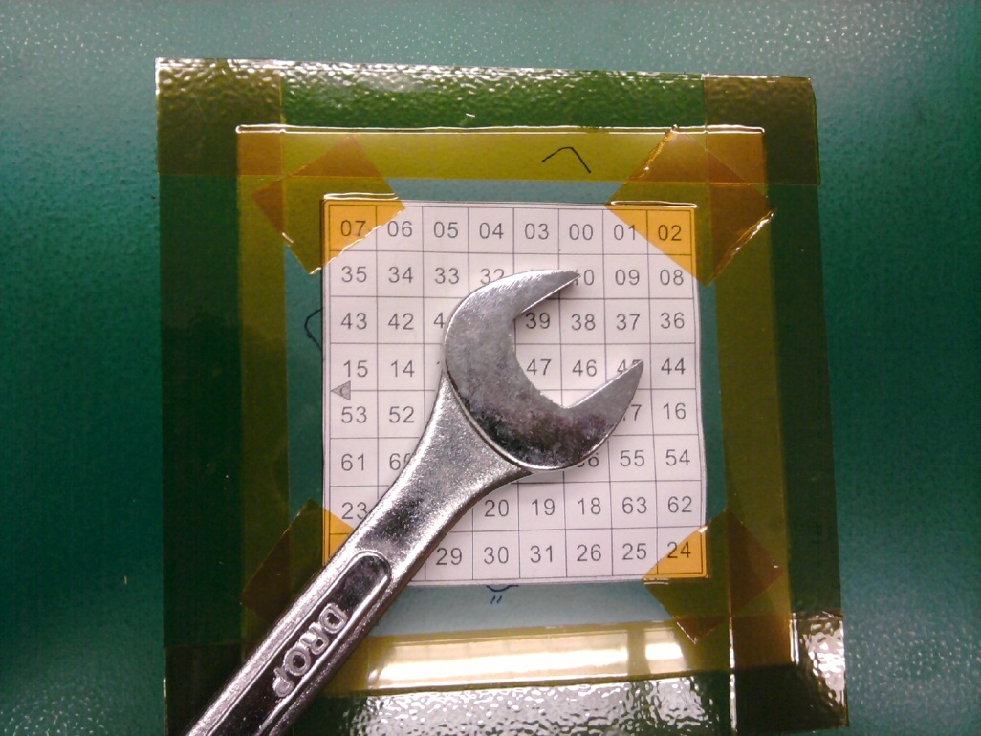
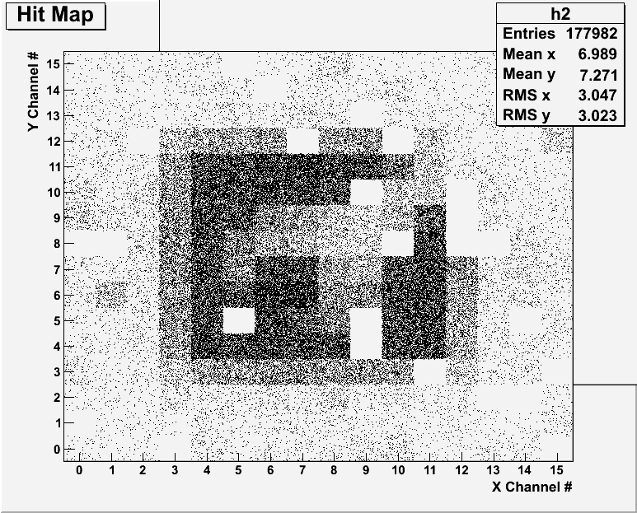
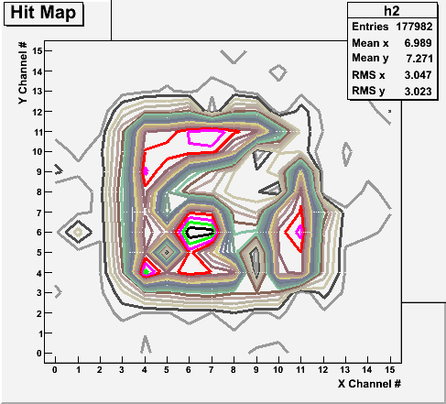
X-ray Image of an object with a prototype
Can you see what the object is?

Slide 30
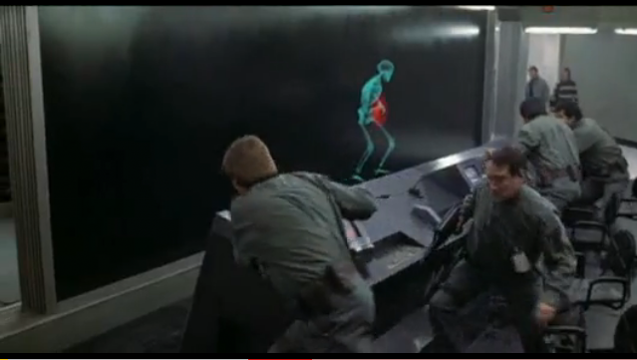
And in not too distant future, we could do …

Slide 31
Information & Communication Source
Course web page: http://www-hep.uta.edu/~yu/teaching/fall14-1443-004/fall14-1443-004.html
Contact information & Class Schedule
  Syllabus
  Homework
  Holidays and Exam days
  Evaluation Policy
  Class Style & Communication
  Other information
Primary communication tool is e-mail: Make sure that your e-mail at the time of course registration is the one you most frequently read!!
Office Hours for Dr. Yu: 11:00am – 12:00pm, Tuesdays and Thursdays or by appointments

Slide 32
Grade Evaluation Policy
Homework: 25%
Exams
  Midterm and Final Comprehensive Exams (10/21 and 12/11): 19% each
  One better of the two term Exams: 12%
    Total of two non-comprehensive term exams (9/23 and 11/23)
    One better of the two exams will be used for the final grade
    Missing an exam is not permissible unless pre-approved
      No makeup test
      You will get an F if you miss any of the exams without a prior approval
Lab score: 15%
Pop-quizzes: 10%
Extra credits: 10% of the total
  Random attendances
  Strong participation in the class discussions
  Special projects (These are the biggest!!)
  Planetarium shows and many other opportunities
Grading will be done on a sliding scale
100%

Slide 33
Homework
Solving homework problems is the only way to comprehend class material
An electronic homework system has been setup for you
  Details are in the material distributed today and on the web
  https://quest.cns.utexas.edu/student/courses/list
  Choose the course PHYS1443-004, unique number 43014
  Download homework #1, solve the problems and submit them online
  Multiple unsuccessful tries will deduct points
  Roster will close Thursday, Aug. 27
  You need a UT e-ID: Go and apply at the URL https://idmanager.its.utexas.edu/eid_self_help/?createEID&qwicap-page-id=EA027EFF7E2DA39E if you don’t have one.
Each homework carries the same weight
ALL homework grades will be used for the final grade
Home work will constitute 25% of the total ➔ A good way of keeping your grades high
Strongly encouraged to collaborate ➔ Does not mean you can copy

Slide 34
Attendances and Class Style
Attendances:
  Will be taken randomly
  Will be used for extra credits
Class style:
  Lectures will be on electronic media
    The lecture notes will be posted on the web AFTER each class
  Will be mixed with traditional methods
  Active participation through questions and discussions are STRONGLY encouraged ➔ Extra credit….
  Communication between you and me is extremely important
    If you have problems, please do not hesitate talking to me

Slide 35
Lab and Physics Clinic
Physics Labs:
  Starts in the week of Sept. 1
  Important to understand physical principles through experiments
  15% of the grade
  Lab syllabus is available in your assigned lab rooms.
    Go by the lab room and pick up the syllabus
Physics Clinic:
  Free service
  They provide general help on physics, including help solving homework problems
    Do not expect solutions of the problem from them!
    Do not expect them to tell you whether your answers are correct!
    It is your responsibility to make sure that you have done everything correctly!
  11am – 6pm, Mon – Thu in SH 007
  This service begins today, Tuesday, Sept. 2

Slide 36
Extra credit
Up to 10% addition to the total
  Could boost a B to A, C to B or D to C
What constitute for extra credit?
  Random attendances
  Strong participation in the class discussions
  Special projects
  Watch the valid planetarium shows
  Many other opportunities

Slide 37
Valid Planetarium Shows
Regular running shows
  Astronaut
  Two Small Pieces of Glass
  We are Astronomers
Shows that need special arrangements
  Back to the Moon for Good; Bad Astronomy
  Black Holes (can watch up to 2 times)
  Experience the Aurora; IBEX; Ice Worlds; Magnificent Sun; Mayan Prophecies
  Nano Cam; Stars of the Pharaohs; TimeSpace
  Unseen Universe: The Vision of SOFIA; Violent Universe
How to submit for extra credit?
  Obtain the ticket stub that is signed and dated by the planetarium star lecturer of the day
  Collect the ticket stubs
  Tape all of them on a sheet of paper with your name and ID written on it
  Submit the sheet at the end of the semester when asked

Slide 38
What can you expect from this class?
All A’s?
  This would be really nice, wouldn’t it?
  But if it is too easy it is not fulfilling or meaningful….
This class is not going to be a stroll in the park!!
You will earn your grade in this class.
  You will need to put in sufficient time and sincere efforts
  Exams and quizzes will be tough!!
    Sometimes problems might not look exactly like what you learned in the class
    Just putting the right answer in free response problems does not work!
But you have a great control of your grade in your hands, up to 50%!!!
  Homework is 25% of the total grade!!
    Means you will have many homework problems
      Sometimes much more than any other classes
      Sometimes homework problems will be something that you have yet to learn in class
      Exam’s problems will be easier that homework problems but the same principles!!
  Lab 15%
  Extra credit 10%
I will work with you so that your efforts are properly rewarded

Slide 39
What do we want to learn in this class?
Physics is everywhere around you.
Skills to understand the fundamental principles that surrounds you in everyday lives…
Skills to identify what laws of physics applies to what phenomena and use them appropriately
Understand the impact of physical laws and apply them
Learn skills to think, research and analyze observations.
Learn skills to express observations and measurements in mathematical language
Learn skills to express your research in systematic manner in writing
But most importantly the confidence in your physics ability and to take on any challenges laid in front of you!!
Most importantly, let us have a lot of FUN!!

Slide 40
In this course, you will learn…
Fundamentals of mechanics
Kinematic equations and description of motions
Concepts of physical quantities that describe motions, such as velocity, speed, acceleration, etc
Vector and scalar quantities
Concepts of force, energy and momentum and relationship between them and their conservation laws
Techniques to use conservation laws for motions
Rotational motions and Equilibrium conditions
Fluid and wave motions and thermodynamics

