Slide 1
PHYS 1443 – Section 004 Lecture #3
Tuesday, Sept. 2, 2014
Dr. Jaehoon Yu
Estimates
Dimensional Analysis
Fundamentals of kinematics
Concepts of kinematic quantities
Displacement
Average Velocity and Speed
Instantaneous velocity and speed
Acceleration

Slide 2
Announcements
Quiz results
Class average: 41.6/58
Equivalent to 71.7/100
Top score: 57/58
Some Homework tips
When inputting answers to the Quest homework system
Unless the problem explicitly asks for significant figures, input as many digits as you can
The Quest is dumb. So it does not know about anything other than numbers
More details are http://web4.cns.utexas.edu/quest/support/student/#Num
Physics department colloquium
4pm every Wednesday in SH101
Tomorrow is the faculty research expo

Slide 3
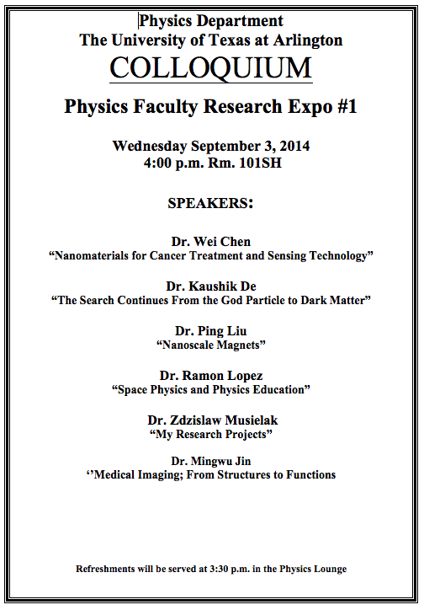

Slide 4
Reminder: Special Project #1 for Extra Credit
Find the solutions for yx²-zx+v=0 ➔ 5 points
X is the unknown variable, and y, z and v are constant coefficients!
You cannot just plug into the quadratic equations!
You must show a complete algebraic process of obtaining the solutions!
Derive the kinematic equation from first principles and the known kinematic equations ➔ 10 points
You must show your OWN work in detail to obtain the full credit
Must be in much more detail than in this lecture note!!!
Please do not copy from the lecture note or from your friends. You will all get 0!
Due Thursday, Sept. 4

Slide 5
Estimates & Order-of-Magnitude Calculations
Estimate = Approximation
Useful for rough calculations to determine the necessity of higher precision
Usually done under certain assumptions
Might require modification of assumptions, if higher precision is necessary
Order of magnitude estimate: Estimates done to the precision of 10s or exponents of 10s;
Three orders of magnitude: 10³=1,000
Round up for Order of magnitude estimate; 8x10⁷ ~ 10⁸
Similar terms: “Ball-park-figures”, “guesstimates”, etc
5

Slide 6
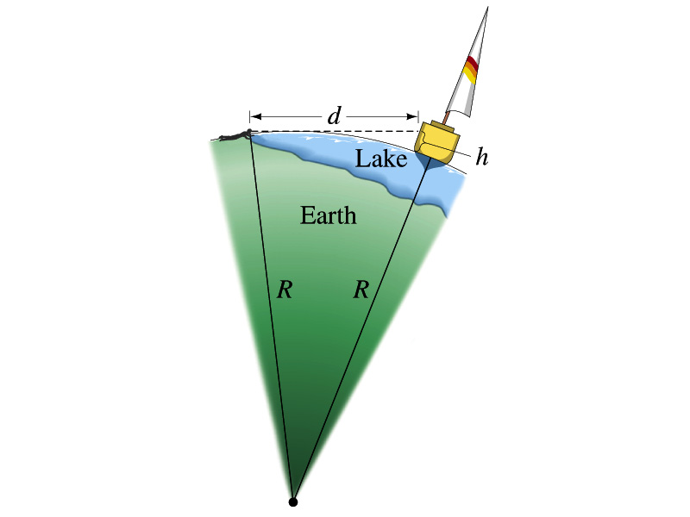
Example for Estimates
Estimate the radius of the Earth using triangulation as shown in the picture when d=4.4km and h=1.5m.
Pythagorian theorem
D=4.4km
Solving for R
R
R+h
6
Real R=6380km

Slide 7
Dimensions of Units and Dimensional Analysis
An extremely useful concept in solving physical problems
Good to write physical laws in mathematical expressions
No matter what units are used the base quantities are the same
Length (distance) is length whether meter or inch is used to express the size: Usually denoted as [L]
The same is true for Mass ([M])and Time ([T])
One can say “Dimension of Length, Mass or Time”
Dimensions are treated as algebraic quantities: Can perform two algebraic operations; multiplication or division
7

Slide 8
Dimensions of units and Dimensional Analysis cnt’d
One can use dimensions only to check the validity of one’s expression: Dimensional analysis
Eg: Speed [v] = [L]/[T]=[L][T⁻¹]
Distance (L) traveled by a car running at the speed V in time T
L = V*T = [L/T]*[T]=[L]
More general expression of dimensional analysis is using exponents: eg. [v]=[L^{n}T^{m}] =[L][T⁻¹] where n = 1 and m = -1
8

Slide 9
Examples
Show that the expression [v] = [at] is dimensionally correct
Speed: [v] =[L]/[T]
Acceleration: [a] =[L]/[T]²
Thus, [at] = (L/T²)xT=LT⁽⁻²⁺¹⁾ =LT⁻¹ =[L]/[T]= [v]
Suppose the acceleration a of a circularly moving particle with speed v and radius r is proportional to r^{n} and v^{m}. What are n andm?
a
r
v
Dimensionless
constant
Length
Speed
9

Slide 10
Some Fundamentals
Kinematics: Description of Motion without understanding the cause of the motion
Dynamics: Description of motion accompanied with understanding the cause of the motion
Vector and Scalar quantities:
Scalar: Physical quantities that require magnitude but no direction
Speed, length, mass, height, volume, area, magnitude of a vector quantity, etc
Vector: Physical quantities that require both magnitude and direction
Velocity, Acceleration, Force, Momentum
It does not make sense to say “I ran with velocity of 10miles/hour.”
Objects can be treated as point-like if their sizes are smaller than the scale in the problem
Earth can be treated as a point like object (or a particle)in celestial problems
Simplification of the problem (The first step in setting up to solve a problem…)
Any other examples?
10

Slide 11
Some More Fundamentals
Motions: Can be described as long as the position is known at any given time (or position is expressed as a function of time)
Translation: Linear motion along a line
Rotation: Circular or elliptical motion
Vibration: Oscillation
Dimensions of geometry
0 dimension: A point
1 dimension: Linear drag of a point, resulting in a line ➔ Motion in one-dimension is a motion on a line
2 dimension: Linear drag of a line resulting in a surface
3 dimension: Perpendicular Linear drag of a surface, resulting in a stereo object
11

Slide 12
Displacement, Velocity and Speed
One dimensional displacement is defined as:
A vector quantity
Displacement is the difference between initial and final poisitions of the motion and is a vector quantity. How is this different than distance?
Unit?
m
The average velocity is defined as:
Unit?
m/s
A vector quantity
Displacement per unit time in the interval throughout the motion
The average speed is defined as:
Unit?
m/s
A scalar quantity
Can someone tell me what the difference between speed and velocity is?

Slide 13
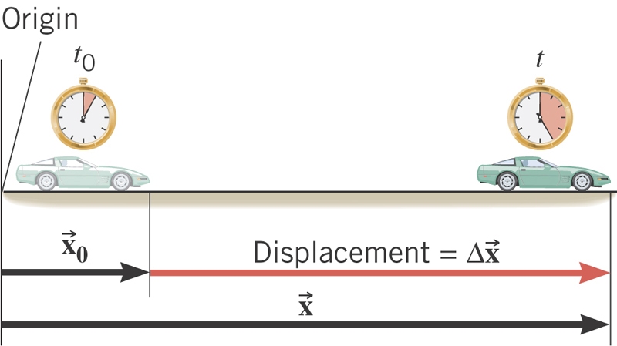
What is the displacement?
How much is the elapsed time?
What is the average velocity?
What is the average speed?

Slide 14
Difference between Speed and Velocity
Let’s take a simple one dimensional translational motion that has many segments:
Let’s call this line as X-axis
Let’s have a couple of motions in a total time interval of 20 sec.
+10m
+15m
+5m
-5m
-10m
-15m
Total Displacement:
Average Velocity:
Total Distance Traveled:
Average Speed:
14

Slide 15
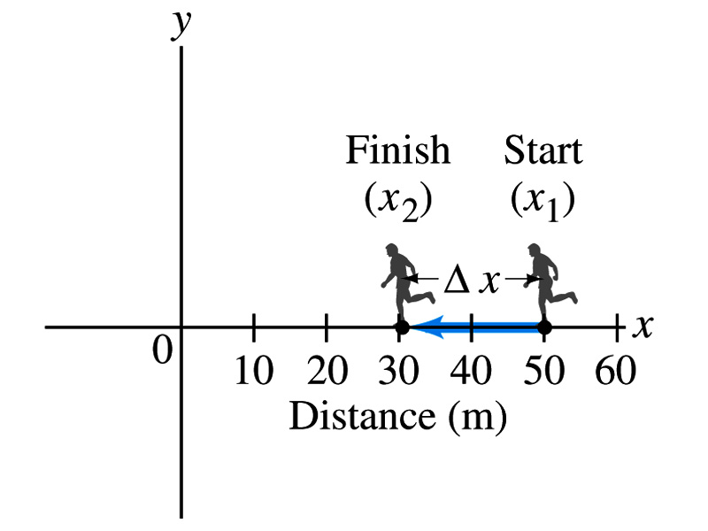
Example
The position of a runner as a function of time is plotted as moving along the x axis of a coordinate system. During a 3.00-s time interval, the runner’s position changes from x₁=50.0m to x₂=30.5 m, as shown in the figure. What was the runner’s average velocity? What was the average speed?
Displacement:
Average Velocity:
Average Speed:
15

Slide 16
Example of a segmented motion
You drive a beat-up pickup truck along a straight road for 8.4km at 70km/h, at which point the truck runs out of gasoline and stops. Over the next 30min, you walk another 2.0km farther along the road to a gas station.
(a) what is your overall displacement from the beginning of your drive to your arrival at the station?
You can split this motion in two segments
Segment 1: from the start to the point where the truck ran out of gas, Δx₁
Segment 2: from the point where you started walking to the gas station, Δx₂
Overall displacement Δx is
16

Slide 17
Example
You drive a beat-up pickup truck along a straight road for 8.4km at 70km/h, at which point the truck runs out of gasoline and stops. Over the next 30min, you walk another 2.0km farther along the road to a gas station.
(b) What is the time interval Δt from the beginning of your drive to your arrival at the station?
Figure out the time interval in each segments of the motion and add them together.
We know what the interval for the second segment is: Δt₂=30min
What is the interval for the first segment, Δt₁?
Use the definition of average velocity and solve it for Δt₁
Add the two time intervals for total time interval Δt
17

Slide 18
Example
You drive a beat-up pickup truck along a straight road for 8.4km at 70km/h, at which point the truck runs out of gasoline and stops. Over the next 30min, you walk another 2.0km farther along the road to a gas station.
(c) What is your average velocity v_{avg} from the beginning of your drive to your arrival at the station?
Using the definition of the average velocity, just simply divide the overall displacement by the overall time interval:
What is the average speed?
What is the average velocity and average speed in km/h?
18

Slide 19
Instantaneous Velocity and Speed
Can average quantities tell you the detailed story of the whole motion?
NO!!
Instantaneous velocity is defined as:
What does this mean?
Displacement in an infinitesimal time interval
Average velocity over a very, very short amount of time
Instantaneous speed is the size (magnitude) of the velocity vector:
*Magnitude of Vectors are Expressed in absolute values

Slide 20
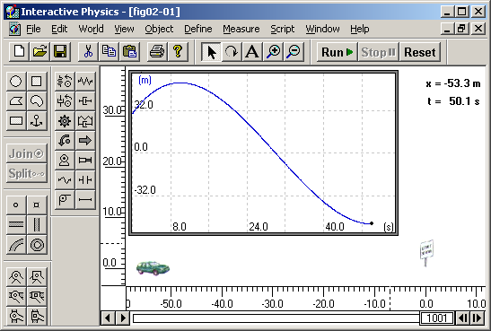
Instantaneous Velocity
Instantaneous Velocity
Average Velocity
Time
20
20

Slide 21
Position vs Time Plot
Position
It is helpful to understand motions to draw them on position vs time plots.
x₁
1
2
3
x=0
time
t=0
t₁
t₂
t₃
Running at a constant velocity (go from x=0 to x=x₁ in t₁, Displacement is + x₁ in t₁ time interval)
Velocity is 0 (go from x₁ to x₁ no matter how much time changes)
Running at a constant velocity but in the reverse direction as 1. (go from x₁ to x=0 in t₃-t₂ time interval, Displacement is - x₁ in t₃-t₂ time interval)
Does this motion physically make sense?
21
21

Slide 22
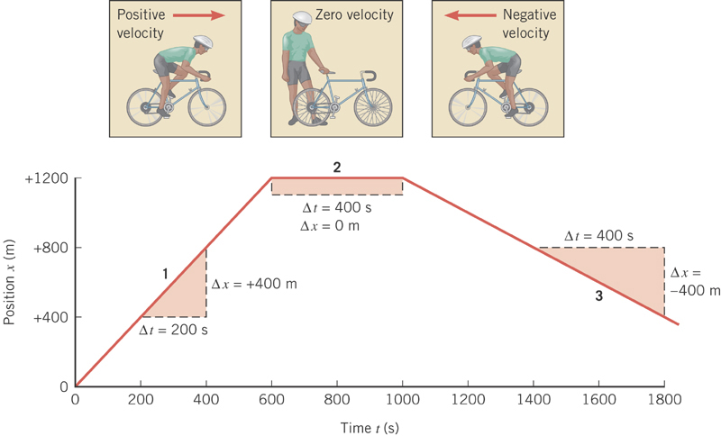

Slide 23
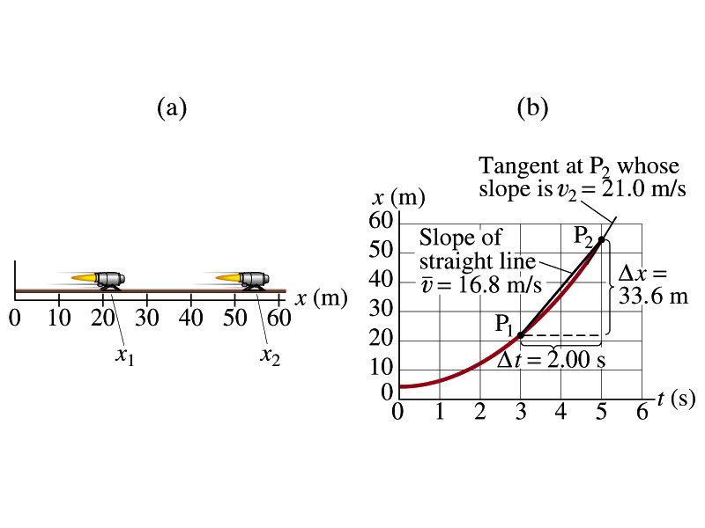
Example
A jet engine moves along a track. Its position as a function of time is given by the equation x=At²+B where A=2.10m/s² and B=2.80m.
(a) Determine the displacement of the engine during the interval from t₁=3.00s to t₂=5.00s.
Displacement is, therefore:
(b) Determine the average velocity during this time interval.
23
23

Slide 24
Example cont’d
(c) Determine the instantaneous velocity at t=t₂=5.00s.
Calculus formula for derivative
and
The derivative of the engine’s equation of motion is
The instantaneous velocity at t=5.00s is
24
24

Slide 25
Definitions of Displacement, Velocity and Speed
Displacement
Average velocity
Average speed
Instantaneous velocity
Instantaneous speed
25
25

Slide 26
Acceleration
Change of velocity in time (what kind of quantity is this?)
Vector
Definition of the average acceleration:
analogous to
Definition of the instantaneous acceleration:
analogous to
In calculus terms: The slope (derivative) of the velocity vector with respect to time or the change of slopes of position as a function of time

Slide 27
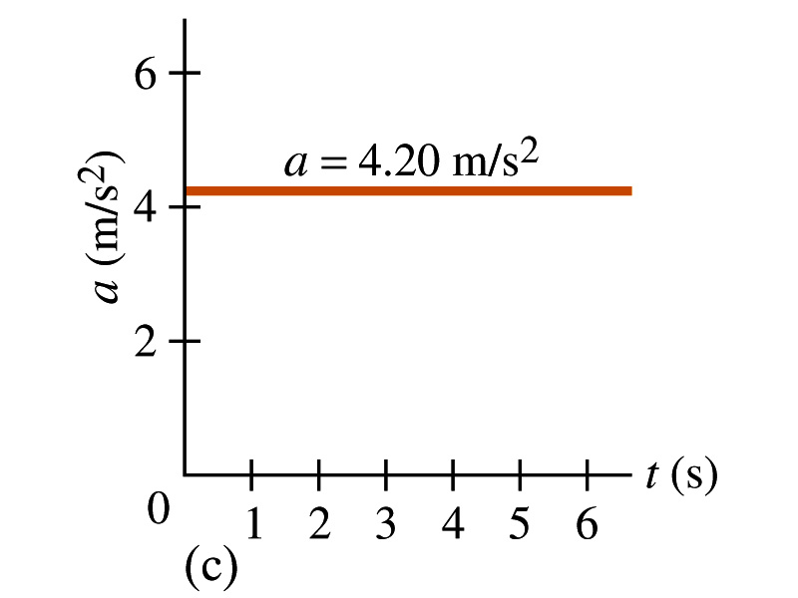
Acceleration vs Time Plot
What does this plot tell you?
Yes, you are right!!
The acceleration of this motion is a constant!!

Slide 28
Example
A car accelerates along a straight road from rest to 75km/h in 5.0s.
What is the magnitude of its average acceleration?

Slide 29
Few Confusing Things on Acceleration
When an object is moving in a constant velocity (v=v₀), there is no acceleration (a=0)
Is there any acceleration when an object is not moving?
When an object is moving faster as time goes on, (v=v(t) ), acceleration is positive (a>0).
Incorrect, since the object might be moving in negative direction initially
When an object is moving slower as time goes on, (v=v(t) ), acceleration is negative (a<0)
Incorrect, since the object might be moving in negative direction initially
In all cases, velocity is positive, unless the direction of the movement changes.
Incorrect, since the object might be moving in negative direction initially
Is there acceleration if an object moves in a constant speed but changes direction?
The answer is YES!!

