Slide 1
PHYS 1443 – Section 004
Lecture #5
Tuesday, Sept. 9, 2014
Dr. Jaehoon Yu
Motion in two dimensions
  Coordinate system
  Vector and scalars, their operations
  Motion under constant acceleration
  Projectile Motion
  Maximum range and height

Slide 2
Announcements
Quiz #2
  Beginning of the class this Thursday, Sept. 11
  Covers CH1.1 through what we learn today (CH4 – 4) plus math refresher
  Mixture of multiple choice and free response problems
  Bring your calculator but DO NOT input formula into it!
    Your phones or portable computers are NOT allowed as a replacement!
  You can prepare a one 8.5x11.5 sheet (front and back) of handwritten formulae and values of constants for the exam
    None of the parts of the solutions of any problems
    No derived formulae, derivations of equations or word definitions!
    No additional formulae or values of constants will be provided!
Colloquium at 4pm tomorrow, Wednesday, in SH101, UTA faculty expo II

Slide 3
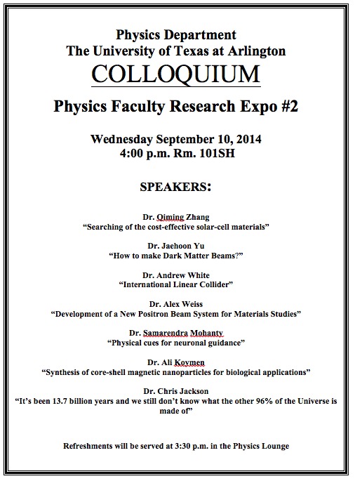

Slide 4
Reminder: Special Project #2 for Extra Credit
Show that the trajectory of a projectile motion is a parabola!!
  20 points
  Due: Thursday, Sept. 11
  You MUST show full details of your OWN computations to obtain any credit
    Beyond what was covered in this lecture note and in the book!

Slide 5
2D Coordinate Systems
They make it easy and consistent to express locations or positions
Two commonly used systems, depending on convenience, are
  Cartesian (Rectangular) Coordinate System
    Coordinates are expressed in (x,y)
  Polar Coordinate System
    Coordinates are expressed in distance from the origin ® and the angle measured from the x-axis, θ (r,θ)
Vectors become a lot easier to express and compute
+y
How are Cartesian and Polar coordinates related?
y₁
(x₁,y₁)
(r₁,θ₁)
=
r₁
θ₁
+x
O (0,0)
x₁

Slide 6
Example
Cartesian Coordinate of a point in the xy plane are (x,y)= (-3.50,-2.50)m. Find the equivalent polar coordinates of this point.
y
θ
x
θ_{s}
r
(-3.50,-2.50)m

Slide 7
Vector and Scalar
Vector quantities have both magnitudes (sizes) and directions
Force, gravitational acceleration, momentum
Normally denoted in BOLD letters, F, or a letter with arrow on top
Their sizes or magnitudes are denoted with normal letters, F, or absolute values:
Scalar quantities have magnitudes only
Can be completely specified with a value and its unit
Energy, heat, mass, time
Normally denoted in normal letters, E
Both have units!!!

Slide 8
Properties of Vectors
sizes
directions
Two vectors are the same if their and the are the same, no matter where they are on a coordinate system!!
y
Which ones are the same vectors?
D
F
A=B=E=D
A
Why aren’t the others?
B
x
C: The same magnitude but opposite direction: C=-A:A negative vector
E
C
F: The same direction but different magnitude

Slide 9
Vector Operations
Addition:
  Triangular Method: One can add vectors by connecting the head of one vector to the tail of the other (head-to-tail)
  Parallelogram method: Connect the tails of the two vectors and extend
  Addition is commutative: Changing order of operation does not affect the results A+B=B+A, A+B+C+D+E=E+C+A+B+D
A+B
A
A+B
B
=
OR
B
A+B
B
A
A
Subtraction:
  The same as adding a negative vector:A - B = A + (-B)
A
-B
Since subtraction is the equivalent to adding a negative vector, subtraction is also commutative!!!
A-B
Multiplication by a scalar is increasing the magnitude A, B=2A
A
B=2A

Slide 10
Example for Vector Addition
A car travels 20.0km due north followed by 35.0km in a direction 60.0º west of north. Find the magnitude and direction of resultant displacement.
Bsin60º
N
B
60^{ο}
Bcos60^{ο}
20
r
θ
A
E
Do this using components!!

Slide 11
Components and Unit Vectors
Coordinate systems are useful in expressing vectors in their components
y
(+,+)
A_{y}
(A_{x},A_{y})
}Components
A
(-,+)
θ
x
} Magnitude
(-,-)
(+,-)
A_{x}

Slide 12
Unit Vectors
Unit vectors are the ones that tells us the directions of the components
Dimensionless
Magnitudes these vectors are exactly 1
Unit vectors are usually expressed in i, j, k or
So a vector A can be expressed as

Slide 13
Examples of Vector Operations
Find the resultant vector which is the sum of A=(2.0i+2.0j) and B =(2.0i-4.0j)
Find the resultant displacement of three consecutive displacements: d₁=(15i+30j +12k)cm, d₂=(23i+14j -5.0k)cm, and d₃=(-13i+15j)cm
Magnitude

Slide 14
Displacement, Velocity, and Acceleration in 2-dim
Displacement:
Average Velocity:
How is each of these quantities defined in 1-D?
Instantaneous Velocity:
Average Acceleration
Instantaneous Acceleration:

Slide 15
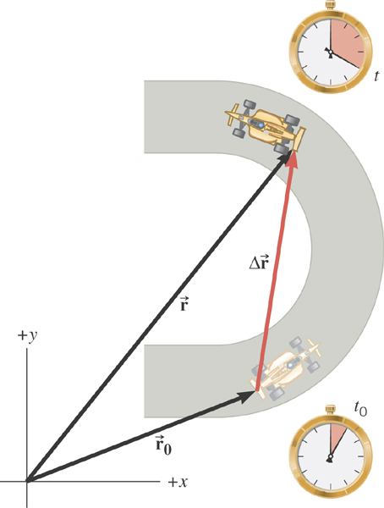
2D Displacement

Slide 16
2D Average Velocity
Average velocity is the
displacement divided by
the elapsed time.

Slide 17
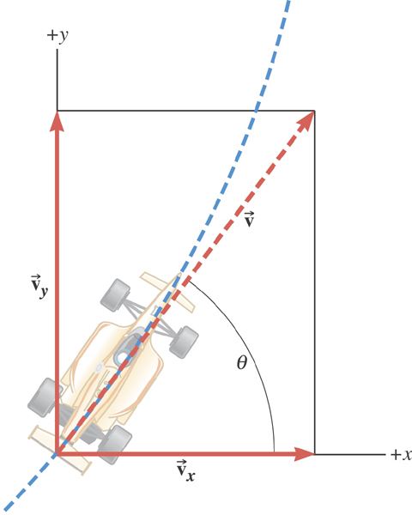
The instantaneous velocity indicates how fast the car moves and the direction of motion at each instant of time.

Slide 18
2D Average Acceleration

Slide 19
Kinematic Quantities in 1D and 2D
Quantities | 1 Dimension | 2 Dimension
Displacement
Average Velocity
Inst. Velocity
Average Acc.
Inst. Acc.
What is the difference between 1D and 2D quantities?

Slide 20
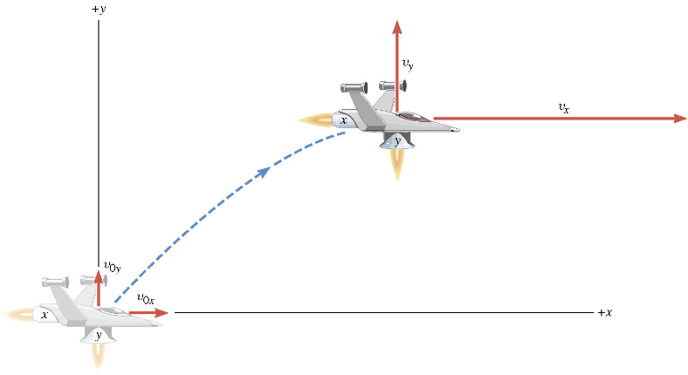
A Motion in 2 Dimension
This is a motion that could be viewed as two motions combined into one. (superposition…)

Slide 21
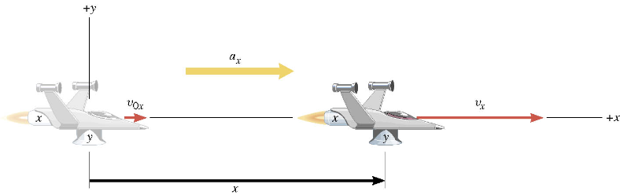
Motion in horizontal direction (x)

Slide 22
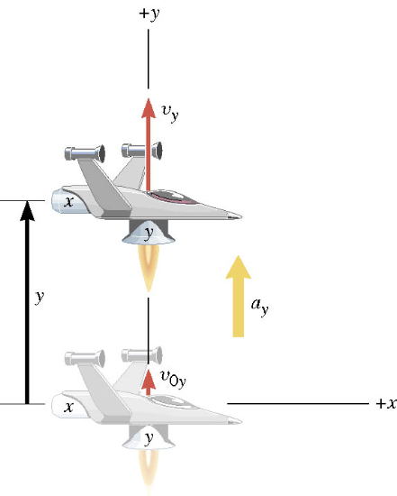
Motion in vertical direction (y)

Slide 23
A Motion in 2 Dimension
Imagine you add the two 1 dimensional motions on the left. It would make up a one 2 dimensional motion on the right.

Slide 24
Kinematic Equations in 2-Dim
x-component
y-component

Slide 25
Ex. A Moving Spacecraft
In the x direction, the spacecraft in zero-gravity zone has an initial velocity component of +22 m/s and an acceleration of +24 m/s². In the y direction, the analogous quantities are +14 m/s and an acceleration of +12 m/s². Find (a) x and v_{x}, (b) y and v_{y}, and (c) the final velocity of the spacecraft at time 7.0 s.

Slide 26
How do we solve this problem?
Visualize the problem ➔ Draw a picture!
Decide which directions are to be called positive (+) and negative (-).
Write down the values that are given for any of the five kinematic variables associated with each direction.
Verify that the information contains values for at least three of the kinematic variables. Do this for x and y separately. Select the appropriate equation.
When the motion is divided into segments in time, remember that the final velocity of one time segment is the initial velocity for the next.
Keep in mind that there may be two possible answers to a kinematics problem.

Slide 27
Ex. continued
In the x direction, the spacecraft in a zero gravity zone has an initial velocity component of +22 m/s and an acceleration of +24 m/s². In the y direction, the analogous quantities are +14 m/s and an acceleration of +12 m/s². Find (a) x and v_{x}, (b) y and v_{y}, and (c) the final velocity of the spacecraft at time 7.0 s.
x | a_{x} | v_{x} | v_{ox} | t
? |  | ?
+24.0 m/s²
+22.0 m/s
7.0 s
y | a_{y} | v_{y} | v_{oy} | t
? |  | ?
+12.0 m/s²
+14.0 m/s
7.0 s

Slide 28
First, the motion in x-direciton…
x | a_{x} | v_{x} | v_{ox} | t
? | +24.0 m/s² | ? | +22 m/s | 7.0 s

Slide 29
Now, the motion in y-direction…
y | a_{y} | v_{y} | v_{oy} | t
? | +12.0 m/s² | ? | +14 m/s | 7.0 s

Slide 30
The final velocity…
A vector can be fully described when the magnitude and the direction are given. Any other way to describe it?
Yes, you are right! Using components and unit vectors!!

Slide 31
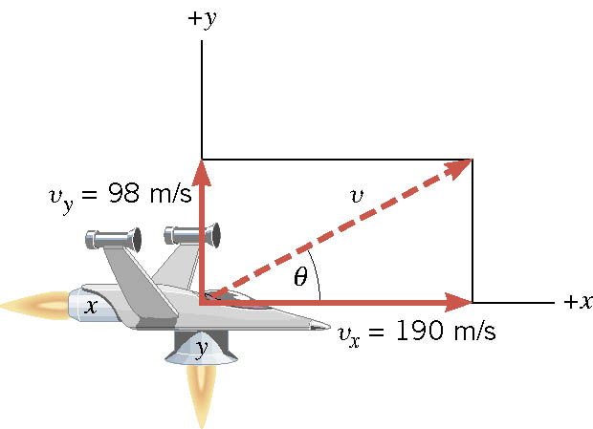
If we visualize the motion…

Slide 32
2-dim Motion Under Constant Acceleration
Position vectors in x-y plane:
Velocity vectors in x-y plane:
Velocity vectors in terms of the acceleration vector
X-comp
Y-comp

Slide 33
2-dim Motion Under Constant Acceleration
How are the 2D position vectors written in acceleration vectors?
Position vector components
Putting them together in a vector form
Regrouping the above
2D problems can be interpreted as two 1D problems in x and y

Slide 34
Example for 2-D Kinematic Equations
A particle starts at origin when t=0 with an initial velocity v=(20i-15j)m/s. The particle moves in the xy plane with a_{x}=4.0m/s². Determine the components of the velocity vector at any time t.
Velocity vector
Compute the velocity and the speed of the particle at t=5.0 s.

Slide 35
Example for 2-D Kinematic Eq. Cnt’d
Angle of the Velocity vector
Determine the x and y components of the particle at t=5.0 s.
Can you write down the position vector at t=5.0s?

