Slide 1
PHYS 1443 – Section 004 Lecture #6
Thursday, Sept. 11, 2014
Dr. Jaehoon Yu
Motion in two dimensions
Projectile Motion
Maximum range and height
Newton’s Laws of Motion
Mass
Newton’s second law of motion
Newton’s third law of motion
Today’s homework is homework #4, due 11pm, Thursday, Sept. 18!!

Slide 2
Announcements
Term exam #1
In class Thursday, Sept. 25
Covers CH1.1 through what we learn Tuesday Sept. 23 plus the math refresher
Mixture of multiple choice and free response problems
Bring your calculator but DO NOT input formula into it!
Your phones or portable computers are NOT allowed as a replacement!
You can prepare a one 8.5x11.5 sheet (front and back) of handwritten formulae and values of constants for the exam
None of the parts of the solutions of any problems
No derived formulae, derivations of equations or word definitions!
No additional formulae or values of constants will be provided!

Slide 3
Projectile Motion
A 2-dim motion of an object under the gravitational acceleration with the following assumptions
Free fall acceleration, g, is constant over the range of the motion
Air resistance and other effects are negligible
A motion under constant acceleration!!!! ➔ Superposition of two motions
Horizontal motion with constant velocity ( no acceleration )
Vertical motion under constant acceleration ( g )

Slide 4
Show that a projectile motion is a parabola!!!
x-component
y-component
In a projectile motion, the only acceleration is gravitational one whose direction is always toward the center of the earth (downward).
a_{x}=0
Plug t into
the above
What kind of parabola is this?

Slide 5
Projectile Motion
The only acceleration in this motion. It is a constant!!

Slide 6
Example for Projectile Motion
A ball is thrown with an initial velocity v=(20i+40j)m/s. Determine the time of flight and the distance the ball is from the original position when landed.
Which component determines the flight time and the distance?
Flight time is determined by the y component, because the ball stops moving when it is on the ground after the flight.
So the possible solutions are…
Distance is determined by the x component in 2-dim, because the ball is at y=0 position when it completed it’s flight.
Why isn’t 0 the solution?

Slide 7
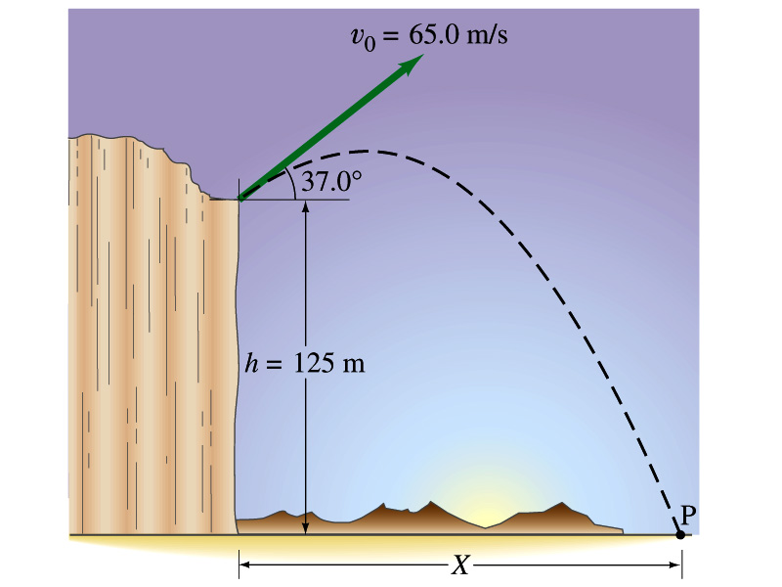
Example for a Projectile Motion
A stone was thrown upward from the top of a cliff at an angle of 37º to horizontal with initial speed of 65.0m/s. If the height of the cliff is 125.0m, how long is it before the stone hits the ground?
Becomes
The stone land after the initial time.
7

Slide 8
Example cont’d
What is the speed of the stone just before it hits the ground?
What are the maximum height and the maximum range of the stone?
Do these yourselves at home for fun!!!
8

Slide 9
Example for a Projectile Motion
A rescue plane flies at 198km/h (=55.0m/s) and constant height h=500m toward a point directly over a victim, where a rescue capsule is to land. What should be the angle Φ of the pilot’s line of sight to the victim when the capsule release is made?
Once the rescue capsule is release, it will undergo a projectile motion, and this is becomes a simple trigonometry problem. What is the initial angle of capsule release?
What is the velocity of the capsule as it reaches the water? If it stops after pushing the victim 50cm into the water, what would be the acceleration of the capsule?
9

Slide 10
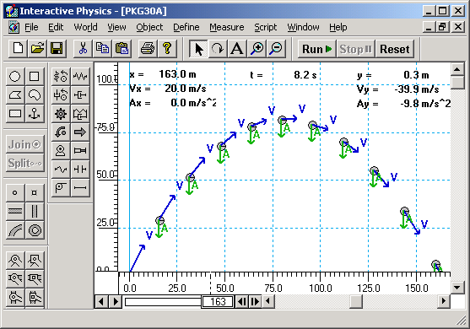
Horizontal Range and Max Height
Based on what we have learned, one can analyze a projectile motion in more detail
Maximum height an object can reach
Maximum range
What happens at the maximum height?
At the maximum height the object’s vertical motion stops to turn around!!
v_{i}
h
θ
Solve for t_{A}
This is the time to reach the peak!
10

Slide 11
Horizontal Range and Max Height
Since no acceleration is in x direction, it still flies even if v_{y}=0.
Range
Height
11

Slide 12
Maximum Range and Height
What are the conditions that give maximum height and range of a projectile motion?
This formula tells us that the maximum height can be achieved when θ_{i}=90º!!!
This formula tells us that the maximum range can be achieved when 2θ_{i}=90º, i.e., θ_{i}=45º!!!
12

