Slide 1
PHYS 1443 – Section 004 Lecture #8
Tuesday, Sept. 16, 2014
Dr. Jaehoon Yu
Newton’s Laws of Motion
Mass
Newton’s second law of motion
Newton’s third law of motion
Categories of Forces
Gravitational Force and Weight
Force of Friction

Slide 2
Announcements
Quiz #2 results
Class average: 23.3/45
Equivalent to 51.8/100
Previous quiz: 71.7/100
Top score: 45/45
Reminder for Term exam #1
In class Thursday, Sept. 25. Do NOT Miss the exam!
Covers CH1.1 through what we learn Tuesday Sept. 23 plus the math refresher
Mixture of multiple choice and free response problems
Bring your calculator but DO NOT input formula into it!
Your phones or portable computers are NOT allowed as a replacement!
You can prepare a one 8.5x11.5 sheet (front and back) of handwritten formulae and values of constants for the exam
None of the parts of the solutions of any problems
No derived formulae, derivations of equations or word definitions!
Two colloquia this week:
Dr. Haleh Hadavand, 4pm today, in SH103
Dr. Manfred Cuntz, 4pm, tomorrow, in SH101

Slide 3
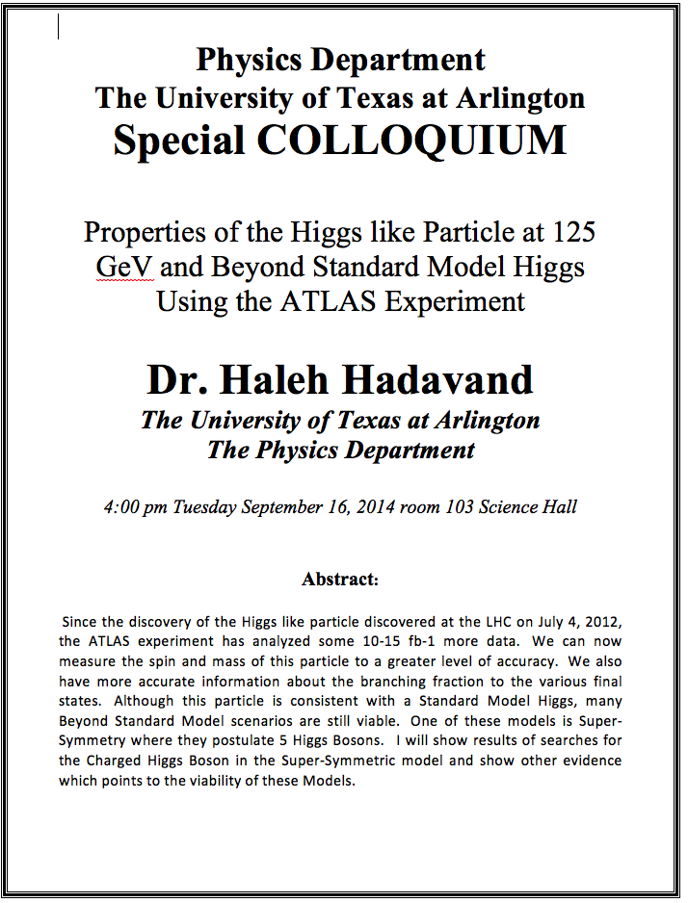

Slide 4
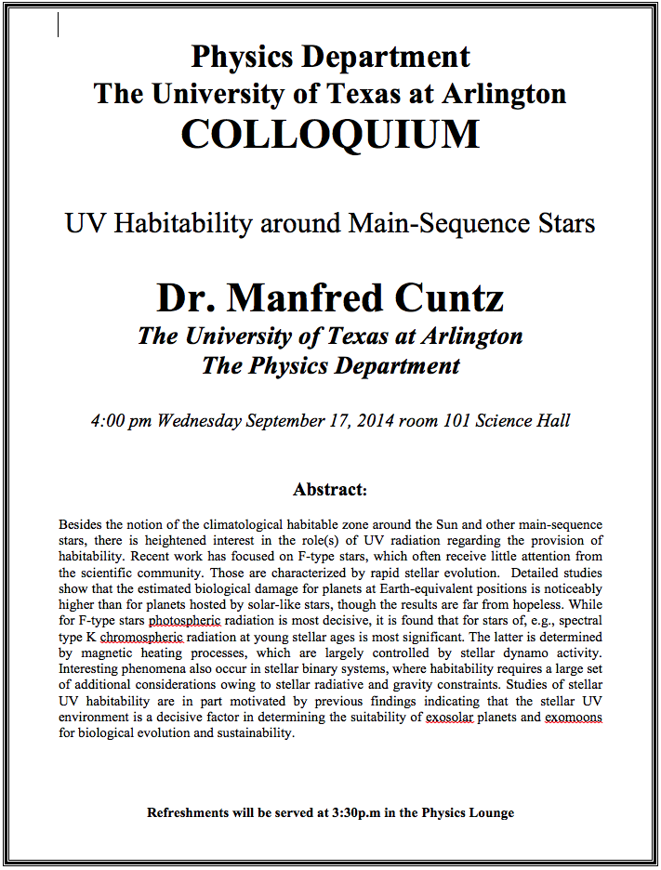

Slide 5
Force
We’ve been learning kinematics; describing motion without understanding what the cause of the motion is. Now we are going to learn dynamics!!
FORCE is what causes an object to move.
Can someone tell me what FORCE is?
The above statement is not entirely correct. Why?
Because when an object is moving with a constant velocity no force is exerted on the object!!!
FORCEs are what cause changes to the velocity of an object!!
What does this statement mean?
When there is force, there is change of velocity!!
What does force cause?
It causes an acceleration.!!
What happens if there are several forces being exerted on an object?
Forces are vector quantities, so vector sum of all forces, the NET FORCE, determines the direction of the resulting acceleration of the object.
F₁
F₂
NET FORCE, F= F₁+F₂
When the net force on an object is 0, it has constant velocity and is at its equilibrium!!

Slide 6
More Forces
There are various classes of forces
Contact Forces: Forces exerted by physical contact of objects
Examples of Contact Forces: Baseball hit by a bat, Car collisions
Field Forces: Forces exerted without physical contact of objects
Examples of Field Forces: Gravitational Force, Electro-magnetic force
What are possible ways to measure the strength of a force?
A calibrated spring whose length changes linearly with the force exerted .
Forces are vector quantities, so the addition of multiple forces must be done following the rules of vector additions.

Slide 7
Newton’s First Law and Inertial Frames
Aristotle (384-322BC): The natural state of a body is rest. Thus force is required to move an object. To move faster, ones needs larger forces.
Galileo’s statement on natural states of matter: Any velocity once imparted to a moving body will be rigidly maintained as long as the external causes of retardation are removed!!
Galileo’s statement is formulated by Newton into the 1st law of motion (Law of Inertia): In the absence of external forces, an object at rest remains at rest and an object in motion continues in motion with a constant velocity.
What does this statement tell us?
When no net force is exerted on an object, the velocity of the object cannot change
This means that the object cannot accelerate.
Objects would like to keep its current state of motion, as long as there are no net force that interferes with the motion. This tendency is called the Inertia.
A frame of reference that is moving at a constant velocity is called the Inertial Frame.
The Newtonian mechanics holds in an Inertial reference Frame.
Is a frame of reference with an acceleration an Inertial Frame?
NO!

Slide 8
Mass
Mass: A measure of the inertia of an object or the quantity of matter
A fundamental property of matter
Independent of the object’s surroundings: The same no matter where you go.
Independent of the method of measurement: The same no matter how you measure it.
The heavier the object, the bigger the inertia !!
It is harder to make changes of motion of a heavier object than a lighter one.
The same forces applied to two different masses result in different accelerations depending on the mass.
Note that the mass and the weight of an object are two different quantities!!
Weight of an object is the magnitude of the gravitational force exerted on the object.
Not an inherent property of an object!!!
Weight will change if you measure on the Earth or on the moon but the mass won’t!!
Unit of mass?

Slide 9
Newton’s Second Law of Motion
The acceleration of an object is directly proportional to the net force exerted on it and is inversely proportional to the object’s mass.
How do we write the above statement in a mathematical expression?
From this we obtain
Newton’s 2nd Law of Motion
Since force is a vector quantity, each component must also satisfy:
When working with forces, one must identify an object and only the forces act on that object, no other forces!

Slide 10
Unit of Force
From the vector expression in the previous page, what do you conclude the dimension and the unit of the force are?
The dimension of force is
The unit of force in SI is
For ease of use, we define a new derived unit called, Newton (N)

Slide 11
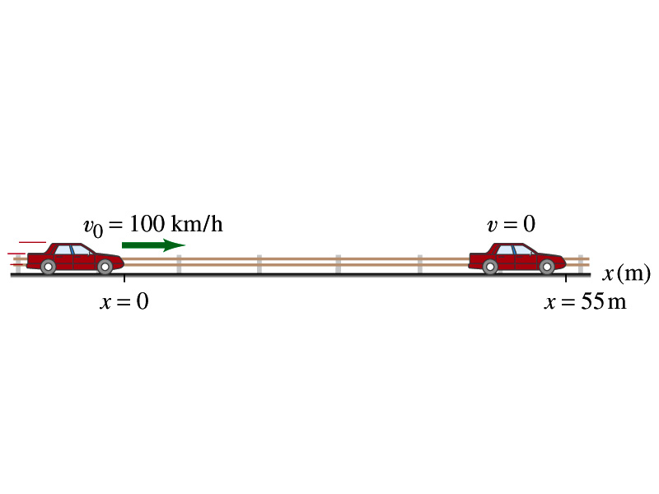
Example for Force
What constant net force is required to bring a 1500kg car to rest from a speed of 100km/h within a distance of 55m?
What do we need to know to figure out the force?
Acceleration!!
What are given?
Initial speed:
Final speed:
Displacement:
This is a one dimensional motion. Which kinetic formula do we use to find acceleration?
Acceleration
Thus, the force needed to stop the car is
Linearly proportional to the mass of the car
Squarely proportional to the speed of the car
Inversely proportional to the force by the brake
Given the force how far does the car move till it stops?

Slide 12
Free Body Diagram
A free-body-diagram is a diagram that represents the object and the forces that act on it.

Slide 13
Ex. Pushing a stalled car
What is the net force in this example?
F=
275 N
+ 395 N
– 560 N =
+110 N
Which direction?
The + x axis of the coordinate system.

Slide 14
What is the acceleration the car receives?
If the mass of the car is 1850 kg, then by Newton’s second law, the acceleration is
Since the motion is
in 1 dimension
Now we solve this
equation for a

Slide 15
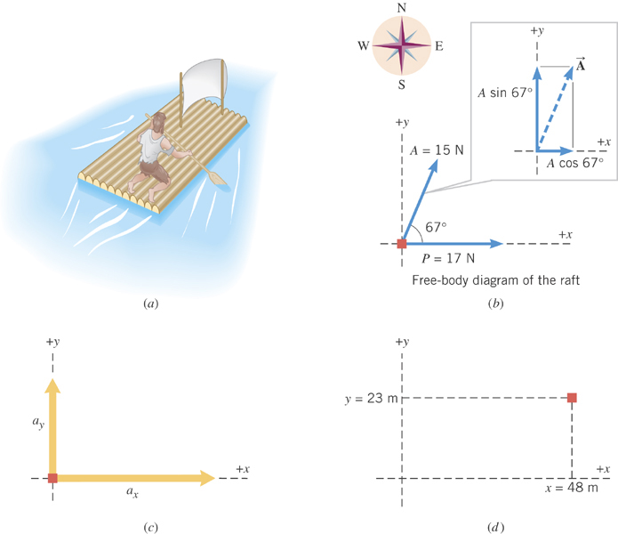
Ex. Stranded man on a raft
A man is stranded on a raft (mass of man and raft = 1300kg)m as shown in the figure. By paddling, he causes an average force P of 17N to be applied to the raft in a direction due east (the +x direction). The wind also exerts a force A on the raft. This force has a magnitude of 15N and points 67º north of east. Ignoring any resistance from the water, find the x and y components of the rafts acceleration.

Slide 16
First, let’s compute the net force on the raft as follows:
Force | x component | y component
+17 N
0 N
+(15N)cos67º
+(15N)sin67º
+17+15cos67º=
+15sin67º=
+23(N)
+14(N)

Slide 17
Now compute the acceleration components in x and y directions!!
And put them all together for the overall acceleration:

Slide 18
Example for Newton’s 2nd Law of Motion
Determine the magnitude and direction of the acceleration of the puck whose mass is 0.30kg and is being pulled by two forces, F1 and F2, as shown in the picture, whose magnitudes of the forces are 8.0 N and 5.0 N, respectively.
Components of F₁
F₁
θ₁=60^{ο}
Components of F₂
θ₂=−20^{ο}
F₂
Components of total force F
Magnitude and direction of acceleration a
Acceleration
Vector a
18

