Slide 1
PHYS 1443 – Section 004
Lecture #9
Thursday, Sept. 18, 2014
Dr. Jaehoon Yu
Newton’s Laws of Motion
  third law of motion
  Categories of Forces
  Gravitational Force and Weight
Today’s homework is homework #5, due 11pm, Tuesday, Sept. 23!!

Slide 2
Announcements
Reminder for Term exam #1
  In class Thursday, Sept. 25. Do NOT Miss the exam!
  Covers CH1.1 through what we learn Tuesday Sept. 23 plus the math refresher
  Mixture of multiple choice and free response problems
  Bring your calculator but DO NOT input formula into it!
    Your phones or portable computers are NOT allowed as a replacement!
  You can prepare a one 8.5x11.5 sheet (front and back) of handwritten formulae and values of constants for the exam
    None of the parts of the solutions of any problems
    No derived formulae, derivations of equations or word definitions!

Slide 3
Special Project #3
The mass of the spacecraft is 11,000 kg and the mass of the astronaut is 92 kg. What is the velocity of the space craft and the astronaut 10 sec into the motion if they were in contact for 50cm during with the astronaut is applying the force of 36N? (20 points)
Deadline: Beginning of the class Tuesday, Sept. 30
Please be sure to show details of your OWN work!

Slide 4
Newton’s Third Law (Law of Action and Reaction)
If two objects interact, the force F₁₂ that object 1 exerts on object 2 is equal in magnitude and opposite in direction to the force F₂₁ object 2 exerts on object 1.
F₁₂
F₂₁
2
1
The reaction force is equal in magnitude to the action force but in opposite direction. These two forces always act on different objects.
What is the reaction force to the force of a free falling object?
The gravitational force exerted by the object to the Earth!
Stationary objects on top of a table has a reaction force (called the normal force) from the table to balance the action force, the gravitational force.
4

Slide 5
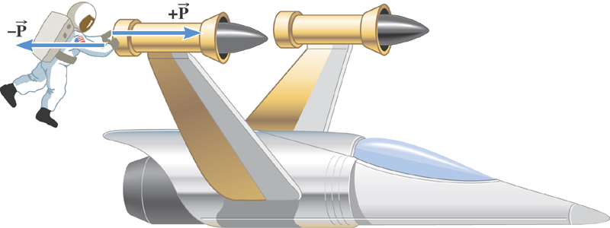
Ex. The Accelerations Produced by Action and Reaction Forces
Which one do you think will get larger acceleration?
Suppose that the magnitude of the force P is 36 N. If the mass of the spacecraft is 11,000 kg and the mass of the astronaut is 92 kg, what are the accelerations?

Slide 6
Ex. continued
Force exerted on the space craft by the astronaut
Force exerted on the astronaut by the space craft
space craft’s acceleration
astronaut’s acceleration

Slide 7
Example of Newton’s 3rd Law
A large man and a small boy stand facing each other on frictionless ice. They put their hands together and push against each other so that they move apart. a) Who moves away with the higher speed and by how much?
F₁₂
F₂₁= - F₁₂
m
M
Since
and
Establish the
equation
Divide by m
7

Slide 8
Example of Newton’s 3rd Law, cnt’d
Man’s velocity
Boy’s velocity
So boy’s velocity is higher than man’s, if M>m, by the ratio of the masses.
b) Who moves farther while their hands are in contact?
Boy’s displacement
Man’s displacement
Given in the same time interval, since the boy has higher acceleration and thereby higher speed, he moves farther than the man.
8

Slide 9
Categories of Forces
Fundamental Forces: Truly unique forces that cannot be derived from any other forces
  Total of three fundamental forces
    Gravitational Force
    Electro-Weak Force (the unified force of EM and Weak)
    Strong Nuclear Force
Non-fundamental forces: Forces that can be derived from fundamental forces
  Friction
  Tension in a rope
  Normal or support forces

Slide 10
Gravitational Force and Weight
The attractive force exerted on an object by the Earth
Gravitational Force, F_{g}
Weight of an object with mass M is
Since weight depends on the magnitude of gravitational acceleration, g, it varies depending on geographical location.
By measuring the forces one can determine masses. This is why you can measure mass using the spring scale.

Slide 11
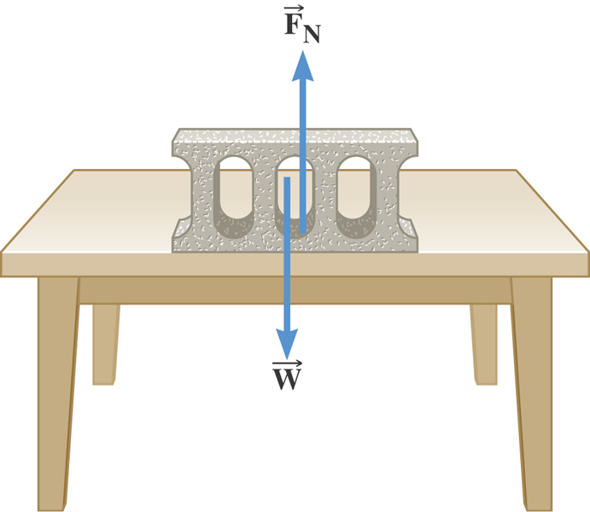
The Normal Force
The normal force is one component of the force that a surface exerts on an object with which it is in contact – namely, the component that is perpendicular to the surface.

Slide 12
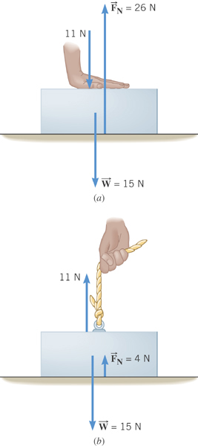
Some normal force exercises
Case 1: Hand pushing down on the book
Case 2: Hand pulling up the book

Slide 13
Some Basic Information
When Newton’s laws are applied, external forces are only of interest!!
Because, as described in Newton’s first law, an object will keep its current motion unless non-zero net external force is applied.
Why?
Reaction force that reacts to action forces due to the surface structure of an object. Its direction is perpendicular to the surface.
Normal Force, n:
Tension, T:
The reactionary force by a stringy object against an external force exerted on it.
A graphical tool which is a diagram of external forces on an object and is extremely useful analyzing forces and motion!! Drawn only on an object.
Free-body diagram

Slide 14
Free Body Diagrams and Solving Problems
Free-body diagram: A diagram of vector forces acting on an object
A great tool to solve a problem using forces or using dynamics
Select a point on an object in the problem
Identify all the forces acting only on the selected object
Define a reference frame with positive and negative axes specified
Draw arrows to represent the force vectors on the selected point
Write down net force vector equation
Write down the forces in components to solve the problems
No matter which one we choose to draw the diagram on, the results should be the same, as long as they are from the same motion
Which one would you like to select to draw FBD?
What do you think are the forces acting on this object?
M
Gravitational force
the force supporting the object exerted by the floor
Which one would you like to select to draw FBD?
What do you think are the forces acting on this elevator?
M_{e}
Gravitational force
The force pulling the elevator (Tension)
What about the box in the elevator?
Gravitational force
Normal force
m

Slide 15
Applications of Newton's Laws
Suppose you are pulling a box on frictionless ice, using a rope.
What are the forces being exerted on the box?
M
T
Gravitational force: F_{g}
n= -F_{g}
Normal force: n
Free-body diagram
T
Tension force: T
n= -F_{g}
Total force: F=F_{g}+n+T=T
F_{g}=Mg
T
If T is a constant force, a_{x}, is constant
F_{g}=Mg
What happened to the motion in y-direction?

Slide 16
Example for Using Newton’s Laws
A traffic light weighing 125 N hangs from a cable tied to two other cables fastened to a support. The upper cables make angles of 37.0º and 53.0º with the horizontal. Find the tension in the three cables.
y
37º
53º
Free-body
Diagram
T₁
T₂
37º
53º
x
T₃
Newton’s 2nd law
x-comp. of net force
y-comp. of net force

Slide 17
Example w/o Friction
A crate of mass M is placed on a frictionless inclined plane of angle θ.
a) Determine the acceleration of the crate after it is released.
y
y
n
y
M
a
n
x
x
d
Free-body
Diagram
x
F_{g}
θ
θ
F= -Mg
Supposed the crate was released at the top of the incline, and the length of the incline is d. How long does it take for the crate to reach the bottom and what is its speed at the bottom?
Work on sample problem 5.03 on page 108!

