Slide 1
PHYS 1443 – Section 004
Lecture #10
Tuesday, Sept. 23, 2014
Dr. Jaehoon Yu
Newton’s Laws of Motion
  Force of Friction
  Uniform Circular Motion
  Newton’s Law of Universal Gravitation
Work Done by a Constant Force
The deadline for homework #5 is 11pm Today, Sept. 23!!

Slide 2
Announcements
Reminder for Term exam #1
  In class this Thursday, Sept. 25. Do NOT Miss the exam!
  Covers CH1.1 through what we learn Today plus the math refresher
  Mixture of multiple choice and free response problems
  Bring your calculator but DO NOT input formula into it!
    Your phones or portable computers are NOT allowed as a replacement!
  You can prepare a one 8.5x11.5 sheet (front and back) of handwritten formulae and values of constants for the exam
    None of the parts of the solutions of any problems
    No derived formulae, derivations of equations or word definitions!

Slide 3
Special Project #3
The mass of the spacecraft is 11,000 kg and the mass of the astronaut is 92 kg. What is the velocity of the space craft and the astronaut 10 sec into the motion if they were in contact for 50cm during with the astronaut is applying the force of 36N? (20 points)
Deadline: Beginning of the class Tuesday, Sept. 30
Please be sure to show details of your OWN work!

Slide 4
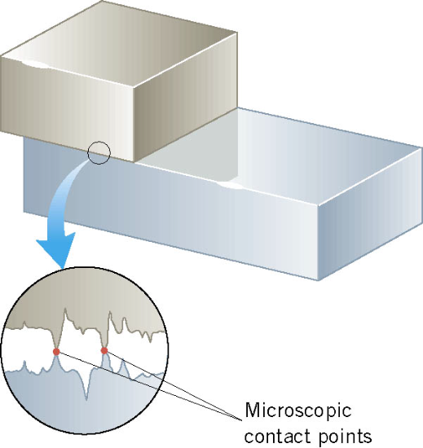
Friction Force
When an object is in contact with a surface there is a force acting on that object. The component of this force that is parallel to the surface is called the friction force.
This resistive force is exerted on a moving object due to
viscosity or other types of frictional property of the medium in or surface on which the object moves.
Always opposite to the movement!!

Slide 5
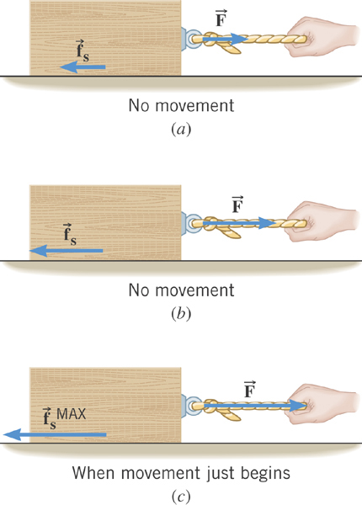
Static Friction
When the two surfaces are not sliding across one another
the friction is called static friction.
The resistive force act
on the object up to the time just before the object starts moving.

Slide 6
Magnitude of the Static Friction
The magnitude of the static friction force can have any value from zero up to the maximum value.
is called the coefficient of static friction.
What is the unit?
None
Once the object starts moving, there is NO MORE static friction!!
Kinetic friction applies during the move!!

Slide 7
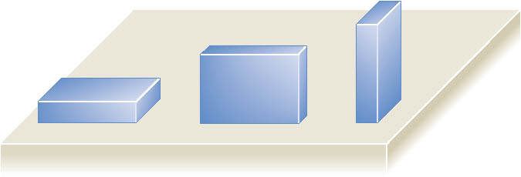
Note that the magnitude of the frictional force does not depend on the contact area of the surfaces.

Slide 8
Kinetic Friction
Static friction opposes the impending relative motion between
two objects.
Kinetic friction opposes the relative sliding motions that is happening. The resistive force act on the object only during its movement.
Normally much smaller than static friction!!
is called the coefficient of kinetic friction.
What is the direction of friction forces?
opposite to the movement

Slide 9
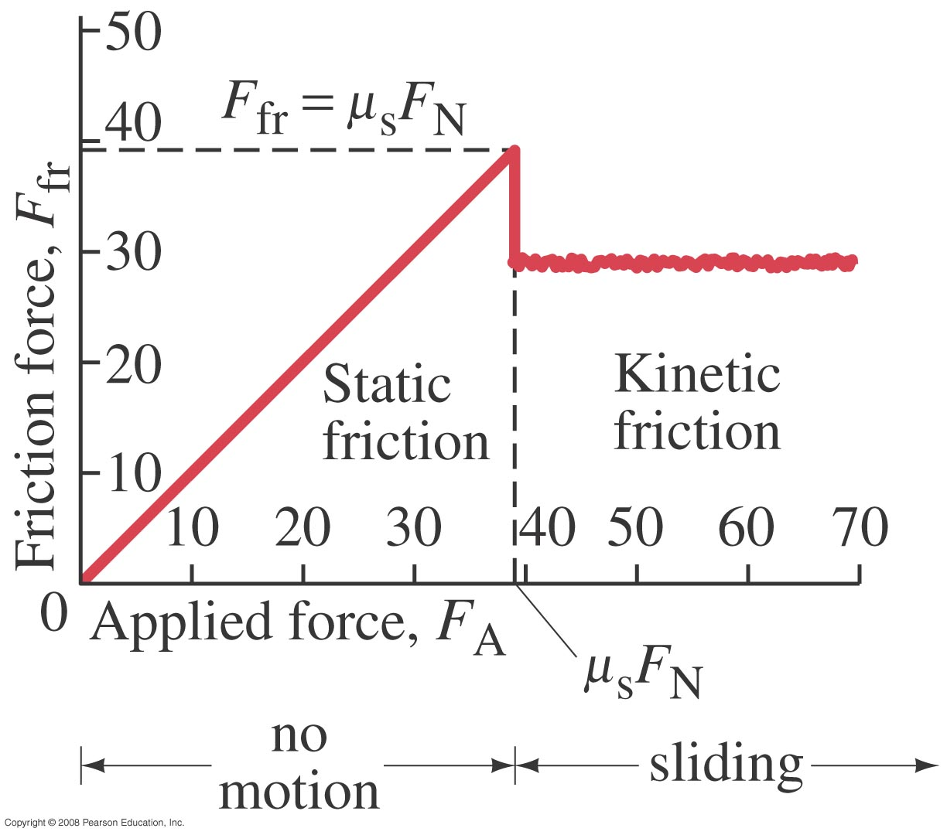
Friction Force vs Applied Force

Slide 10
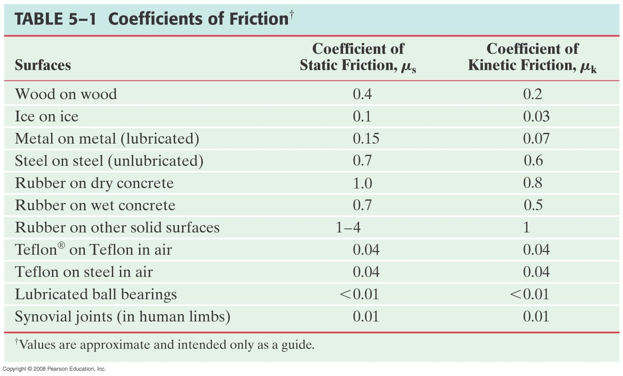
Coefficients of Friction
What are these?

Slide 11
Forces of Friction Summary
Resistive force exerted on a moving object due to viscosity or other types frictional property of the medium in or surface on which the object moves.
These forces are either proportional to the velocity or the normal force.
Force of static friction, f_{s}:
The resistive force exerted on the object until just before the beginning of its movement
Empirical Formula
What does this formula tell you?
Frictional force increases till it reaches the limit!!
Beyond the limit, the object moves, and there is NO MORE static friction but the kinetic friction takes it over.
Force of kinetic friction, f_{k}
The resistive force exerted on the object during its movement
Which direction does kinetic friction apply?
Opposite to the motion!

Slide 12
Look at this problem again…
Suppose you are pulling a box on a rough surfice, using a rope.
What are the forces being exerted on the box?
M
T
Gravitational force: F_{g}
Normal force: n
n= -F_{g}
Tension force: T
Free-body diagram
F_{f}
T
Friction force: F_{f}
n= -F_{g}
Total force:
F=F_{g}+n+T+F_{f}
F_{g}=Mg
F_{f}
T
If T is a constant force, a_{x}, is constant
F_{g}=Mg

Slide 13
Example w/ Friction
Suppose a block is placed on a rough surface inclined relative to the horizontal. The inclination angle is increased till the block starts to move. Show that by measuring this critical angle, θ_{c}, one can determine coefficient of static friction, μ_{s}.
y
f_{s}=μ_{s}n
n
y
M
Free-body
Diagram
a
n
x
f_{s}=μ_{s}n
x
F_{g}
θ
θ
F= -Mg
Net force
x comp.
y comp.

Slide 14
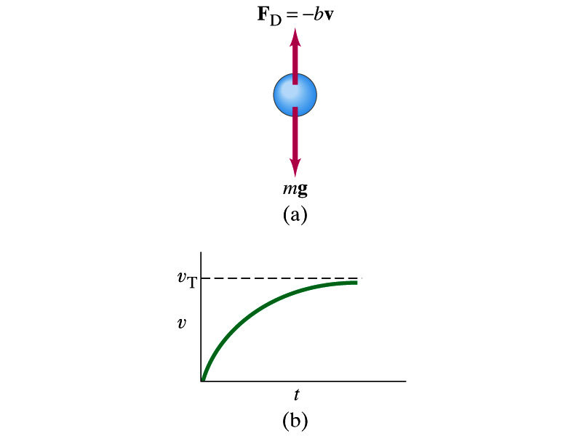
Motion in Resistive Forces
Medium can exert resistive forces on an object moving through it due to viscosity or other types frictional properties of the medium.
Some examples?
Air resistance, viscous force of liquid, etc
These forces are exerted on moving objects in opposite direction of the movement.
These forces are proportional to such factors as speed. They almost always increase with increasing speed.
Two different cases of proportionality:
  Forces linearly proportional to speed: Slowly moving or very small objects
  Forces proportional to square of speed: Large objects w/ reasonable speed

Slide 15
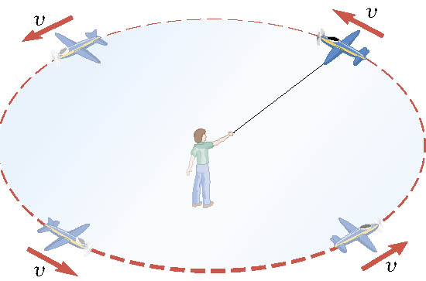
Definition of the Uniform Circular Motion
Uniform circular motion is the motion of an object traveling at a constant speed on a circular path.

Slide 16
Speed of a uniform circular motion?
Let T be the period of this motion, the time it takes for the object to travel once around the complete circle whose radius is r is

Slide 17
Ex. : A Tire-Balancing Machine
The wheel of a car has a radius of 0.29m and is being rotated at 830 revolutions per minute on a tire-balancing machine. Determine the speed at which the outer edge of the wheel is moving.

Slide 18
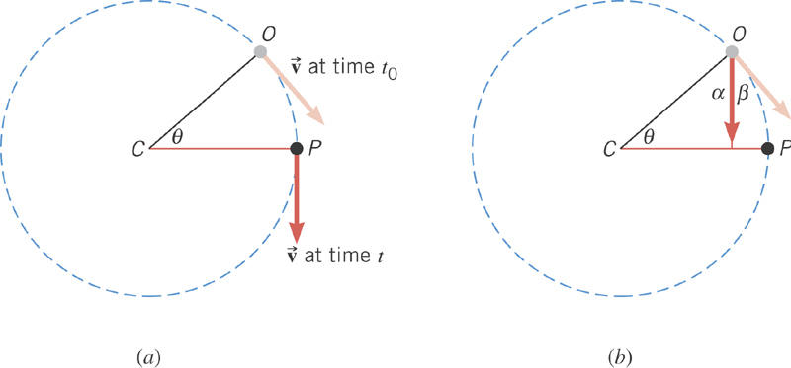
Centripetal Acceleration
In uniform circular motion, the speed is constant, but the direction of the velocity vector is not constant.
The change of direction of the velocity is the same as the change of the angle in the circular motion!

Slide 19
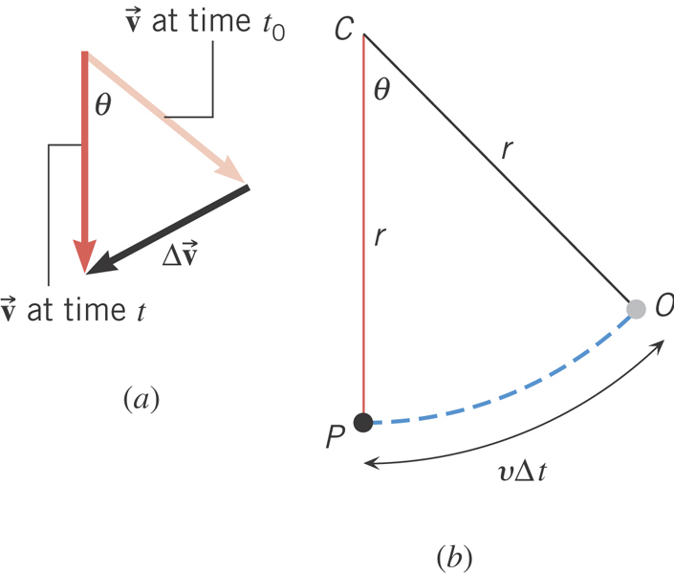
Centripetal Acceleration
From the geometry
What is the direction of a_{c}?
Always toward the center of circle!
Centripetal Acceleration

Slide 20
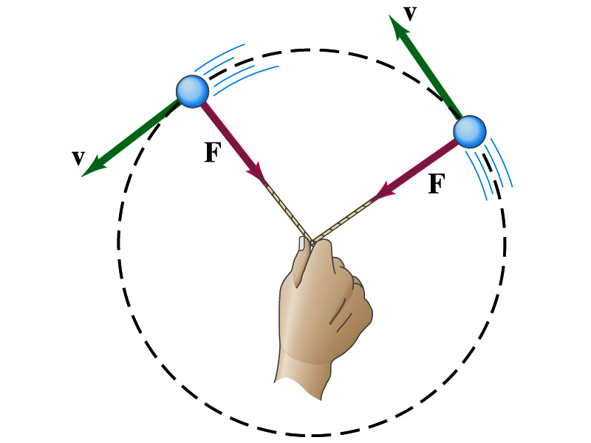
Newton’s Second Law & Uniform Circular Motion
The centripetal * acceleration is always perpendicular to the velocity vector, v, and points to the center of the axis (radial direction) in a uniform circular motion.
Are there forces in this motion? If so, what do they do?
The force that causes the centripetal acceleration acts toward the center of the circular path and causes the change in the direction of the velocity vector. This force is called the centripetal force.
What do you think will happen to the ball if the string that holds the ball breaks?
The external force no longer exist. Therefore, based on Newton’s 1st law, the ball will continue its motion without changing its velocity and will fly away along the tangential direction to the circle.
*Mirriam Webster: Proceeding or acting in the direction toward the center or axis

Slide 21
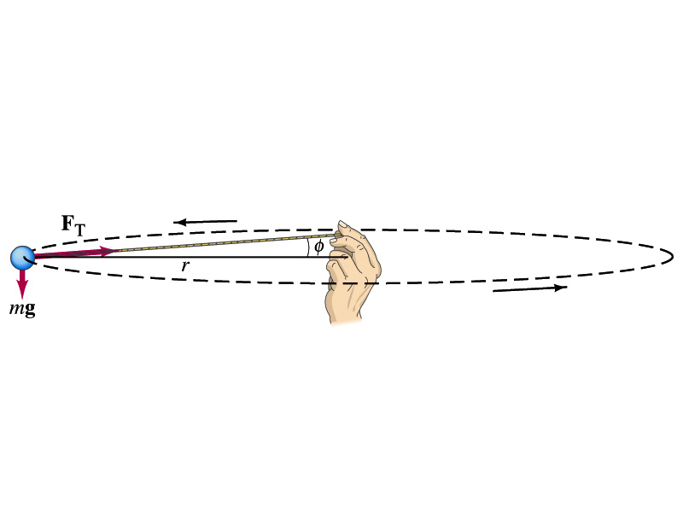
Ex. For Uniform Circular Motion
A ball of mass 0.500kg is attached to the end of a 1.50m long cord. The ball is moving in a horizontal circle. If the string can withstand the maximum tension of 50.0 N, what is the maximum speed the ball can attain before the cord breaks?
Centripetal acceleration:
When does the string break?
when the required centripetal force is greater than the sustainable tension.
Calculate the tension of the cord when speed of the ball is 5.00m/s.

Slide 22
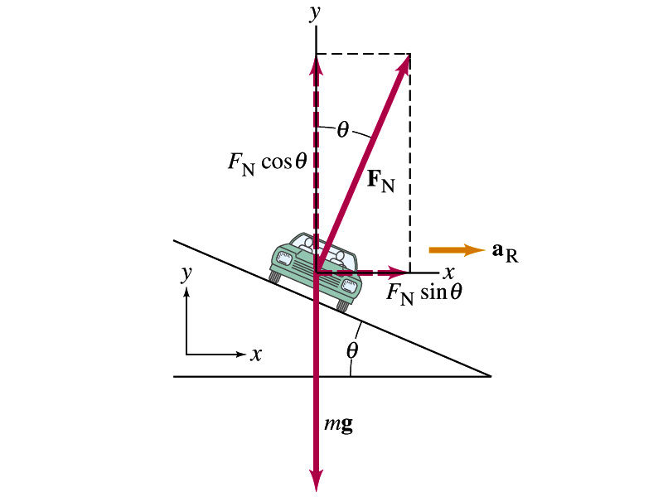
Example: Banked Highway
(a) For a car traveling with speed v around a curve of radius r, determine the formula for the angle at which the road should be banked so that no friction is required to keep the car from skidding.
y
x comp.
x
y comp.
(b) What is this angle for an expressway off-ramp curve of radius 50m at a design speed of 50km/h?

Slide 23
Forces in Non-uniform Circular Motion
The object has both tangential and radial accelerations.
What does this statement mean?
The object is moving under both tangential and radial forces.
F_{r}
F
F_{t}
These forces cause not only the velocity but also the speed of the ball to change. The object undergoes a curved motion in the absence of constraints, such as a string.
What is the magnitude of the net acceleration?

Slide 24
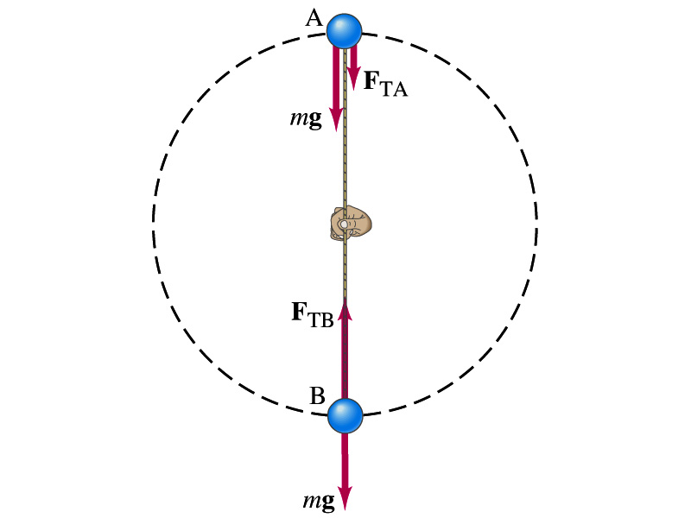
Ex. for Non-Uniform Circular Motion
A ball of mass m is attached to the end of a cord of length R. The ball is moving in a vertical circle. Determine the tension of the cord at any instance in which the speed of the ball is v and the cord makes an angle θ with vertical.
V
What are the forces involved in this motion?
m
T
The gravitational force F_{g}
The radial force, T, providing the tension.
θ
R
F_{g}=mg
tangential comp.
Radial comp.
At what angles the tension becomes the maximum and the minimum. What are the tensions?

