Slide 1
PHYS 1443 – Section 004
Lecture #11
Tuesday, Sept. 30, 2014
Dr. Jaehoon Yu
Newton’s Law of Universal Gravitation
Work Done by a Constant Force
Scalar Product
Work Done by a Varying Force
Work-Kinetic Energy Theorem
Work under friction
Today’s homework is homework #6, due 10pm, Tuesday, Oct. 7!!

Slide 2
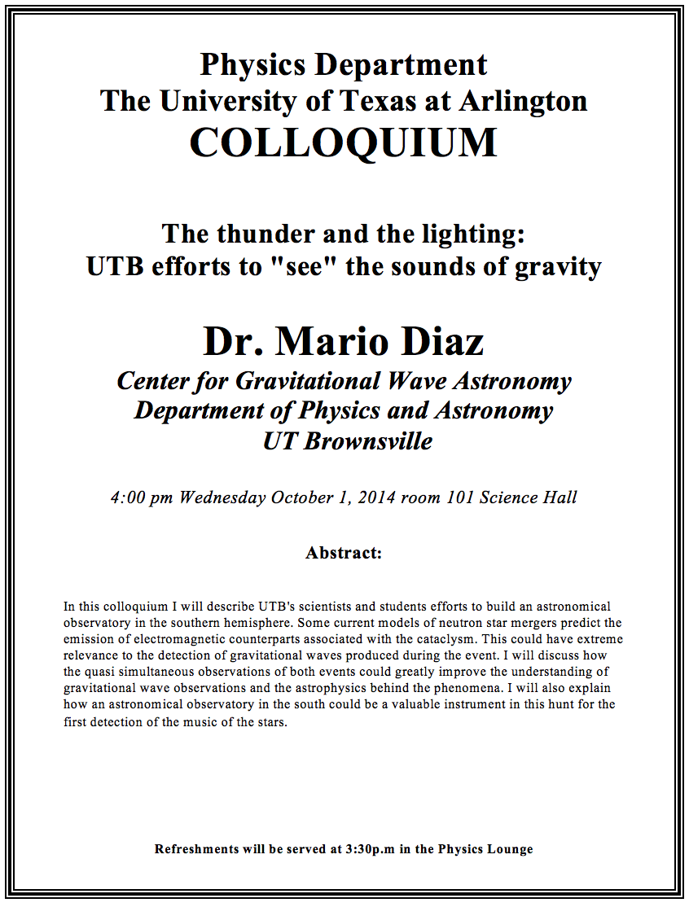

Slide 3
Special Project #4
Two protons are separated by 1m.
  Compute the gravitational force (F_{G}) between the two protons (10 points)
  Compute the electric force (F_{E}) between the two protons (10 points)
  Compute the ratio of FG/FE (5 points) and explain what this tells you (5 point)
You must specify the formulae for each of the forces and the values of necessary quantities, such as mass, charge, constants, etc, in your report
Due: Beginning of the class, Tuesday, Oct. 7

Slide 4
Newton’s Law of Universal Gravitation
People have been very curious about the stars in the sky, making observations for a long time. The data people collected, however, have not been explained until Newton has discovered the law of gravitation.
Every object in the universe attracts every other object with a force that is directly proportional to the product of their masses and inversely proportional to the square of the distance between them.
How would you write this law mathematically?
With G
G is the universal gravitational constant, and its value is
Unit?
This constant is not given by the theory but must be measured by experiments.
This form of forces is known as the inverse-square law, because the magnitude of the force is inversely proportional to the square of the distances between the objects.

Slide 5
Free Fall Acceleration & Gravitational Force
The weight of an object with mass m is mg. Using the force exerting on a particle of mass m on the surface of the Earth, one can obtain
What would the gravitational acceleration be if the object is at an altitude h above the surface of the Earth?
Distance from the center of the Earth to the object at the altitude h.
What do these tell us about the gravitational acceleration?
The gravitational acceleration is independent of the mass of the object
The gravitational acceleration decreases as the altitude increases
If the distance from the surface of the Earth gets infinitely large, the weight of the object approaches 0.

Slide 6
Ex. for Gravitational Force
The international space station is designed to operate at an altitude of 350km. Its designed weight (measured on the surface of the Earth) is 4.22x10⁶N. What is its weight in its orbit?
The total weight of the station on the surface of the Earth is
M_{E}
Since the orbit is at 350km above the surface of the Earth, the gravitational force at that altitude is
Therefore the weight in the orbit is

Slide 7
Example for Universal Gravitation
Using the fact that g=9.80m/s² on the Earth’s surface, find the average density of the Earth.
Since the gravitational acceleration is
Solving for g
Solving for M_{E}
Therefore the density of the Earth is

Slide 8
Work Done by a Constant Force
A meaningful work in physics is done only when the net forces exerted on an object changes the energy of the object.
y
F
Free Body
Diagram
θ
M
M
θ
x
d
Which force did the work?
Force
Why?
What kind?
Scalar
Unit?
How much work did it do?
What does this mean?
Physically meaningful work is done only by the component of the force along the movement of the object.
Work is an energy transfer!!

Slide 9
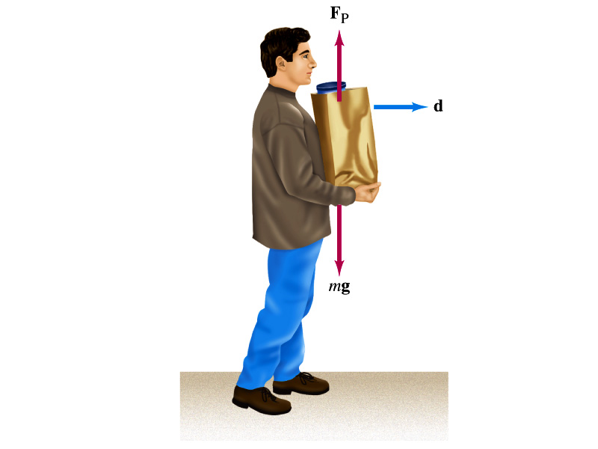
Let’s think about the meaning of work!
A person is holding a grocery bag and walking at a constant velocity.
Is he doing any work ON the bag?
  No
  Why not?
  Because the force he exerts on the bag, F_{p}, is perpendicular to the displacement!!
  This means that he is not adding any energy to the bag.
So what does this mean?
  In order for a force to perform any meaningful work, the energy of the object the force exerts on must change!!
What happened to the person?
  He spends his energy just to keep the bag up but did not perform any work on the bag.

Slide 10
Scalar Product of Two Vectors
Product of magnitude of the two vectors and the cosine of the angle between them
Operation is commutative
Operation follows the distribution law of multiplication
Scalar products of Unit Vectors
How does scalar product look in terms of components?
=0

Slide 11
Example of Work by Scalar Product
A particle moving on the xy plane undergoes a displacement d=(2.0i+3.0j)m as a constant force F=(5.0i+2.0j) N acts on the particle.
Y
a) Calculate the magnitude of the displacement and that of the force.
F
d
X
b) Calculate the work done by the force F.
Can you do this using the magnitudes and the angle between d and F?

Slide 12
Example of Work by a Constant Force
A man cleaning a floor pulls a vacuum cleaner with a force of magnitude F=50.0N at an angle of 30.0º with East. Calculate the work done by the force on the vacuum cleaner as the vacuum cleaner is displaced by 3.00m to East.
F
M
30^{ο}
M
d
Does work depend on mass of the object being worked on?
No
Why ?
This is because the work done by the force bringing the object to a displacement d is constant independent of the mass of the object being worked on. The only difference would be the acceleration and the final speed of each of the objects after the completion of the work!!

Slide 13
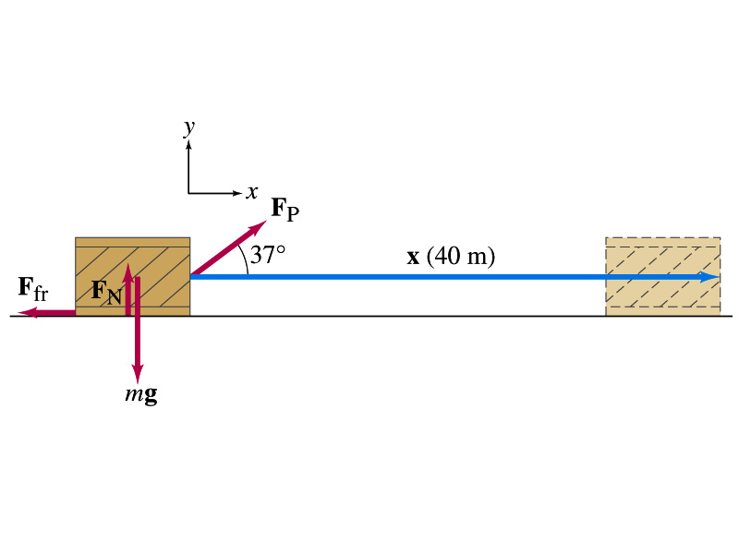
Ex. Work done on a crate
A person pulls a 50kg crate 40m along a horizontal floor by a constant force F_{p}=100N, which acts at a 37º angle as shown in the figure. The floor is rough and exerts a friction force F_{fr}=50N. Determine (a) the work done by each force and (b) the net work done on the crate.
What are the forces exerting on the crate?
F_{p}
F_{fr}
F_{G}=-mg
F_{N}=+mg
Which force performs the work on the crate?
F_{p}
F_{fr}
Work done on the crate by F_{G}
Work done on the crate byF_{N}
Work done on the crate by F_{p}:
Work done on the crate by F_{fr}:
So the net work on the crate
This is the same as

Slide 14
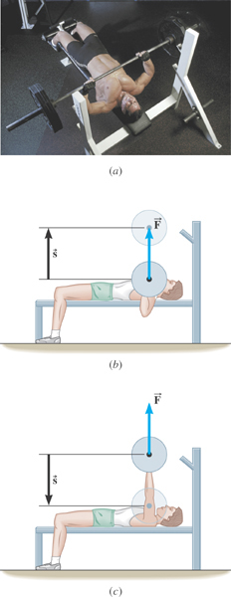
Ex. Bench Pressing and The Concept of Negative Work
A weight lifter is bench-pressing a barbell whose weight is 710N a distance of 0.65m above his chest. Then he lowers it the same distance. The weight is raised and lowered at a constant velocity. Determine the work in the two cases.
What is the angle between the force and the displacement?
What does the negative work mean?
The gravitational force does the work on the weight lifter!

Slide 15
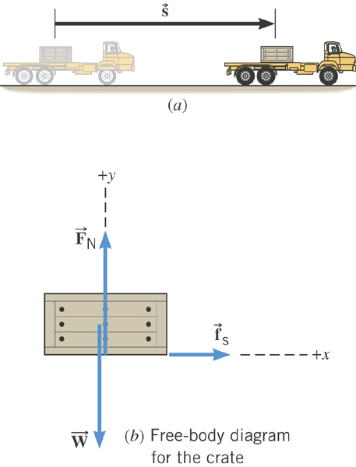
Ex. Accelerating a Crate
The truck is accelerating at a rate of +1.50 m/s². The mass of the crate is 120-kg and it does not slip. The magnitude of the displacement is 65 m. What is the total work done on the crate by all of the forces acting on it?
What are the forces acting in this motion?
Gravitational force on the crate, weight, W or F_{g}
Normal force force on the crate, F_{N}
Static frictional force on the crate, f_{s}

Slide 16
Ex. Continued…
Let’s figure what the work done by each force in this motion is.
Work done by the gravitational force on the crate, W or F_{g}
Work done by Normal force force on the crate, F_{N}
Work done by the static frictional force on the crate, f_{s}
Which force did the work?
Static frictional force on the crate, f_{s}
How?
By holding on to the crate so that it moves with the truck!

Slide 17
Work Done by a Varying Force
If the force depends on the position of the object in motion,
one must consider the work in small segments of the displacement where the force can be considered constant
  Then add all the work-segments throughout the entire motion (x_{i}→ x_{f})
In the limit where Δx→0
  If more than one force is acting, the net work done by the net force is
One of the position dependent forces is the force by the spring
The work done by the spring force is
Hooke’s Law

Slide 18
Kinetic Energy and Work-Kinetic Energy Theorem
Some problems are hard to solve using Newton’s second law
  If forces exerting on an object during the motion are complicated
  Relate the work done on the object by the net force to the change of the speed of the object
ΣF
Suppose net force ΣF was exerted on an object for displacement d to increase its speed from v_{i} to v_{f}.
M
M
v_{i}
v_{f}
The work on the object by the net force ΣF is
s
Using the kinematic equation of motion
Kinetic Energy
Work
Work
Work done by the net force causes change in the object’s kinetic energy.
Work-Kinetic Energy Theorem

Slide 19
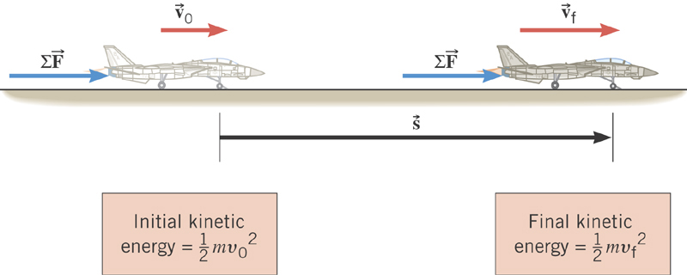
Work-Kinetic Energy Theorem
When a net external force by the jet engine does work on and object, the kinetic energy of the object changes according to

Slide 20
Work and Kinetic Energy
A meaningful work in physics is done only when the sum of the forces exerted on an object made a motion to the object.
What does this mean?
However much tired your arms feel, if you were just holding an object without moving it you have not done any physical work to the object.
Mathematically, the work is written as the product of magnitudes of the net force vector, the magnitude of the displacement vector and the angle between them.
Kinetic Energy is the energy associated with the motion and capacity to perform work. Work causes change of energy after the completion⬅ Work-Kinetic energy theorem
Nm=Joule

Slide 21
Example for Work-KE Theorem
A 6.0kg block initially at rest is pulled to East along a horizontal, frictionless surface by a constant horizontal force of 12N. Find the speed of the block after it has moved 3.0m.
M
F
M
Work done by the force F is
v_{i}=0
v_{f}
d
From the work-kinetic energy theorem, we know
Since initial speed is 0, the above equation becomes
Solving the equation for v_{f}, we obtain

Slide 22
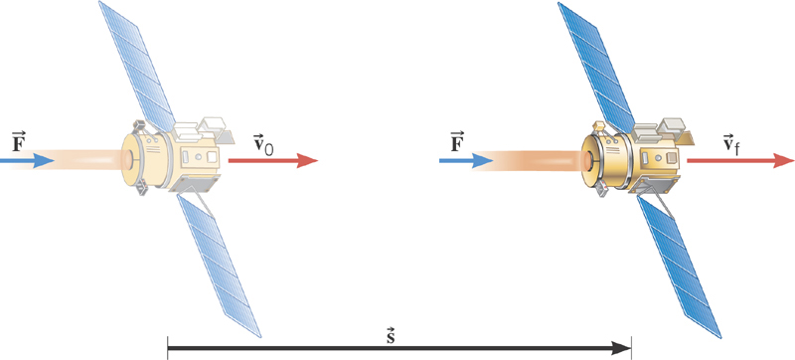
Ex. Deep Space 1
The mass of the space probe is 474-kg and its initial velocity is 275 m/s. If the 56.0-mN force acts on the probe parallel through a displacement of 2.42×10⁹m, what is its final speed?
Solve for v_{f}

Slide 23
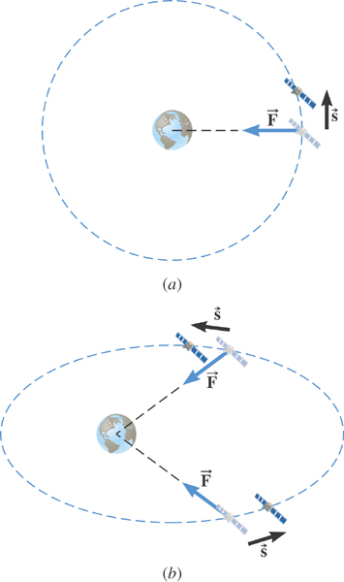
Ex. Satellite Motion and Work By the Gravity
A satellite is moving about the earth in a circular orbit and an elliptical orbit. For these two orbits, determine whether the kinetic energy of the satellite changes during the motion.
For a circular orbit
No change!
Why not?
Gravitational force is the only external force but it is perpendicular to the displacement. So no work.
For an elliptical orbit
Changes!
Why?
Gravitational force is the only external force but its angle with respect to the displacement varies. So it performs work.

