Slide 1
PHYS 1443 – Section 004
Lecture #12
Thursday, Oct. 2, 2014
Dr. Jaehoon Yu
Work-Kinetic Energy Theorem
Work under friction
Potential Energy and the Conservative Force
  Gravitational Potential Energy
  Elastic Potential Energy
Conservation of Energy
Energy Diagram

Slide 2
Reminder for Special Project #4
Two protons are separated by 1m.
  Compute the gravitational force (F_{G}) between the two protons (10 points)
  Compute the electric force (F_{E}) between the two protons (10 points)
  Compute the ratio of FG/FE (5 points) and explain what this tells you (5 point)
You must specify the formulae for each of the forces and the values of necessary quantities, such as mass, charge, constants, etc, in your report
Due: Beginning of the class, Tuesday, Oct. 7

Slide 3
Work and Energy Involving Kinetic Friction
What do you think the work looks like if there is friction?
  Static friction does not matter! Why?
  Then which friction matters?
It isn’t there when the object is moving.
Kinetic Friction
Friction force F_{fr} works on the object to slow down
F_{fr}
M
M
The work on the object by the friction F_{fr} is
v_{i}
v_{f}
d
The negative sign means that the work is done on the friction!
The final kinetic energy of an object, taking into account its initial kinetic energy, friction force and all other sources of work, is
t=0, KE_{i}
Friction,
Engine work
t=T, KE_{f}

Slide 4
Example of Work Under Friction
A 6.0kg block initially at rest is pulled to East along a horizontal surface with coefficient of kinetic friction μ_{k}=0.15 by a constant horizontal force of 12N. Find the speed of the block after it has moved 3.0m.
M
F
M
Work done by the force F is
F_{k}
v_{i}=0
v_{f}
d=3.0m
Work done by friction F_{k} is
Thus the total work is
Using work-kinetic energy theorem and the fact that initial speed is 0, we obtain
Solving the equation
for v_{f}, we obtain

Slide 5
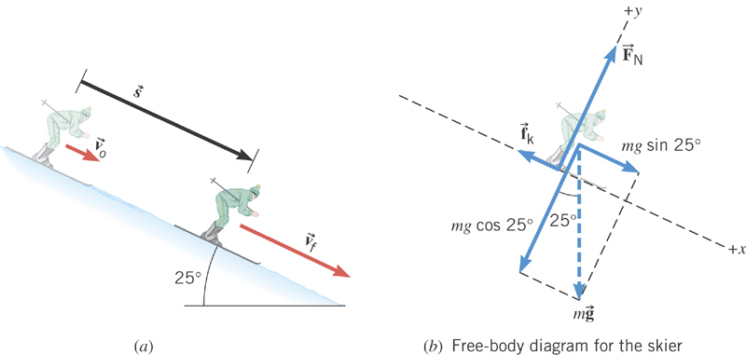
Ex. Downhill Skiing
A 58kg skier is coasting down a 25º slope. A kinetic frictional force of magnitude f_{k}=70N opposes her motion. At the top of the slope, the skier’s speed is v₀=3.6m/s. Ignoring air resistance, determine the speed v_{f} at the point that is displaced 57m downhill.
y
x
What are the forces in this motion?
Gravitational force: F_{g}
Normal force: F_{N}
Kinetic frictional force: f_{k}
What are the X and Y component of the net force in this motion?
Y component
From this we obtain
What is the coefficient of kinetic friction?

Slide 6
Ex. Now with the X component
X component
Total work by this force
From work-kinetic energy theorem
Solving for v_{f}
What is her acceleration?

Slide 7
Potential Energy & Conservation of Mechanical Energy
Energy associated with a system of objects ➔ Stored energy which has the potential or the possibility to work or to convert to kinetic energy
In order to describe potential energy, U, a system must be defined.
What does this mean?
The concept of potential energy can only be used under the special class of forces called the conservative force which results in the principle of conservation of mechanical energy.
What are other forms of energies in the universe?
Mechanical Energy
Chemical Energy
Biological Energy
Electromagnetic Energy
Nuclear Energy
These different types of energies are stored in the universe in many different forms!!!
If one takes into account ALL forms of energy, the total energy in the entire universe is conserved. It just transforms from one form to another.

Slide 8
Gravitational Potential Energy
This potential energy is given to an object by the gravitational field in the system of Earth by virtue of the object’s height from an arbitrary zero level
When an object is falling, the gravitational force, Mg, performs the work on the object, increasing the object’s kinetic energy. So the potential energy of an object at height h, the potential to do work, is expressed as
m
h_{i}
mg
m
The work done on the object by the gravitational force as the brick drops from h_{i} to h_{f} is:
h_{f}
(since )
What does this mean?
Work by the gravitational force as the brick drops from y_{i} to y_{f} is the negative change of the system’s potential energy
➔ Potential energy was spent in order for the gravitational force to increase the brick’s kinetic energy.

Slide 9
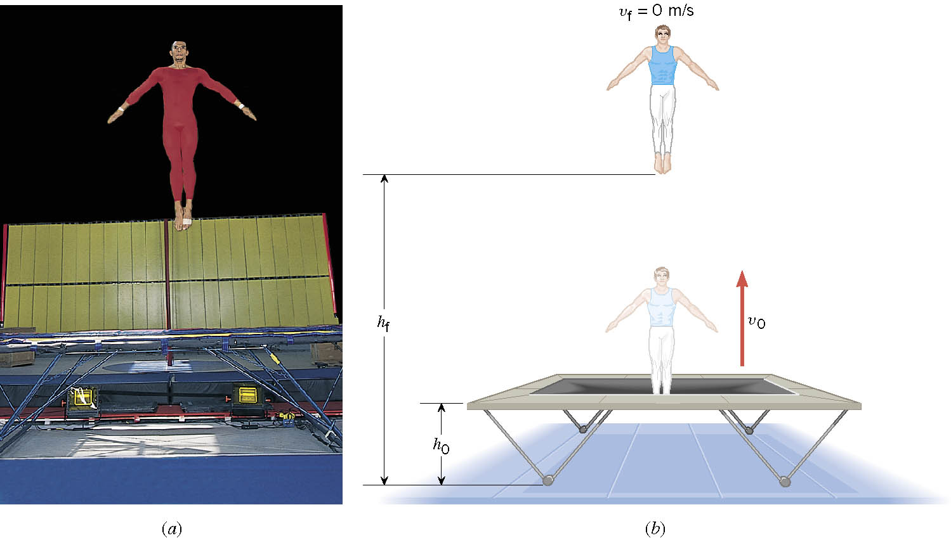
Ex. A Gymnast on a Trampoline
The gymnast leaves the trampoline at an initial height of 1.20 m and reaches a maximum height of 4.80 m before falling back down. What was the initial speed of the gymnast?

Slide 10
Ex. Continued
From the work-kinetic energy theorem
Work done by the gravitational force
Since at the maximum height, the final speed is 0. Using work-KE theorem, we obtain

Slide 11
Conservative Forces and Potential Energy
The work done on an object by a conservative force is equal to the decrease in the potential energy of the system
What does this statement tell you?
The work done by a conservative force is equal to the negative change of the potential energy associated with that force.
Only the changes in potential energy of a system is physically meaningful!!
We can rewrite the above equation in terms of the potential energy U
So the potential energy associated with a conservative force at any given position becomes
Potential energy function
What can you tell from the potential energy function above?
Since U_{i} is a constant, it only shifts the resulting U_{f}(x) by a constant amount. One can always change the initial potential so that U_{i} can be 0.

Slide 12
More Conservative and Non-conservative Forces
The work done on an object by the gravitational force does not depend on the object’s path in the absence of a retardation force.
N
When directly falls, the work done on the object by the gravitation force is
m
h
l
When sliding down the hill of length l, the work is
mg
θ
How about if we lengthen the incline by a factor of 2, keeping the height the same??
Still the same amount of work☺
So the work done by the gravitational force on an object is independent of the path of the object’s movements. It only depends on the difference of the object’s initial and final position in the direction of the force.
Forces like gravitational and elastic forces are called the conservative force
If the work performed by the force does not depend on the path.
If the net work performed on a closed path is 0.
Total mechanical energy is conserved!!

Slide 13
Example for Potential Energy
A bowler drops bowling ball of mass 7kg on his toe. Choosing the floor level as y=0, estimate the total work done on the ball by the gravitational force as the ball falls on the toe.
Let’s assume the top of the toe is 0.03m from the floor and the hand was 0.5m above the floor.
M
b) Perform the same calculation using the top of the bowler’s head as the origin.
What has to change?
First we must re-compute the positions of the ball in his hand and on his toe.
Assuming the bowler’s height is 1.8m, the ball’s original position is –1.3m, and the toe is at –1.77m.

Slide 14
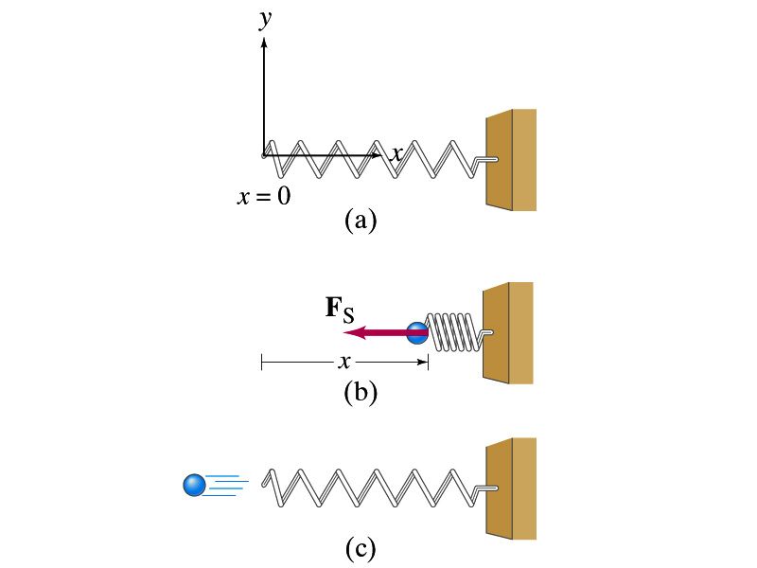
Elastic Potential Energy
Potential energy given to an object by a spring or an object with elasticity in the system that consists of an object and the spring.
The force spring exerts on an object when it is distorted from its equilibrium by a distance x is
Hooke’s Law
The work performed on the object by the spring is
The potential energy of this system is
What do you see from the above equations?
The work done on the object by the spring depends only on the initial and final position of the distorted spring.
Where else did you see this trend?
The gravitational potential energy, U_{g}
So what does this tell you about the elastic force?
A conservative force!!!

