Slide 1
PHYS 1443 – Section 004
Lecture #14
Thursday, Oct. 9, 2014
Dr. Jaehoon Yu
Power
Linear Momentum and Force
Linear Momentum Conservation
Collisions and Impulse

Slide 2
Announcements
Mid-term comprehensive exam
  In class 9:30 – 10:50am, Tuesday, Oct. 21
  Covers CH 1.1 through what we finish Thursday, Oct. 16 plus the math refresher
  Mixture of multiple choice and free response problems
  Bring your calculator but DO NOT input formula into it!
    Your phones or portable computers are NOT allowed as a replacement!
  You can prepare a one 8.5x11.5 sheet (front and back) of handwritten formulae and values of constants for the exam
    None of the parts of the solutions of any problems
    No derived formulae, derivations of equations or word definitions!
  Do NOT Miss the exam!

Slide 3
Special Project #5
Make a list of the rated power of all electric and electronic devices at your home and compiled them in a table. (2 points each for the first 10 items and 1 point for each additional item.)
  What is an item?
    Similar electric devices count as one item.
      All light bulbs make up one item, computers another, refrigerators, TVs, dryers (hair and clothes), electric cooktops, heaters, microwave ovens, electric ovens, dishwashers, etc.
      All you have to do is to count add all wattages of the light bulbs together as the power of the item
Estimate the cost of electricity for each of the items (taking into account the number of hours you use the device) on the table using the electricity cost per kWh of the power company that serves you and put them in a separate column in the above table for each of the items. (2 points each for the first 10 items and 1 point each additional items). Clearly write down what the unit cost of the power is per kWh above the table.
Estimate the the total amount of energy in Joules and the total electricity cost per month and per year for your home. (5 points)
Due: Beginning of the class Thursday, Oct. 16

Slide 4
Special Project Spread Sheet
Download this spread sheet from: http://www-hep.uta.edu/~yu/teaching/fall14-1443-004/sp5-spreadsheet.xlsx

Slide 5
Power
Rate at which the work is done or the energy is transferred
  What is the difference for the same car with two different engines (4 cylinder and 8 cylinder) climbing the same hill?
  ➔ The time… 8 cylinder car climbs up the hill faster!
Is the total amount of work done by the engines different?
NO
Then what is different?
The rate at which the same amount of work performed is higher for 8 cylinders than 4.
Average power
Instantaneous power
Unit?
What do power companies sell?
Energy

Slide 6
Energy Loss in Automobile
Automobile uses only 13% of its fuel to propel the vehicle.
Why?
67% in the engine:
Incomplete burning
Heat
Sound
16% in friction in mechanical parts
4% in operating other crucial parts such as oil and fuel pumps, etc
13% used for balancing energy loss related to moving vehicle, like air resistance and road friction to tire, etc
Two frictional forces involved in moving vehicles
Coefficient of Rolling Friction; μ=0.016
Air Drag
Total Resistance
Total power to keep speed v=26.8m/s=60mi/h
Power to overcome each component of resistance

Slide 7
Linear Momentum
The principle of energy conservation can be used to solve problems that are harder to solve just using Newton’s laws. It is used to describe the motion of an object or a system of objects.
A new concept of linear momentum can also be used to solve physical problems, especially the problems involving collisions of objects.
Linear momentum of an object whose mass is m and is moving at the velocity of v is defined as
What can you tell from this definition about momentum?
Momentum is a vector quantity.
The heavier the object the higher the momentum
The higher the velocity the higher the momentum
Its unit is kg.m/s
What else can use see from the definition? Do you see force?
The change of momentum in a given time interval

Slide 8
Linear Momentum and Forces
What can we learn from this force-momentum relationship?
The rate of the change of particle’s momentum is the same as the net force exerted on it.
When the net force is 0, the particle’s linear momentum is a constant as a function of time.
If a particle is isolated, the particle experiences no net force. Therefore its momentum does not change and is conserved.
Something else we can do with this relationship. What do you think it is?
The relationship can be used to study the case where the mass changes as a function of time.
Can you think of a few cases like this?
Motion of a meteorite
Motion of a rocket

Slide 9
Conservation of Linear Momentum in a Two Particle System
Consider an isolated system with two particles that do not have any external forces exerting on it. What is the impact of Newton’s 3rd Law?
If particle#1 exerts force on particle #2, there must be another force that the particle #2 exerts on #1 as the reaction force. Both the forces are internal forces, and the net force in the entire SYSTEM is still 0.
Now how would the momenta of these particles look like?
Let say that the particle #1 has momentum p₁ and #2 has p₂ at some point of time.
Using momentum-force relationship
and
And since net force of this system is 0
Therefore
The total linear momentum of the system is conserved!!!

Slide 10
More on Conservation of Linear Momentum in a Two Body System
From the previous slide we’ve learned that the total momentum of the system is conserved if no external forces are exerted on the system.
What does this mean?
As in the case of energy conservation, this means that the total vector sum of all momenta in the system is the same before and after any interactions
Mathematically this statement can be written as
This can be generalized into conservation of linear momentum in many particle systems.
Whenever two or more particles in an isolated system interact, the total momentum of the system remains constant.

Slide 11
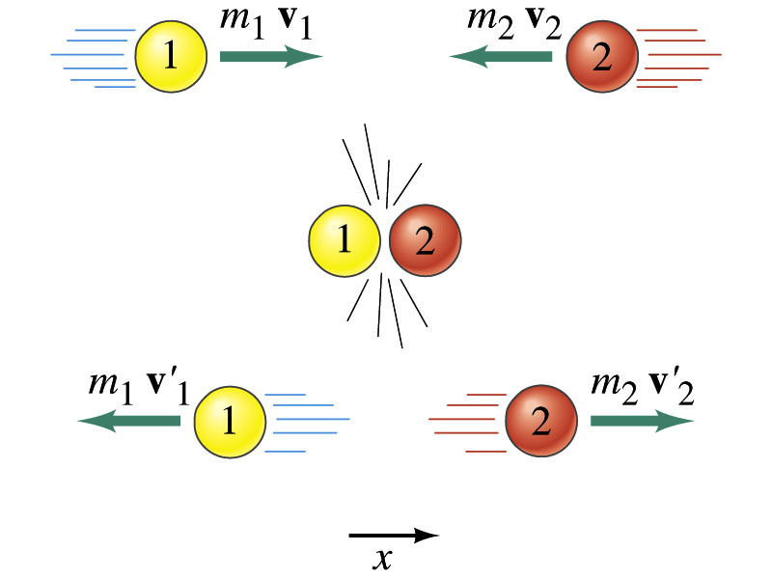
Linear Momentum Conservation
Initial
Final

Slide 12
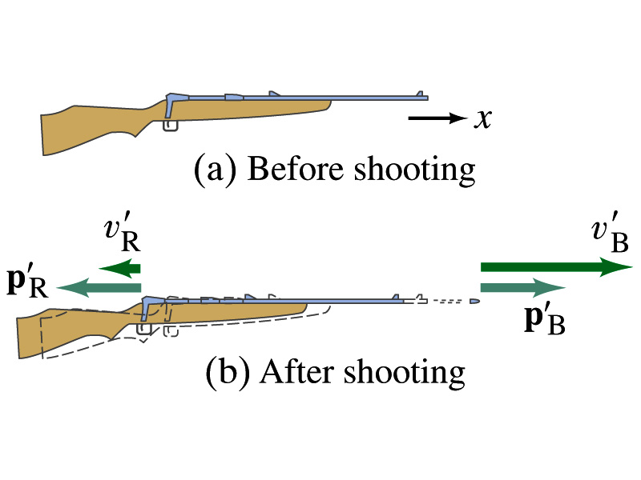
Example: Rifle Recoil
Calculate the recoil velocity of a 5.0kg rifle that shoots a 0.020kg bullet at a speed of 620m/s.
From momentum conservation, we can write
The x-comp
Solving the above for v_{R} and using the rifle’s mass and the bullet’s mass, we obtain

Slide 13
Example for Linear Momentum Conservation
Estimate an astronaut’s (M=70kg) resulting velocity after he throws his book (m=1kg) to a direction in the space to move to another direction.
v_{A}
v_{B}
From momentum conservation, we can write
Assuming the astronaut’s mass is 70kg, and the book’s mass is 1kg and using linear momentum conservation
Now if the book gained a velocity of 20 m/s in +x-direction, the Astronaut’s velocity is

Slide 14
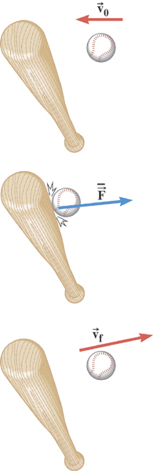
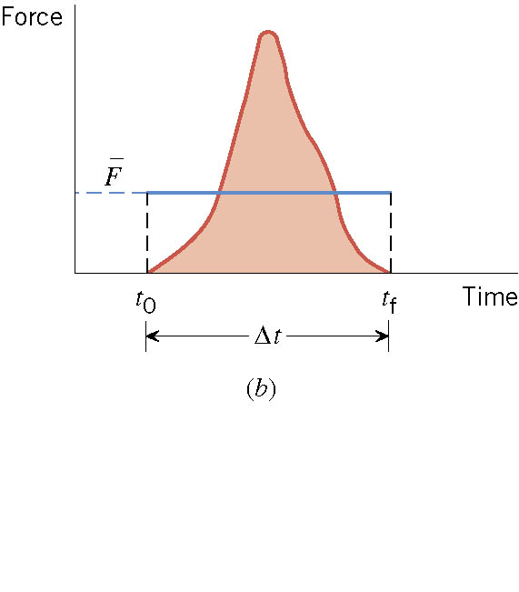
Impulse
There are many situations when the force on an object is not constant and in fact quite complicated!!

Slide 15
Ball Hit by a Bat
Multiply either side by Δt

Slide 16
Impulse and Linear Momentum
Net force causes change of momentum ➔ Newton’s second law
By integrating the above equation in a time interval t_{i} to t_{f}, one can obtain impulse I.
Effect of the force F acting on an object over the time interval Δt=t_{f}-t_{i} is equal to the change of the momentum of the object caused by that force. Impulse is the degree of which an external force changes an object’s momentum.
So what do you think an impulse is?
The above statement is called the impulse-momentum theorem and is equivalent to Newton’s second law.
What are the dimension and unit of Impulse? What is the direction of an impulse vector?
Defining a time-averaged force
Impulse can be rewritten
If force is constant
It is generally assumed that the impulse force acts on a short time but much greater than any other forces present.

