Slide 1
PHYS 1443 – Section 004
Lecture #15
Tuesday, Oct. 14, 2014
Dr. Jaehoon Yu
Collisions and Impulse
Collisions – Elastic and Inelastic Collisions
Collisions in two dimension
Today’s homework is homework #8, due 11pm, Monday, Oct. 20!!

Slide 2
Announcements
Quiz #3 results
  Class average: 24.2/41
    Equivalent to: 59/100
    Previous quizzes: 72 and 51
  Class top score: 41
Mid-term comprehensive exam
  In class 9:30 – 10:50am, next Tuesday, Oct. 21
  Covers CH 1.1 through what we finish this Thursday, Oct. 16 plus the math refresher
  Mixture of multiple choice and free response problems
  Bring your calculator but DO NOT input formula into it!
    Your phones or portable computers are NOT allowed as a replacement!
  You can prepare a one 8.5x11.5 sheet (front and back) of handwritten formulae and values of constants for the exam
    None of the parts of the solutions of any problems
    No derived formulae, derivations of equations or word definitions!
  Do NOT Miss the exam!

Slide 3
Reminder: Special Project #5
Make a list of the rated power of all electric and electronic devices at your home and compiled them in a table. (2 points each for the first 10 items and 1 point for each additional item.)
  What is an item?
    Similar electric devices count as one item.
      All light bulbs make up one item, computers another, refrigerators, TVs, dryers (hair and clothes), electric cooktops, heaters, microwave ovens, electric ovens, dishwashers, etc.
      All you have to do is to count add all wattages of the light bulbs together as the power of the item
Estimate the cost of electricity for each of the items (taking into account the number of hours you use the device) on the table using the electricity cost per kWh of the power company that serves you and put them in a separate column in the above table for each of the items. (2 points each for the first 10 items and 1 point each additional items). Clearly write down what the unit cost of the power is per kWh above the table.
Estimate the the total amount of energy in Joules and the total electricity cost per month and per year for your home. (5 points)
Due: Beginning of the class this Thursday, Oct. 16

Slide 4
Special Project Spread Sheet
Download this spread sheet from: http://www-hep.uta.edu/~yu/teaching/fall14-1443-004/sp5-spreadsheet.xlsx

Slide 5
Impulse and Linear Momentum
Net force causes a change of momentum ➔ Newton’s second law
By integrating the above equation in a time interval t_{i} to t_{f}, one can obtain impulse I.
Effect of the force F acting on an object over the time interval Δt=t_{f}-t_{i} is equal to the change of the momentum of the object caused by that force. Impulse is the degree of which an external force changes an object’s momentum.
So what do you think an impulse is?
The above statement is called the impulse-momentum theorem and is equivalent to Newton’s second law.
What are the dimension and unit of Impulse? What is the direction of an impulse vector?
Defining a time-averaged force
Impulse can be rewritten
If force is constant
It is generally assumed that the impulse force acts on a short time but much greater than any other forces present.

Slide 6
Example for Impulse
In a crash test, an automobile of mass 1500kg collides with a wall. The initial and final velocities of the automobile are v_{i}= -15.0i m/s and v_{f}=2.60i m/s. If the collision lasts for 0.150 seconds, what would be the impulse caused by the collision and the average force exerted on the automobile?
Let’s assume that the force involved in the collision is a lot larger than any other forces in the system during the collision. From the problem, the initial and final momentum of the automobile before and after the collision is
Therefore the impulse on the automobile due to the collision is
The average force exerted on the automobile during the collision is

Slide 7
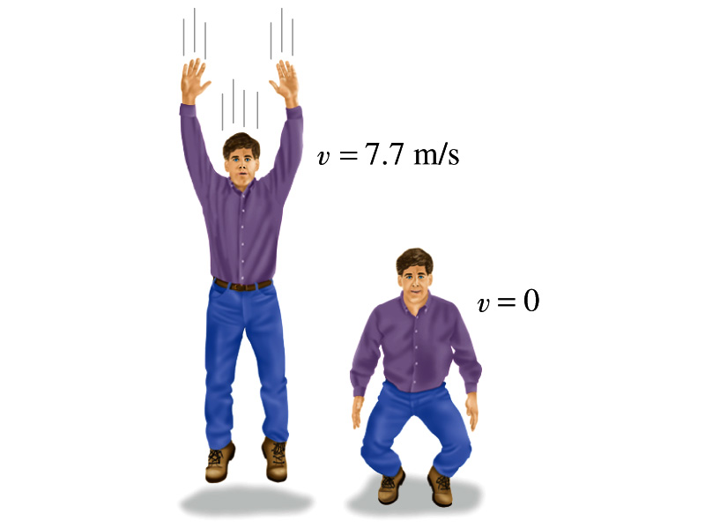
Another Example for Impulse
(a) Calculate the impulse experienced when a 70 kg person lands on firm ground after jumping from a height of 3.0 m. Then estimate the average force exerted on the person’s feet by the ground, if the landing is (b) stiff-legged and (c) with bent legs. In the former case, assume the body moves 1.0cm during the impact, and in the second case, when the legs are bent, about 50 cm.
We don’t know the force. How do we do this?
Obtain velocity of the person before striking the ground.
Solving the above for velocity v, we obtain
Then as the person strikes the ground, the momentum becomes 0 quickly giving the impulse

Slide 8
Example cont’d
In coming to rest, the body decelerates from 7.7m/s to 0m/s in a distance d=1.0cm=0.01m.
The average speed during this period is
The time period the collision lasts is
Since the magnitude of impulse is
The average force on the feet during this landing is
How large is this average force?
If landed in stiff legged, the feet must sustain 300 times the body weight. The person will likely break his leg.
For bent legged landing:

Slide 9
Collisions
Generalized collisions must cover not only the physical contact but also the collisions without physical contact such as that of electromagnetic ones on a microscopic scale.
The collisions of these ions never involve physical contact because the electromagnetic repulsive force between these two become great as they get closer causing a collision.
Consider a case of a collision between a proton on a helium ion.
F
F₁₂
Assuming no external forces, the force exerted on particle 1 by particle 2, F₂₁, changes the momentum of particle 1 by
t
F₂₁
Likewise for particle 2 by particle 1
Using Newton’s 3rd law we obtain
So the momentum change of the system in a collision is 0, and the momentum is conserved

Slide 10
Elastic and Inelastic Collisions
Momentum is conserved in any collisions as long as external forces are negligible.
Collisions are classified as elastic or inelastic based on whether the kinetic energy is conserved, meaning whether it is the same before and after the collision.
Elastic Collision
A collision in which the total kinetic energy and momentum are the same before and after the collision.
Inelastic Collision
A collision in which the momentum is the same before and after the collision but not the total kinetic energy .
Two types of inelastic collisions:Perfectly inelastic and inelastic
Perfectly Inelastic: Two objects stick together after the collision, moving together with the same velocity.
Inelastic: Colliding objects do not stick together after the collision but some kinetic energy is lost.
Note: Momentum is constant in all collisions but kinetic energy is only in elastic collisions.

Slide 11
Elastic and Perfectly Inelastic Collisions
In perfectly inelastic collisions, the objects stick together after the collision, moving together. Momentum is conserved in this collision, so the final velocity of the stuck system is
How about elastic collisions?
In elastic collisions, both the momentum and the kinetic energy are conserved. Therefore, the final speeds in an elastic collision can be obtained in terms of initial speeds as
From momentum
conservation above
What happens when the two masses are the same?

Slide 12
Example for a Collision
A car of mass 1800kg stopped at a traffic light is rear-ended by a 900kg car, and the two become entangled. If the lighter car was moving at 20.0m/s before the collision what is the velocity of the entangled cars after the collision?
Before collision
The momenta before and after the collision are
m₂
20.0m/s
m₁
After collision
Since momentum of the system must be conserved
m₂
m₁
v_{f}
What can we learn from these equations on the direction and magnitude of the velocity before and after the collision?
The cars are moving in the same direction as the lighter car’s original direction to conserve momentum.
The magnitude is inversely proportional to its own mass.

Slide 13
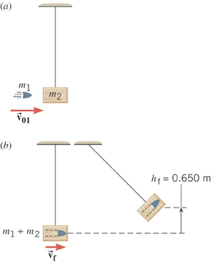
Example: A Ballistic Pendulum
The mass of a block of wood is 2.50-kg and the mass of the bullet is 0.0100-kg. The block swings to a maximum height of 0.650 m above the initial position. Find the initial speed of the bullet.
What kind of collision?
Perfectly inelastic collision
No net external force ➔ momentum conserved
Solve for V₀₁
What do we not know?
The final speed!!
How can we get it?
Using the mechanical energy conservation!

Slide 14
Ex. A Ballistic Pendulum, cnt’d
Now using the mechanical energy conservation
Solve for V_{f}
Using the solution obtained previously, we obtain

Slide 15
Two dimensional Collisions
In two dimension, one needs to use components of momentum and apply momentum conservation to solve physical problems.
v_{1i}
m₁
x-comp.
m₂
y-comp.
v_{1f}
m₁
θ
Consider a system of two particle collisions and scatters in two dimension as shown in the picture. (This is the case at a fixed target accelerator experiment.) The momentum conservation tells us:
Φ
m₂
v_{2f}
And for the elastic collisions, the kinetic energy is conserved:
What do you think we can learn from these relationships?

Slide 16
Example for Two Dimensional Collisions
Proton #1 with a speed 3.50x10⁵ m/s collides elastically with proton #2 initially at rest. After the collision, proton #1 moves at an angle of 37º to the horizontal axis and proton #2 deflects at an angle ϕ to the same axis. Find the final speeds of the two protons and the scattering angle of proton #2, Φ.
v_{1i}
Since both the particles are protons m₁=m₂=m_{p}.
m₁
m₂
Using momentum conservation, one obtains
v_{1f}
x-comp.
m₁
θ
y-comp.
Φ
Canceling m_{p} and putting in all known quantities, one obtains
m₂
v_{2f}
From kinetic energy conservation:
Solving Eqs. 1-3, one gets
Do this at home☺

