Slide 1
PHYS 1443 – Section 004
Lecture #16
Thursday, Oct. 16, 2014
Dr. Jaehoon Yu
Center of Mass
Center of mass of a rigid body
Motion of a Group of Objects
Fundamentals of Rotational Motion
Rotational Kinematics

Slide 2
Announcements
Mid-term comprehensive exam
  In class 9:30 – 10:50am, next Tuesday, Oct. 21
  Covers CH 1.1 through what we finish today (CH10.2) plus the math refresher
  Mixture of multiple choice and free response problems
  Bring your calculator but DO NOT input formula into it!
    Your phones or portable computers are NOT allowed as a replacement!
  You can prepare a one 8.5x11.5 sheet (front and back) of handwritten formulae and values of constants for the exam
    None of the parts of the solutions of any problems
    No derived formulae, derivations of equations or word definitions!
  Do NOT Miss the exam!

Slide 3
Center of Mass
We’ve been solving physical problems treating objects as sizeless points with masses, but in realistic situations objects have shapes with masses distributed throughout the body.
Center of mass of a system is the average position of the system’s mass and represents the motion of the system as if all the mass is on the point.
What does above statement tell you concerning the forces being exerted on the system?
The total external force exerted on the system of total mass M causes the center of mass to move at an acceleration given by as if all the mass of the system is concentrated on the center of mass.
Consider a massless rod with two balls attached at either end.
m₁
m₂
x₁
x₂
The position of the center of mass of this system is the mass averaged position of the system
x_{CM}
CM is closer to the heavier object

Slide 4
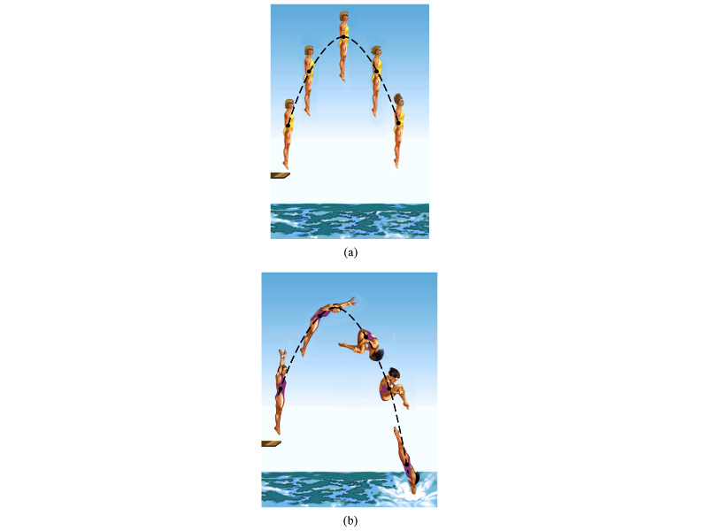
Motion of a Diver and the Center of Mass
A diver performs a simple dive.
The motion of the center of mass follows a parabola since it is a projectile motion.
A diver performs a complicated dive.
The motion of the center of mass still follows the same parabola since it still is a projectile motion.
The motion of the center of mass of the diver is always the same.

Slide 5
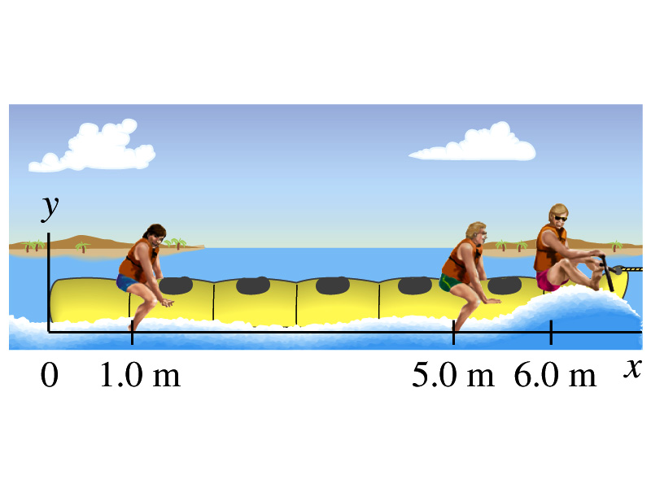
Example for CM
Thee people of roughly equivalent mass M on a lightweight (air-filled) banana boat sit along the x axis at positions x₁=1.0m, x₂=5.0m, and x₃=6.0m. Find the position of CM.
Using the formula for CM

Slide 6
Example for Center of Mass in 2-D
A system consists of three particles as shown in the figure. Find the position of the center of mass of this system.
Using the formula for CM for each position vector component
y=2
m₁
(0,2)
(0.75,1)
r_{CM}
(1,0)
(2,0)
m₂
m₃
x=1
x=2
One obtains
If

Slide 7
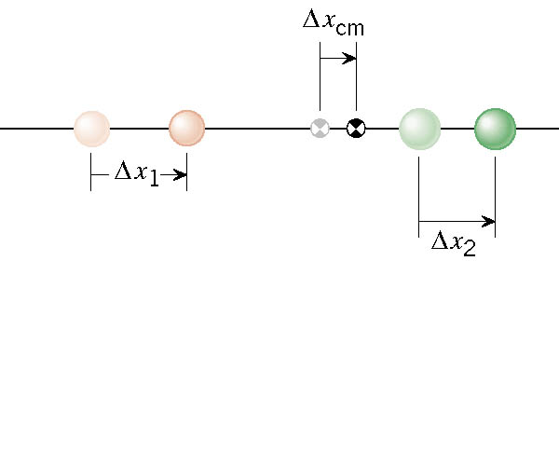
Velocity of the Center of Mass
In an isolated system, the total linear momentum does not change, therefore the velocity of the center of mass does not change.

Slide 8
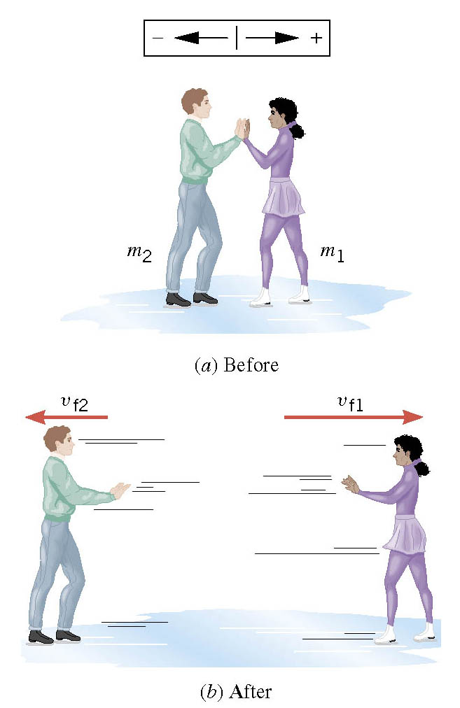
Another Look at the Ice Skater Problem
Starting from rest, two skaters push off against each other on ice where friction is negligible. One is a 54-kg woman and one is a 88-kg man. The woman moves away with a velocity of +2.5 m/s. Man’s velocity?

Slide 9
Center of Mass of a Rigid Object
The formula for CM can be extended to a system of many particles or a Rigid Object
The position vector of the center of mass of a many particle system is
A rigid body – an object with shape and size with mass spread throughout the body, ordinary objects – can be considered as a group of particles with mass m_{i} densely spread throughout the given shape of the object
Δm_{i}
r_{i}
r_{CM}

Slide 10
Example: CM of a thin rod
Show that the center of mass of a rod of mass M and length L lies in midway between its ends, assuming the rod has a uniform mass per unit length.
L
The formula for CM of a continuous object is
x
Since the density of the rod (λ) is constant;
dx
Δm=λdx
The mass of a small segment
Therefore
Find the CM when the density of the rod non-uniform but varies linearly as a function of x, λ=αx

Slide 11
Center of Mass and Center of Gravity
CM
The center of mass of any symmetric object lies on the axis of symmetry and on any plane of symmetry, if the object’s mass is evenly distributed throughout the body.
Axis of symmetry
One can use gravity to locate CM.
Hang the object by one point and draw a vertical line following a plum-bob.
Hang the object by another point and do the same.
The point where the two lines meet is the CM.
How do you think you can determine the CM of the objects that are not symmetric?
Center of Gravity
Since a rigid object can be considered as a collection of small masses, one can see the total gravitational force exerted on the object as
Δm_{i}
What does this equation tell you?
The net effect of these small gravitational forces is equivalent to a single force acting on a point (Center of Gravity) with mass M.
Δm_{i}g
The CoG is the point in an object as if all the gravitational force is acting on!

Slide 12
Motion of a Group of Particles
We’ve learned that the CM of a system can represent the motion of a system. Therefore, for an isolated system of many particles in which the total mass M is preserved, the velocity, total momentum, acceleration of the system are
Velocity of the system
Total Momentum of the system
Acceleration of the system
The external force acting on the system
What about the internal forces?
System’s momentum is conserved.
If net external force is 0

Slide 13
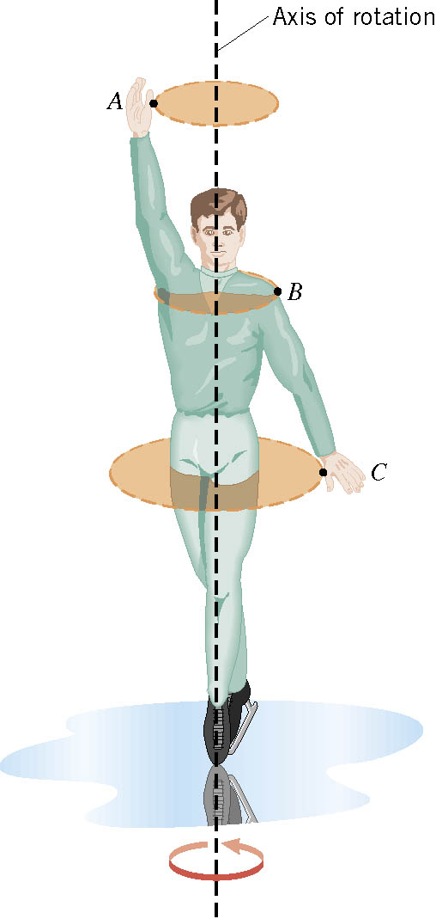
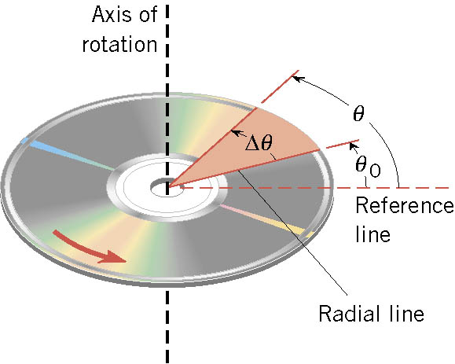
Rotational Motion and Angular Displacement
In the simplest kind of rotation, points on a rigid object move on circular paths around an axis of rotation.
The angle swept out by the line passing through any point on the body and intersecting the axis of rotation perpendicularly is called the angular displacement.
It’s a vector!! So there must be a direction…
How do we define directions?
+:if counter-clockwise
-:if clockwise
The direction vector points gets determined based on the right-hand rule.
These are just conventions!!

Slide 14
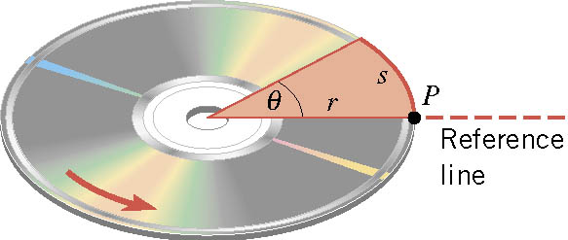

SI Unit of the Angular Displacement
Dimension?
None
For one full revolution:
Since the circumference of a circle is
2πr
One radian is an angle subtended by an arc of the same length as the radius!

Slide 15
Unit of the Angular Displacement
How many degrees are in one radian?
1 radian is
How radians is one degree?
And one degrees is
How many radians are in 10.5 revolutions?
Very important: In solving angular problems, all units, degrees or revolutions, must be converted to radians.

Slide 16
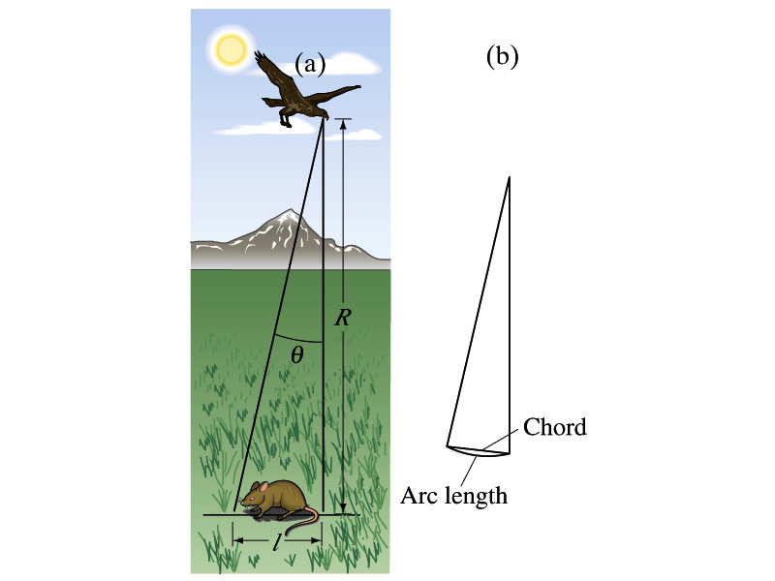
Example
A particular bird’s eyes can just distinguish objects that subtend an angle no smaller than about 3x10⁻⁴ rad. (a) How many degrees is this? (b) How small an object can the bird just distinguish when flying at a height of 100m?
(a) One radian is 360º/2π. Thus
(b) Since l=rθ and for small angle arc length is approximately the same as the chord length.

Slide 17
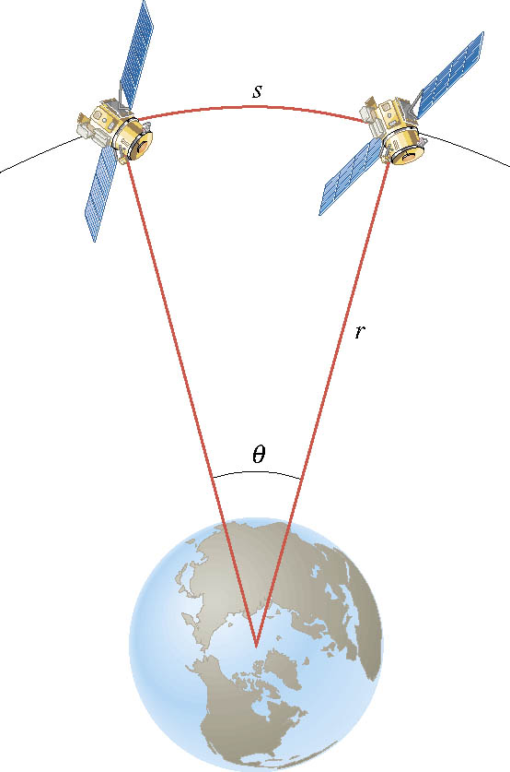
Ex. Adjacent Synchronous Satellites
Synchronous satellites are put into an orbit whose radius is 4.23×10⁷m. If the angular separation of the two satellites is 2.00 degrees, find the arc length that separates them.
What do we need to find out?
The Arc length!!!
Convert degrees to radians

Slide 18
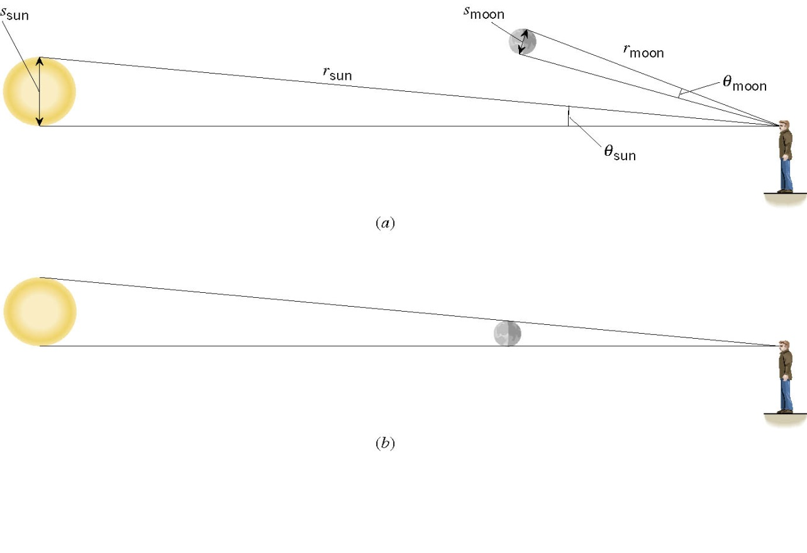
Ex. A Total Eclipse of the Sun
The diameter of the sun is about 400 times greater than that of the moon. By coincidence, the sun is also about 400 times farther from the earth than is the moon. For an observer on the earth, compare the angle subtended by the moon to the angle subtended by the sun and explain why this result leads to a total solar eclipse.
I can even cover the entire sun with my thumb!! Why?
Because the distance (r) from my eyes to my thumb is far shorter than that to the sun.

Slide 19
Angular Displacement, Velocity, and Acceleration
Angular displacement is defined as
θ_{f}
θ_{i}
How about the average angular velocity, the rate of change of angular displacement?
Unit?
rad/s
Dimension?
[T⁻¹]
By the same token, the average angular acceleration, rate of change of the angular velocity, is defined as…
Unit?
rad/s²
Dimension?
[T⁻²]
When rotating about a fixed axis, every particle on a rigid object rotates through the same angle and has the same angular speed and angular acceleration.

Slide 20
Problem Solving Strategy
Visualize the problem by drawing a picture.
Write down the values that are given for any of the five kinematic variables and convert them to SI units.
  Remember that the unit of the angle must be radians!!
Verify that the information contains values for at least three of the five kinematic variables. Select the appropriate equation.
When the motion is divided into segments, remember that the final angular velocity of one segment is the initial velocity for the next.
Keep in mind that there may be two possible answers to a kinematics problem.

Slide 21
Ex. Rotational Kinematics
A wheel rotates with a constant angular acceleration of 3.50 rad/s². If the angular speed of the wheel is 2.00 rad/s at t_{i}=0, a) through what angle does the wheel rotate in 2.00s?
Using the angular displacement formula in the previous slide, one gets

Slide 22
Example for Rotational Kinematics cnt’d
What is the angular speed at t=2.00s?
Using the angular speed and acceleration relationship
Find the angle through which the wheel rotates between t=2.00s and t=3.00s.
Using the angular kinematic formula
At t=2.00s
At t=3.00s
Angular displacement

Slide 23
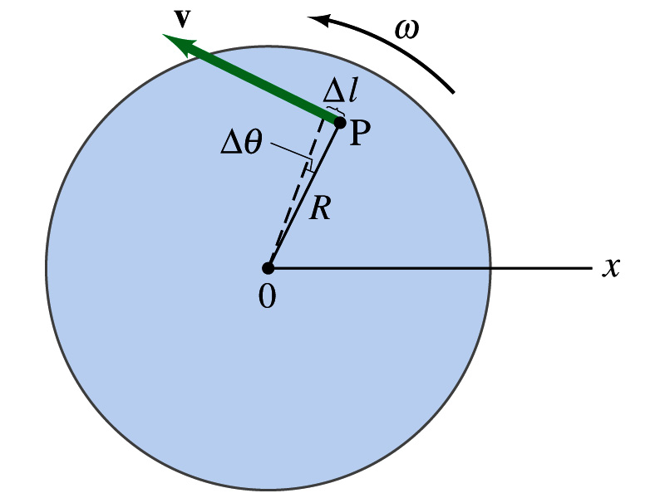
Relationship Between Angular and Linear Quantities
What do we know about a rigid object that rotates about a fixed axis of rotation?
Every particle (or masslet) in the object moves in a circle centered at the same axis of rotation.
When a point rotates, it has both the linear and angular components in its motion.
What is the linear component of the motion you see?
The direction of ω follows the right-hand rule.
Linear velocity along the tangential direction.
How do we related this linear component of the motion with angular component?
The arc-length is
So the tangential speed v is
What does this relationship tell you about the tangential speed of the points in the object and their angular speed?:
Although every particle in the object has the same angular speed, its tangential speed differs and is proportional to its distance from the axis of rotation.
The farther away the particle is from the center of rotation, the higher the tangential speed.

Slide 24
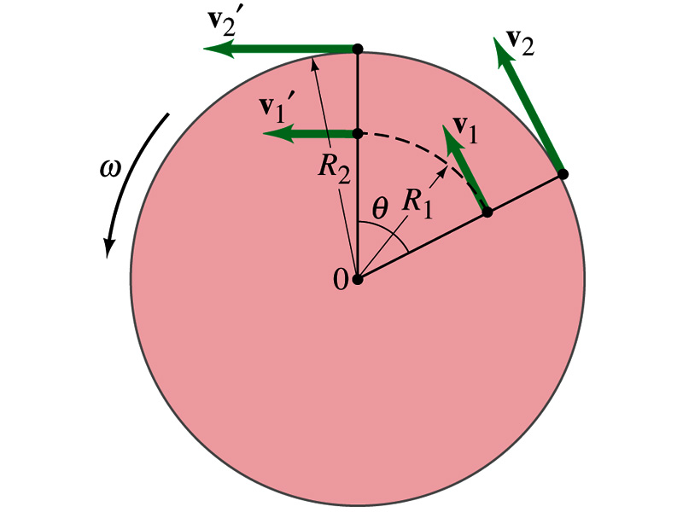
Is the lion faster than the horse?
A rotating carousel has one child sitting on a horse near the outer edge and another child on a lion halfway out from the center. (a) Which child has the greater linear speed? (b) Which child has the greater angular speed?
Linear speed is the distance traveled divided by the time interval. So the child sitting at the outer edge travels more distance within the given time than the child sitting closer to the center. Thus, the horse is faster than the lion.
(b) Angular speed is the angle traveled divided by the time interval. The angle both the children travel in the given time interval is the same. Thus, both the horse and the lion have the same angular speed.

Slide 25
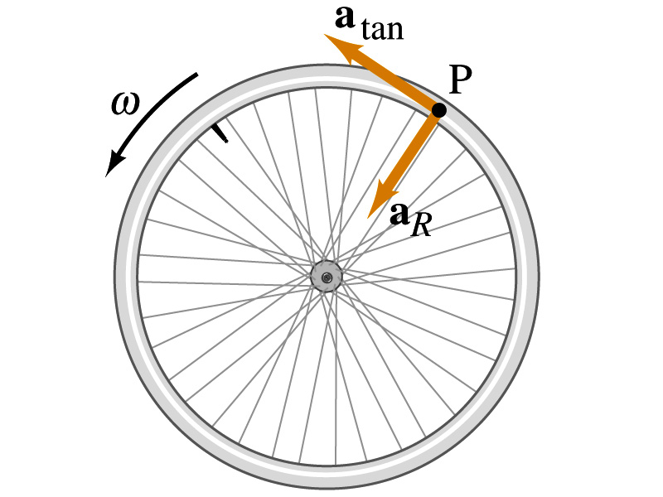
How about the acceleration?
How many different linear acceleration components do you see in a circular motion and what are they?
Two
Tangential, a_{t}, and the radial acceleration, a_{r}.
Since the tangential speed v is
The magnitude of tangential acceleration a_{t} is
What does this relationship tell you?
Although every particle in the object has the same angular acceleration, its tangential acceleration differs proportional to its distance from the axis of rotation.
The radial or centripetal acceleration a_{r} is
What does this tell you?
The father away the particle is from the rotation axis, the more radial acceleration it receives. In other words, it receives more centripetal force.
Total linear acceleration is

Slide 26
Example
(a) What is the linear speed of a child seated 1.2m from the center of a steadily rotating merry-go-around that makes one complete revolution in 4.0s? (b) What is her total linear acceleration?
First, figure out what the angular speed of the merry-go-around is.
Using the formula for linear speed
Since the angular speed is constant, there is no angular acceleration.
Tangential acceleration is
Radial acceleration is
Thus the total acceleration is

Slide 27
Example for Rotational Motion
Audio information on compact discs are transmitted digitally through the readout system consisting of laser and lenses. The digital information on the disc are stored by the pits and flat areas on the track. Since the speed of readout system is constant, it reads out the same number of pits and flats in the same time interval. In other words, the linear speed is the same no matter which track is played. a) Assuming the linear speed is 1.3 m/s, find the angular speed of the disc in revolutions per minute when the inner most (r=23mm) and outer most tracks (r=58mm) are read.
Using the relationship between angular and tangential speed

Slide 28
b) The maximum playing time of a standard music CD is 74 minutes and 33 seconds. How many revolutions does the disk make during that time?
c) What is the total length of the track past through the readout mechanism?
d) What is the angular acceleration of the CD over the 4473s time interval, assuming constant α?

