Slide 1
PHYS 1443 – Section 004
Lecture #19
Thursday, Oct. 30, 2014
Dr. Jaehoon Yu
Rolling Kinetic Energy
Work, Power and Energy in Rotation
Angular Momentum
Angular Momentum Conservation
Conditions for Equilibrium
Today’s homework is homework #10, due 11pm, Thursday, Nov. 6!!

Slide 2
Announcements
2nd Non-comprehensive term exam
  In class 9:30 – 10:50am, Thursday, Nov. 13
  Covers CH 10.1 through what we finish Tuesday, Nov. 11
  Mixture of multiple choice and free response problems
  Bring your calculator but DO NOT input formula into it!
    Your phones or portable computers are NOT allowed as a replacement!
  You can prepare a one 8.5x11.5 sheet (front and back) of handwritten formulae and values of constants for the exam
    None of the parts of the solutions of any problems
    No derived formulae, derivations of equations or word definitions!
  Do NOT Miss the exam!

Slide 3
Ex: Rolling Kinetic Energy
For a solid sphere as shown in the figure, calculate the linear speed of the CM at the bottom of the hill and the magnitude of linear acceleration of the CM. Solve this problem using Newton’s second law, the dynamic method.
n
What are the forces involved in this motion?
f
y
Gravitational Force,
Frictional Force,
Normal Force
M
h
x
Newton’s second law applied to the CM gives
x
Mg
θ
Since the forces Mg and n go through the CM, their moment arm is 0 and do not contribute to torque, while the static friction f causes torque
We know that
We obtain
Substituting f in dynamic equations

Slide 4
Work, Power, and Energy in Rotation
F
Let’s consider the motion of a rigid body with a single external force F exerting on the point P, moving the object by Δs.
Fsinφ
φ
Δs
The work done by the force F as the object rotates through the infinitesimal distance Δs=rΔθ is
Δθ
r
Fcosφ
O
What is Fsinϕ?
The tangential component of the force F.
What is the work done by radial component Fcosϕ?
Zero, because it is perpendicular to the displacement.
Since the magnitude of torque is rFsinϕ,
How was the power defined in linear motion?
The rate of work, or power, becomes
The rotational work done by an external force equals the change in rotational Kinetic energy.
The work put in by the external force then
Work-kinetic Energy Theorem

Slide 5
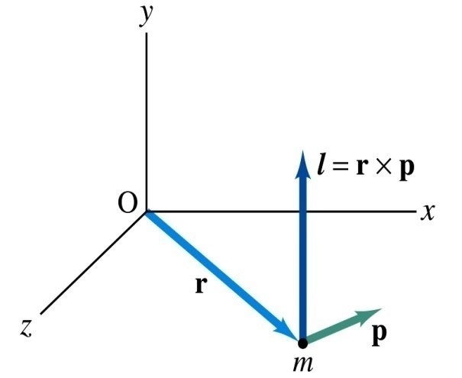
Angular Momentum of a Particle
If you grab onto a pole while running, your body will rotate about the pole, gaining angular momentum. We’ve used the linear momentum to solve physical problems with linear motions, the angular momentum will do the same for rotational motions.
z
Let’s consider a point-like object ( particle) with mass m located at the vector location r and moving with linear velocity v
The angular momentum L of this particle relative to the origin O is
y
What is the unit and dimension of angular momentum?
x
Note that L depends on origin O.
Why?
Because r changes
What else do you learn?
The direction of L is +z.
Since p is mv, the magnitude of L becomes
What do you learn from this?
If the direction of linear velocity points to the origin of rotation, the particle does not have any angular momentum.
If the linear velocity is perpendicular to position vector, the particle moves exactly the same way as a point on a rim.

Slide 6
Angular Momentum and Torque
Can you remember how net force exerting on a particle and the change of its linear momentum are related?
Total external forces exerting on a particle is the same as the change of its linear momentum.
The same analogy works in rotational motion between torque and angular momentum.
Net torque acting on the particle is
z
L=rxp
O
y
Why does this work?
Because v is parallel to the linear momentum
r
m
φ
p
x
Thus the torque-angular momentum relationship
The net torque acting on a particle is the same as the time rate change of its angular momentum

Slide 7
Angular Momentum of a System of Particles
The total angular momentum of a system of particles about some point is the vector sum of the angular momenta of the individual particles
Since the individual angular momentum can change, the total angular momentum of the system can change.
Both internal and external forces can provide torque to individual particles. However, the internal forces do not generate net torque due to Newton’s third law.
Let’s consider a two particle system where the two exert forces on each other.
Since these forces are the action and reaction forces with directions lie on the line connecting the two particles, the vector sum of the torque from these two becomes 0.
Thus the time rate change of the angular momentum of a system of particles is equal to only the net external torque acting on the system

Slide 8
Ex. for Angular Momentum
A particle of mass m is moving on the xy plane in a circular path of radius r and linear velocity v about the origin O. Find the magnitude and the direction of the angular momentum with respect to O.
y
Using the definition of angular momentum
v
r
Since both the vectors, r and v, are on x-y plane and using right-hand rule, the direction of the angular momentum vector is +z (coming out of the screen)
O
x
The magnitude of the angular momentum is
So the angular momentum vector can be expressed as
Find the angular momentum in terms of angular velocity ω.
Using the relationship between linear and angular speed

Slide 9
Angular Momentum of a Rotating Rigid Body
z
Let’s consider a rigid body rotating about a fixed axis
L=rxp
Each particle of the object rotates in the xy plane about the z-axis at the same angular speed, ω
O
y
Magnitude of the angular momentum of a particle of mass m_{i} about origin O is m_{i}v_{i}r_{i}
r
m
φ
p
x
Summing over all particle’s angular momentum about z axis
What do you see?
Since I is constant for a rigid body
α is the angular acceleration
Thus the torque-angular momentum relationship becomes
The net external torque acting on a rigid body rotating about a fixed axis is equal to the moment of inertia about that axis multiplied by the object’s angular acceleration with respect to that axis.

Slide 10
Example for Rigid Body Angular Momentum
A rigid rod of mass M and length l is pivoted without friction at its center. Two particles of mass m₁ and m₂ are attached to either end of the rod. The combination rotates on a vertical plane with an angular speed of ω. Find an expression for the magnitude of the angular momentum.
y
The moment of inertia of this system is
m₂
l
m₂ g
θ
O
x
m₁
Find an expression for the magnitude of the angular acceleration of the system when the rod makes an angle θ with the horizon.
m₁ g
If m₁ = m₂, no angular momentum because the net torque is 0.
If θ=+/−π/2, at equilibrium so no angular momentum.
First compute the net external torque
Thus α becomes

