Slide 1
PHYS 1443 – Section 004 Lecture #20
Tuesday, Nov. 4, 2014
Dr. Jaehoon Yu
Angular Momentum Conservation
Conditions for Equilibrium
Elastic Properties of Solids
Density and Specific Gravity
Fluid and Pressure
Variation of Pressure and Depth
Pascal’s Principle

Slide 2
Announcements
Quiz results
Class Average: 14.9/30 ➔ equivalent to 49.7/100
Top score: 27/30
Reminder 2nd Non-comprehensive term exam
In class 9:30 – 10:50am, Thursday, Nov. 13
Covers CH 10.1 through what we finish Tuesday, Nov. 11
Mixture of multiple choice and free response problems
Bring your calculator but DO NOT input formula into it!
Your phones or portable computers are NOT allowed as a replacement!
You can prepare a one 8.5x11.5 sheet (front and back) of handwritten formulae and values of constants for the exam
None of the parts of the solutions of any problems
No derived formulae, derivations of equations or word definitions!
Do NOT Miss the exam!

Slide 3
Conservation of Angular Momentum
Remember under what condition the linear momentum is conserved?
Linear momentum is conserved when the net external force is 0.
By the same token, the angular momentum of a system is constant in both magnitude and direction, if the resultant external torque acting on the system is 0.
What does this mean?
Angular momentum of the system before and after a certain change is the same.
Three important conservation laws for isolated system that does not get affected by external forces
Mechanical Energy
Linear Momentum
Angular Momentum

Slide 4
Ex. Neutron Star
A star rotates with a period of 30 days about an axis through its center. After the star undergoes a supernova explosion, the stellar core, which had a radius of 1.0x10⁴km, collapses into a neutron star of radius 3.0km. Determine the period of rotation of the neutron star.
What is your guess about the answer?
The period will be significantly shorter, because its radius got smaller.
Let’s make some assumptions:
There is no external torque acting on it
The shape remains spherical
Its mass remains constant
Using angular momentum conservation
The angular speed of the star with the period T is
Thus

Slide 5
Kepler’s Second Law and Angular Momentum Conservation
Consider a planet of mass M_{p} moving around the Sun in an elliptical orbit.
D
Since the gravitational force acting on the planet is always toward radial direction, it is a central force
r
A
S
dr
Therefore the torque acting on the planet by this force is always 0.
B
C
Since torque is the time rate change of angular momentum L, the angular momentum is constant.
Because the gravitational force exerted on a planet by the Sun results in no torque, the angular momentum L of the planet is constant.
Since the area swept by the motion of the planet is
This is Keper’s second law which states that the radius vector from the Sun to a planet sweeps out equal areas in equal time intervals.

Slide 6
Similarity Between Linear and Rotational Motions
All physical quantities in linear and rotational motions show striking similarity.
Quantities | Linear | Rotational
Mass | Mass | Moment of Inertia
Length of motion | Distance | Angle (Radian)
Speed
Acceleration
Force | Force | Torque
Work | Work | Work
Power
Momentum
Kinetic Energy | Kinetic | Rotational

Slide 7
Conditions for Equilibrium
What do you think the term “An object is at its equilibrium” means?
The object is either at rest (Static Equilibrium) or its center of mass is moving at a constant velocity (Dynamic Equilibrium).
When do you think an object is at its equilibrium?
Translational Equilibrium: Equilibrium in linear motion
Is this it?
The above condition is sufficient for a point-like object to be at its translational equilibrium. However for an object with size this is not sufficient. One more condition is needed. What is it?
Let’s consider two forces equal in magnitude but in opposite direction acting on a rigid object as shown in the figure. What do you think will happen?
F
d
CM
The object will rotate about the CM. Since the net torque acting on the object about a rotational axis is not 0.
d
-F
For an object to be at its static equilibrium, the object should not have linear or angular speed.

Slide 8
More on Conditions for Equilibrium
To simplify the problem, we will only deal with forces acting on x-y plane, giving torque only along z-axis. What do you think the conditions for equilibrium be in this case?
The six possible equations from the two vector equations turns to three equations.
AND
What happens if there are many forces exerting on an object?
If an object is at its translational static equilibrium, and if the net torque acting on the object is 0 about one axis, the net torque must be 0 about any arbitrary axis.
F₁
F₂
O
r’
r₅
O’
F₃
F₅
Why is this true?
F₄
Because the object is not moving, no matter what the rotational axis is, there should not be any motion. It is simply a matter of mathematical manipulation.

Slide 9
Center of Gravity Revisited
When is the center of gravity of a rigid body the same as the center of mass?
Under the uniform gravitational field throughout the body of the object.
Let’s consider an arbitrary shaped object
m₃g₃
The center of mass of this object is at
CM
m_{i}g_{i}
CoG
m₂g₂
Let’s now examine the case that the gravitational acceleration on each point is g_{i}
m₁g₁
Since the CoG is the point as if all the gravitational force is exerted on, the torque due to this force becomes
Generalized expression for different g throughout the body
If g is uniform throughout the body

Slide 10
How do we solve static equilibrium problems?
Select the object to which the equations for equilibrium are to be applied.
Identify all the forces and draw a free-body diagram with them indicated on it & with their directions and locations properly indicated
Choose a convenient set of x and y axes and write down the force equation for each x and y component with correct signs.
Apply the equations that specify the balance of forces at equilibrium. Set the net force in the x and y directions equal to 0.
Select the most optimal rotational axis for torque calculations ➔ Selecting the axis such that the torque of one or more of the unknown forces become 0 makes the problem much easier to solve.
Write down the torque equation with proper signs.
Solve the force and torque equations for the desired unknown quantities.

Slide 11
Example for Mechanical Equilibrium
A uniform 40.0 N board supports the father and the daughter each weighing 800 N and 350 N, respectively, and is not moving. If the support (or fulcrum) is under the center of gravity of the board, and the father is 1.00 m from the center of gravity (CoG), what is the magnitude of the normal force n exerted on the board by the support?
1m
x
Since there is no linear motion, this system is in its translational equilibrium
n
F
D
M_{F}g
M_{D}g
M_{B}g
Therefore the magnitude of the normal force
Determine where the child should sit to balance the system.
The net torque about the fulcrum by the three forces are
Therefore to balance the system the daughter must sit

Slide 12
Example for Mech. Equilibrium Cont’d
Determine the position of the child to balance the system for different position of axis of rotation.
Rotational axis
1m
x
n
x/2
F
D
M_{F}g
M_{F}g
The net torque about the axis of rotation by all the forces are
M_{B}g
Since the normal force is
The net torque can be rewritten
What do we learn?
Therefore
No matter where the rotation axis is, net effect of the torque is identical.

Slide 13
Ex. Human Forearm
A person holds a 50.0N sphere in his hand. The forearm is horizontal. The biceps muscle is attached 3.00 cm from the joint, and the sphere is 35.0cm from the joint. Find the upward force exerted by the biceps on the forearm and the downward force exerted by the upper arm on the forearm and acting at the joint. Neglect the weight of forearm.
Since the system is in equilibrium, from the translational equilibrium condition
F_{B}
d
O
F_{U}
l
mg
From the rotational equilibrium condition
Thus, the force exerted by the biceps muscle is
Force exerted by the upper arm is

Slide 14
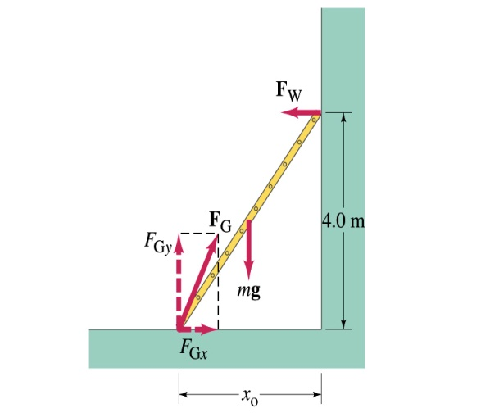
Example: Ladder Balance
A 5.0 m long ladder leans against a wall at a point 4.0m above the ground. The ladder is uniform and has mass 12.0kg. Assuming the wall is frictionless (but ground is not), determine the forces exerted on the ladder by the ground and the wall.
F_{W}
First the translational equilibrium, using components
FBD
F_{Gy}
mg
O
F_{Gx}
Thus, the y component of the force by the ground is
The length x₀ is, from Pythagorian theorem

Slide 15
Example cont’d
From the rotational equilibrium
Thus the force exerted on the ladder by the wall is
The x component of the force by the ground is
Solve for F_{Gx}
Thus the force exerted on the ladder by the ground is
The angle between the ground force to the floor

