Slide 1
PHYS 1443 – Section 004 Lecture #21
Thursday, Nov. 6, 2014
Dr. Jaehoon Yu
Elastic Properties of Solids
Density and Specific Gravity
Fluid and Pressure
Variation of Pressure and Depth
Pascal’s Principle
Today’s homework is homework #11, due 11pm, Tuesday, Nov. 11!!

Slide 2
Announcements
Reminder 2nd Non-comprehensive term exam
In class 9:30 – 10:50am, Thursday, Nov. 13
Covers CH 10.1 through what we finish Tuesday, Nov. 11
Mixture of multiple choice and free response problems
Bring your calculator but DO NOT input formula into it!
Your phones or portable computers are NOT allowed as a replacement!
You can prepare a one 8.5x11.5 sheet (front and back) of handwritten formulae and values of constants for the exam
None of the parts of the solutions of any problems
No derived formulae, derivations of equations or word definitions!
Do NOT Miss the exam!
No class Tuesday, Nov. 11, for your exam preparations!

Slide 3
Elastic Properties of Solids
We have been assuming that the objects do not change their shapes when external forces are exerting on it. It this realistic?
No. In reality, objects get deformed as external forces act on it, though the internal forces resist the deformation as it takes place.
Deformation of solids can be understood in terms of Stress and Strain
Stress: The amount of the deformation force per unit area the object is subjected
Strain: The measure of the degree of deformation
It is empirically known that for small stresses, strain is proportional to stress
The constants of proportionality are called Elastic Modulus
Three types of Elastic Modulus
Young’s modulus: Measure of the elasticity in a length
Shear modulus: Measure of the elasticity in an area
Bulk modulus: Measure of the elasticity in a volume

Slide 4
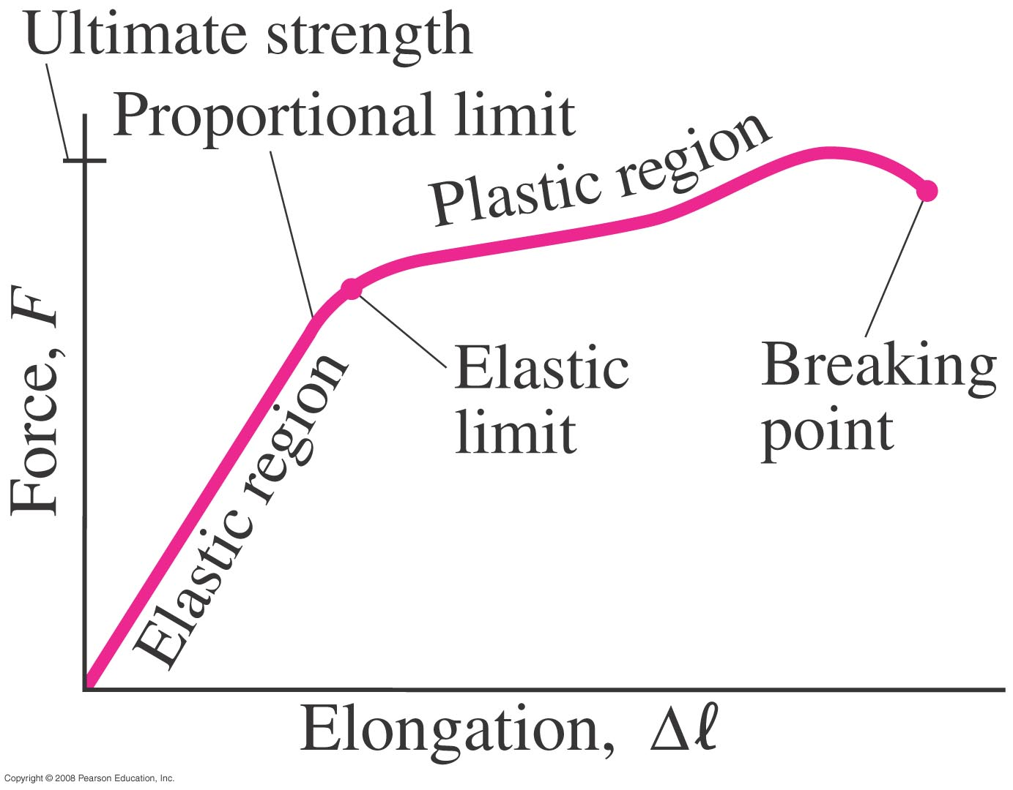
Elastic Limit and Ultimate Strength
Elastic limit: The limit of elasticity beyond which an object cannot recover its original shape or the maximum stress that can be applied to the substance before it becomes permanently deformed
Ultimate strength: The maximum force that can be applied on the object before breaking it

Slide 5
Young’s Modulus
Let’s consider a long bar with cross sectional area A and initial length L_{i}.
L_{i}
After the stretch
L_{f}=L_{i}+ΔL
F_{ex}
F_{ex}
F_{in}
A:cross sectional area
F_{ex}=F_{in}
Tensile stress
Tensile strain
Used to characterize a rod or wire stressed under tension or compression
Young’s Modulus is defined as
What is the unit of Young’s Modulus?
Force per unit area
Experimental Observations
For a fixed external force, the change in length is proportional to the original length
The necessary force to produce the given strain is proportional to the cross sectional area

Slide 6
Bulk Modulus
Bulk Modulus characterizes the response of a substance to uniform squeezing or reduction of pressure.
F
V
After the pressure change
F
V’
F
F
Volume stress =pressure
If the pressure on an object changes by ΔP=ΔF/A, the object will undergo a volume change ΔV.
Bulk Modulus is defined as
Because the change of volume is reverse to change of pressure.
Compressibility is the reciprocal of Bulk Modulus

Slide 7
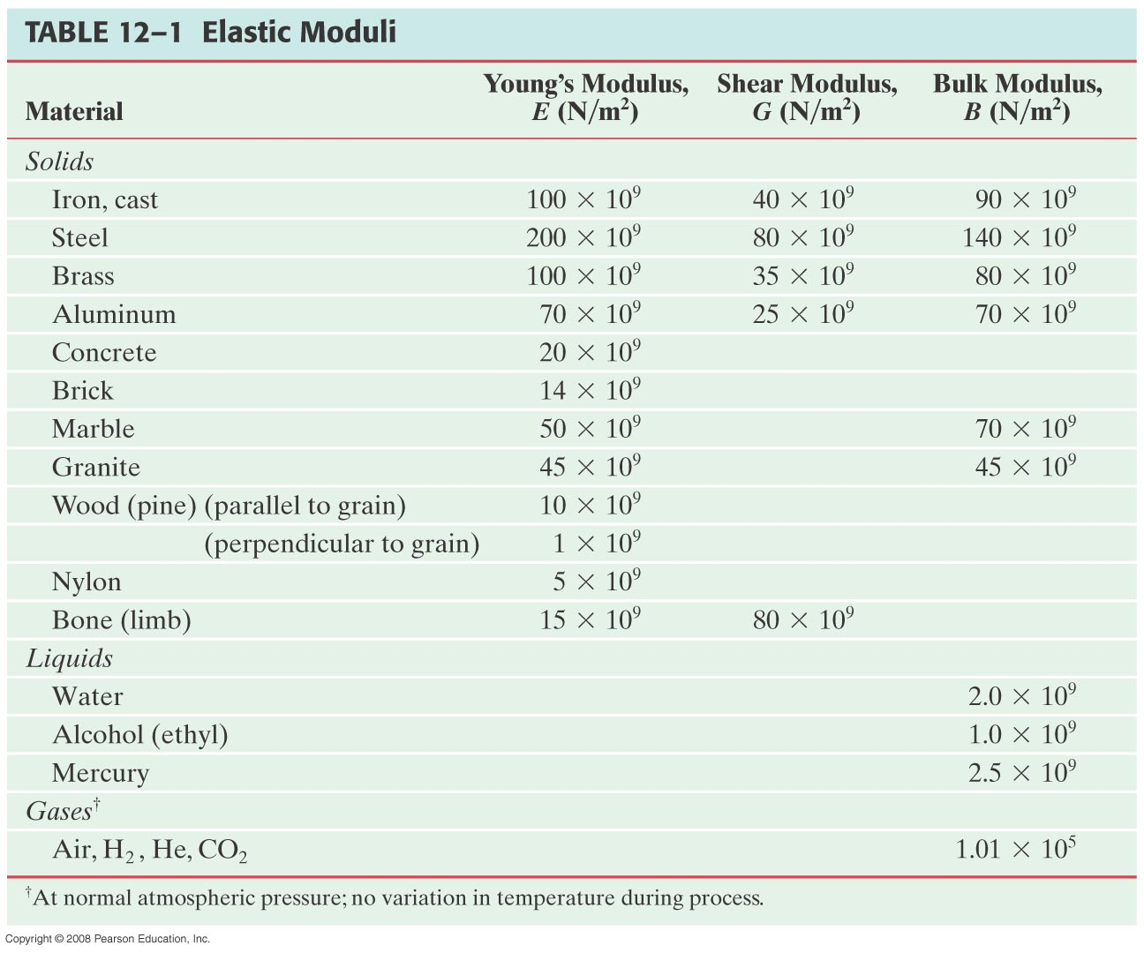
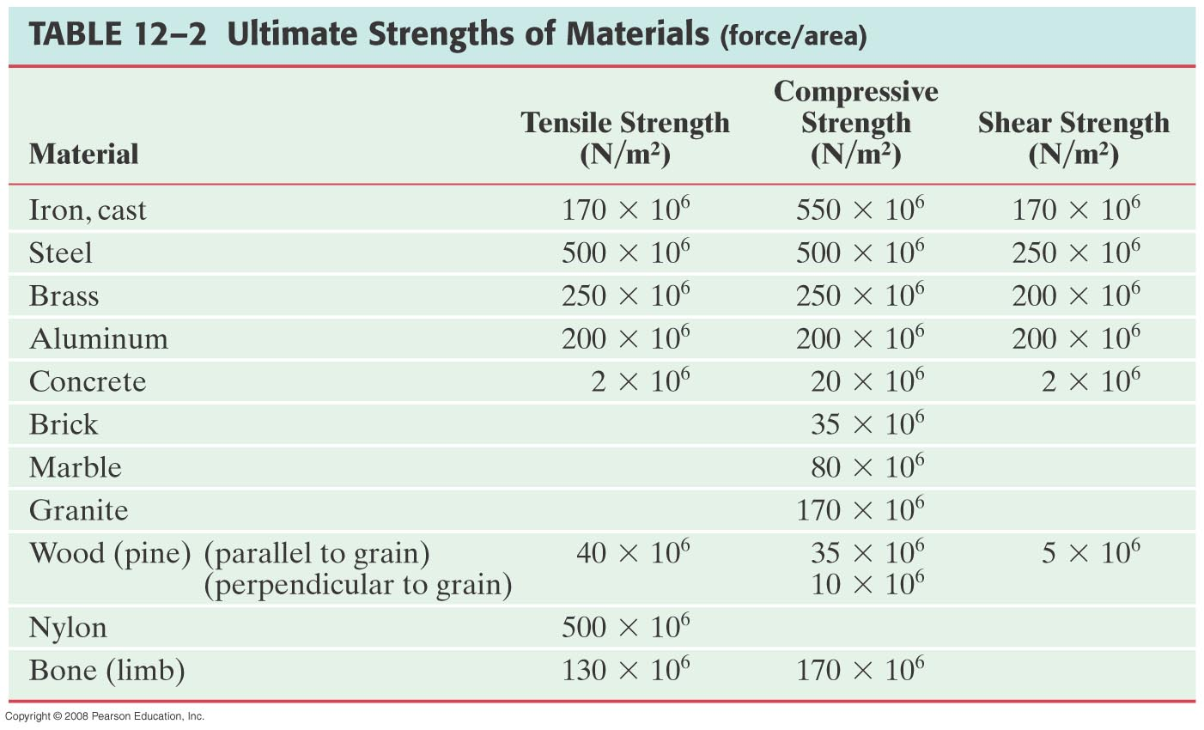
Elastic Moduli and Ultimate Strengths of Materials

Slide 8
Example for Solid’s Elastic Property
A solid brass sphere is initially under normal atmospheric pressure of 1.0x10⁵N/m². The sphere is lowered into the ocean to a depth at which the pressures is 2.0x10⁷N/m². The volume of the sphere in air is 0.5m³. By how much its volume change once the sphere is submerged?
Since bulk modulus is
The amount of volume change is
From table 12.1, bulk modulus of brass is 8.0x10¹⁰ N/m²
The pressure change ΔP is
Therefore the resulting volume change ΔV is
The volume has decreased.

Slide 9
Density and Specific Gravity
Density, ρ(rho), of an object is defined as mass per unit volume
Unit?
Dimension?
Specific Gravity of a substance is defined as the ratio of the density of the substance to that of water at 4.0 ºC (ρ_{H2O}=1.00g/cm³).
Unit?
None
Dimension?
None
What do you think would happen of a substance in the water dependent on SG?
Sink in the water
Float on the surface

Slide 10
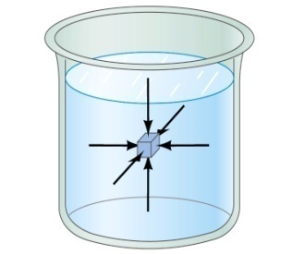
Fluid and Pressure
What are the three states of matter?
Solid, Liquid and Gas
How do you distinguish them?
Using the time it takes for a particular substance to change its shape in reaction to external forces.
What is a fluid?
A collection of molecules that are randomly arranged and loosely bound by forces between them or by an external container.
We will first learn about mechanics of fluid at rest, fluid statics.
In what ways do you think fluid exerts stress on the object submerged in it?
Fluid cannot exert shearing or tensile stress. Thus, the only force the fluid exerts on an object immersed in it is the force perpendicular to the surface of the object.
This force by the fluid on an object usually is expressed in the form of the force per unit area at the given depth, the pressure, defined as
Expression of pressure for an infinitesimal area dA by the force dF is
Note that pressure is a scalar quantity because it’s the magnitude of the force on a surface area A.
What is the unit and the dimension of pressure?
Unit:N/m²
Dim.: [M][L⁻¹][T⁻²]
Special SI unit for pressure is Pascal

Slide 11
Example for Pressure
The mattress of a water bed is 2.00m long by 2.00m wide and 30.0cm deep. a) Find the weight of the water in the mattress.
The volume density of water at the normal condition (4ºC and 1 atm) is 1000kg/m³. So the total mass of the water in the mattress is
Therefore the weight of the water in the mattress is
b) Find the pressure exerted by the water on the floor when the bed rests in its normal position, assuming the entire lower surface of the mattress makes contact with the floor.
Since the surface area of the mattress is 4.00 m², the pressure exerted on the floor is

Slide 12
Variation of Pressure and Depth
Water pressure increases as a function of depth, and the air pressure decreases as a function of altitude. Why?
P₀A
It seems that the pressure has a lot to do with the total mass of the fluid above the object that puts weight on the object.
Let’s imagine the liquid contained in a cylinder with height h and the cross sectional area A immersed in a fluid of density ρ at rest, as shown in the figure, and the system is in its equilibrium.
h
Mg
If the liquid in the cylinder is the same substance as the fluid, the mass of the liquid in the cylinder is
PA
Since the system is in its equilibrium
Therefore, we obtain
The pressure at the depth h below the surface of the fluid open to the atmosphere is greater than the atmospheric pressure by ρgh.
Atmospheric pressure P₀ is

Slide 13
Pascal’s Principle and Hydraulics
A change in the pressure applied to a fluid is transmitted undiminished to every point of the fluid and to the walls of the container.
What happens if P₀is changed?
The resultant pressure P at any given depth h increases as much as the change in P₀.
This is the principle behind hydraulic pressure. How?
A₂
Since the pressure change caused by the the force F₁ applied onto the area A₁ is transmitted to the F₂ on an area A₂.
d₁
F₁
d₂
A₁
F₂
In other words, the force gets multiplied by the ratio of the areas A₂/A₁ and is transmitted to the force F₂ on the surface.
Therefore, the resultant force F₂ is
This seems to violate some kind of conservation law, doesn’t it?
No, the actual displaced volume of the fluid is the same. And the work done by the forces are still the same.

Slide 14
Example for Pascal’s Principle
In a car lift used in a service station, compressed air exerts a force on a small piston that has a circular cross section and a radius of 5.00cm. This pressure is transmitted by a liquid to a piston that has a radius of 15.0cm. What force must the compressed air exert to lift a car weighing 13,300N? What air pressure produces this force?
Using the Pascal’s principle, one can deduce the relationship between the forces, the force exerted by the compressed air is
Therefore the necessary pressure of the compressed air is

Slide 15
Example for Pascal’s Principle
Estimate the force exerted on your eardrum due to the water above when you are swimming at the bottom of the pool with a depth 5.0 m. Assume the surface area of the eardrum is 1.0cm².
We first need to find out the pressure difference that is being exerted on the eardrum. Then estimate the area of the eardrum to find out the force exerted on the eardrum.
Since the outward pressure in the middle of the eardrum is the same as normal air pressure
Estimating the surface area of the eardrum at 1.0cm²=1.0x10⁻⁴ m², we obtain

Slide 16
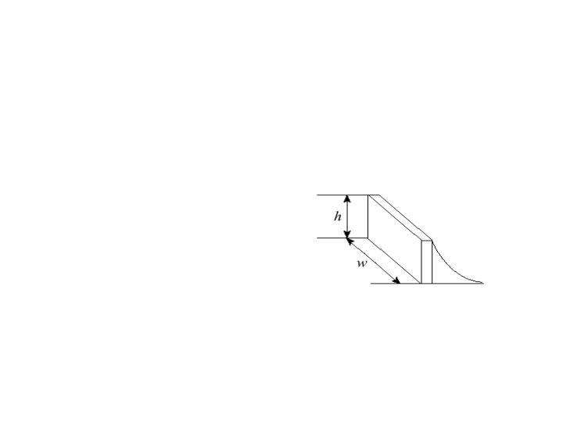
Example for Pascal’s Principle
Water is filled to a height H behind a dam of width w. Determine the resultant force exerted by the water on the dam.
Since the water pressure varies as a function of depth, we will have to do some calculus to figure out the total force.
H
h
The pressure at the depth h is
dy
y
The infinitesimal force dF exerting on a small strip of dam dy is
Therefore the total force exerted by the water on the dam is

