Slide 1
PHYS 1443 – Section 004 Lecture #22
Tuesday, Nov. 18, 2014
Dr. Jaehoon Yu
Absolute and Relative Pressure
Archimedes Principle
Equation of Continuity
Bernoulli’s Principle
Simple Harmoic Motion
Today’s homework is homework #12, due 11pm, Tuesday, Nov. 25!!

Slide 2
Absolute and Relative Pressure
How can one measure pressure?
One can measure the pressure using an open-tube manometer where one end is connected to the system with unknown pressure P and the other open to air with pressure P₀.
P
P₀
h
The measured pressure of the system is
This is called the absolute pressure, because it is the actual value of the system’s pressure.
In many cases we measure the pressure difference with respect to the atmospheric pressure to avoid the effect of the changes in P₀ that depends on the environment. This is called gauge or relative pressure.
The common barometer which consists of a mercury column with one end closed at vacuum and the other open to the atmosphere was invented by Evangelista Torricelli.
Since the closed end is at vacuum, it does not exert any force. 1 atm of air pressure pushes mercury up 76cm. So 1 atm is
If one measures the tire pressure with a gauge at 220kPa the actual pressure is 101kPa+220kPa=303kPa.

Slide 3
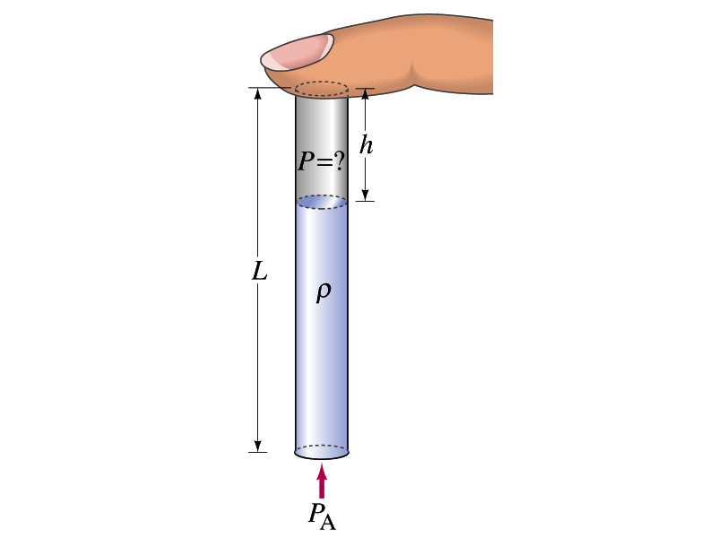
Finger Holds Water in Straw
You insert a straw of length L into a tall glass of your favorite beverage. You place your finger over the top of the straw so that no air can get in or out, and then lift the straw from the liquid. You find that the straw strains the liquid such that the distance from the bottom of your finger to the top of the liquid is h. Does the air in the space between your finger and the top of the liquid in the straw have a pressure P that is (a) greater than, (b) equal to, or (c) less than, the atmospheric pressure P_{A} outside the straw?
p_{in}A
Less
What are the forces in this problem?
Gravitational force on the mass of the liquid
Force exerted on the top surface of the liquid by inside air pressure
Force exerted on the bottom surface of the liquid by the outside air
mg
Since it is at equilibrium
Cancel A and
solve for p_{in}
p_{A}A
So p_{in} is less than P_{A} by ρg(L-h).

Slide 4
Buoyant Forces and Archimedes’ Principle
Why is it so hard to put an inflated beach ball under water while a small piece of steel sinks in the water easily?
The water exerts force on an object immersed in the water.
This force is called the buoyant force.
How large is the buoyant force?
The magnitude of the buoyant force always equals the weight of the fluid in the volume displaced by the submerged object.
This is called the Archimedes’ principle. What does this mean?
Let‘s consider a cube whose height h and cross sectional area A is filled with fluid and in its equilibrium so that its weight Mg is balanced by the buoyant force B.
The pressure at the bottom of the cube is larger than the top by ρgh.
h
B
Therefore,
Mg
Where Mg is the weight of the fluid in the cube.

Slide 5
More Archimedes’ Principle
Let’s consider the buoyant force in two special cases.
Case 1: Totally submerged object
Let’s consider an object of mass M, with density ρ₀, is fully immersed in the fluid with density ρ_{f} .
The magnitude of the buoyant force is
The weight of the object is
h
Mg
B
Therefore total force in the system is
What does this tell you?
The total force applies to different directions depending on the difference of the density between the object and the fluid.
If the density of the object is smaller than the density of the fluid, the buoyant force will push the object up to the surface.
If the density of the object is larger than the fluid’s, the object will sink to the bottom of the fluid.

Slide 6
More Archimedes’ Principle
Case 2: Floating object
Let’s consider an object of mass M, with density ρ₀, is in static equilibrium floating on the surface of the fluid with density ρ_{f} , and the volume submerged in the fluid is V_{f}.
h
Mg
B
The magnitude of the buoyant force is
The weight of the object is
Therefore total force of the system is
Since the system is in static equilibrium
What does this tell you?
Since the object is floating, its density is smaller than that of the fluid.
The ratio of the densities between the fluid and the object determines the submerged volume under the surface.

Slide 7
Ex. for Archimedes’ Principle
Archimedes was asked to determine the purity of the gold used in the crown. The legend says that he solved this problem by weighing the crown in air and in water. Suppose the scale read 7.84N in air and 6.86N in water. What should he have to tell the king about the purity of the gold in the crown?
In the air the tension exerted by the scale on the object is the weight of the crown
In the water the tension exerted by the scale on the object is
Therefore the buoyant force B is
Since the buoyant force B is
The volume of the displaced water by the crown is
Therefore the density of the crown is
Since the density of pure gold is 19.3x10³kg/m³, this crown is not made of pure gold.

Slide 8
Example for Buoyant Force
What fraction of an iceberg is submerged in the sea water?
Let’s assume that the total volume of the iceberg is V_{i}. Then the weight of the iceberg F_{gi} is
Let’s then assume that the volume of the iceberg submerged in the sea water is V_{w}. The buoyant force B caused by the displaced water becomes
Since the whole system is at its static equilibrium, we obtain
Therefore the fraction of the volume of the iceberg submerged under the surface of the sea water is
About 90% of the entire iceberg is submerged in the water!!!

Slide 9
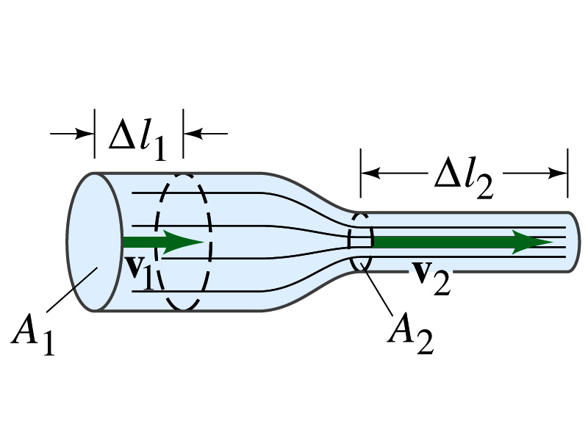
Flow Rate and the Equation of Continuity
Study of fluid in motion: Fluid Dynamics
If the fluid is water:
Water dynamics??
Hydro-dynamics
Streamline or Laminar flow: Each particle of the fluid follows a smooth path, a streamline
Turbulent flow: Erratic, small, whirlpool-like circles called eddy current or eddies which absorbs a lot of energy
Two primary types of flows
Flow rate: the mass of fluid that passes the given point per unit time
since the total flow must be conserved
Equation of Continuity

Slide 10
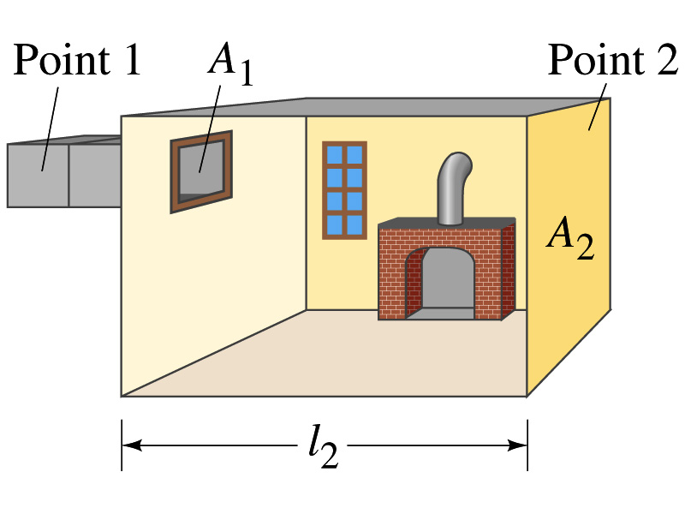
Ex. for Equation of Continuity
How large must a heating duct be if the air moving at 3.0m/s through it can replenish the air in a room of 300m³ volume every 15 minutes? Assume the density of the air remains constant.
Using equation of continuity
Since the air density is constant
Now let’s imagine the room as the large section of the duct

