Slide 1
PHYS 1443 – Section 004 Lecture #23
Thursday, Nov. 20, 2014
Dr. Jaehoon Yu
Bernoulli’s Principle
Simple Block-Spring System
Solution for SHM
Energy of the Simple Harmonic Oscillator

Slide 2
Announcements
Last Quiz
Beginning of the class coming Tuesday, Nov. 25
Covers CH14.1 through what we finish today (CH15.1?)
BYOF
Final comprehensive exam
In this room, 9:00 – 10:30am, Thursday, Dec. 11
Covers CH 1.1 through what we finish Tuesday, Dec. 2 plus the math refresher
Mixture of multiple choice and free response problems
Bring your calculator but DO NOT input formula into it!
Your phones or portable computers are NOT allowed as a replacement!
You can prepare a one 8.5x11.5 sheet (front and back) of handwritten formulae and values of constants for the exam
None of the parts of the solutions of any problems
No derived formulae, derivations of equations or word definitions!
Do NOT Miss the exam!

Slide 3
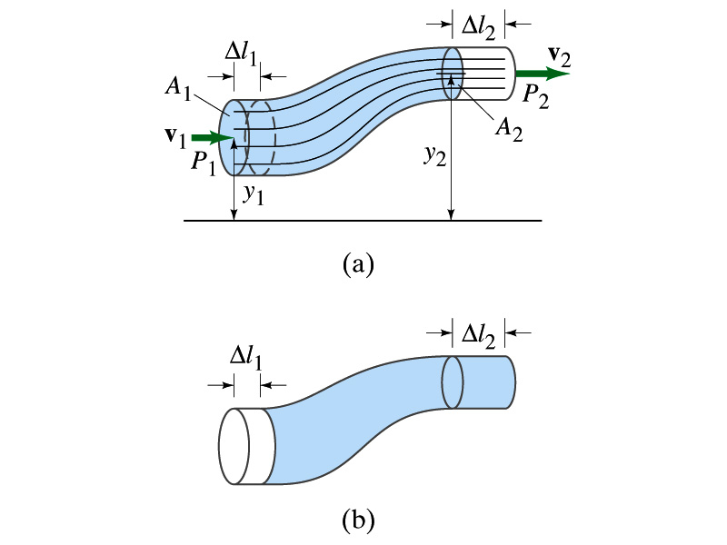
Bernoulli’s Principle
Bernoulli’s Principle: Where the velocity of fluid is high, the pressure is low, and where the velocity is low, the pressure is high.
Amount of the work done by the force, F₁, that exerts pressure, P₁, at point 1
Amount of the work done by the force on the other section of the fluid is
Work done on the gravitational force to move the fluid mass, m, from y₁ to y₂ is

Slide 4
Bernoulli’s Equation cont’d
The total amount of the work done on the fluid is
From the work- kinetic energy principle
Since the mass m is contained in the volume that flowed in the motion
and
Thus,

Slide 5
Bernoulli’s Equation cont’d
Since
We obtain
Re-organize
Bernoulli’s Equation
Thus, for any two points in the flow
Result of Energy conservation!
Pascal’s Law
For static fluid
For the same heights
The pressure at the faster section of the fluid is smaller than slower section.

Slide 6
Ex. for Bernoulli’s Equation
Water circulates throughout a house in a hot-water heating system. If the water is pumped at the speed of 0.5m/s through a 4.0cm diameter pipe in the basement under a pressure of 3.0atm, what will be the flow speed and pressure in a 2.6cm diameter pipe on the second 5.0m above? Assume the pipes do not divide into branches.
Using the equation of continuity, flow speed on the second floor is
Using Bernoulli’s equation, the pressure in the pipe on the second floor is

Slide 7
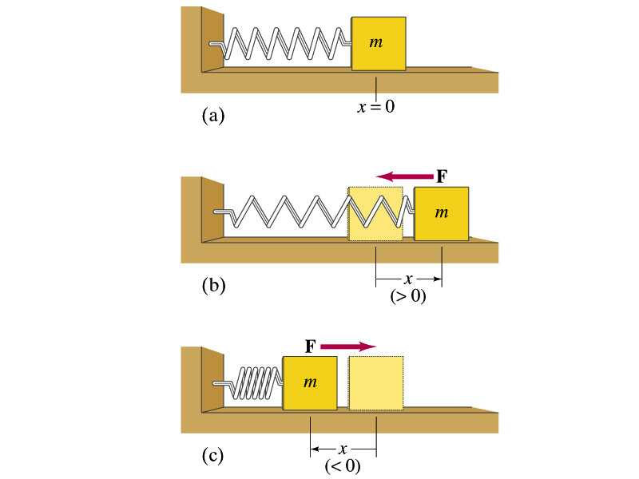
Vibration or Oscillation
Tuning fork
A pendulum
A car going over a bump
Buildings and bridges
The spider web with a prey
What are the things that vibrate/oscillate?
So what is a vibration or oscillation?
A periodic motion that repeats over the same path.
A simplest case is a block attached at the end of a coil spring.

Slide 8
Simple Harmonic Motion
A motion that is caused by a force that depends on displacement, and the force is always directed toward the system’s equilibrium position.
When a spring is stretched from its equilibrium position by a length x, the force acting on the mass is
It’s negative, because the force resists against the change of length, directed toward the equilibrium position.
From Newton’s second law
we obtain
This is a second order differential equation that can be solved but it is beyond the scope of this class.
Condition for simple harmonic motion
What do you observe from this equation?
Acceleration is proportional to displacement from the equilibrium.
Acceleration is opposite direction to the displacement.
This system is doing a simple harmonic motion (SHM).

Slide 9
Equation of Simple Harmonic Motion
The solution for the 2nd order differential equation
Generalized expression of a simple harmonic motion
Amplitude
Phase
Angular Frequency
Phase constant
Let’s think about the meaning of this equation of motion
What happens when t=0 and ϕ=0?
What is φ if x is not A at t=0?
An oscillation is fully characterized by its:
Amplitude
Period or frequency
Phase constant
What are the maximum/minimum possible values of x?
A/-A

Slide 10
Vibration or Oscillation Properties
The maximum displacement from the equilibrium is
Amplitude
One cycle of the oscillation
The complete to-and-fro motion from an initial point
Period of the motion, T
The time it takes to complete one full cycle
Unit?
sec
Frequency of the motion, f
The number of complete cycles per second
Unit?
s⁻¹
Relationship between period and frequency?
or

Slide 11
More on Equation of Simple Harmonic Motion
What is the time for full cycle of oscillation?
Since after a full cycle the position must be the same
The period
One of the properties of an oscillatory motion
How many full cycles of oscillation does this undergo per unit time?
What is the unit?
Frequency
1/s=Hz
Let’s now think about the object’s speed and acceleration.
Speed at any given time
Max speed
Max acceleration
Acceleration at any given time
What do we learn about acceleration?
Acceleration is reverse direction to displacement
Acceleration and speed are π/2 off phase of each other:
When v is maximum, a is at its minimum

Slide 12
Simple Harmonic Motion continued
Phase constant determines the starting position of a simple harmonic motion.
At t=0
This constant is important when there are more than one harmonic oscillation involved in the motion and to determine the overall effect of the composite motion
Let’s determine phase constant and amplitude
At t=0
By taking the ratio, one can obtain the phase constant
By squaring the two equations and adding them together, one can obtain the amplitude

Slide 13
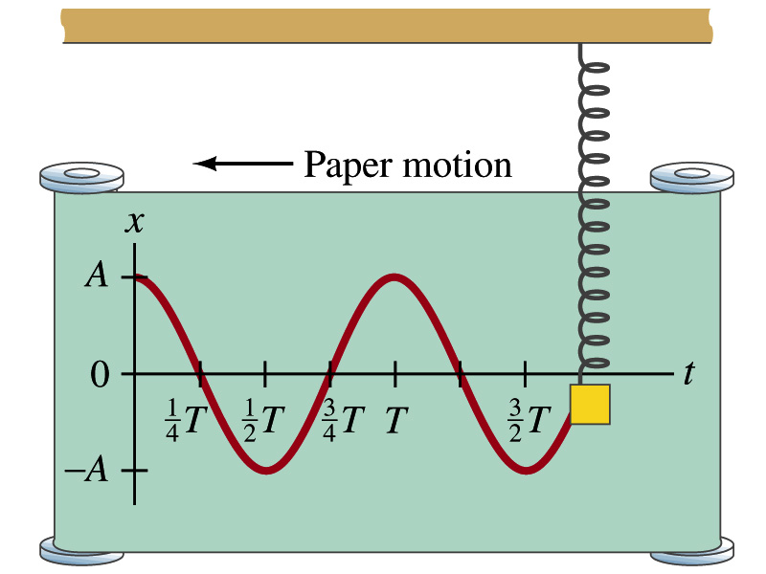
Sinusoidal Behavior of SHM
What do you think the trajectory will look if the oscillation was plotted against time?

Slide 14
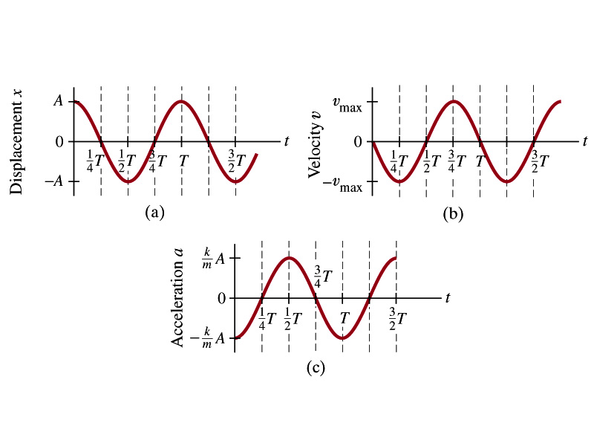
Sinusoidal Behavior of SHM

Slide 15
Example for A Simple Harmonic Motion
An object oscillates with simple harmonic motion along the x-axis. Its displacement from the origin varies with time according to the equation; where t is in seconds and the angles in the parentheses are in radians. a) Determine the amplitude, frequency, and period of the motion.
From the equation of motion:
The amplitude, A, is
The angular frequency, ϖ, is
Therefore, frequency and period are
b)Calculate the velocity and acceleration of the object at any time t.
Taking the first derivative on the equation of motion, the velocity is
By the same token, taking the second derivative of equation of motion, the acceleration, a, is

Slide 16
Simple Block-Spring System
A block attached at the end of a spring on a frictionless surface experiences acceleration when the spring is displaced from an equilibrium position.
This becomes a second order differential equation
If we denote
The resulting differential equation becomes
Since this satisfies condition for simple harmonic motion, we can take the solution
Does this solution satisfy the differential equation?
Let’s take derivatives with respect to time
Now the second order derivative becomes
Whenever the force acting on an object is linearly proportional to the displacement from some equilibrium position and is in the opposite direction, the particle moves in simple harmonic motion.

Slide 17
More Simple Block-Spring System
How do the period and frequency of this harmonic motion look?
Since the angular frequency ϖ is
What can we learn from these?
Frequency and period do not depend on amplitude
Period is inversely proportional to spring constant and proportional to mass
The period, T, becomes
So the frequency is
Let’s consider that the spring is stretched to a distance A, and the block is let go from rest, giving 0 initial speed; x_{i}=A, v_{i}=0,
Special case #1
This equation of motion satisfies all the SHM conditions. So it is the solution for this motion.
Special case #2
Suppose a block is given non-zero initial velocity v_{i} to positive x at the instant it is at the equilibrium, x_{i}=0
Is this a good solution?

Slide 18
Example for Spring Block System
A car with a mass of 1300kg is constructed so that its frame is supported by four springs. Each spring has a force constant of 20,000N/m. If two people riding in the car have a combined mass of 160kg, find the frequency of vibration of the car after it is driven over a pothole in the road.
Let’s assume that mass is evenly distributed to all four springs.
The total mass of the system is 1460kg.
Therefore each spring supports 365kg each.
From the frequency relationship based on Hook’s law
Thus the frequency for vibration of each spring is
How long does it take for the car to complete two full vibrations?
The period is
For two cycles

Slide 19
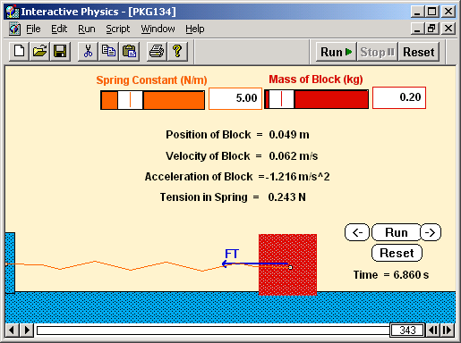
Example for Spring Block System
A block with a mass of 200g is connected to a light spring for which the force constant is 5.00 N/m and is free to oscillate on a horizontal, frictionless surface. The block is displaced 5.00 cm from equilibrium and released from reset. Find the period of its motion.
From the Hook’s law, we obtain
X=0.05
As we know, period does not depend on the amplitude or phase constant of the oscillation, therefore the period, T, is simply
X=0
Determine the maximum speed of the block.
From the general expression of the simple harmonic motion, the speed is

