Slide 1
PHYS 1443 – Section 004 Lecture #24
Tuesday, Nov. 25, 2014
Dr. Jaehoon Yu
Refresher: Simple Block-Spring system
Energy of the Simple Harmonic Oscillator
Pendulum
Simple Pendulum
Physical Pendulum
Torsion Pendulum
SHM & Uniform Circular Motion
Superposition and Interference
Today’s homework is homework #13, due 11pm, Tuesday, Dec. 2!!

Slide 2
Announcements
Final comprehensive exam
In this room, 9:00 – 10:30am, Thursday, Dec. 11 in this room
Covers CH 1.1 through what we finish Tuesday, Dec. 2 plus the math refresher
Mixture of multiple choice and free response problems
Bring your calculator but DO NOT input formula into it!
Your phones or portable computers are NOT allowed as a replacement!
You can prepare a one 8.5x11.5 sheet (front and back) of handwritten formulae and values of constants for the exam
None of the parts of the solutions of any problems
No derived formulae, derivations of equations or word definitions!
Do NOT Miss the exam!
Happy Thanksgiving!

Slide 3
Refresher: Simple Block-Spring System
A block attached at the end of a spring on a frictionless surface experiences acceleration when the spring is displaced from an equilibrium position.
This becomes a second order differential equation
If we denote
The resulting differential equation becomes
Since this satisfies condition for simple harmonic motion, we can take the solution
Does this solution satisfy the differential equation?
Let’s take derivatives with respect to time
Now the second order derivative becomes
Whenever the force acting on an object is linearly proportional to the displacement from some equilibrium position and is in the opposite direction, the particle moves in simple harmonic motion.

Slide 4
Refresher: Simple Block-Spring System
How do the period and frequency of this harmonic motion look?
Since the angular frequency ϖ is
What can we learn from these?
Frequency and period do not depend on amplitude
Period is inversely proportional to spring constant and proportional to mass
The period, T, becomes
So the frequency is
Let’s consider that the spring is stretched to a distance A, and the block is let go from rest, giving 0 initial speed; x_{i}=A, v_{i}=0,
Special case #1
This equation of motion satisfies all the SHM conditions. So it is the solution for this motion.
Special case #2
Suppose a block is given non-zero initial velocity v_{i} to positive x at the instant it is at the equilibrium, x_{i}=0
Is this a good solution?

Slide 5
Example for Spring Block System
A car with a mass of 1300kg is constructed so that its frame is supported by four springs. Each spring has a force constant of 20,000N/m. If two people riding in the car have a combined mass of 160kg, find the frequency of vibration of the car after it is driven over a pothole in the road.
Let’s assume that mass is evenly distributed to all four springs.
The total mass of the system is 1460kg.
Therefore each spring supports 365kg each.
From the frequency relationship based on Hook’s law
Thus the frequency for vibration of each spring is
How long does it take for the car to complete two full vibrations?
The period is
For two cycles

Slide 6
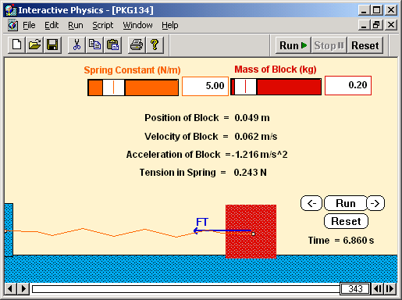
Example for Spring Block System
A block with a mass of 200g is connected to a light spring for which the force constant is 5.00 N/m and is free to oscillate on a horizontal, frictionless surface. The block is displaced 5.00 cm from equilibrium and released from reset. Find the period of its motion.
From the Hook’s law, we obtain
X=0.05
As we know, period does not depend on the amplitude or phase constant of the oscillation, therefore the period, T, is simply
X=0
Determine the maximum speed of the block.
From the general expression of the simple harmonic motion, the speed is

Slide 7
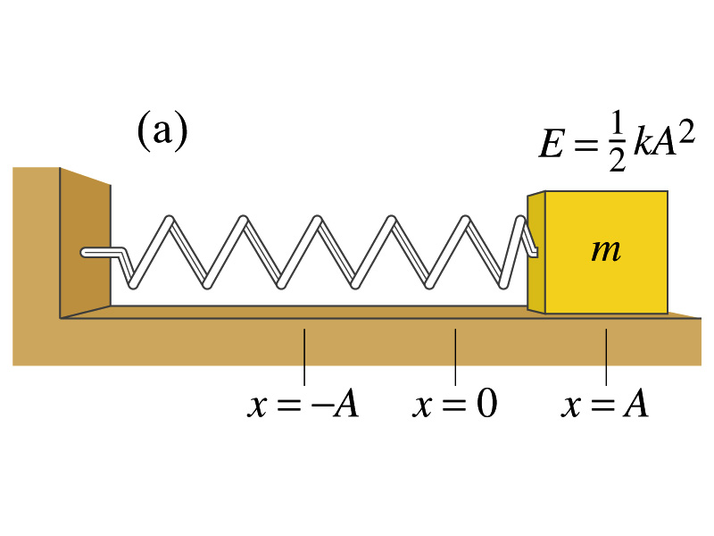
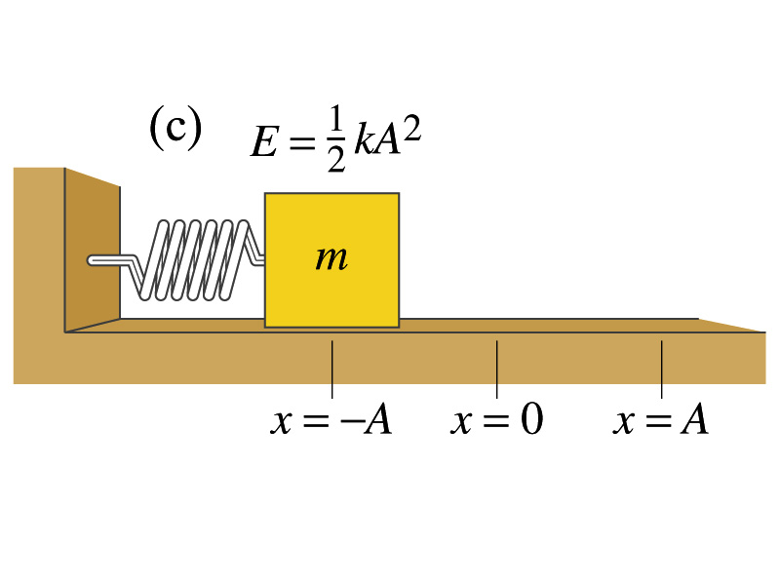
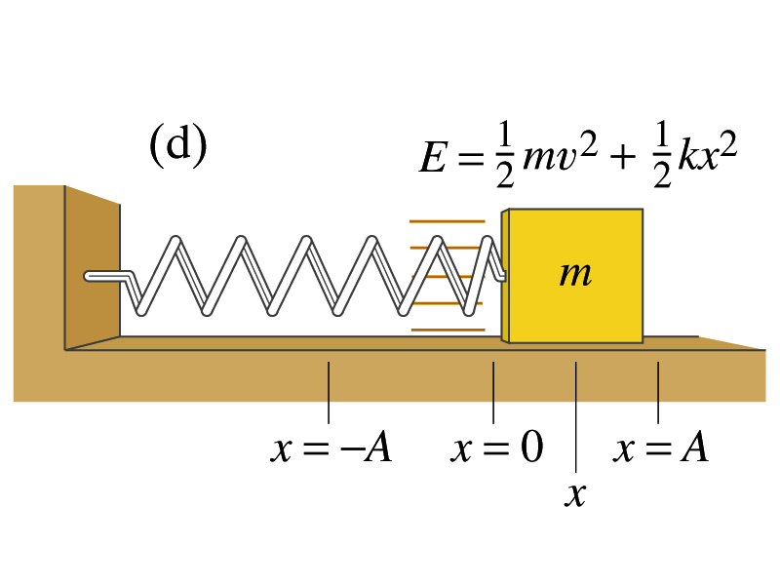
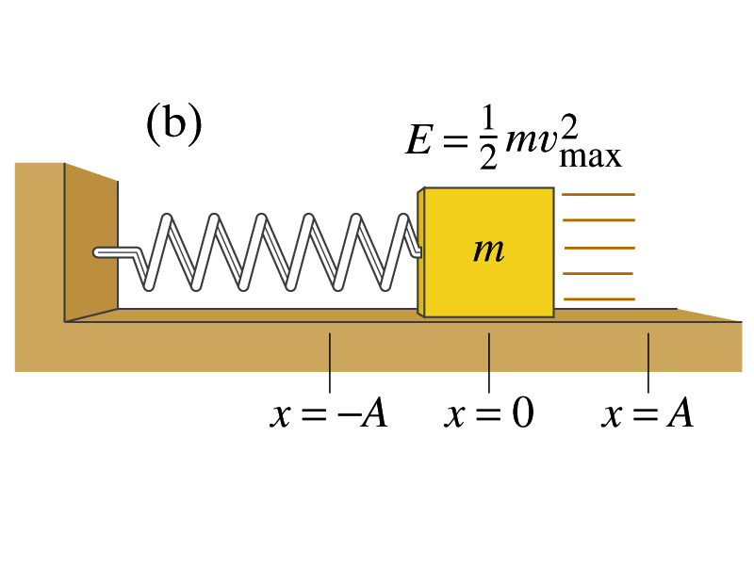
Energy of the Simple Harmonic Oscillator
What do you think the mechanical energy of the harmonic oscillator look without friction?
Kinetic energy of a harmonic oscillator is
The elastic potential energy stored in the spring
Therefore the total mechanical energy of the harmonic oscillator is
Since
Total mechanical energy of a simple harmonic oscillator is proportional to the square of the amplitude.

Slide 8
Energy of the Simple Harmonic Oscillator cont’d
Maximum KE is when PE=0
Maximum speed
The speed at any given point of the oscillation
KE/PE
E=KE+PE=kA²/2
-A
A
x

Slide 9
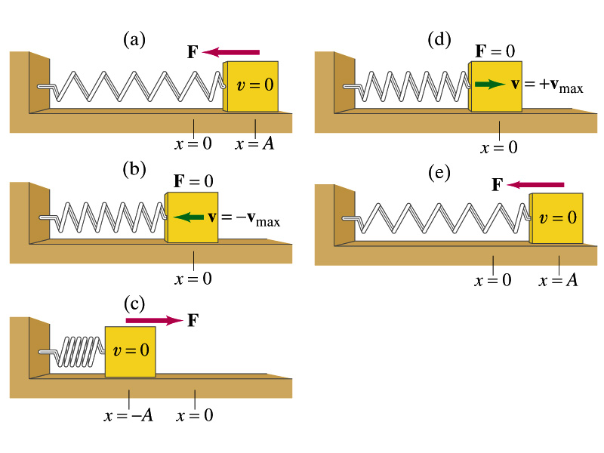
Oscillation Properties
Amplitude?
A
When is the force greatest?
When is the speed greatest?
When is the acceleration greatest?
When is the potential energy greatest?
When is the kinetic energy greatest?

Slide 10
Example for Energy of Simple Harmonic Oscillator
A 0.500kg cube connected to a light spring for which the force constant is 20.0 N/m oscillates on a horizontal, frictionless track. a) Calculate the total energy of the system and the maximum speed of the cube if the amplitude of the motion is 3.00 cm.
From the problem statement, A and k are
The total energy of the cube is
Maximum speed occurs when kinetic energy is the same as the total energy
b) What is the velocity of the cube when the displacement is 2.00 cm.
velocity at any given displacement is
c) Compute the kinetic and potential energies of the system when the displacement is 2.00 cm.
Kinetic energy, KE
Potential energy, PE

