Slide 1
PHYS 3446 – Lecture #3
Wednesday, Sept 7, 2016
Dr. Jae Yu
Rutherford Scattering
Rutherford Scattering with Coulomb force
Scattering Cross Section
Measurement of Cross Sections

Slide 2
Announcements
1st colloquium at 4pm today
  UTA Physics faculty expo
Physics department picnic
  12 – 3pm, Sat. Sept. 10
  1st Floor MAC

Slide 3
Reminder: Homework Assignment #1
Compute the masses of electron, proton and alpha particles in MeV/c^{2,} using E=mc². (9 points)
  Need to look up and specify the masses of electrons, protons and alpha particles in kg on your paper.
Compute the gravitational and the Coulomb forces between two protons separated by 10⁻¹⁰m and compare their strengths (15)
Derive the following equations in your book:
  Eq. # 1.3 (5 pts) , 1.17 (8 pts), 1.32 (12 pts)
  Must show detailed work and accompany explanations
  Copying the book or your friend will result in no credit for both of you!
These assignments are due coming Monday, Sept. 12.

Slide 4
Rutherford Scattering
A fixed target experiment with alpha particle as projectile shot on thin gold foil
  Alpha particle’s energy is low ➔ Speed is well below 0.1c (non-relativistic)
An elastic scattering of the particles
What are the conserved quantities in an elastic scattering?
  Momentum
  Kinetic Energy

Slide 5
Elastic Scattering
After the Collision
m_{α}
θ
m_{α}
φ
m_{t}
m_{t}
From momentum conservation
From the kinetic energy conservation
From these two, we obtain

Slide 6
Analysis Case I
If m_{t}<<m_{α},
  left-hand side becomes positive
  v_{α} and v_{t} must be in the same hemisphere
  Using the actual masses
  and
  We obtain
  If m_{t}=m_{e}, then m_{t}/m_{α}~10⁻⁴. ➔
  ➔
  Thus, momentum transfer to target is p_{e}/p_{α0}<10⁻⁴.
  Change of momentum of alpha particle is negligible

Slide 7
Analysis Case II
If m_{t}>>m_{α},
  left-hand side of the above becomes negative
  v_{α} and v_{t} are in opposite hemisphere
  Using the actual masses
  and
  We obtain so v_{t} is small
  If m_{t}=m_{Au}, then m_{t}/m_{α}~50. ➔
  ➔
  Thus, p_{e}/p_{α0} could be as large as 2p_{α0}.
  Change of momentum of alpha particle is large
    α particle can even recoil

Slide 8
Rutherford Scattering with EM Force 1
Let’s take into account only the EM force between the α and the atom
Coulomb force is a central force, so a conservative force
Coulomb potential between particles with Ze and Z’e electrical charge separated by distance r is
Since the total mechanical energy is conserved,

Slide 9
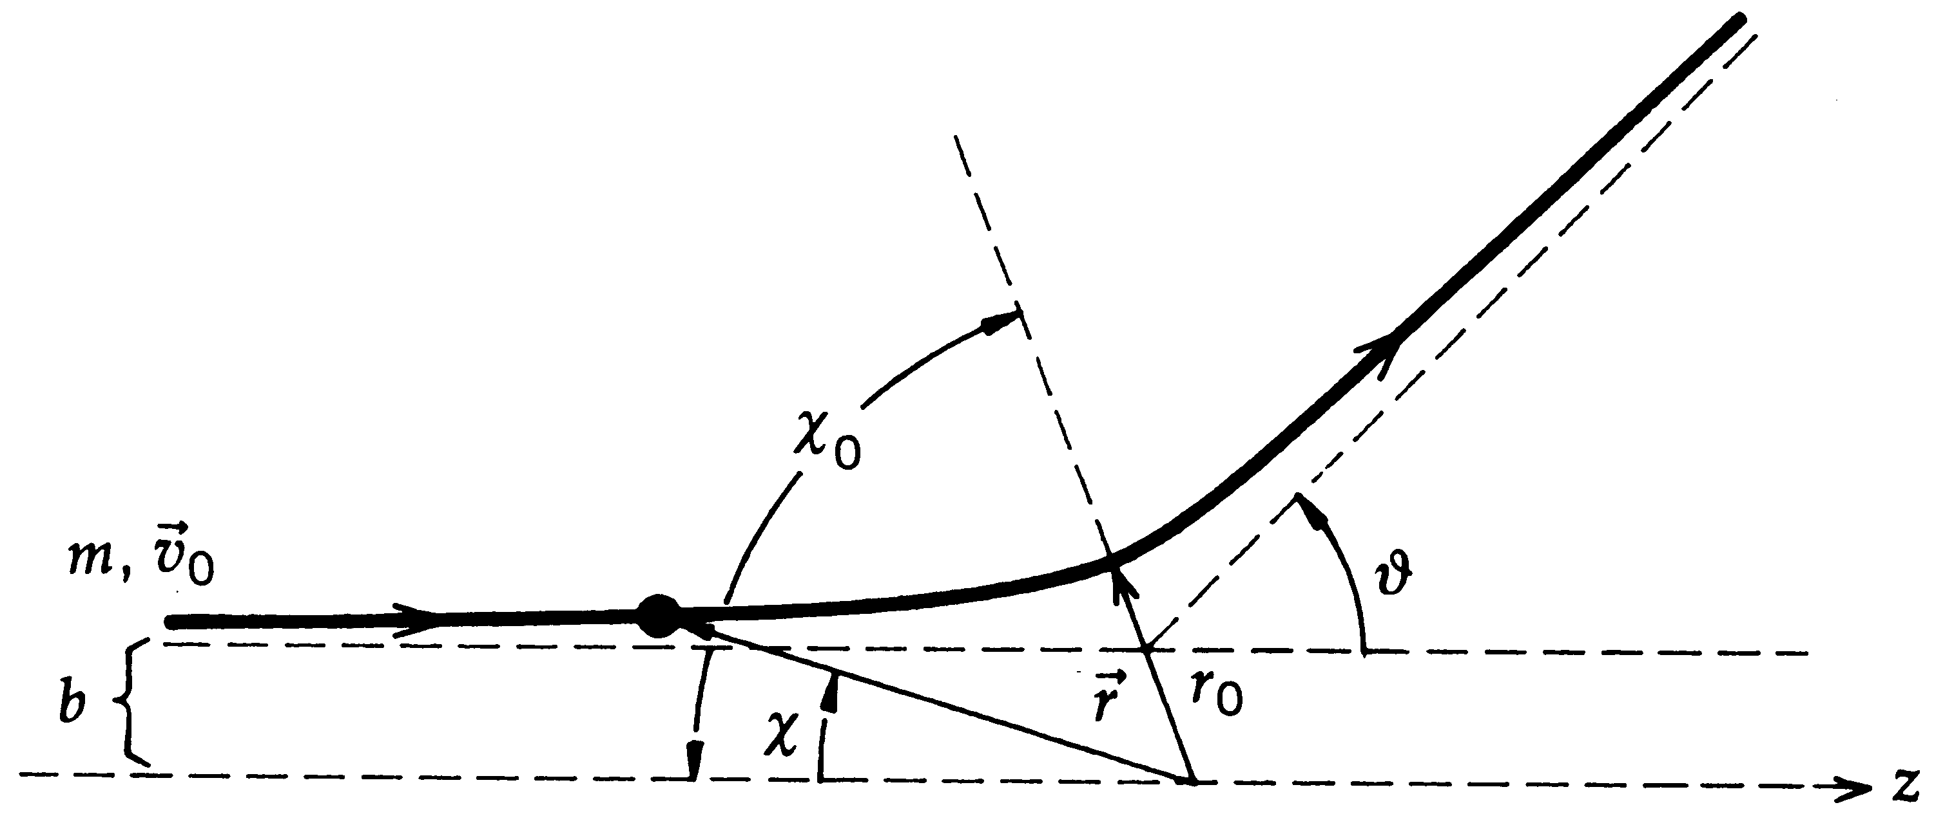
Rutherford Scattering with EM Force 2
The distance vector r is always the same direction as the force throughout the entire motion, so the net torque (rxF) is 0.
Since there is no net torque, the angular momentum (l=rxp) is conserved. ➔ The magnitude of the angular momentum is l=mv₀b.
Impact parameter
From the energy relation, we obtain
From the definition of angular momentum, we obtain an equation of motion
From energy conservation, we obtain another equation of motion
Centrifugal barrier
Effective potential

Slide 10
Rutherford Scattering with EM Force 3
Rearranging the terms for approach, we obtain
and
Integrating this from r₀ to infinity gives the angular distribution of the outgoing alpha particle
Distance of closest approach

Slide 11
Rutherford Scattering with EM Force 4
What happens at the DCA?
  Kinetic energy reduces to 0.
  The incident alpha could turn around and accelerate
  We can obtain
  This allows us to determine DCA for a given potential and χ₀.
Define scattering angle θ as the changes in the asymptotic angles of the trajectory, we obtain

Slide 12
Rutherford Scattering with EM Force 5
For a Coulomb potential
DCA can be obtained for the given impact parameter b,
And the angular distribution becomes

Slide 13
Rutherford Scattering with EM Force 6
Replace the variable 1/r=x, and performing the integration, we obtain
This can be rewritten
Solving this for b, we obtain

Slide 14
Rutherford Scattering with EM Force 7
From the solution for b, we can learn the following
  For fixed b, E and Z’
    The scattering angle is larger for a larger value of Z.
      Makes perfect sense since Coulomb potential is stronger with larger Z.
      Results in larger deflection.
  For fixed b, Z and Z’
    The scattering angle is larger when E is smaller.
      If particle has low energy, its velocity is smaller
      Spends more time in the potential, suffering greater deflection
  For fixed Z, Z’, and E
    The scattering angle is larger for smaller impact parameter b
      Makes perfect sense also, since as the incident particle is closer to the nucleus, it feels stronger Coulomb force.

Slide 15
What do we learn from scattering?
Scattering of a particle in a potential is completely determined when we know both
  The impact parameter, b, and
  The energy of the incident particle, E
For a fixed energy, the deflection is defined by
  The impact parameter, b.
What do we need to perform a scattering experiment?
  Incident flux of beam particles with known E
  A device that can measure the number of scattered particles at various scattering angle, θ.
  Measurements of the number of scattered particles reflect
    Impact parameters of the incident particles
    The effective size of the scattering center
By measuring the scattering angle θ, we can learn about the potential or the force between the target and the projectile

Slide 16
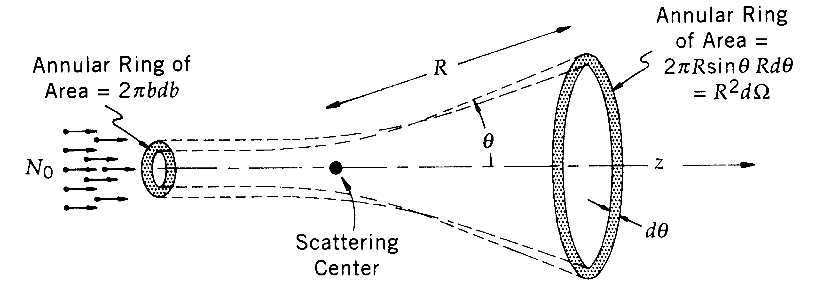
Scattering Cross Section
All these land here
N₀: The number of particles incident on the target foil per unit area per unit time.
Any incident particles entering with impact parameter b and b+db will scatter to the angle θ and θ-dθ.
In other words, they scatter into the solid angle dΩ (=2πsinθdθ).
So the number of particles scattered into the solid angle dΩ per unit time is 2πN₀bdb.

Slide 17
Scattering Cross Section
For a central potential
  Such as Coulomb potential
  Which has spherical symmetry
The scattering center presents an effective transverse x-sectional area of
For the particles to scatter into θ and θ+dθ

Slide 18
Scattering Cross Section
In more generalized cases, Δσ depends on both θ & φ.
With a spherical symmetry, φ can be integrated out:
Why negative?
Since the deflection and the change of b are in opposite direction!!
What is the dimension of the differential cross section?
Differential
Cross Section
reorganize
Area!!

Slide 19
Scattering Cross Section
For a central potential, measuring the yield as a function of θ, or the differential cross section, is equivalent to measuring the entire effect of the scattering
So what is the physical meaning of the differential cross section?
Measurement of yield as a function of specific experimental variable
This is equivalent to measuring the probability of occurrence of a physical process in a specific kinematic phase space
Cross sections are measured in the unit of barns:
Where does this come from?
Cross sectional area of a uranium nucleus!
couldn't hit the broad side of a barn!!

