Slide 1
PHYS 3446 – Lecture #4
Monday, Sept 12, 2016
Dr. Jae Yu
Scattering Cross Section
Total Cross Section
Measurement of Cross Sections

Slide 2
Announcements
Colloquium at 4pm this Wednesday
  UTA Physics faculty expo II
A special lecture this Wednesday
  Dr. Ben Jones

Slide 3
Homework Assignment #2
  Plot the differential cross section of the Rutherford scattering as a function of the scattering angle θ with some sensible lower limit of the angle + express your opinion on the sensibility of the cross section, along with good physical reasons (10points)
  Compute the total cross section of the Rutherford scattering in unit of barns to the cut-off angle of your choice above (5 points)
  Make a list of tasks, goals and milestones to accomplish each of the projects
  This list should be written up and presented by each group at the beginning of the class on Monday Sept. 19
  Send me power point slides no later than 10pm Sunday, Sept. 18
Due for this homework is Monday Sept. 19

Slide 4
Scattering Cross Section
For a central potential, measuring the yield as a function of θ, the differential cross section, is equivalent to measuring the entire effect of the scattering
So what is the physical meaning of the differential cross section?
Measurement of yield as a function of specific experimental variable
This is equivalent to measuring the probability of occurrence of a physical process in a specific kinematic phase space
Cross sections are measured in the unit of barns:
Where does this come from?
Cross sectional area of a uranium nucleus!

Slide 5
Total Cross Section
Total cross section is the integration of the differential cross section over the entire solid angle, Ω:
Total cross section represents the effective size of the scattering center at all possible impact parameter

Slide 6
Cross Section of Rutherford Scattering
The impact parameter in Rutherford scattering is
Thus,
Differential cross section of Rutherford scattering is

Slide 7
Rutherford Scattering Cross Section
Let’s plug in the numbers
  Z_{Au}=79
  Z_{He}=2
  For E=10keV
Differential cross section of Rutherford scattering

Slide 8
Total X-Section of Rutherford Scattering
To obtain the total cross section of Rutherford scattering, one integrates the differential cross section over all θ:
What is the result of this integration?
  Infinity!!
Does this make sense?
  Yes
Why?
  Since the Coulomb force’s range is infinite.
Is this physically meaningful?
  No
What would be the sensible thing to do?
  Integrate to a cut-off angle since after certain distance the force is too weak to impact the scattering. (θ=θ₀>0)

Slide 9
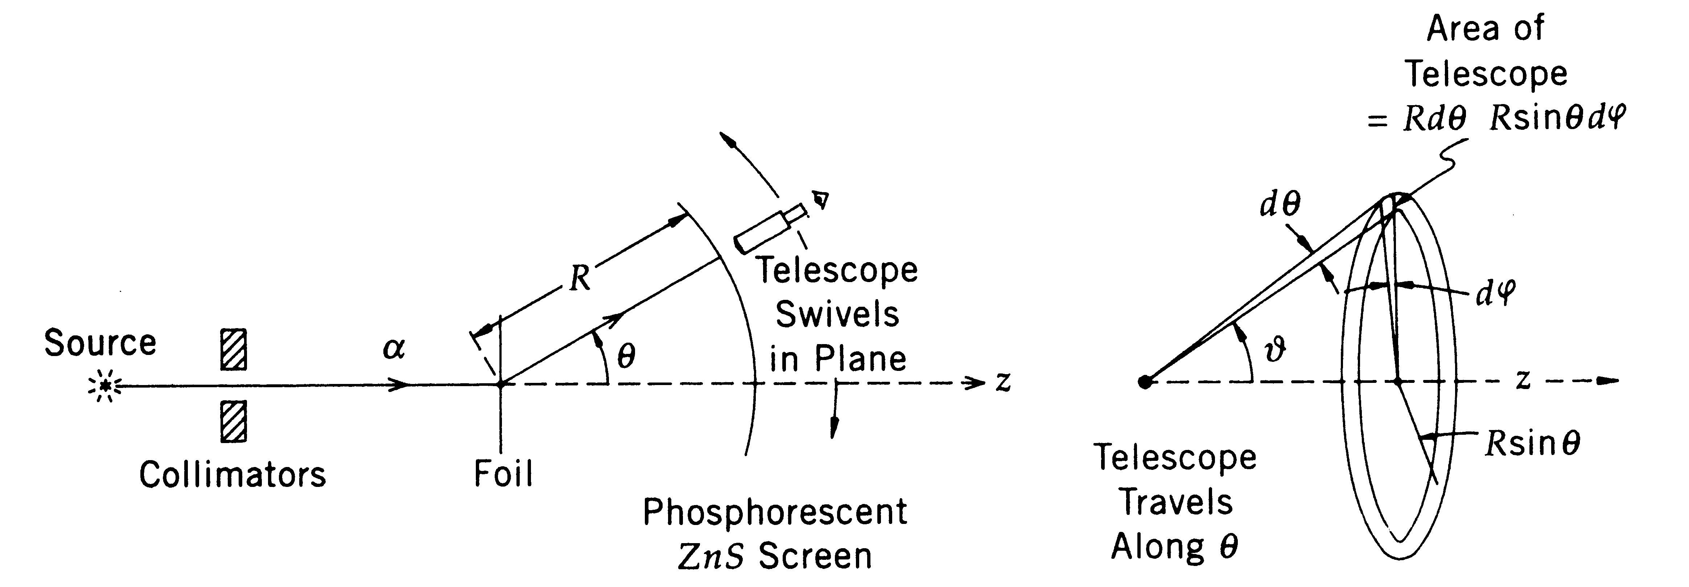
Measuring Cross Sections
Rutherford scattering experiment
  Used a collimated beam of α particles emitted from Radon
  A thin Au foil target
  A scintillating glass screen with ZnS phosphor deposit
  Telescope to view limited area of solid angle
  Telescope only need to move along θ not φ. Why?
    Due to the spherical symmetry, scattering only depends on θ not φ.

Slide 10
Measuring Cross Sections
With the incident flux of N₀ per unit area per second
Any α particles in b and b+db will be scattered into θ and θ-dθ
The telescope aperture limits the measurable area to
How could they have increased the rate of measurement?
  By constructing an annular telescope
  By how much would it increase?
2π/dφ

Slide 11
Measuring Cross Sections
Fraction of incident particles approaching the target in the small area Δσ=b²dφdθ at the impact parameter b is –dn/N₀.
  dn particles scatter into R²dΩ, the aperture of the telescope
This ratio is the same as
  The sum of Δσ over all N nuclear centers in the entire foil divided by the total area (S) of the foil.
  Probability for incident particles to enter within the N areas of the annular rings and subsequently scatter into the telescope aperture
So this ratio can be expressed as
2

Slide 12
Measuring Cross Sections
For a foil with thickness t, mass density ρ, atomic weight A:
Since from what we have learned previously
The number of α scattered into the detector angle (θ,φ) is
A₀: Avogadro’s number of atoms per mol
2

Slide 13
Measuring Cross Sections
Detector acceptance
Number of detected particles
Projectile particle flux
Density of the target particles
Scattering cross section
This is the general expression for any scattering process, independent of the existence of theory
This gives an observed counts per second

Slide 14
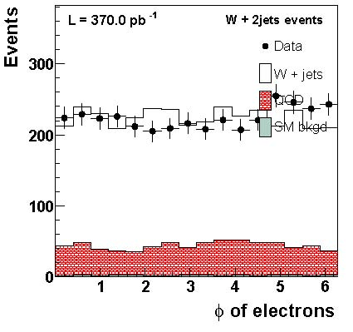
Some Example Cross Section Measurements
Azimuthal angle distribution of electrons in W+2jet events

Slide 15
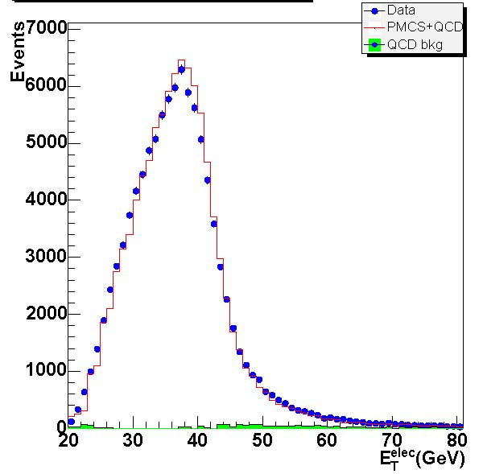
Example Cross Section: W(→eν) +X
Transverse momentum distribution of electrons in W+X events
Mass of the W boson is 80GeV

Slide 16
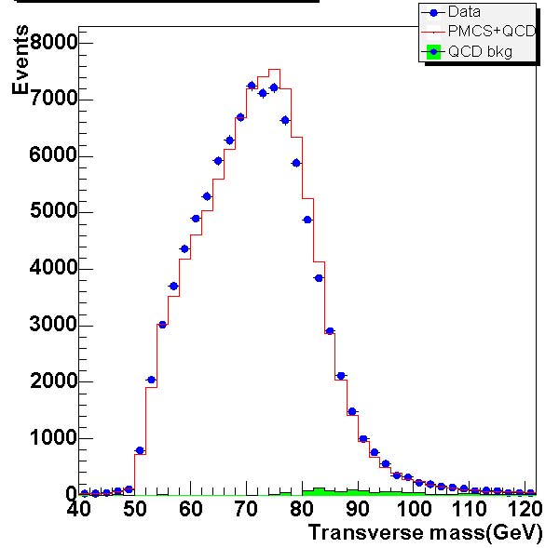
Example Cross Section: W(→eν) +X
Transverse mass distribution of electrons in W+X events

Slide 17
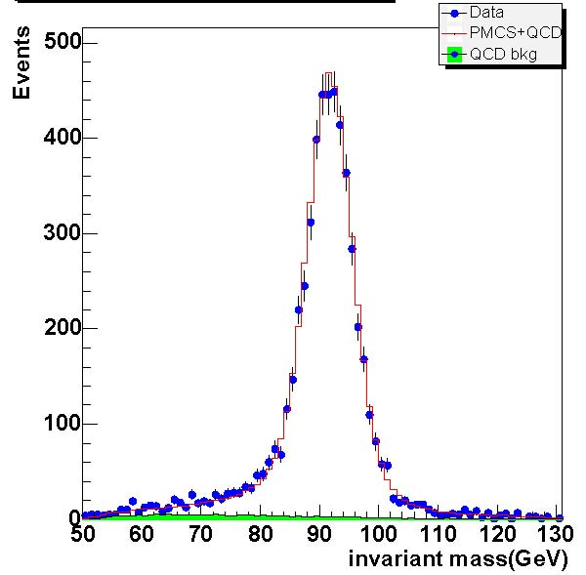
Example Cross Section: W(→ee) +X
Invariant mass distribution of electrons in Z+X events
Mass of the Z boson is 91GeV

Slide 18
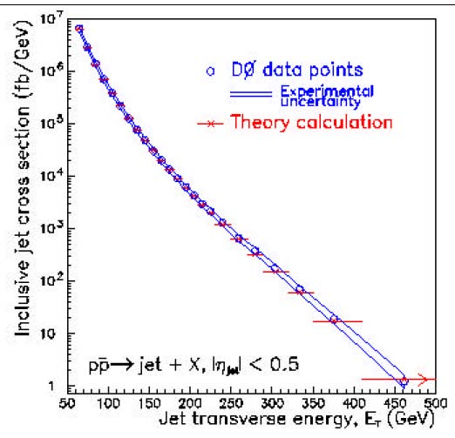
Example Cross Section: Jet +X
Inclusive jet production cross section as a function of transverse energy

