Slide 1
PHYS 3446 – Lecture #5
Monday, Sept 19, 2016
Dr. Jae Yu
Lab Frame and Center of Mass Frame
Relativistic Treatment
Feynman Diagram
Invariant kinematic variable
Nuclear properties
  Mott scattering
  Spin and Magnetic Moments
  Stability and Instability of Nuclei

Slide 2
Homework Assignment #3
Derive Eq. 1.55 starting from 1.48 and 1.49 (5 points)
Derive the formulae for the available CMS energy ( ) for
  Fixed target experiment with masses m₁ and m₂ with incoming energy E₁. (5points)
  Collider experiment with masses m₁ and m₂ with incoming energies E₁ and E₂. (5points)
End of chapter problem 1.7 ( 5points)
These assignments are due next Monday, Sept. 26
Reading assignment: Section 1.7

Slide 3
Lab Frame and Center of Mass Frame
We assumed that the target nuclei do not move throughout the collision in Rutherford Scattering
In reality, they recoil as a result of scattering
Sometimes we use two beams of particles for scattering experiments (target is moving)
This situation could be complicated but,
If the motion can be described in the Center of Mass frame under a central potential, it can be simplified

Slide 4
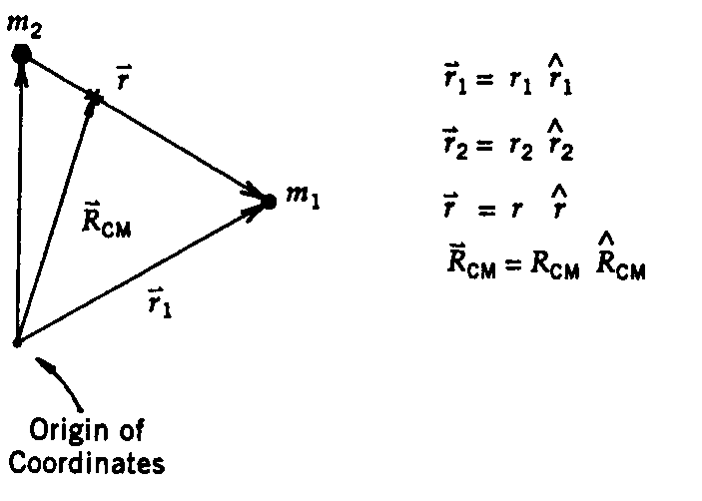
Lab Frame and CM Frame
The equations of motion can be written
where
Since the potential depends only on relative separation of the particles, we redefine new variables, relative coordinates & coordinate of CM
and

Slide 5
Lab Frame and CM Frame
From the equations in previous slides
Reduced Mass
and
Thus
What do we learn from this exercise?
For a central potential, the motion of the two particles can be decoupled from that of the reference frame when re-written in terms of
  a relative coordinate
  The coordinate of center of mass

Slide 6
Now with some simple arithmatics
From the equations of motion, we obtain
Since the momentum of the system is conserved:
Rearranging the terms, we obtain

Slide 7
Lab Frame and CM Frame
The CM is moving at a constant velocity in the lab frame independent of the form of the central potential
The overall motion is as if that of a fictitious particle with mass μ (the reduced mass) and coordinate r.
In the frame where CM is stationary, the dynamics becomes equivalent to that of a single particle of mass μ scattering off of a fixed scattering center.
Frequently we define the Center of Mass frame as the frame where the sum of the momenta of all the interacting particles is 0.

Slide 8
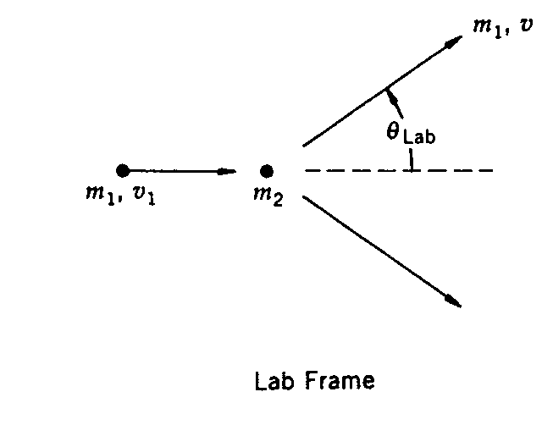
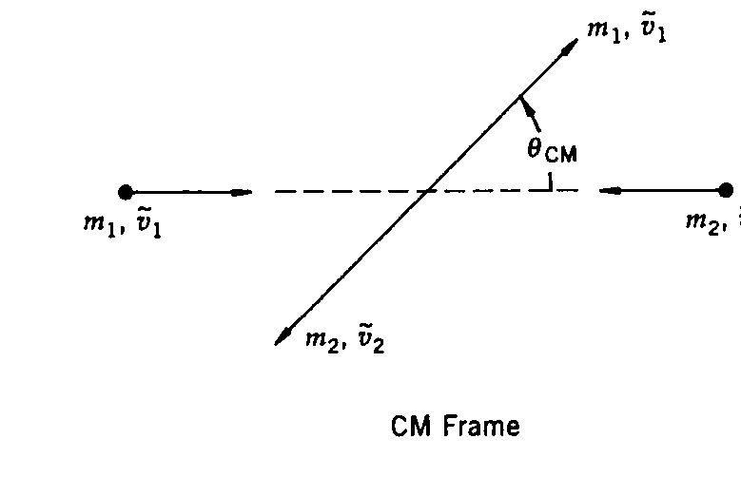
Relationship of variables in Lab and CMS
CMS
The speed of CM is
Speeds of the particles in CMS are
The momenta of the two particles are equal and opposite!!
and

Slide 9
Scattering angles in Lab and CMS
θ_{CM} represents the changes in the direction of the relative position vector r as a result of the collision in CMS
Thus, it must be identical to the scattering angle for the particle with the reduced mass, μ.
Z components of the velocities of particle wit mass m₁ after the scattering in lab and CMS are:
The perpendicular components of the velocities are:
Thus, the angles are related, for elastic scattering only, as:

Slide 10
Differential cross sections in Lab and CMS
The particles that scatter in lab at an angle θ_{Lab} into solid angle dΩ_{Lab} scatter at θ_{CM} into the solid angle dΩ_{CM} in CM.
Since φ is invariant, dφ_{Lab} = dφ_{CM}.
  Why?
  φ is perpendicular to the direction of boost, thus is invariant.
Thus, the differential cross section becomes:
reorganize
Using Eq. 1.53

