Slide 1
PHYS 3446 – Lecture #6
Wednesday, Sept 21, 2016
Dr. Jae Yu
Relativistic Treatment
Feynman Diagram
Nuclear Phenomenology
Properties of Nuclei
  Labeling
  Masses
  Sizes
  Nuclear Spin and Dipole Moment
  Stability and Instability of Nuclei

Slide 2
Announcement
Faculty expo #3
  4pm today in SH100
Reading assignment
  Read and follow through Appendix A, special relativity

Slide 3
Reminder: Homework Assignment #3
Derive Eq. 1.55 starting from 1.48 and 1.49 (5 points)
Derive the formulae for the available CMS energy ( ) for
  Fixed target experiment with masses m₁ and m₂ with incoming energy E₁. (5points)
  Collider experiment with masses m₁ and m₂ with incoming energies E₁ and E₂. (5points)
End of chapter problem 1.7 ( 5points)
These assignments are due next Monday, Sept. 26
Reading assignment: Section 1.7

Slide 4
Some Quantities in Special Relativity
Fractional velocity:
Lorentz γ factor
Relative momentum and the total energy of the particle moving at a velocity is
Square of the four momentum P=(E,pc), rest mass energy

Slide 5
Relativistic Variables
Velocity of CM in the scattering of two particles with rest mass m₁ and m₂ is:
If m₁ is the mass of the projectile and m₂ is that of the target, for a fixed target we obtain

Slide 6
Relativistic Variables
At very low energies where m₁c²>>P₁c, the velocity reduces to:
At very high energies where m₁c²<<P₁c and m₂c²<<P₁c , the velocity can be written as:
Expansion

Slide 7
Relativistic Variables
For high energies, if m₁~m₂,
γ_{CM} becomes:

Slide 8
Relativistic Variables
In general, we can rewrite
Thus the generalized notation of γ_{CM} becomes
Invariant Scalar: s

Slide 9
Relativistic Variables
The invariant scalar, s, is defined as:
So what is this the CMS frame?
Thus, represents the total available energy in the CMS
0

Slide 10
Useful Invariant Scalar Variables
Another invariant scalar, t, the four momentum transfer (differences in four momenta), is useful for scattering:
Since momentum and total energy are conserved in all collisions, t can be expressed in terms of target variables
In CMS frame for an elastic scattering, where P^{i}_{CM}=P^{f}_{CM} =P_{CM} and E^{i}_{CM}=E^{f}_{CM}:

Slide 11
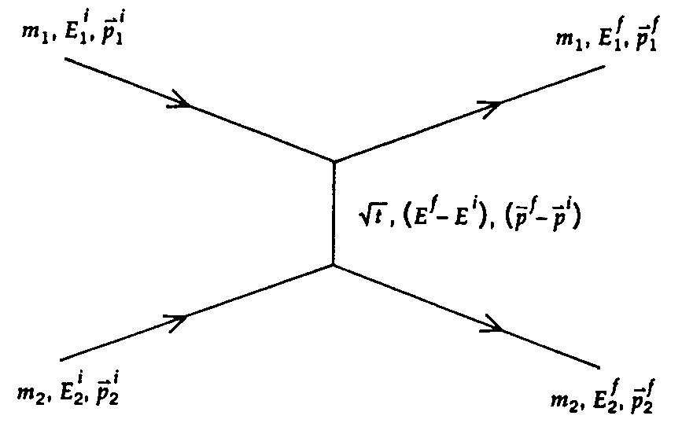
Feynman Diagram
The variable t is always negative for an elastic scattering
The variable t could be viewed as the square of the invariant mass of a particle with and exchanged in the scattering
While the virtual particle cannot be detected in the scattering, the consequence of its exchange can be calculated and observed!!!
  A virtual particle is a particle whose mass is different than the rest mass
t-channel diagram
Momentum of the carrier is the momentum difference between the two particles.
Time

Slide 12
Useful Invariant Scalar Variables
For convenience we define a variable q²,
In the lab frame, , thus we obtain:
In the non-relativistic limit:
q² represents “hardness of the collision”. Small θ_{CM} corresponds to small q².

Slide 13
Relativistic Scattering Angles in Lab and CMS
For a relativistic scattering, the relationship between the scattering angles in Lab and CMS is:
For Rutherford scattering (m=m₁<<m₂, v~v₀<<c):
Divergence at q²~0, a characteristics of a Coulomb field
Resulting in a
cross section

Slide 14
Nuclear Phenomenology
Rutherford scattering experiment clearly demonstrated the existence of a positively charged central core in an atom
The formula deviated for high energy α particles (E>25MeV), especially for low Z nuclei.
1920’s James Chadwick noticed serious discrepancies between Coulomb scattering expectation and the observed elastic scattering of α particle on He.
None of the known effects, including quantum effect, described the discrepancy.
Clear indication of something more than Coulomb force involved in the interactions.
Before Chadwick’s discovery of neutron in 1932, people thought nucleus contain protons and electrons. ➔ We now know that there are protons and neutrons (nucleons) in nuclei.

Slide 15
Properties of Nuclei: Labeling
The nucleus of an atom X can be labeled uniquely by its:
  Electrical Charge or atomic number Z (number of protons).
  Total number of nucleons A (=N_{p}+N_{n})
Isotopes: Nuclei with the same Z but different A
  Same number of protons but different number of neutrons
  Have similar chemical properties
Isobars: Nuclei with same A but different Z
  Same number of nucleons but different number of protons
Isomers or resonances of the ground state: Excited nucleus to a higher energy level
Mirror nuclei: Nuclei with the same A but with switched N_{p} and N_{n}

Slide 16
Nuclear Properties: Masses of Nuclei
A nucleus of has N_{p}=Z and N_{n}=A-Z
Naively one would expect
Where m_{p}~938.27MeV/c² and m_{n}=939.56MeV/c²
However measured mass turns out to be
This is one of the explanations for nucleus not falling apart into its nucleon constituents

Slide 17
Nuclear Properties: Binding Energy
The mass deficit
Is always negative and is proportional to the nuclear binding energy
How are the BE and mass deficit related?
What is the physical meaning of BE?
  A minimum energy required to release all nucleons from a nucleus
  So B= -BE is the energy required to keep a nucleus

Slide 18
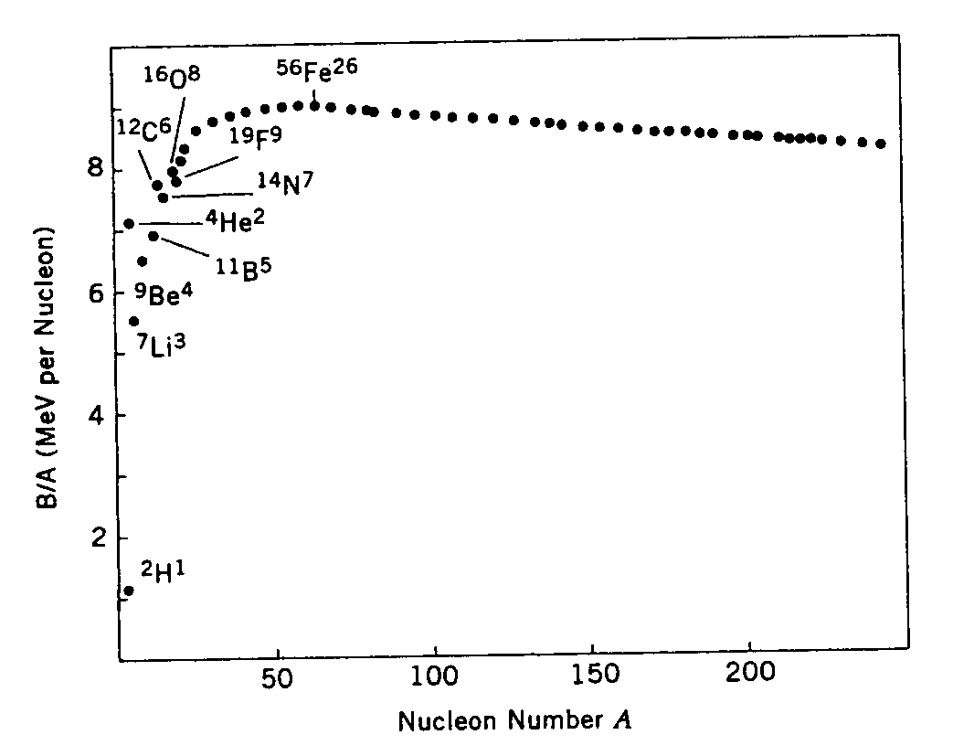
Nuclear Properties: Binding Energy
BE per nucleon is
9MeV
Rapidly increase with A till A~60 at which point B/A~9MeV.
A>60, the B/A gradually decrease ➔ For most the large A nucleus, B/A~8MeV.

Slide 19
Nuclear Properties: Binding Energy
de Broglie’s wavelength:
  Where is the Planck’s constant
  And is the reduced wave length
Assuming 8MeV was given to a nucleon (m~940MeV), the wavelength is
Makes sense for nucleons to be inside a nucleus since the size is small.
If it were electron with 8MeV, the wavelength is ~10fm, a whole lot larger than a nucleus.

Slide 20
Nuclear Properties: Sizes
At relativistic energies, the magnetic moment of electron also contributes to the scattering
  Neville Mott formulated Rutherford scattering in QM and included the spin effects
  R. Hofstadter, et al., discovered the effect of spin, nature of nuclear (& proton) form factor in late 1950s
Mott scattering x-sec (scattering of a point particle) is related to Rutherford x-sec:
Deviation from the distribution expected for point-scattering provides a measure of size (structure)

Slide 21
Nuclear Properties: Sizes
Another way is to use the strong nuclear force of sufficiently energetic strongly interacting particles (π mesons, protons, etc)
  What is the advantage of using these particles?
    If the energy is high, Coulomb interaction can be neglected
    These particles readily interact with nuclei, getting “absorbed” into the nucleus
    Thus, probe strong interactions directly
  These interactions can be treated the same way as the light absorptions resulting in diffraction, similar to that of light passing through gratings or slits

Slide 22
Nuclear Properties: Sizes
The size of a nucleus can be inferred from the diffraction pattern
All these phenomenological investigation provided the simple formula for the radius of the nucleus to its number of nucleons or atomic number, A:
How would you interpret this formula?

Slide 23
Nuclear Properties: Spins
Both protons and neutrons are fermions with spins
Nucleons inside a nucleus can have orbital angular momentum
In Quantum Mechanics orbital angular momenta are integers
Thus the total angular momentum of a nucleus is
  Integers: if even number of nucleons in the nucleus
  Half integers: if odd number of nucleons in the nucleus
Interesting facts are
  All nucleus with even number of p and n are spin 0.
  Large nuclei have very small spins in their ground state
Hypothesis: Nucleon spins in the nucleus are very strongly paired to minimize their overall effect

