Slide 1
PHYS 3446 – Lecture #7
Monday, Sept 26, 2016
Dr. Jae Yu
Properties of Nuclei
  Nuclear Spin and Dipole Moment
  Stability and Instability of Nuclei
Nature of the Nuclear Force
  Short Range Nature of the Nuclear Force
  Shape of the Nuclear Potential
  Yukawa Potential
  Range of Yukawa Potential
Nuclear Models

Slide 2
Announcement
First quiz
  Beginning of class Wednesday, Sept. 28
First term exam
  Date and time: 2:30 – 4:50pm, Monday, Oct. 10
  Location: SH125
  Covers: Ch 1 – Ch 3 or what we finish Wednesday, Oct. 5, + Appendix A
Colloquium
  Dr. Amir Farbin on Deep Learning

Slide 3
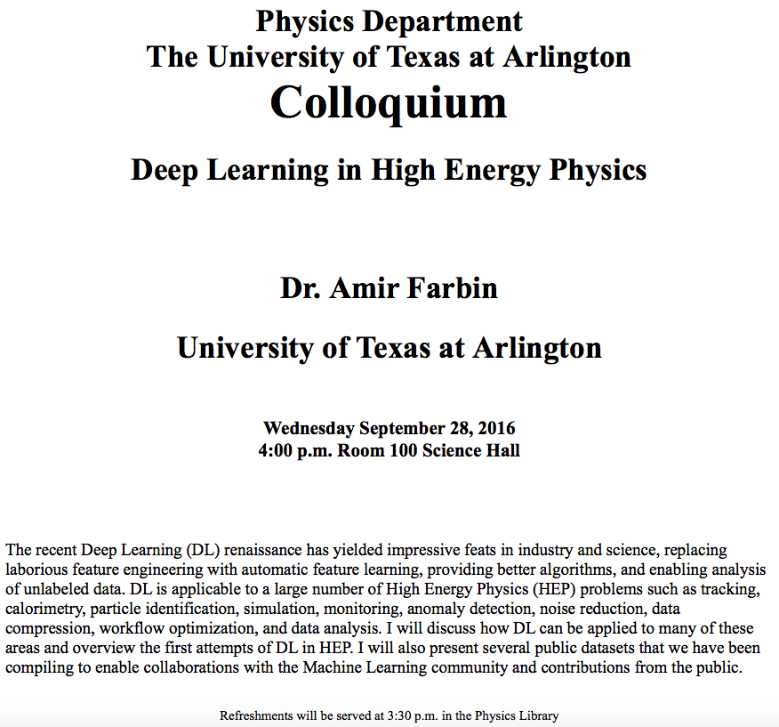

Slide 4
Homework Assignment #4
Compute the mass density of a nucleus (10points)
  Pick two nuclei for this. I would like you guys to do different ones.
Compute the de Broglie wavelengths for (15 points)
  Protons in Fermilab’s Tevatron Collider
  Protons in CERN’s Large Hadron Collider (LHC)
  500 GeV electrons in the International Linear Collider
Compute the actual value of the nuclear magneton (5 points)
Due for the above is next Monday, Oct. 3

Slide 5
Nuclear Properties: Spins
Both protons and neutrons are fermions with intrinsic spin
Nucleons inside a nucleus can have orbital angular momenta
In Quantum Mechanics orbital angular momenta are integers
Thus the total angular momentum (vector sum of orbital and intrinsic momenta of all constituents) of a nucleus is
  Integers: if even number of nucleons in the nucleus
  Half integers: if odd number of nucleons in the nucleus
Interesting facts are
  All nucleus with even number of p and even n are spin 0.
  Large nuclei have very small spins in their ground state
Hypothesis: Nucleon spins in a nucleus are very strongly paired to minimize their overall effect (entropy)

Slide 6
Nuclear Properties: Magnetic Dipole Moments
Every charged particle has a magnetic dipole moment associated with its spin
e, m and S are the charge, mass and the intrinsic spin of the charged particle
The constant g is called Landé factor with its value:
  : for a point like particle, such as the electron
  : Particle possesses an anomalous magnetic moment, an indication of having a substructure

Slide 7
Nuclear Properties: Magnetic Dipole Moments
For electrons, μ_{e}~μ_{B}, where μ_{B} is Bohr Magneton of a point-like particle
For nucleons, magnetic dipole moment is measured in nuclear magneton, defined using proton mass
Measured magnetic moments of proton and neutron:

Slide 8
Nuclear Properties: Magnetic Dipole Moments
What important information do you get from these?
  The Landé factors of the nucleons deviate significantly from 2.
    Strong indication of substructure
  An electrically neutral neutron has a significant magnetic moment
    Must have extended charge distributions
Measurements show that magnetic moment of nuclei lie -3μ_{N}~10μ_{N}
  Indication of strong pairing
  Electrons cannot reside in nucleus (μ_{e}~μ_{B}~2000μ_{N})

Slide 9
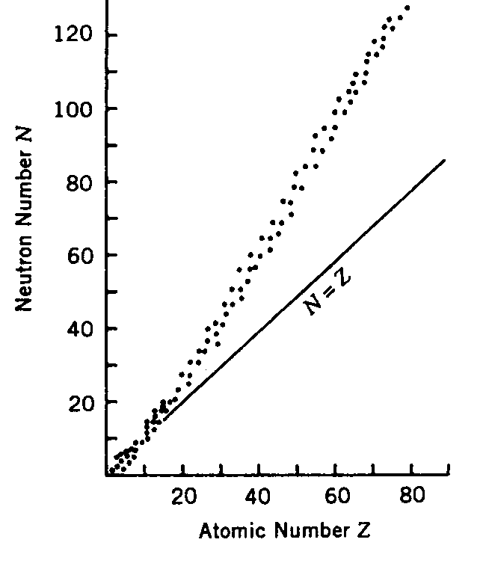
Nuclear Properties: Stability
The number of protons and neutrons inside the stable nuclei are
  A<40: Equal (N=Z)
  A>40: N~1.7Z
  Neutrons outnumber protons
  Most are even-p + even–n
    See table 2.1
  Supports strong pairing
N~1.7Z
N | Z | N_{nucl}
Even | Even | 156
Even | Odd | 48
Odd | Even | 50
Odd | Odd | 5
N=Z

Slide 10
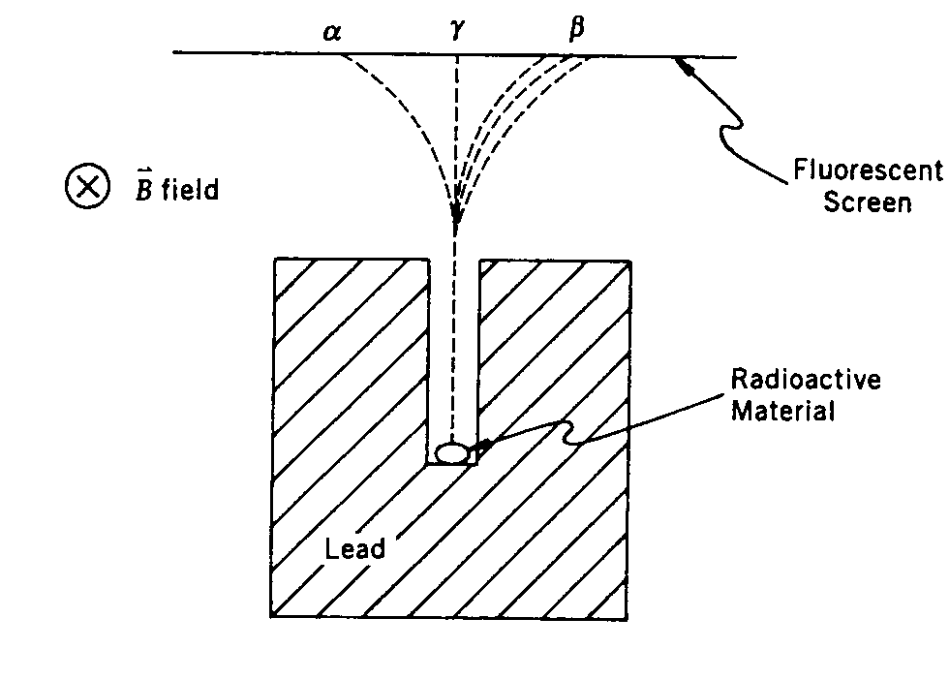
Nuclear Properties: Instability
In 1896 H. Becquerel accidently discovered natural radioactivity
  Study of Uranium salts’ fluorescent properties
Nuclear radio activity involves emission of three radiations: α, β, and γ
These can be characterized using the device on the right
  α: Nucleus of He (v~0.1c), short range (a sheet of paper can stop it)
  β: electrons (v<0.99c), has longer range and produces less ionization than α, can be stopped by 3mm lead
  γ: photons, long range, few cm lead to stop
What do you see from above?
  α and β are charged particles while γ is neutral.
  α is mono-energetic
  β has broad spectrum
What else could you see?

Slide 11
Nature of the Nuclear Force
Scattering experiments help to
  Determine the properties of nuclei
  Learn more global information on the characteristics of the nuclear force
From what we have learned, it is clear that there is no classical analog to nuclear force
  Gravitational force is too weak to provide the binding
  Can’t have an electromagnetic origin
    Deuteron nucleus has one neutron and one proton
    Coulomb force would destabilize the nucleus

Slide 12
Short-range Nature of the Nuclear Force
Atomic structure is well explained by the electromagnetic interaction
  Thus the range of nucleus cannot be much greater than the radius of the nucleus
  Nuclear force should range ~ 10⁻¹³ – 10⁻¹²cm
Binding energy is constant per each nucleon, essentially independent of the size of the nucleus
  If the nuclear force is long-ranged, like the Coulomb force
  For A nucleons, there would be ½ A(A-1) pair-wise interactions
  Thus, the BE which reflects all possible interactions among the nucleons would grow as a function of A
For large A

Slide 13
Short-range Nature of the Nuclear Force
If the nuclear force is long-ranged and is independent of the presence of other nucleons, BE per nucleon will increase linearly with A
  This is because long-range forces do not saturate
  Since any single particle can interact with as many other particle as are available
  Binding becomes tighter as the number of interacting objects increases
  The size of the interacting region stays fairly constant
  Atoms with large number of electrons have the sizes compatible to those with smaller number of electrons

Slide 14
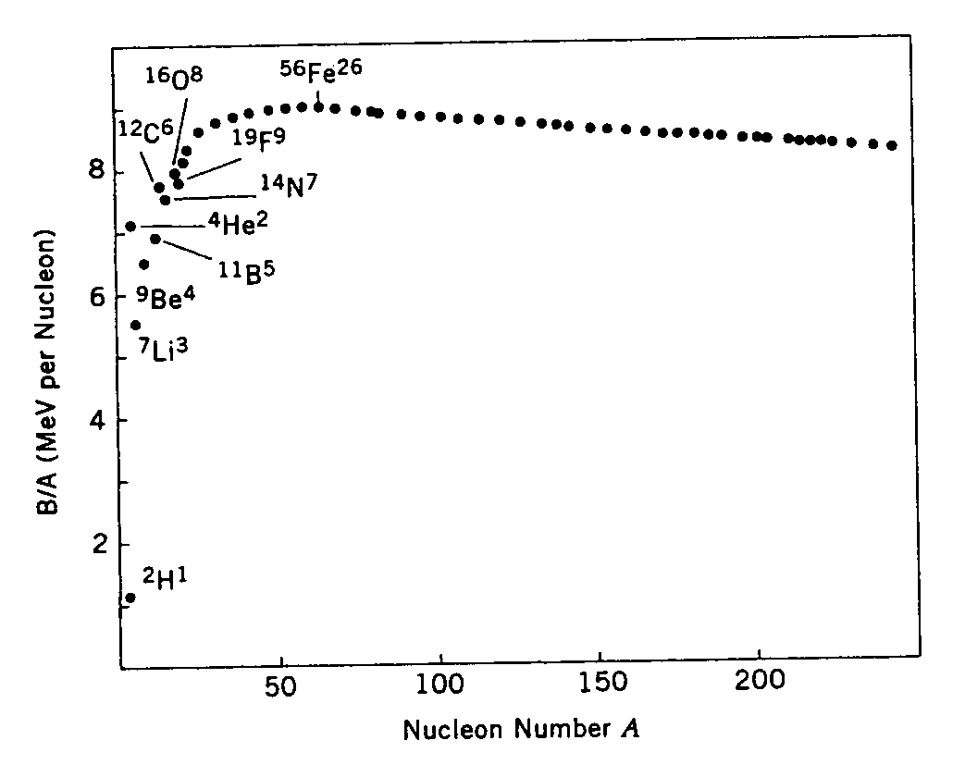
Short-range Nature of the Nuclear Force
Long-rangeness of nuclear force is disputed by the experimental measurement that the BE/nucleon stays constant
  Nuclear force must saturate
  Any given nucleon can only interact with a finite number of nucleons in its vicinity
What does adding more nucleons to a nucleus do?
  Only increases the size of the nucleus
    Recall that R ~ A^{1/3}
  The size of a nucleus grows slowly with A and keeps the nuclear density constant
  Another supporting evidence of short-range nature of nuclear force

Slide 15
Shape of the Nuclear Potential
Nuclear force keeps the nucleons within the nucleus.
  What does this tell you about the nature of the nuclear force?
  It must be attractive!!
However, scattering experiments with high energy revealed a repulsive core!!
  Below a certain length scale, the nuclear force changes from attractive to repulsive.
  What does this tell you?
    Nucleons have a substructure….
This feature is good, why?
  If the nuclear force were attractive at all distances, the nucleus would collapse in on itself.

Slide 16
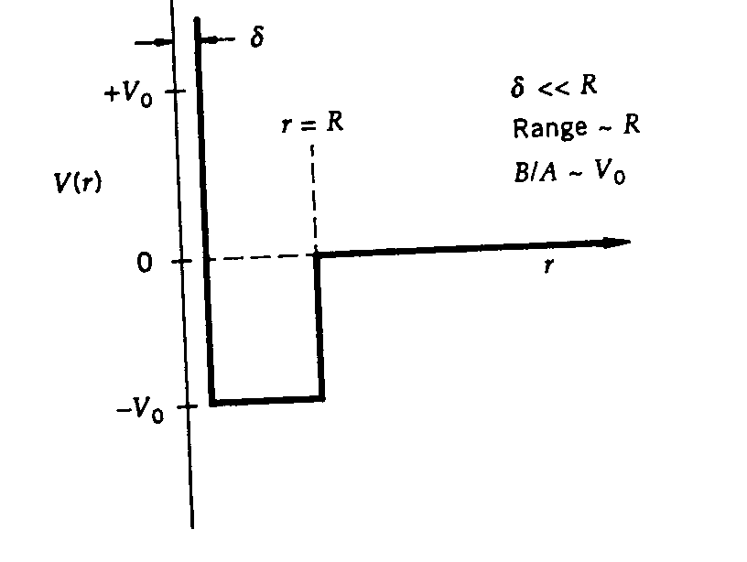
Shape of the Nuclear Potential
We can turn these behaviors into a square-well potential
  For low energy particles, the repulsive core can be ignored, why?
    Can’t get there..
This model is too simplistic, since there are too many abrupt changes in potential.
  There would be additional effects by the Coulomb force
Attractive force
Repulsive Core

Slide 17
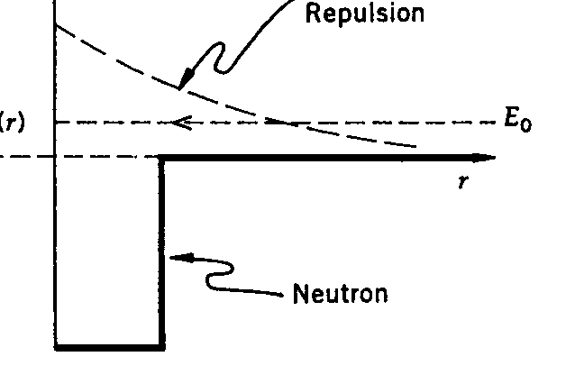
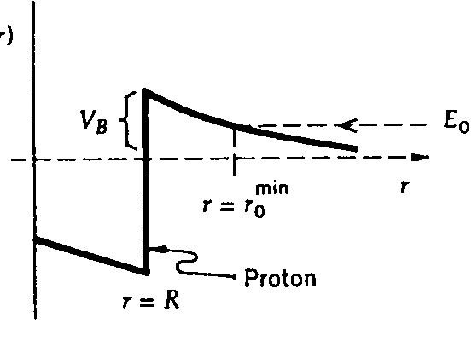
Nuclear Potential w/ Coulomb Corrections
Results in
Classically an incident proton with total energy E₀ cannot be closer than r=r₀. Why?
  For R<r<r₀, V(r) >E₀ and KE<0 ➔ Physically impossible
What about a neutron?
  Could penetrate into the nuclear center.
Low energy scattering experiment did not provide the exact shape of the potential but the range and height of the potential
The square-well shape provides a good phenomenological description of the nuclear force.

Slide 18
Nuclear Potential
A square well nuclear potential ➔ provides the basis of quantum theory with discrete energy levels and corresponding bound state just like in atoms
  Presence of nuclear quantum states have been confirmed through
    Scattering experiments
    Studies of the energies emitted in nuclear radiation
Studies of mirror nuclei and the scatterings of protons and neutrons demonstrate
  Without the Coulomb effects, the forces between two neutrons, two protons or a proton and a neutron are the same
    Nuclear force is independent of electrical charge
    Protons and neutrons behave the same under the nuclear force
  Inferred as charge independence of nuclear force.

Slide 19
Nuclear Potential – Iso-spin symmetry
Strong nuclear force is independent of the electric charge carried by nucleons
  Concept of strong isotopic-spin symmetry.
    proton and neutron are the two different iso-spin state of the same particle called nucleon
  In other words,
    If the Coulomb effect were turned off, protons and neutrons would be indistinguishable in their nuclear interactions
    Can you give another case just like this???
  This is analogues to the indistinguishability of spin up and down states in the absence of a magnetic field!!
This is called Iso-spin symmetry!!!

Slide 20
Range of the Nuclear Force
EM force can be understood as a result of a photon exchange
  Photon propagation is described by the Maxwell’s equation
  Photons propagate at the speed of light.
  What does this tell you about the mass of the photon?
    Massless
Coulomb potential is
What does this tell you about the range of the Coulomb force?
  Long range. Why?
Massless particle exchange

Slide 21
Yukawa Potential
For massive particle exchanges, the potential takes the form
  What is the mass, m, in this expression?
    Mass of the particle exchanged in the interaction
      The force mediator mass
This form of potential is called Yukawa Potential
  Formulated by Hideki Yukawa in 1934
What does Yukawa potential turn to in the limit m →0?
  Coulomb potential

Slide 22
Ranges in Yukawa Potential
From the form of the Yukawa potential
The range of the interaction is given by some characteristic value of r. What is this?
  Compton wavelength of the mediator with mass, m:
What does this mean?
  Once the mass of the mediator is known, range can be predicted
  Once the range is known, the mass can be predicted

Slide 23
Ranges in Yukawa Potential
Let’s put Yukawa potential to work
What is the range of the nuclear force?
  About the same as the typical size of a nucleus
    1.2x10⁻¹³cm
  thus the mediator mass is
This is close to the mass of a well known π meson (pion)
Thus, it was thought that π are the mediators of the nuclear force

