Slide 1
PHYS 3446 – Lecture #8
Wednesday, Sept 28, 2016
Dr. Jae Yu
Nuclear Models
Liquid Drop Model
Fermi Gas Model

Slide 2
Announcement
First term exam
Date and time: 2:30 – 3:50pm, Monday, Oct. 10
Location: SH125
Covers: Ch 1 – Ch 3 or what we finish Wednesday, Oct. 5, + Appendix A
Can bring your calculator but no phone or computer can be used as a replacement
Colloquium
Dr. Amir Farbin on Deep Learning

Slide 3
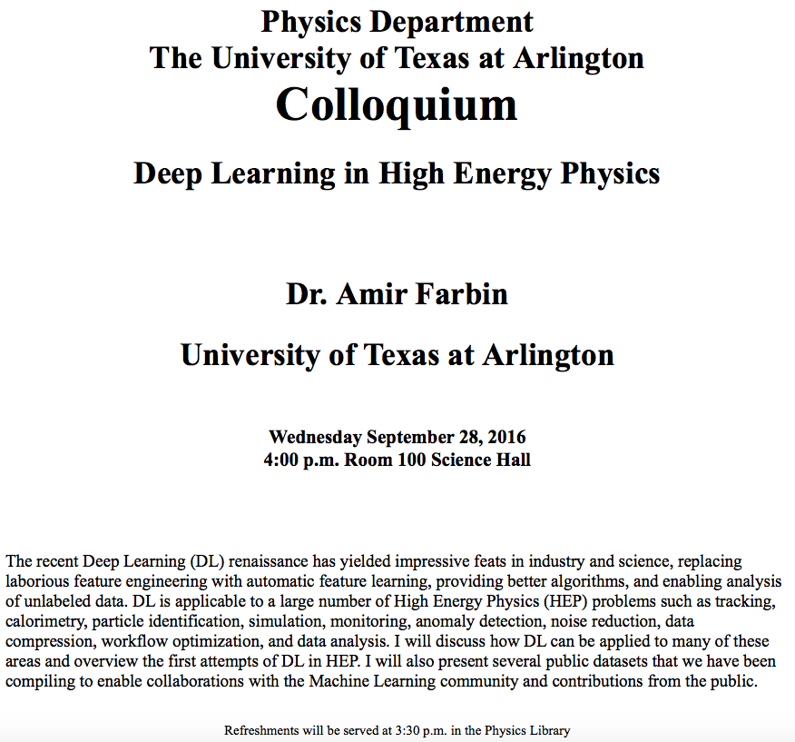

Slide 4
Reminder: Homework Assignment #4
Compute the mass density of a nucleus (10points)
Pick two nuclei for this. I would like you guys to do different ones.
Compute the de Broglie wavelengths for (15 points)
Protons in Fermilab’s Tevatron Collider
Protons in CERN’s Large Hadron Collider (LHC)
500 GeV electrons in the International Linear Collider
Compute the actual value of the nuclear magneton (5 points)
Due for the above is next Monday, Oct. 3

Slide 5
Nuclear Models
Experiments showed very different characteristics of nuclear forces than other forces
Quantification of nuclear forces and the structure of nucleus were not straightforward
Fundamentals of nuclear force were not well understood
Several phenomenological models (not theories) that describe only limited cases of experimental findings
Most the models assume central potential, just like the Coulomb potential

Slide 6
Nuclear Models: Liquid Droplet Model
An earliest phenomenological success in describing binding energy of a nucleus (George Gamow)
Nucleus is essentially spherical with radius proportional to A^{1/3}.
Densities are independent of the number of nucleons
Led to a model that envisions the nucleus as an incompressible liquid droplet
In this model, nucleons are equivalent to molecules
Quantum properties of individual nucleons are ignored

Slide 7
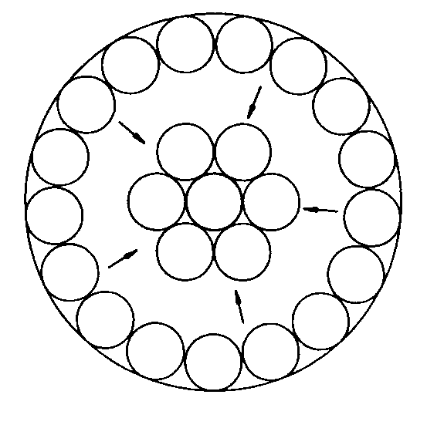
Nuclear Models: Liquid Droplet Model
Nucleus is imagined to consist of
A stable central core of nucleons where nuclear force is completely saturated
A surface layer of nucleons that are not bound tightly
This weaker binding at the surface decreases the effective BE per nucleon (B/A)
Provides an attraction of the surface nucleons towards the core just as the surface tension to the liquid would

Slide 8
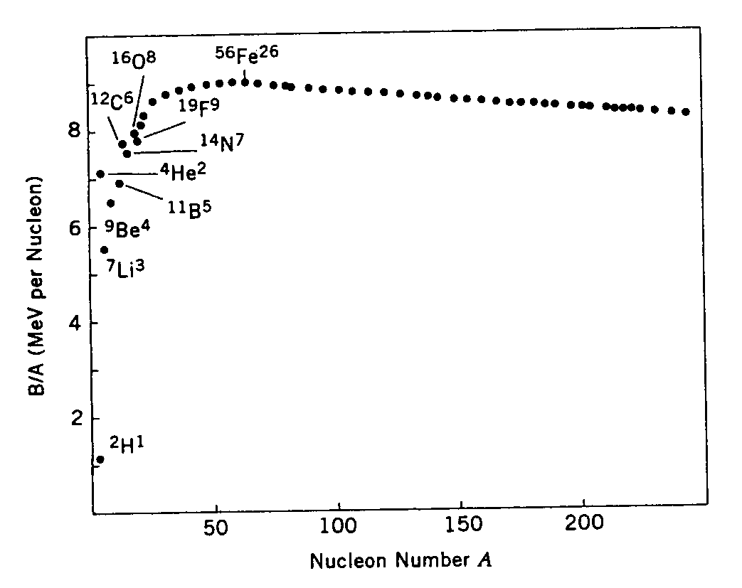
Liquid Droplet Model: Binding Energy
If a constant BE per nucleon is due to the saturation of the nuclear force, the nuclear BE can be written as:
What do you think each term does?
First term: volume energy for uniform saturated binding
Second term corrects for weaker surface tension
This can explain the low BE/nucleon behavior of low A nuclei
For low A nuclei, the proportion of the second term is larger.
Reflects relatively large number of surface nucleons than the core.

Slide 9
Liquid Droplet Model: Binding Energy
Small decrease of BE for heavy nuclei can be understood as due to the Coulomb repulsion
The electrostatic energies of protons have a destabilizing effect
Reflecting this effect, the empirical formula for BE takes a new correction term
Each term of this formula has a classical origin.
This formula does not explain
Lighter nuclei with the equal number of protons and neutrons are stable or have a stronger binding (larger –BE)
Natural abundance of stable even-even nuclei or paucity of odd-odd nuclei
These could mainly arise from quantum effect of spins.

Slide 10
Liquid Droplet Model: Binding Energy
Additional corrections to compensate the deficiency, give corrections to the empirical formula (again…)
All parameters are assumed to be positive
The forth term reflects N=Z stability
The last term
Positive sign is chosen for odd-odd nuclei, reflecting instability
Negative sign is chosen for even-even nuclei
For odd-A nuclei, a₅ is chosen to be 0 since BE can be described well for these nuclei without this term

Slide 11
Liquid Droplet Model: Binding Energy
The parameters are determined by fitting experimentally observed BE for a wide range of nuclei:
Now we can write an empirical formula for masses of nuclei
This is Bethe-Weizsacker semi-empirical mass formula (1935)
Used to predict stability and masses of unknown nuclei of arbitrary A and Z

Slide 12
