Slide 1
PHYS 3446 – Lecture #9
Monday, Oct. 3, 2016
Dr. Jae Yu
Nuclear Models
  Fermi Gas Model
  Shell Model
  Collective Model
  Super-deformed Nuclei
Nuclear Radiation
  Alpha decay
  Beta decay

Slide 2
Announcement
First term exam
  Date and time: 2:30 – 3:50pm, Monday, Oct. 10
  Location: SH125
  Covers: Ch 1 – Ch 3 or what we finish Wednesday, Oct. 5, + Appendix A
  Can bring your calculator but no phone or computer can be used as a replacement
First quiz results
  Class average: 56.5/120
    Equivalent to 47.1/100
  Class top score: 89/120

Slide 3
Nuclear Models: Fermi Gas Model
An early attempt to incorporate quantum effects
Assumes nucleus as a gas of free protons and neutrons confined to the nuclear volume
  The nucleons occupy quantized (discrete) energy levels
  Nucleons are moving inside a spherically symmetric well with the range determined by the radius of the nucleus
  Depth of the well is adjusted to obtain correct binding energy
Protons carry electric charge ➔ Senses slightly different potential than neutrons

Slide 4
Nuclear Models: Fermi Gas Model
Nucleons are Fermions (spin ½ particles) so
  Obey Pauli exclusion principle
  Any given energy level can be occupied by at most two identical nucleons – opposite spin projections
For a greater stability, the energy levels fill up from the bottom up to the Fermi level
  Fermi level: Highest, fully occupied energy level (E_{F})
Binding energies are given as follows:
  BE of the last nucleon= E_{F} since no Fermions above E_{F}
  In other words, the level occupied by Fermion reflects the BE of the last nucleon

Slide 5
Nuclear Models: Fermi Gas Model
Experimental observations show BE is charge independent
If the well depth is the same for p and n, BE for the last nucleon would be charge dependent for heavy nuclei (Why?)
  Since there are more neutrons than protons, neutrons sit higher E_{F}

Slide 6
Same Depth Potential Wells
Neutron Well
Proton Well
…
Nuclear β-decay
…

Slide 7
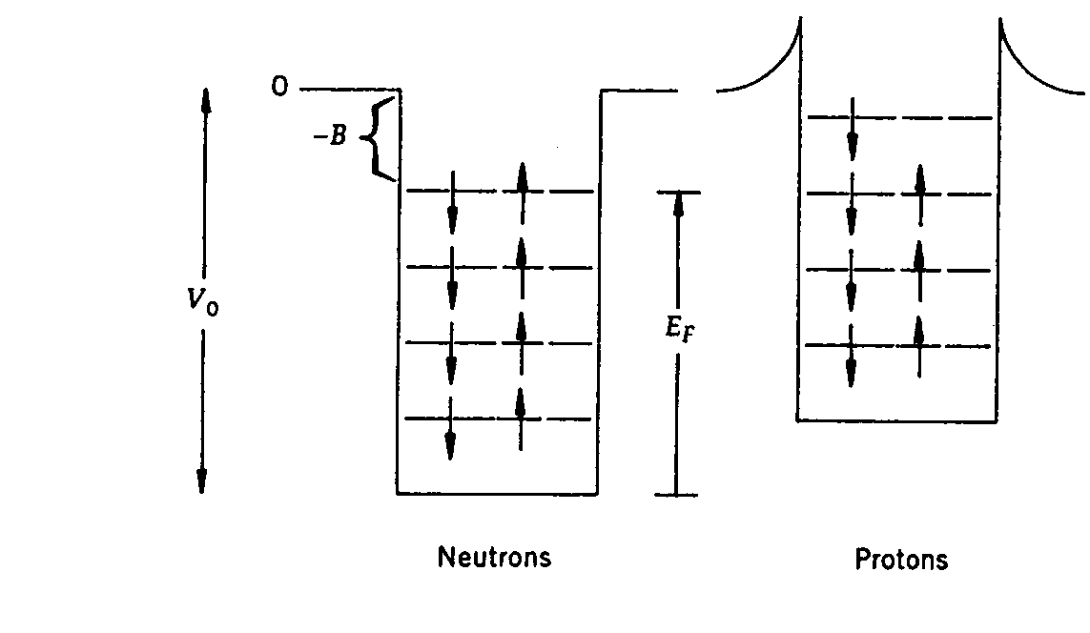
Nuclear Models: Fermi Gas Model
Experimental observations show BE is charge independent
If the well depth is the same for p and n, BE for the last nucleon would be charge dependent for heavy nuclei (Why?)
  Since there are more neutrons than protons, neutrons sit higher E_{F}
  But experiments observed otherwise
E_{F} must be the same for protons and neutrons. How do we make this happen?
  Make protons move to a shallower potential well
What happens if this weren’t the case?
  Nucleus is unstable.
  All neutrons at higher energy levels would undergo a β-decay and transition to lower proton levels

Slide 8
Fermi Gas Model: E_{F} vs n_{F}
Fermi momentum:
Volume for momentum space up to Fermi level
Total volume for the states (kinematic phase space)
  Proportional to the total number of quantum states in the system
Using Heisenberg’s uncertainty principle:
The minimum volume associated with a physical system becomes
The n_{F} that can fill up to E_{F} is
Why?

Slide 9
Fermi Gas Model: E_{F} vs n_{F}
Let’s consider a nucleus with N=Z=A/2 and assume that all states up to Fermi level are filled
What do you see about p_{F} above?
  Fermi momentum is constant, independent of the number of nucleons
Using the average BE of -8MeV, the depth of potential well (V₀) is ~40MeV
  Consistent with other findings
This model is a natural way of accounting for a₄ term in Bethe-Weizsacker mass formula
or

Slide 10
Nuclear Models: Shell Model
Exploit the success of atomic model
  Uses orbital structure of nucleons
  Electron energy levels are quantized
  Limited number of electrons in each level based on the available spin and angular momentum configurations
    For n^{th} energy level, l angular momentum (l<n), one expects a total of 2(2l+1) possible degenerate states for electrons

Slide 11
Atomic Shell Model Reminder
Orbits and energy levels an electron can occupy are labeled by
  Principle quantum number: n
    n can only be integer
  For given n, energy degenerate orbital angular momentum: l
    The values are given from 0 to n – 1 for each n
  For any given orbital angular momentum, there are (2l+1) sub-states: m_{l}
    m_{l}=-l, -l+1, …, 0, 1, …, l – 1, l
    Due to rotational symmetry of the Coulomb potential, all these sub-states are degenerate in energy
  Since electrons are fermions w/ intrinsic spin angular momentum ,
    Each of the sub-states can be occupied by two electrons
  So the total number of state is 2(2l+1)

Slide 12
Nuclear Models: Shell Model
Exploit the success of atomic model
  Uses orbital structure of nucleons
  Electron energy levels are quantized
  Limited number of electrons in each level based on available spin and angular momentum configurations
    For n^{th} energy level, l angular momentum (l<n), one expects a total of 2(2l+1) possible degenerate states for electrons
Quantum numbers of individual nucleons are taken into account to affect the fine structure of spectra

Slide 13
Nuclear Models: Shell Model
Nuclei have magic numbers just like inert atoms
  Atoms: Z=2, 10, 18, 36, 54
  Nuclei: N=2, 8, 20, 28, 50, 82, and 126; Z=2, 8, 20, 28, 50, and 82
  Magic Nuclei: Nuclei with either N or Z a magic number ➔ Stable
  Doubly magic nuclei: Nuclei with both N and Z magic numbers ➔ Particularly stable (some examples?)
Explains well the stability of nucleus

Slide 14
Shell Model: Various Potential Shapes
To solve the equation of motion in quantum mechanics, Schrödinger equation, one must know the shape of the potential
  Details of nuclear potential not well known
A few shapes of potential energies tried out
  Infinite square well: Each shell can contain up to 2(2l+1) nucleons

Slide 15
Nuclear Models: Shell Model – Square well potential case
N_{M} | n | l=n-1 | N_{s}=2(2l+1) | N_{T}
2 | 1 | 0 | 2 | 2
8 | 2 | 0,1 | 2+6 | 8
20 | 3 | 0,1,2 | 2+6+10 | 18
28 | 4 | 0,1,2,3 | 2+6+10+14 | 32
50 | 5 | 0,1,2,3,4 | 2+6+10+14+18 | 50
82 | 6 | 0,1,2,3,4,5 | 2+6+10+14+18+22 | 72

Slide 16
Shell Model: Various Potential Shapes
To solve equation of motion in quantum mechanics, Schrödinger equation, one must know the shape of the potential
  Details of nuclear potential not well known
A few models of potential tried out
  Infinite square well: Each shell can contain up to 2(2l+1) nucleons
    Can predict 2, 8 and 50 but no other magic numbers
  Three dimensional harmonic oscillator:
    Predicts 2, 8, 20, 40 and 70 ➔ Some magic numbers predicted

Slide 17
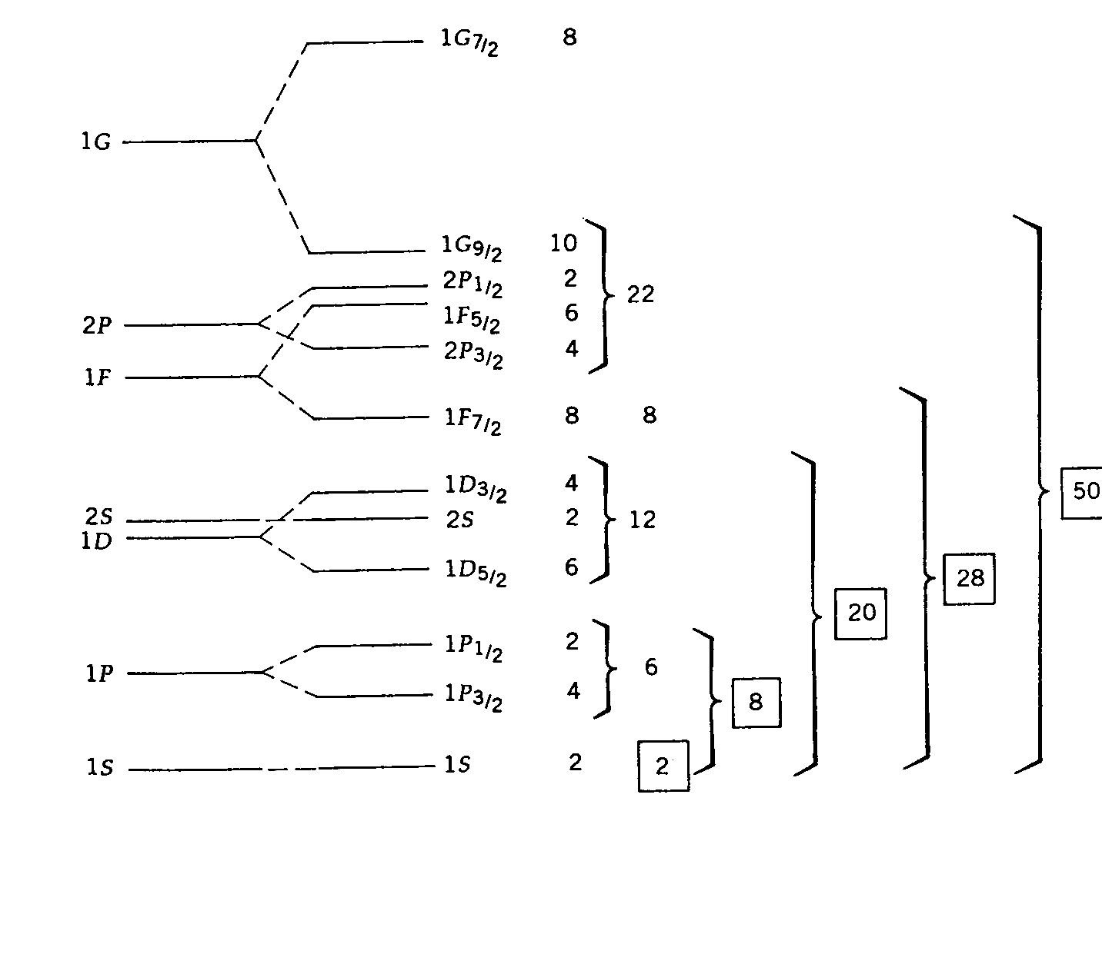
Shell Model: Spin-Orbit Potential
Central potential could not reproduce all magic numbers
In 1940, Mayer and Jesen proposed a central potential + strong spin-orbit interaction w/
  f(r) is an arbitrary empirical function of radial coordinates and chosen to fit the data
For the spin-orbit interaction with the properly chosen f(r), a finite square well can split
Reproduces all the desired magic numbers
Spectroscopic notation: n L j
Orbit number
Orbital angular momentum
Projection of total momentum

Slide 18
Predictions of the Shell Model
Spin-Parity of large number of odd-A nuclei predicted well
  Nucleons are Fermions and obey Pauli exclusion principle
  ➔ Fill up ground state energy levels in pairs
  Ground state of all even-even nuclei have zero total angular momentum
The shell model cannot predict stable odd-odd nuclei spins
  No prescription for how to combine the unpaired proton and neutron spins

Slide 19
Predictions of the Shell Model
Magnetic Moment of neutron and proton are
Intrinsic magnetic moment of unpaired nucleons contribute to total magnetic moment of nuclei
  What does a deuteron consist of?
    Measured value is
  For Boron (¹⁰B⁵) , the 5 neutrons and 5 protons have the same level structure: (1S_{1/2})²(1P_{3/2})³, leaving one of each unpaired proton and neutron in angular momentum l=1 state ➔
    Measured value is
Does not work well with heavy nuclei

Slide 20
Collective Model
For heavy nuclei, shell model predictions do not agree with experimental measurements
  Especially in magnetic dipole moments
Measured values of quadrupole moments for closed shells differ significantly with experiments
  Some nuclei’s large quadrupole moments suggests significant nonspherical shapes
  The assumption of rotational symmetry in shell model does not seem quite right
These deficiencies are somewhat covered through the reconciliation of liquid drop model and the Shell model
  Bohr, Mottelson and Rainwater’s collective model, 1953

Slide 21
Collective Model
Assumption
  Nucleus consists of hard core of nucleons in filled shells
  Outer valence nucleons behave like the surface molecules in a liquid drop
  Non-sphericity of the central core is caused by the surface motion of the valence nucleons
Thus, in the collective model, the potential is a shell model with a spherically asymmetric potential
  Aspherical nuclei can produce additional energy levels upon rotation while spherical ones cannot
Important predictions of the collective model:
  Existence of rotational and vibrational energy levels in nuclei
  Accommodate decrease of spacing between first excite state and the ground level for even-even nuclei as A increases, since moment of inertia increases with A
  Spacing is largest for closed shell nuclei, since they tend to be spherical

Slide 22
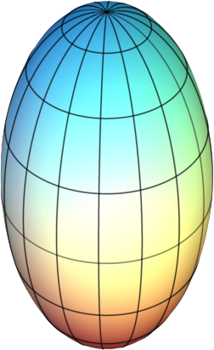
Super-deformed Nuclei
Nuclei tend to have relatively small intrinsic spins
Particularly stable nuclei predicted for A between 150 and 190 with spheroidal character
  Semi-major axis about a factor of 2 larger than semi-minor
Heavy ion collisions in late 1980s produced super-deformed nuclei with angular momentum of
The energy level spacing of these observed through photon radiation seem to be fixed
Different nuclei seem to have identical emissions as they spin down
Problem with collective model and understanding of strong pairing of nucleon binding energy
Understanding nuclear structure still in progress

Slide 23
Nuclear Radiation: Alpha Decay
Represents the disintegration of a parent nucleus to a daughter through an emission of a He nucleus
Reaction equation is
α-decay is a spontaneous fission of the parent nucleus into two daughters of highly asymmetric masses
Assuming parent at rest, from the energy conservation
Re-organizing the terms, we obtain

Slide 24
Nuclear Radiation: Alpha Decay
Since electron masses cancel, we could use atomic mass expression
This is the definition of the disintegration energy or Q-value
  Difference of rest masses of the initial and final states
  Q value is equal to the sum of the final state kinetic energies
  Energy lost during the disintegration process
For non-relativistic particles, KE are

Slide 25
Nuclear Radiation: Alpha Decay
Since the parent is at rest, from the momentum conservation
If , then
We can write the relationship of KE and Q-value as
This means that T_{α} is unique for the given nuclei
Direct consequence of 2-body decay of a parent at rest

Slide 26
Nuclear Radiation: Alpha Decay
KE of the emitted α must be positive
Thus for an α-decay to occur, it must be an exorthermic process
For a massive nuclei, the daughter’s KE is
Since , we obtain

Slide 27
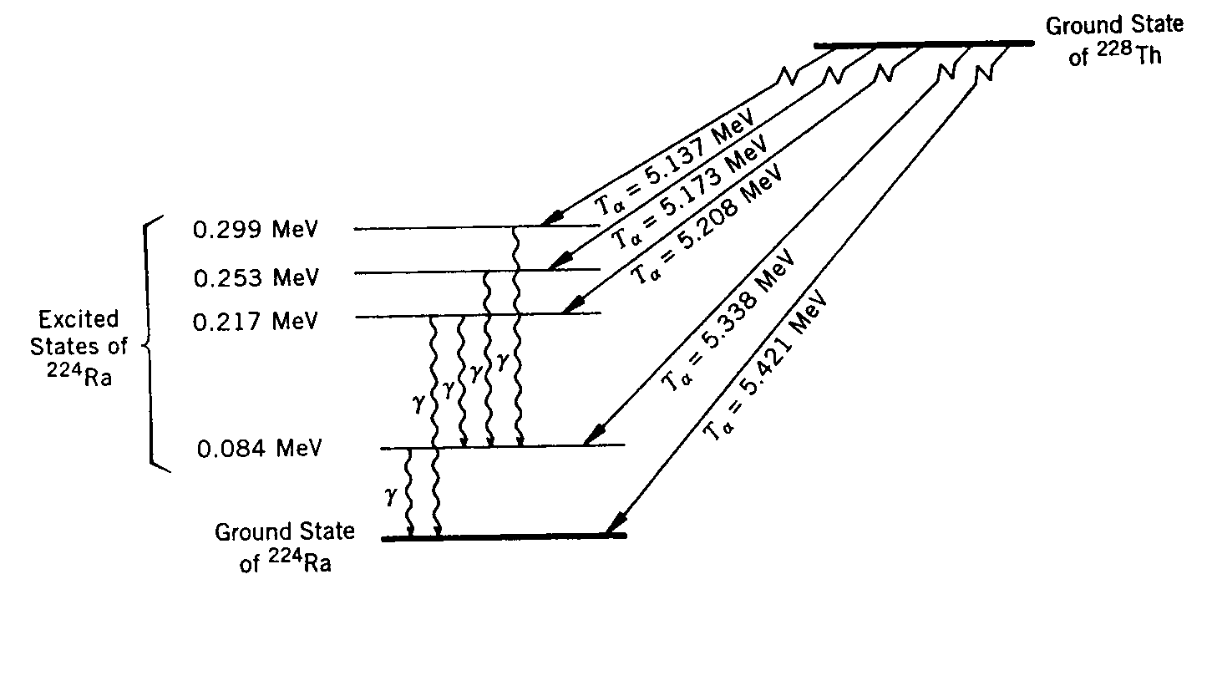
Nuclear Radiation: Alpha Decay
Most energetic α-particles produced alone
  Parent nucleus decays to the ground state of a daughter and produces an α-particle whose KE is the entire Q value
Less energetic ones accompany photons – mostly delayed…
  Indicates quantum energy levels
  Parent decays to an excited state of the daughter after emitting an α
  Daughter then subsequently de-excite by emitting a photon
  Difference in the two Q values corresponds to the energy of the photon

Slide 28
Nuclear Radiation: α-Decay Example
²⁴⁰Pu⁹⁴ decay reaction is
α particles are observed with 5.17MeV and 5.12 MeV
Since
We obtain the two Q-values
Which yields photon energy of
Consistent with experimental measurement, 45KeV
Indicates the energy level spacing of order 100KeV for nuclei
  Compares to order 1eV spacing in atomic levels

Slide 29
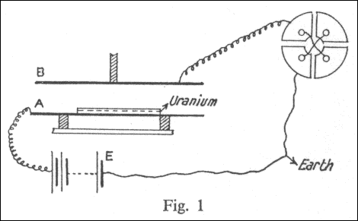
Discovery of Alpha and Beta Radiations
After Bacquerel’s discovery of uranium effect on photo-films in 1896
The Curies began study of radio activity in 1898
Rutherford also studied using a more systematic experimental equipments in 1898
  Measured the currents created by the radiations
While Bacquerel concluded that rays are observed in different levels
Rutherford made the observation using electrometer and determined that there are at least two detectable rays
  Named α and β rays

Slide 30
Nuclear Radiation: β-Decays
Three kinds of β-decays
  Electron emission
    Nucleus with large N_{n}
    Atomic number increases by one
    Nucleon number stays the same
  Positron emission
    Nucleus with many protons
    Atomic number decreases by one
    Nucleon number stays the same
  You can treat nuclear reaction equations algebraically
    The reaction is valid in the opposite direction as well
    Any particle moved over the arrow becomes its anti particle

Slide 31
Nuclear Radiation: β-Decays
  Electron capture
    Nucleus with many protons
    Absorbs a K-shell atomic electron
    Proton number decreases by one
    Causes cascade X-ray emission from the transition of remaining atomic electrons
For β-decay: ΔA=0 and |ΔZ|=1

Slide 32
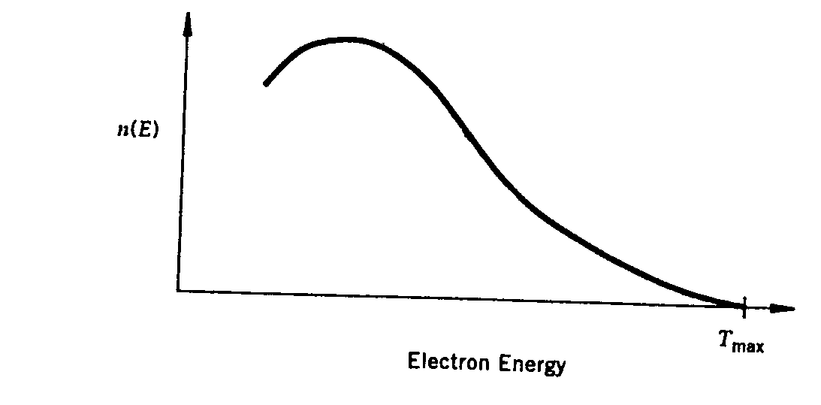
Nuclear Radiation: β-Decays
Initially assumed to be 2-body decay
From energy conservation
Since lighter electron carries most the KE
Results in a unique Q value as in α-decay.
In reality, electrons emitted with continuous E spectrum with an end-point given by the formula above
Energy conservation is violated!!!!
End-point

Slide 33
Nuclear Radiation: β-Decays
Angular momentum is also in trouble
In β-decays total number of nucleons is conserved
  Recall |ΔA|=0 and |ΔZ|=1 in β-decays?
Electrons are fermions with spin
Independent of any changes of an integer orbital angular momentum, the total angular momentum cannot be conserved
  How much does it always differ by?
Angular momentum conservation is violated!!!

Slide 34
Nuclear Radiation: β-Decays
In 1931 Pauli postulated an additional particle emitted in β-decays
  No one observed this particle in experiments
    Difficult to detect
    First observation of ν_{e} in 1956, ν_{μ} in 1962 and ν_{τ} in 1977 (direct 2000)
  Charge is conserved in β-decays
    Electrically neutral
  Maximum energy of electrons is the same as the Q value
    Massless
  Must conserve the angular momentum
    Must be a fermion with spin
This particle is called the neutrino (by Feynman) and expressed as ν

Slide 35
Nuclear Radiation: Neutrinos
Have anti-neutrinos , just like other particles
Neutrinos and anti-neutrinos are distinguished through the spin projection on momentum
  Helicity is used to distinguish them
    Left-handed (spin and momentum opposite direction) anti-electron-neutrinos are produced in β-decays
    Right-handed electron-neutrinos are produced in positron emission
  e⁻ is a particle and e⁺ is the anti-particle to e⁻
  is a particle and is the anti-particle to

Slide 36
β–Decay Reaction Equations with Neutrinos
Electron emission
Positron emission
Electron capture

Slide 37
β-Decays with neutrinos
If the parent nucleus decays from rest, from the conservation of energy
Thus the Q-value of a β-decay can be written
Electron emission can only occur if Q>0
Neglecting all small atomic BE, e emission can occur if

Slide 38
β-Decays with neutrinos
Since the daughter nucleus is much heavier than e or ν, the small recoil energy of daughter can be ignored
  Thus we can obtain
This means that the energy of the electron is not unique and can be any value in the range
  The maximum electron kinetic energy can be Q
  This is the reason why the electron energy spectrum is continuous and has an end point (=Q)
The same can apply to the other two β-decays

Slide 39
Particle Numbers
Baryon numbers: A quantum number assigned to baryons (particles consist of quarks)
  Mostly conserved in many interactions
  Baryons: +1
  Anti-baryons: -1
  Protons and neutrons are baryons with baryon number +1 each
Lepton numbers: A quantum number assigned to leptons (electrons, muons, taus and their corresponding neutrinos)
  Leptons: +1
  Anti-leptons: -1
  Must be conserved at all times under SM in each species

Slide 40
Lepton Numbers
Three charged leptons exist in nature with their own associated neutrinos
These three types of neutrinos are distinct from each other
  muon neutrinos never produce other leptons than muons or anti-muons

Slide 41
Lepton Numbers
For electron neutrinos
For tau neutrinos

Slide 42
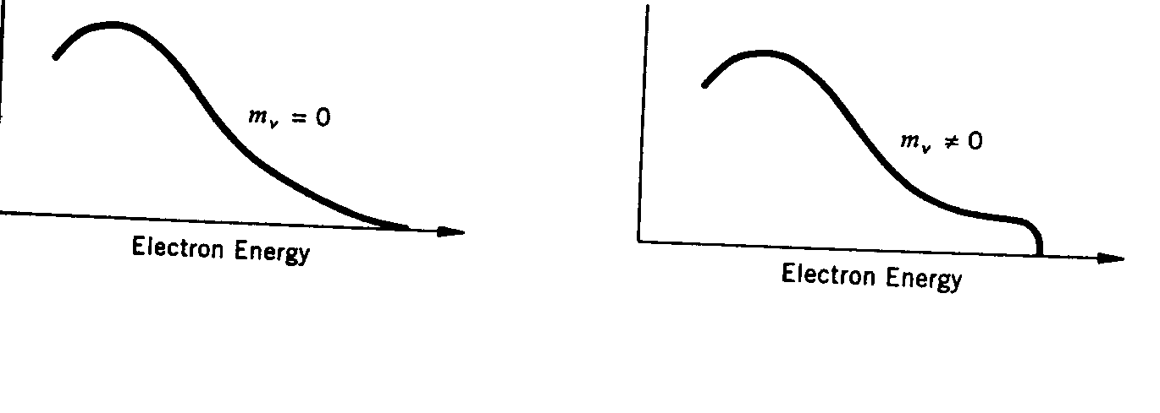
Neutrino Mass
What does neutrino mass do to the β-spectrum?
The higher end tail shape depends on the mass of the neutrino
  β-spectrum could be used to measure the mass of neutrinos
    Very sensitive to the resolution on the device
  Most stringent direct limit is m_{ν}<2eV/c²
Non-zero mass of the neutrino means
  Neutrino Oscillation: Mixing of neutrino species
Smooth tail
Sharp cut-off

Slide 43
Weak Interactions
β-decay can be written at the nucleon level as:
Since neutrons are heavier than protons, they can decay to a proton in a free space
  On the other hand, protons are lighter than neutrons therefore they can only undergo a β-decay within a nucleus
  Life time of a neutron is about 900sec
  This life time is a lot longer than nuclear reaction time scale 10⁻²³ s or EM scale 10⁻¹⁶ s.
This means that a β-decay is a nuclear phenomenon that does not involve strong nuclear or EM forces
Fermi postulated a new weak force responsible for β-decay

Slide 44
Weak Interactions
Weak forces are short ranged
  How do we know this?
    Occurs in the nuclear domain
    Weakness of the strength is responsible for long life time seen in β-decays
Nucleus does not contain electrons
  Electrons in β-decays must come from somewhere else
  Electrons are emitted without time delay
    The electron must come at the time of decay just like the alphas from a nuclear disintegration
  β-decay can be considered to be induced by the weak force

Slide 45
Weak Interactions
The transition probability per unit time, the width, can be calculated from perturbation theory using Fermi’s Golden rule
Where the weak interaction Hamiltonian is

Slide 46
Weak Interactions
Based on β-decay reaction equations, the H_{wk} must be a four fermionic states
  H_{wk} proposed by Fermi in 1933 is a four-fermion interaction or current-current interaction
  Relativistic
  Agreed rather well with experiments for low energy β-decays
Parity violation
  There are only left-handed neutrinos and right-handed anti-neutrinos
  A system is parity invariant if it does not change under inversion of spatial coordinates
  The spin
  The handedness, helicity, changes upon the spatial inversion since the direction of the motion changes while the spin direction does not
  Since there is no right handed neutrinos, parity must be violated in weak interactions

Slide 47
Gamma Decays
When a heavy nuclei undergo alpha and beta decays, the daughters get into an excited state
  Must either break apart
  Or emit another particle
  To bring the daughter into its ground state
Typical energies of photons in γ-decays are a few MeV’s
  These decays are EM interactions thus the life time is on the order of 10⁻¹⁶sec.
Photons carry one unit of angular momentum
  Parity is conserved in this decay

Slide 48
Assignments
Reading assignment: CH 4.3
End of the chapter problems: 3.2
Derive the following equations:
  Eq. 4.8 starting from conservation of energy
  Eq. 4.11 both the formula
Due for these homework problems is next Monday, Oct. 16.

