Slide 1
PHYS 3446 – Lecture #10
Wednesday, Oct. 5, 2016
Dr. Jae Yu
Nuclear Radiation
Beta Decay & Weak Interactions
Gamma Decay
Energy Deposition in Media
Charged Particle Detection
Ionization Process
Photon Energy Loss

Slide 2
Announcement
First term exam
  Date and time: 2:30 – 3:50pm, Monday, Oct. 10
  Location: SH125
  Covers: Ch 1 – Ch 4 + Appendix A
  Can bring your calculator but no phone or computer can be used as a replacement

Slide 3
Assignments
Reading assignment: CH 4.3; CH5
End of the chapter problems: 3.2
Derive the following equations:
  Eq. 4.8 starting from conservation of energy
  Eq. 4.11 both the formula
Due for these homework problems is next Monday, Oct. 16.

Slide 4
Nuclear Radiation: α-Decay Example
²⁴⁰Pu⁹⁴ decay reaction is
α particles are observed with T_{α}=5.17 and 5.12 MeV
Since
We obtain the two Q-values
Which yields photon energy of
Consistent with the experimental measurement, 45KeV
Indicates the energy level spacing of order 100KeV for nuclei
  Compares to order 1eV spacing in atomic levels

Slide 5
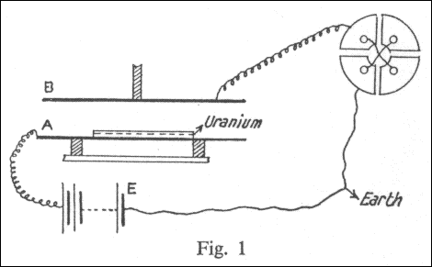
Discovery of Alpha and Beta Radiations
After Bacquerel’s discovery of uranium effect on photo-films in 1896
The Curies began to study radio activity in 1898
Rutherford also studied using a more systematic experimental equipment in 1898
  Measured the currents created by the radiations
While Bacquerel concluded that the rays are observed in different levels
Rutherford made the observation using electrometer and determined that there are at least two detectable rays
  Named α and β rays

Slide 6
Nuclear Radiation: β-Decays
Three kinds of β-decays
  Electron (β) emission
    Nucleus with large N_{n}
    Atomic number increases by one
    Nucleon number stays the same
  Positron (β⁺) emission
    Nucleus with many protons
    Atomic number decreases by one
    Nucleon number stays the same
  You can treat nuclear reaction equations algebraically
    The reaction is valid in the opposite direction as well
    Any particle moved over the arrow becomes its anti particle

Slide 7
Nuclear Radiation: β-Decays
  Electron capture
    Nucleus with many protons
    Absorbs a K-shell atomic electron
    Proton number decreases by one
    Causes cascade X-ray emission from the transition of remaining atomic electrons
For β-decay: ΔA=0 and |ΔZ|=1

Slide 8
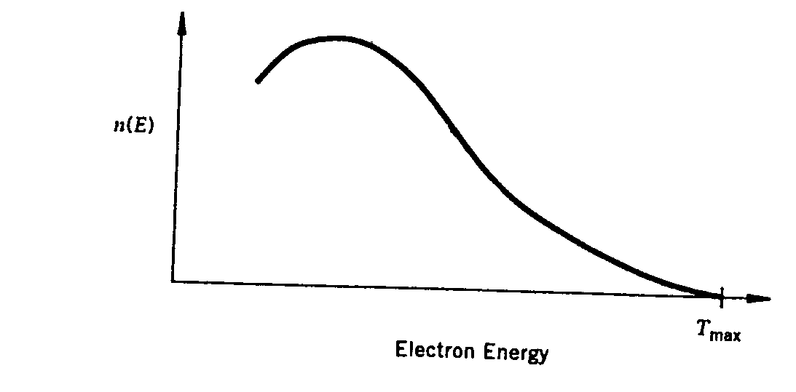
Nuclear Radiation: β-Decays
Initially assumed to be a 2-body decay
From the energy conservation
Since lighter electron carries most the KE
Results in a unique Q value as in α-decay.
In reality, electrons emitted with continuous E spectrum with an end-point given by the formula above
Energy conservation is violated!!!!
End-point

Slide 9
Nuclear Radiation: β-Decays
Angular momentum is also in trouble
In β-decays total number of nucleons is conserved
  Recall |ΔA|=0 and |ΔZ|=1 in β-decays?
Electrons are fermions with spin
No matter how you change the integer orbital angular momentum, the total angular momentum cannot be conserved
  How much does it always differ by?
Angular momentum conservation is violated!!!

Slide 10
Nuclear Radiation: β-Decays
In 1931 Pauli postulated an additional particle emitted in β-decays
  No one observed this particle in experiments
    Difficult to detect
    First observation of ν_{e} in 1956, ν_{μ} in 1962 and ν_{τ} in 1977 (direct 2000)
  Charge is conserved in β-decays
    Electrically neutral
  Maximum energy of electrons is the same as the Q value
    Massless
  Must conserve the angular momentum
    Must be a fermion with spin
This particle is called the neutrino (by Feynman) and expressed as ν

Slide 11
Nuclear Radiation: Neutrinos
Have anti-neutrinos , just like other particles
Neutrinos and anti-neutrinos are distinguished through the spin projection on momentum axis
  Helicity is used to distinguish them
    This is intrinsic for neutrinos
    Right-handed (spin and momentum in opposite direction) anti-electron-neutrinos are produced in β-decays
    Left-handed electron-neutrinos are produced in positron emission
  e⁻ is a particle and e⁺ is the anti-particle to e⁻
  is a particle and is the anti-particle to

Slide 12
β–Decay Reaction Equations with Neutrinos
Electron emission
Positron emission
Electron capture

Slide 13
β-Decays with neutrinos
If the parent nucleus decays from rest, from the conservation of energy
Thus the Q-value of a β-decay can be written
Electron emission can only occur if Q>0
Neglecting all small atomic BE, e emission can occur if

Slide 14
β-Decays with neutrinos
Since the daughter nucleus is much heavier than e or ν, the small recoil kinetic energy of the daughter can be ignored
  Thus we can obtain
This means that the energy of the electron is not unique and can be any value in the range
  The maximum electron kinetic energy can be Q
  This is the reason why the electron energy spectrum is continuous and has an end point (=Q)
The same can apply to the other two β-decays

Slide 15
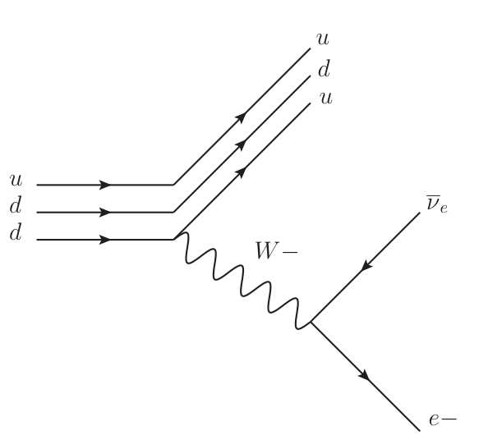
Neutron Beta Decay Feynman Diagram
}p
n{

Slide 16
Particle Numbers
Baryon numbers: The quantum number assigned to baryons (particles consist of quarks)
  Mostly conserved in many interactions
  Baryons: +1
  Anti-baryons: -1
  Protons and neutrons are baryons with baryon number +1 each
Lepton numbers: The quantum number assigned to leptons (electrons, muons, taus and their corresponding neutrinos)
  Leptons: +1
  Anti-leptons: -1
  Must be conserved at all times under SM in each species

Slide 17
Lepton Numbers
Three charged leptons exist in nature with their own associated neutrinos
These three types of neutrinos are distinct from each other
  muon neutrinos never produce other leptons than muons or anti-muons

Slide 18
Lepton Numbers
For electron neutrinos
For tau neutrinos

Slide 19
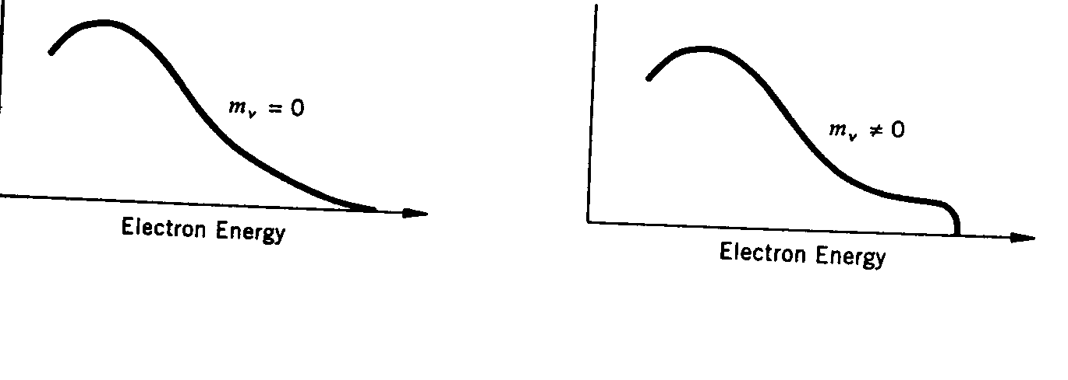
Neutrino Mass
What does neutrino mass do to the β-spectrum?
The higher end tail shape depends on the mass of the neutrino
  β-spectrum could be used to measure the mass of neutrinos
    Very sensitive to the resolution on the device
  Most stringent direct limit is m_{ν}<2eV/c²
Non-zero mass of the neutrino means
  Neutrino Oscillation: Mixing of neutrino species
Smooth tail
Sharp cut-off

Slide 20
Weak Interactions
The β-decay can be written at the nucleon level as:
Since neutrons are heavier than protons, they can decay to a proton in a free space
  On the other hand, protons are lighter than neutrons therefore they can only undergo a β-decay within a nucleus
  Lifetime of a neutron is about 900sec
  This lifetime is a lot longer than nuclear reaction time scale 10⁻²³ s or EM scale 10⁻¹⁶ s.
This means that a β-decay is a nuclear phenomenon that does not involve the strong nuclear or EM forces
Fermi postulated a new weak force (1933) responsible for β-decay (discovered the force mediators in 1983!)

Slide 21
Weak Interactions
Weak forces are short ranged
  How do we know this?
    Occurs in the nuclear domain
    Weakness of the strength is responsible for long lifetime seen in β-decays
Nucleus does not contain electrons
  Electrons in β-decays must come from somewhere else
  Electrons are emitted without a time delay
    The electron must come at the time of decay just like the alphas from a nuclear disintegration
  β-decay can be considered to be induced by the weak force

Slide 22
Weak Interactions
The transition probability per unit time, the width, can be calculated from perturbation theory using Fermi’s Golden rule
Where the weak interaction Hamiltonian is

Slide 23
Weak Interactions
Based on β-decay reaction equations, the H_{wk} must be a four fermionic states
  H_{wk} proposed by Fermi in 1933 is a four-fermion interaction or current-current interaction
  Relativistic
  Agreed rather well with experiments for low energy β-decays
Parity violation
  There are only left-handed neutrinos and right-handed anti-neutrinos
  A system is parity invariant if it does not change under inversion of spatial coordinates
  The spin
  The handedness, helicity, changes upon the spatial inversion since the direction of the motion changes while the spin direction does not
  Since there is no right handed neutrinos, parity must be violated in weak interactions

Slide 24
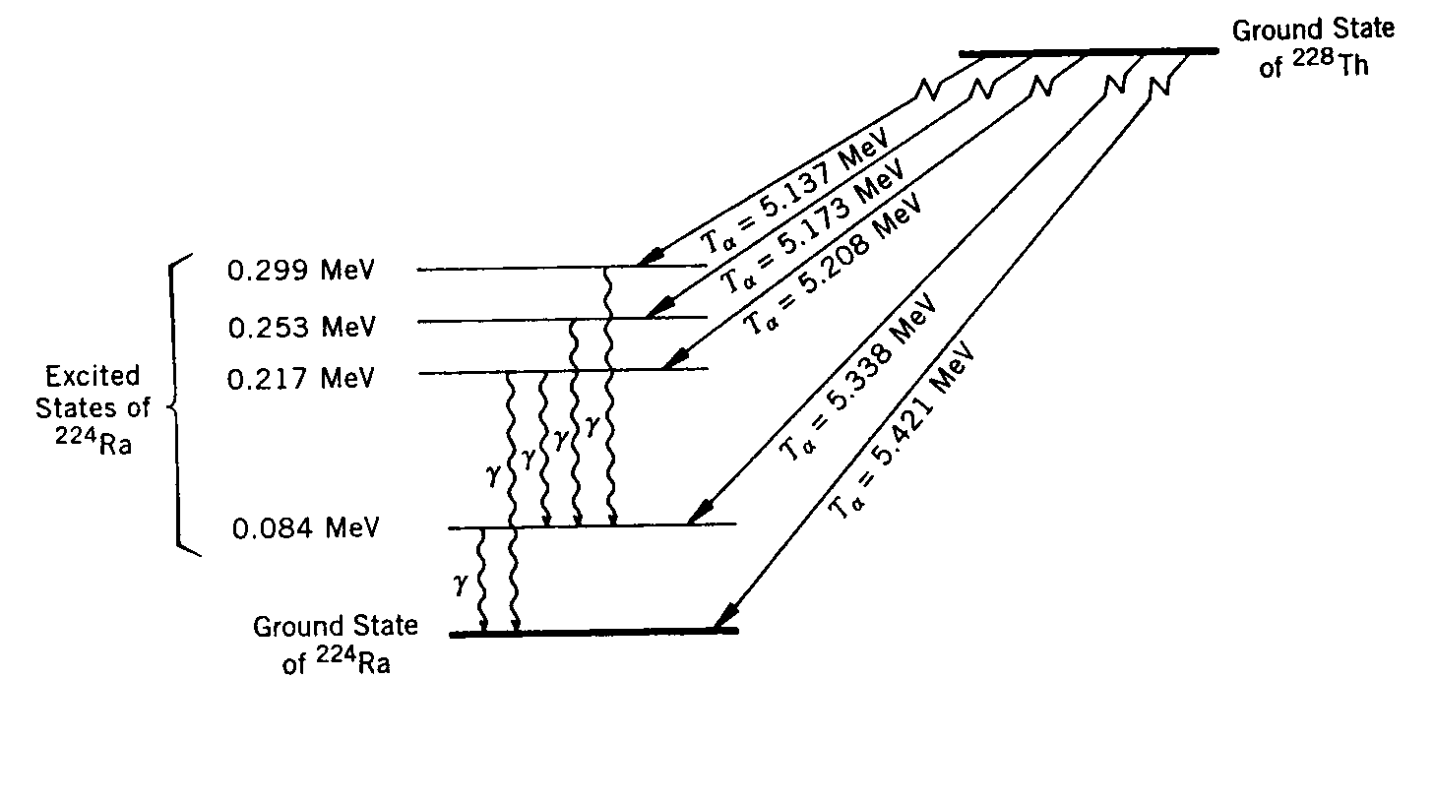
Gamma Decays
When a heavy nuclei undergo alpha and beta decays, the daughters get into an excited state
  Must either break apart
  Or emit another particle
  To bring the daughter into its ground state
Typical energies of photons in γ-decays are a few MeV’s
  These decays are EM interactions thus the lifetime is on the order of 10⁻¹⁶sec.
Photons carry one unit of angular momentum
  Parity is conserved in this decay

Slide 25
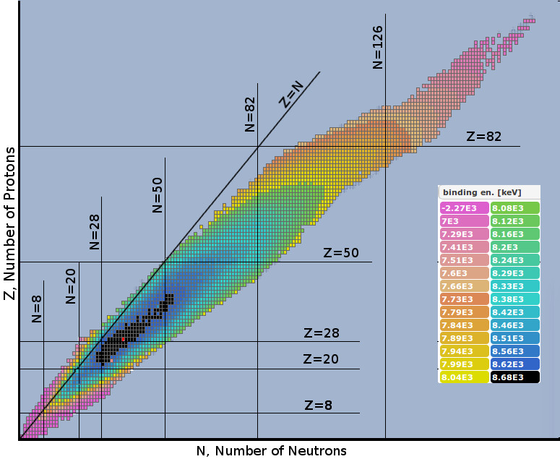
Nuclear Binding Energy – Valley of Stability

Slide 26
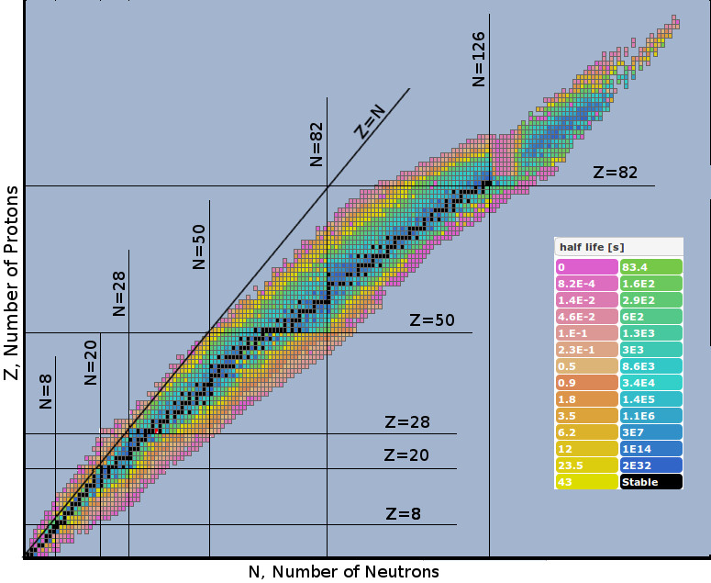
Half Life

Slide 27
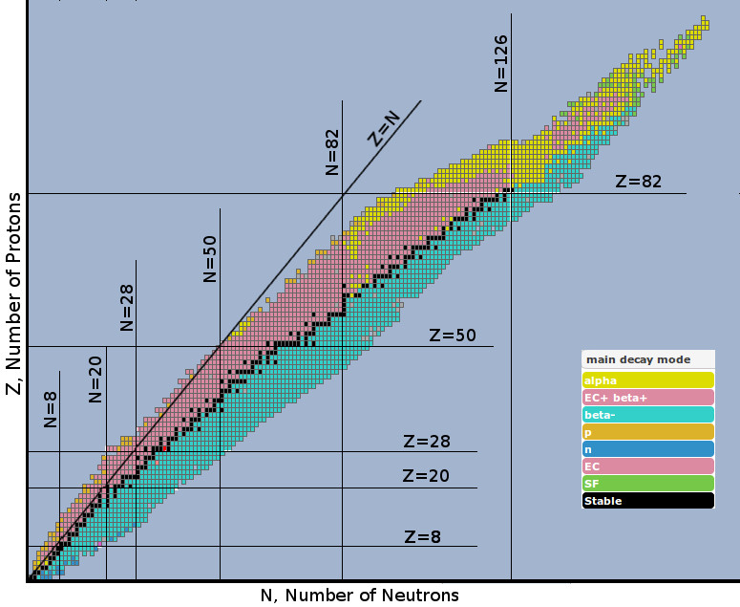
Nuclear Decay Type

