Slide 1
PHYS 3446 – Lecture #11
Wednesday, Oct. 12, 2016
Dr. Jae Yu
Energy Deposition in Media
  Charged Particle Detection
  Ionization Process
  Photon Energy Loss

Slide 2
Reminder: Assignments
Reading assignment: CH 4.3; CH5
End of the chapter problems: 3.2
Derive the following equations:
  Eq. 4.8 starting from conservation of energy
  Eq. 4.11 both the formula
Due for these homework problems is next Monday, Oct. 16.

Slide 3
Forces in Nature
We have learned the discovery of two additional forces
  Gravitational force: formulated through Newton’s laws
  Electro-magnetic force: formulated through Maxwell’s equations
  Strong nuclear force: Discovered through studies of nuclei and their structure
  Weak force: Discovered and postulated through nuclear β-decay

Slide 4
Forewords
Physics is an experimental science
  Understand nature through experiments
In nuclear and particle physics, experiments are performed through scattering of particles
In order for a particle to be detected:
  Must leave a trace of its presence ➔ deposit energy

Slide 5
Forewords
The most ideal detector should
  Detect particle without affecting them
Realistic detectors
  Use electromagnetic interactions of particles with matter
    Ionization of matter by energetic, charged particles
    Ionization electrons can then be accelerated within an electric field to produce detectable electric current
  Sometime catastrophic nuclear collisions but rare
  Particles like neutrinos which do not interact through EM and have low cross sections, need special methods to handle

Slide 6
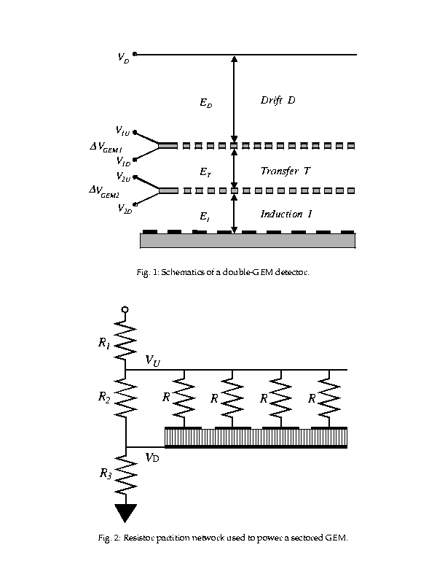
How does a charged particle get detected?
Charged track
Ionization
Filled w/ easily ionizeable gas:ArCO2
+++++++++++
- - - - - - - - - - - -
Current amplification

Slide 7
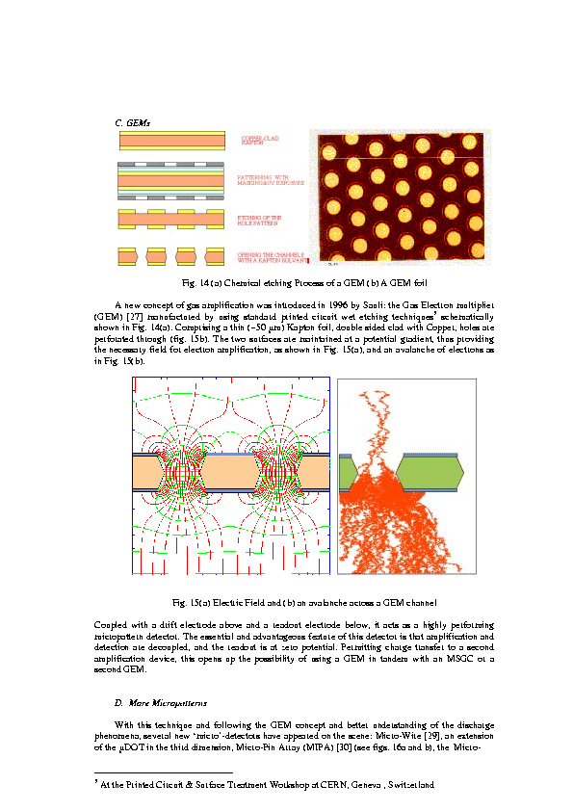
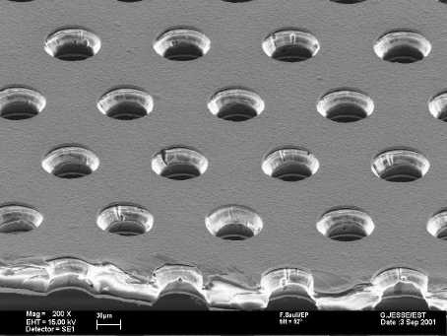
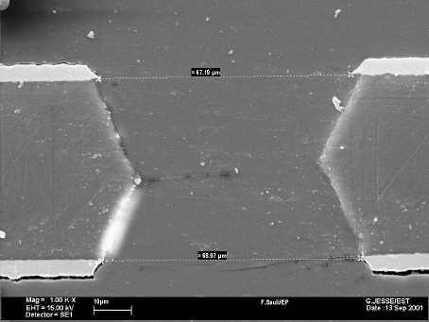
Large amplification
140μm
70μm
CERN-open-2000-344, A. Sharma

Slide 8
Charged Particle Detection
What do you think is the primary interaction when a charged particle is traversing through a medium?
  EM interactions with the atomic electrons in the medium
If the energy of the charged particle is sufficiently high
  It deposits its energy (or loses its energy in the matter) by ionizing the atoms in the path
  Or by exciting atoms or molecules to their excited states
  What are the differences between the above two methods?
    The outcomes are either electrons or photons
If the charged particle is massive, its interactions with atomic electrons will not affect the particles trajectory
Sometimes, the particle undergoes a more catastrophic nuclear collisions
electrons
photons

Slide 9
Ionization Process
Ionization properties can be described by the stopping power variable, S(T)
  Definition: amount of kinetic energy lost by any incident particle per unit length of the path traversed in the medium
  Referred as ionization energy loss or energy loss
    T: Kinetic energy of the incident particle
    n_{ion}: Number of electron-ion pair formed per unit path length
    ‾ I : The average energy needed to ionize an atom in the medium; for large atomic numbers ~10Z eV.
Why negative sign?
The particle’s energy decreases.

Slide 10
Ionization Process
What do you think the stopping power of the given medium depends on?
  Energy of the incident particle
    Depends very little for relativistic particles
  Electric charge of the incident particle
Since ionization is an EM process, easily calculable
  Bethe-Bloch formula for relativistic particle
  z: Incident particle atomic number
  Z: medium atomic number
  n: number of atoms in unit volume (=ρA₀/A)
  m: mass of the incident particle

Slide 11
Ionization Process
In natural α-decay, the formula becomes
  Due to its low kinetic energy (a few MeV) and large mass, relativistic corrections can be ignored
For energetic particles in accelerator experiments or beta emissions, the relativistic corrections are substantial
Bethe-Bloch formula can be used in many media for various incident particles over a wide range of energies
1
~0

Slide 12
Ionization Process
Why does the interaction with atomic electrons dominate the energy loss of the incident particle?
  Interactions with heavy nucleus causes large change of direction of the momentum but little momentum transfer
    Does not necessarily require large loss of kinetic energy
  While momentum transfer to electrons would require large kinetic energy loss
    Typical momentum transfer to electrons is 0.1MeV/c and requires 10KeV of kinetic energy loss
    The same amount of momentum transfer to a gold nucleus would require less than 0.1eV of energy loss
Thus Bethe-Bloch formula is inversely proportional to the mass of the particle

Slide 13
Ionization Process
At low particle velocities, ionization loss is sensitive to particle energy. How do you see this?
  Stopping power decreases as v increases!!
This shows that the particles of different rest mass (M) but the same momentum (p) can be distinguished due to their different energy loss rate
At low velocities (γ~1), particles can be distinguished
v

Slide 14
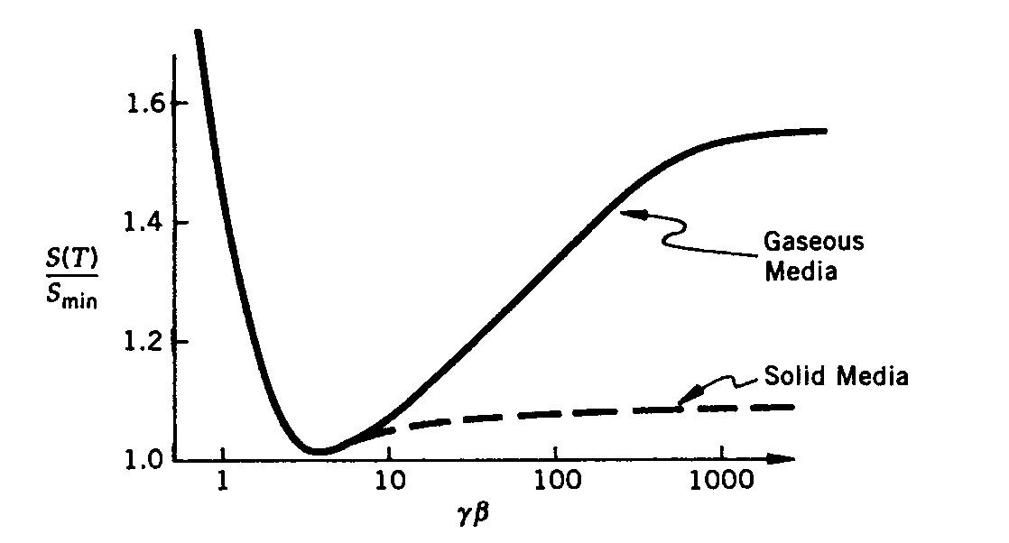
Properties of Ionization Process
The stopping power decreases with increasing particle velocity independent of incident particle mass
  Minimum occurs when γβ~3
    Particle is minimum ionizing when v~0.96c
    For massive particles the minimum occurs at higher momenta
  This is followed by a ln(γβ) relativistic rise by Beth-Bloch formula
  Energy loss plateaus at high γβ due to long range inter-atomic screening effect which is ignored in Beth-Bloch
Plateau due to inter-atomic screening
MIP( Minimum Ionizing Particle)
Relativistic rise ~ln (γβ)

Slide 15
Ionization Process
At very high energies
  Relativistic rise becomes an energy independent constant rate
  Cannot be used to distinguish particle-types purely using ionization
  Except for gaseous media, the stopping power at high energies can be approximated by the value at γβ~3.
At low energies, the stopping power expectation becomes unphysical
  Ionization loss is very small when the velocity is very small
  Detailed atomic structure becomes important

Slide 16
Ranges of Ionization Process
Once the stopping power is known, we can compute the expected range of any particle in the medium
  The distance an incident particle can travel in a medium before its kinetic energy runs out
At low E, two particles with the same KE but different masses can have very different ranges
  This is why α and β radiations have quite different requirements to stop

Slide 17
Units of Energy Loss and Range
What would be the sensible unit for energy loss?
  MeV/cm
  Equivalent thickness of g/cm²: MeV/(g/cm²)
Range is expressed in
  cm or g/cm²
Minimum value of S(T) for z=1 at γβ=3 is
Using <Z>=20 we can approximate

Slide 18
Straggling, Multiple Scattering and Statistical process
Phenomenological calculations can describe average behavior but large fluctuations are observed in an event-by-event bases
  This is due to the statistical nature of the scattering process
    Finite dispersion of energy deposit or scattering angular distributions is measured
Statistical effect of angular deviation experienced in Rutherford scattering off atomic electrons in the medium
  Consecutive collisions add up in a random fashion and provide net deflection of any incident particles from its original path
  Called “Multiple Coulomb Scattering” ➔ Increases as a function of path length
    z: charge of the incident particle, L: material thickness, X₀: the radiation length of the medium

Slide 19
Ex: Multiple Scattering Angles
Compare the multiple scattering angles of 5MeV proton to 5MeV electron through 1cm of Ar gas whose radiation length is 105m at atmospheric pressure and 0ºC.
For proton which is non-relativistic
For the electron which is relativistic

