Slide 1
PHYS 3446 – Lecture #13
Monday, Oct. 17, 2016
Dr. Jae Yu
Energy Deposition in Media
  Bremstraarhlung Process
  Photon Energy Loss
  Neutron Interactions
  Hadron Interactions

Slide 2
Announcement
First term exam results
  Class average: 40.1/97
    Equivalent to 41.3/100
  Top score: 68/97
Evaluation Policy Reminder:
  Two Term Exams: 15 % each ➔ 30%
  Lab Score: 15%
  Final Semester project paper: 20%
  5+2 minute Project oral presentation: 10%
  Homework: 15%
  Quizzes: 10%
  Extra Credit: 10%

Slide 3
Homework #6
Perform the detailed calculations in examples 1 – 7 in CH6
Due for these homework problems is next Monday, Oct. 24.

Slide 4
Straggling, Multiple Scattering and Statistical process
Phenomenological calculations can describe average behavior but large fluctuations are observed in an event-by-event bases
  This is due to the statistical nature of the scattering process
    Finite dispersion of energy deposit or scattering angular distributions is measured
Statistical effect of angular deviation experienced in Rutherford scattering off atomic electrons in the medium
  Consecutive collisions add up in a random fashion and provide net deflection of any incident particles from its original path
  Called “Multiple Coulomb Scattering” ➔ Increases as a function of path length
    z: charge of the incident particle, L: material thickness, X₀: the radiation length of the medium

Slide 5
Ex: Multiple Scattering Angles
Compare the multiple scattering angles of 5MeV proton to 5MeV electron through 1cm of Ar gas whose radiation length is 105m at atmospheric pressure and 0ºC.
For proton which is non-relativistic
For the electron which is relativistic

Slide 6
Energy Loss Through Bremsstrahlung
Energy loss of incident electrons
  Bethe-Bloch formula works well (up to above 1MeV for electrons)
  But due to the small mass, electron’s energy loss gets complicated
    Relativistic corrections take large effect even down to a few keV level
    Electron projectiles can transfer large fractions of energies to the atomic electrons they collide
      Produce δ-rays or knock-on electrons ➔ Which have the same properties as the incident electrons
  Electrons suffer a large acceleration as a result of the interaction with electric field by nucleus. What do these do?
  Causes electrons to radiate or emit photons
    Bremsstrahlung ➔ An important mechanism of relativistic electron energy loss
* Bremsstrahlung: Braking Radiation or Decelerating Radiation

Slide 7
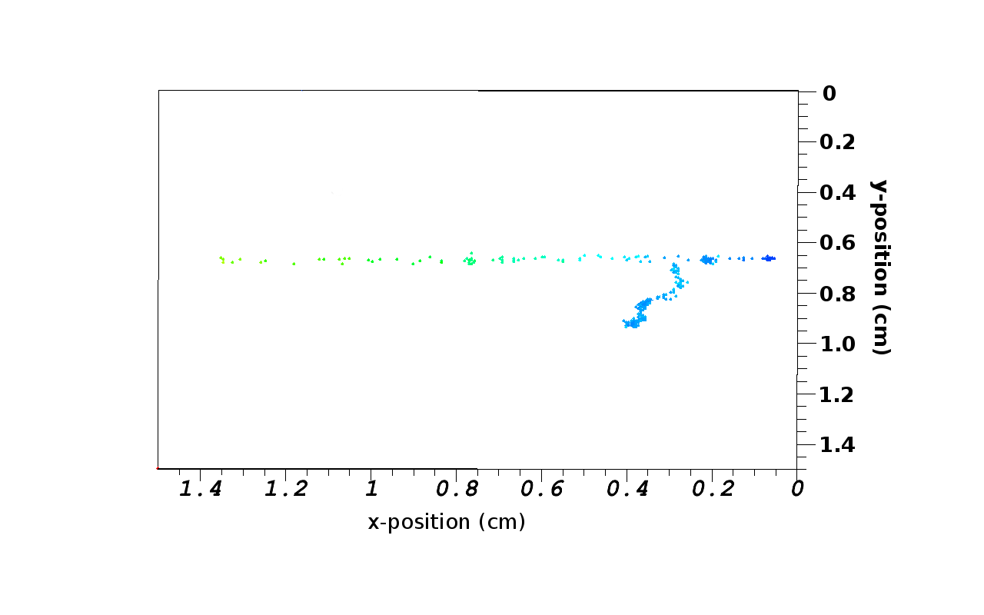
A 3D depiction of a delta ray

Slide 8
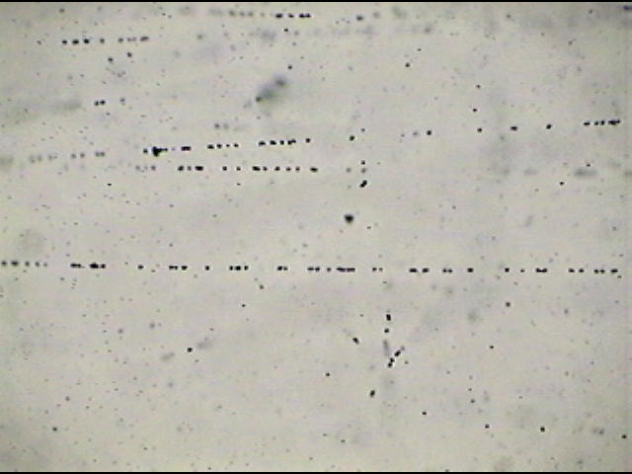
Nuclear Emulsion Photos
Electron tracks
0 μm

Slide 9
Total Electron Energy Loss
The total electron energy loss in matter can be written as
Relative magnitude between Bremsstrahlung and ionization is
    Z: Atomic number of the medium, m_{e}: rest mass of the electron, T: Kinetic energy of the electron in MeV
At high energies, the ionization loss is constant
  Radiation is the dominant energy loss mechanism
  The energy loss is directly proportional to the incident kinetic energy

Slide 10
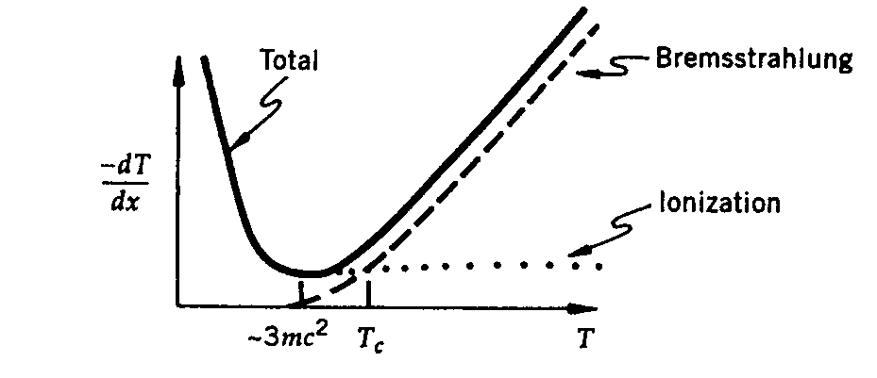
Total Electron Energy Loss
Above the critical energy (T_{c}) the brem process dominates

Slide 11
Photon Energy Loss
Photons are electrically neutral
  They do not feel the Coulomb force
  They cannot directly ionize atoms
Photons are EM force carriers
  Can interact with matter and result in ionization
  What are the possible processes?
    Photo-electric effect
    Compton scattering
    Pair production

Slide 12
Light Attenuation
Reduction of intensity in a medium
Can be described by the effective absorption coefficient μ
  μ reflects the total cross section for the interaction
  μ depends on energy or frequency of the incident light
The intensity of light at any given point through the medium, x, is given as
Half thickness, the thickness of material for photon’s intensity to be half the initial intensity:
μ⁻¹ is the mean free path for absorption

Slide 13
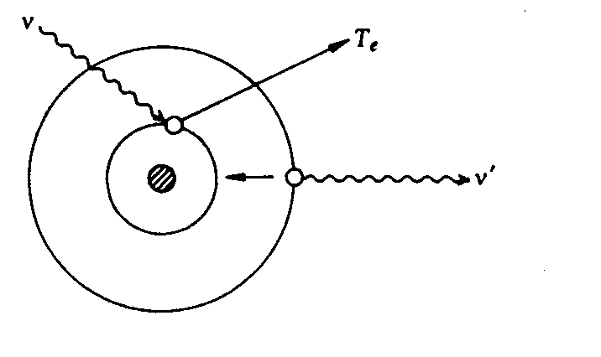
Photo-electric Effect
Low energy photon is absorbed by a bound electron in an atom
  The electron is subsequently emitted with T_{e}
  The energy of electron T_{e} is
I_{B}: Energy needed to free the given atomic electron
ν: Frequency of the incident photon

Slide 14
Photo-electric Effect
The energy I_{B} sets the threshold photon energies for this process to take place
Photo-electric effect cross section is large in the range of X-ray energies (keV)

Slide 15
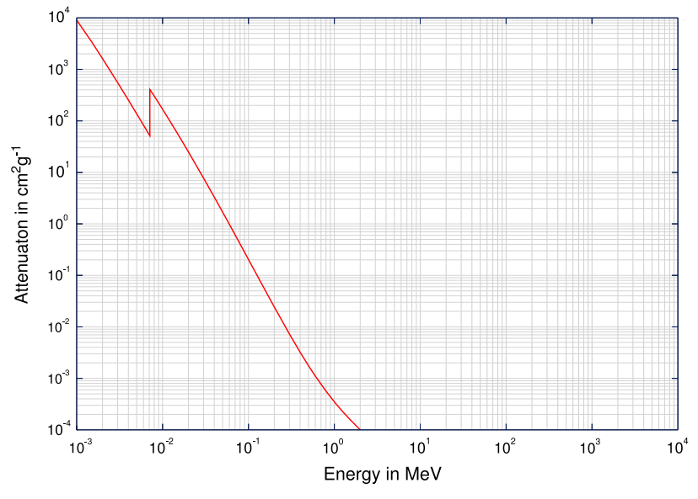
Photo-electric Effect X-sec

Slide 16
Photo-electric Effect
The energy I_{B} sets the threshold photon energies for this process to take place
Photo-electric effect cross section is large in the range of X-ray energies (keV)
The scale of cross section is
What do you conclude from these?
  This process is particularly important for high Z medium
  Not very significant above 1MeV photon energies
When an inner layer electron is emitted, photons from transition accompany the electron
for
and
for

Slide 17
Photo-electric Effect X-sec
Absorption Edge

Slide 18
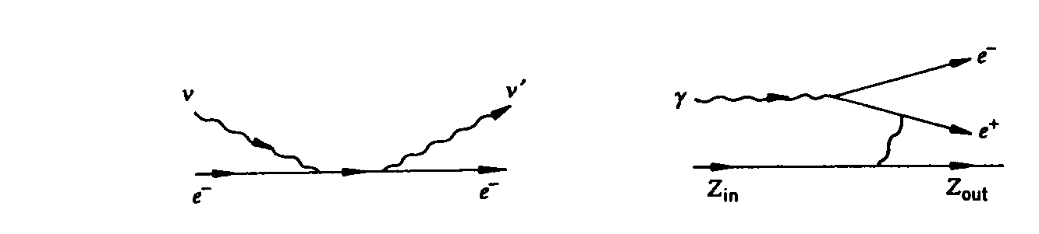
Compton Scattering
Equivalent to photo-electric effect on a free electron
  Like a collision between a photon with energy E=hν and momentum p=E/c on a stationary electron
  Electron absorbs a photon
    Forms an electron like system with excited state and with an unphysical mass (virtual system)
    Emits a photon with different frequency as it de-excites into a physical electron

Slide 19
Compton Scattering
The kinematics of the scattering assumes the free electron
Thus the results will not work for low energy (<100keV) incident photons where the effect of atomic binding can be important
The emitted photon frequency of scattering angle θ is
  For finite scattering angle (θ), the energy of the scattered photon is smaller than that of the incident one
  Some incident photon energy is transferred to the electron, having recoil energy dependent on the scattering angle
  This was a piece of evidence for particle property of light

Slide 20
Pair Production
When a photon has sufficient energy, it can be absorbed in matter and produces a pair of oppositely charged particles
  Should not violate any conservation laws, including quantum number conservations
  Most common one is the conversion to an electron and positron pair
Massless photons cannot produce a pair of massive particles without violating energy-momentum conservation
  In photon’s rest frame, the initial state energy is 0.
  While final state energy is non-zero.
Thus the pair production can only occur in a medium
  Why?
    A recoiling nucleus can absorb any momentum required to assure energy-momentum conservation

Slide 21
Pair Production
What is the minimum energy needed to produce an electron-positron pair?
  Twice the rest mass energy of the electron
The pair production cross section is proportional to Z²
  Z: atomic number of the medium
  Rises rapidly and dominates all energy-loss mechanisms for photon energies above 10MeV or so.
  It saturates and can be characterized by a constant mean free path for the conversion
    A constant absorption coefficient ➔ Electron radiation length of medium

Slide 22
Pair Production
What happens to the positron created in the conversion?
  Positron is the anti-particle of the electron
  Behaves exactly like electrons as they traverse through the matter
    Deposits energy through ionization or Bremsstrahlung
  When it loses most of its kinetic energy, it captures an electron to form a hydrogen like atom, a positronium.
  Positronium is unstable and decays (annihilate) in a life time of 10⁻¹⁰ s
  Why two photons?
    To conserve the angular momentum
  To conserve energy-momentum, the photon energies are exactly 0.511 MeV each
    Good way to detect positronium

