Slide 1
PHYS 3446 – Lecture #14
Wednesday, Oct. 19, 2016
Dr. Jae Yu
Energy Deposition in Media
  Neutron Interactions
  Hadron Interactions
Particle Detection
  Ionization Detectors
  MWPC
  Scintillation Counters
  Time of Flight

Slide 2
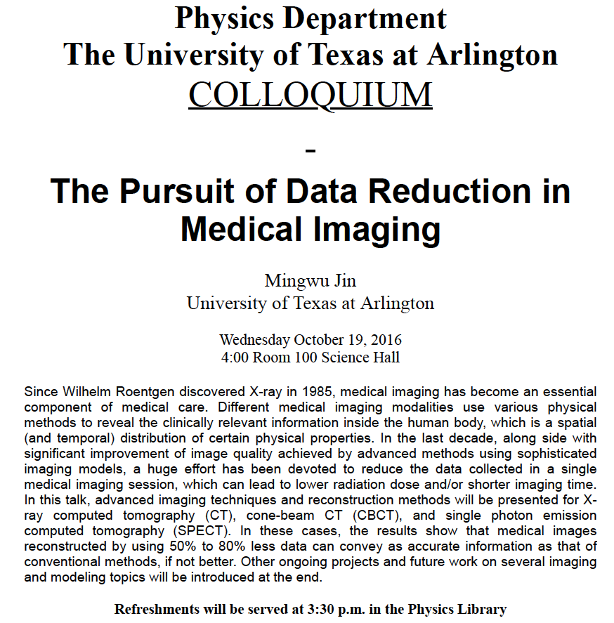

Slide 3
Reminder for Homework #6
Perform the detailed calculations in examples 1 – 7 in CH6
Due for these homework problems is Monday, Oct. 24.

Slide 4
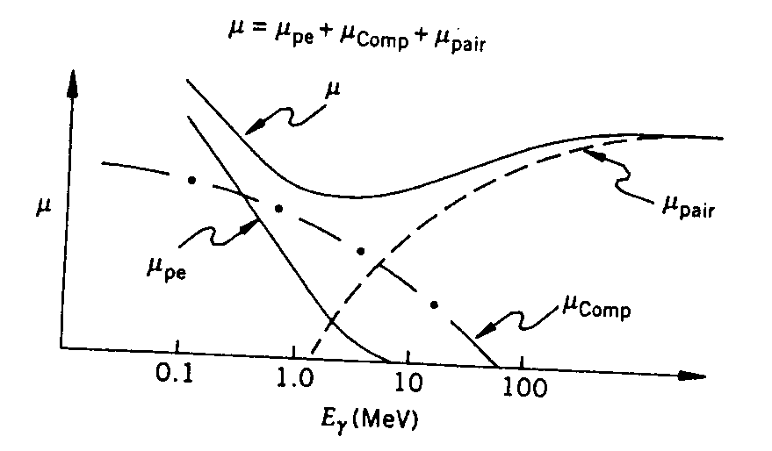
Photon Energy Loss Processes
Total absorption coefficient of photons in a medium can be written as
The absorption coefficient can be related to the cross section as
Virtually flat!!

Slide 5
Example 6.5
The total absorption coefficient for 5MeV photons in lead is about 0.04cm²/g. (a) If the density of lead is 11.3g/cm³, what is the half thickness of lead for these photons? (b) What thickness of lead would be required to reduce the intensity of such photons to 6% of the initial value?
(a) First convert the absorption coefficient to cm⁻¹.
(b) Using the intensity formula:
Solving for x, we obtain
Typical thickness of lead in an apron is 0.25mm to 0.5mm
  What percentage of gamma ray radiations can these thicknesses stop?

Slide 6
Interaction of Neutrons
What are the characteristics of neutrons?
  A constituent of nuclei
  Have the same nucleon number as protons
  Have the same spin as protons
  Electrically neutral ➔ Do not interact through Coulomb force
  Interacts through strong nuclear force
When low energy neutrons interact inelastically
  Nucleus get excited and decay to ground levels through emission of photons or other particles
  Such photons or other particles can be detected through other processes

Slide 7
Interaction of Neutrons
  In an elastic scattering of neutrons, it loses smaller amount of energy if the media’s nucleus is heavy
    Hydrogen rich paraffin is used to slow down neutrons
When neutrons are produced in experiments, they can penetrate deep
  Since normally there are no hydrogen nuclei available for kinetic energy absorption
  The neutron that shines or “albedoes” at accelerators and reactors is often a major source of background
    Can only be reduced with the use of appropriate moderators

Slide 8
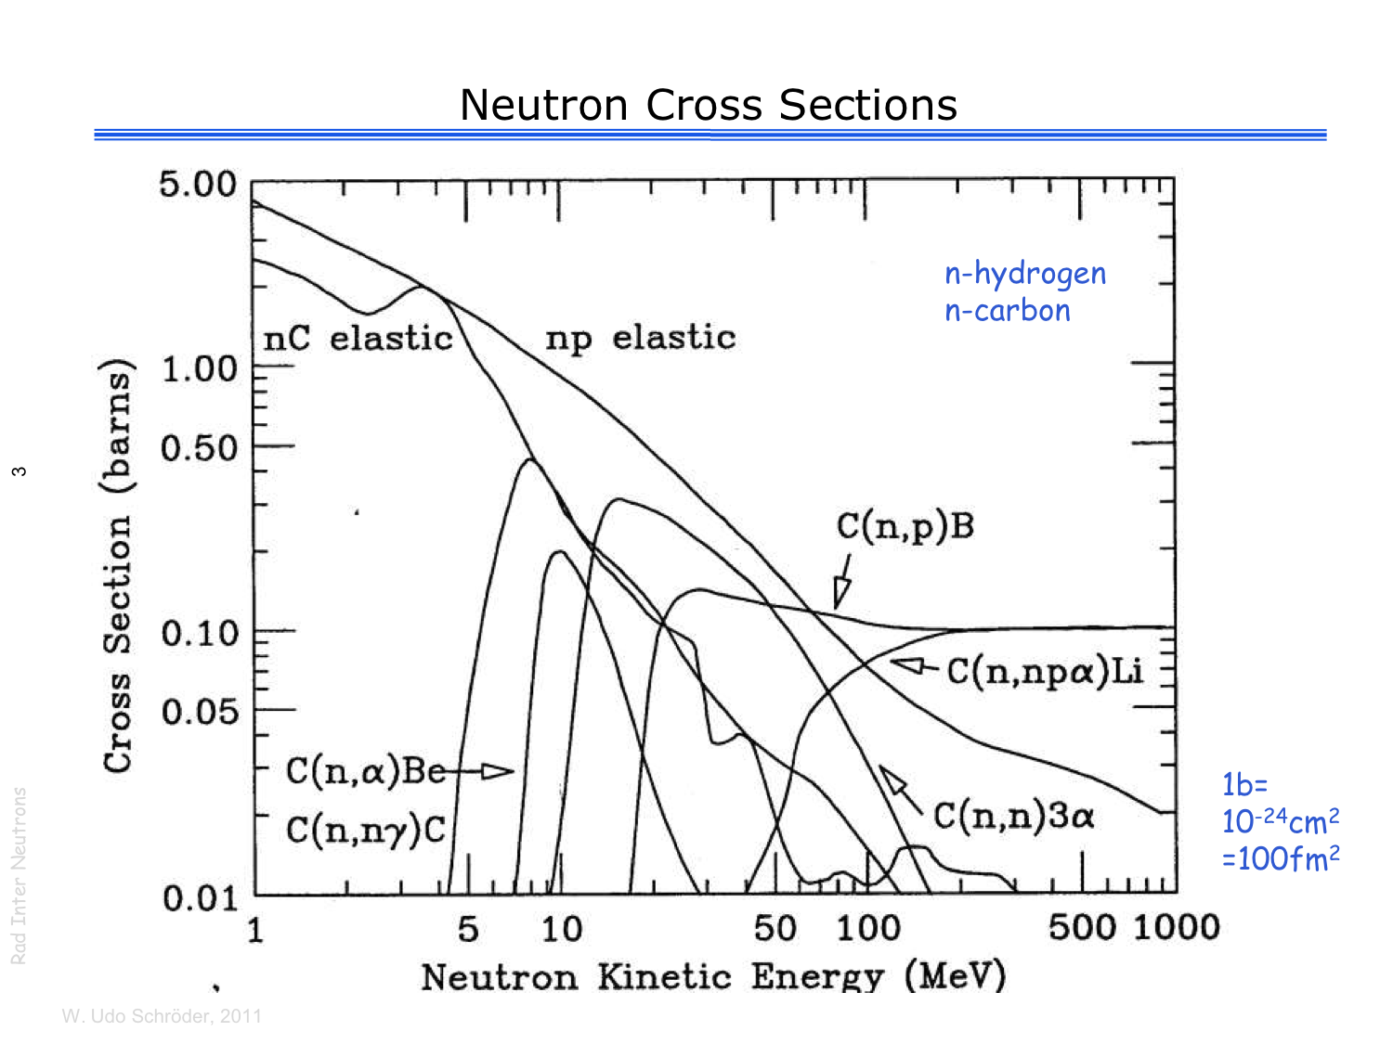
Neutron X-sec w/ H and C

Slide 9
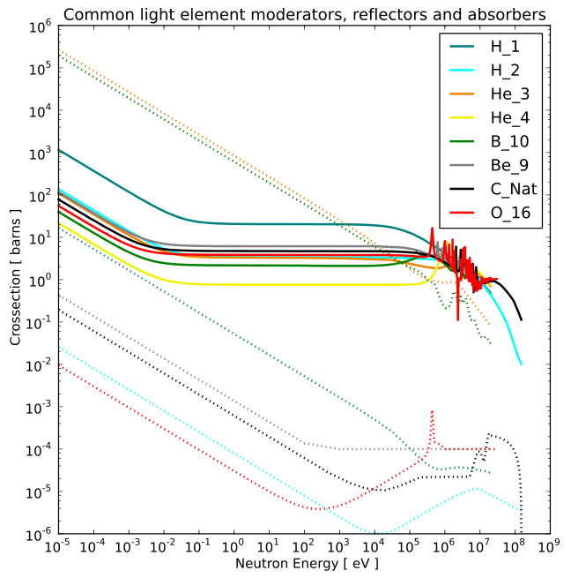
Neutron X-sec w/ Moderators
Solid: Absorption
Dashed: Scattering

Slide 10
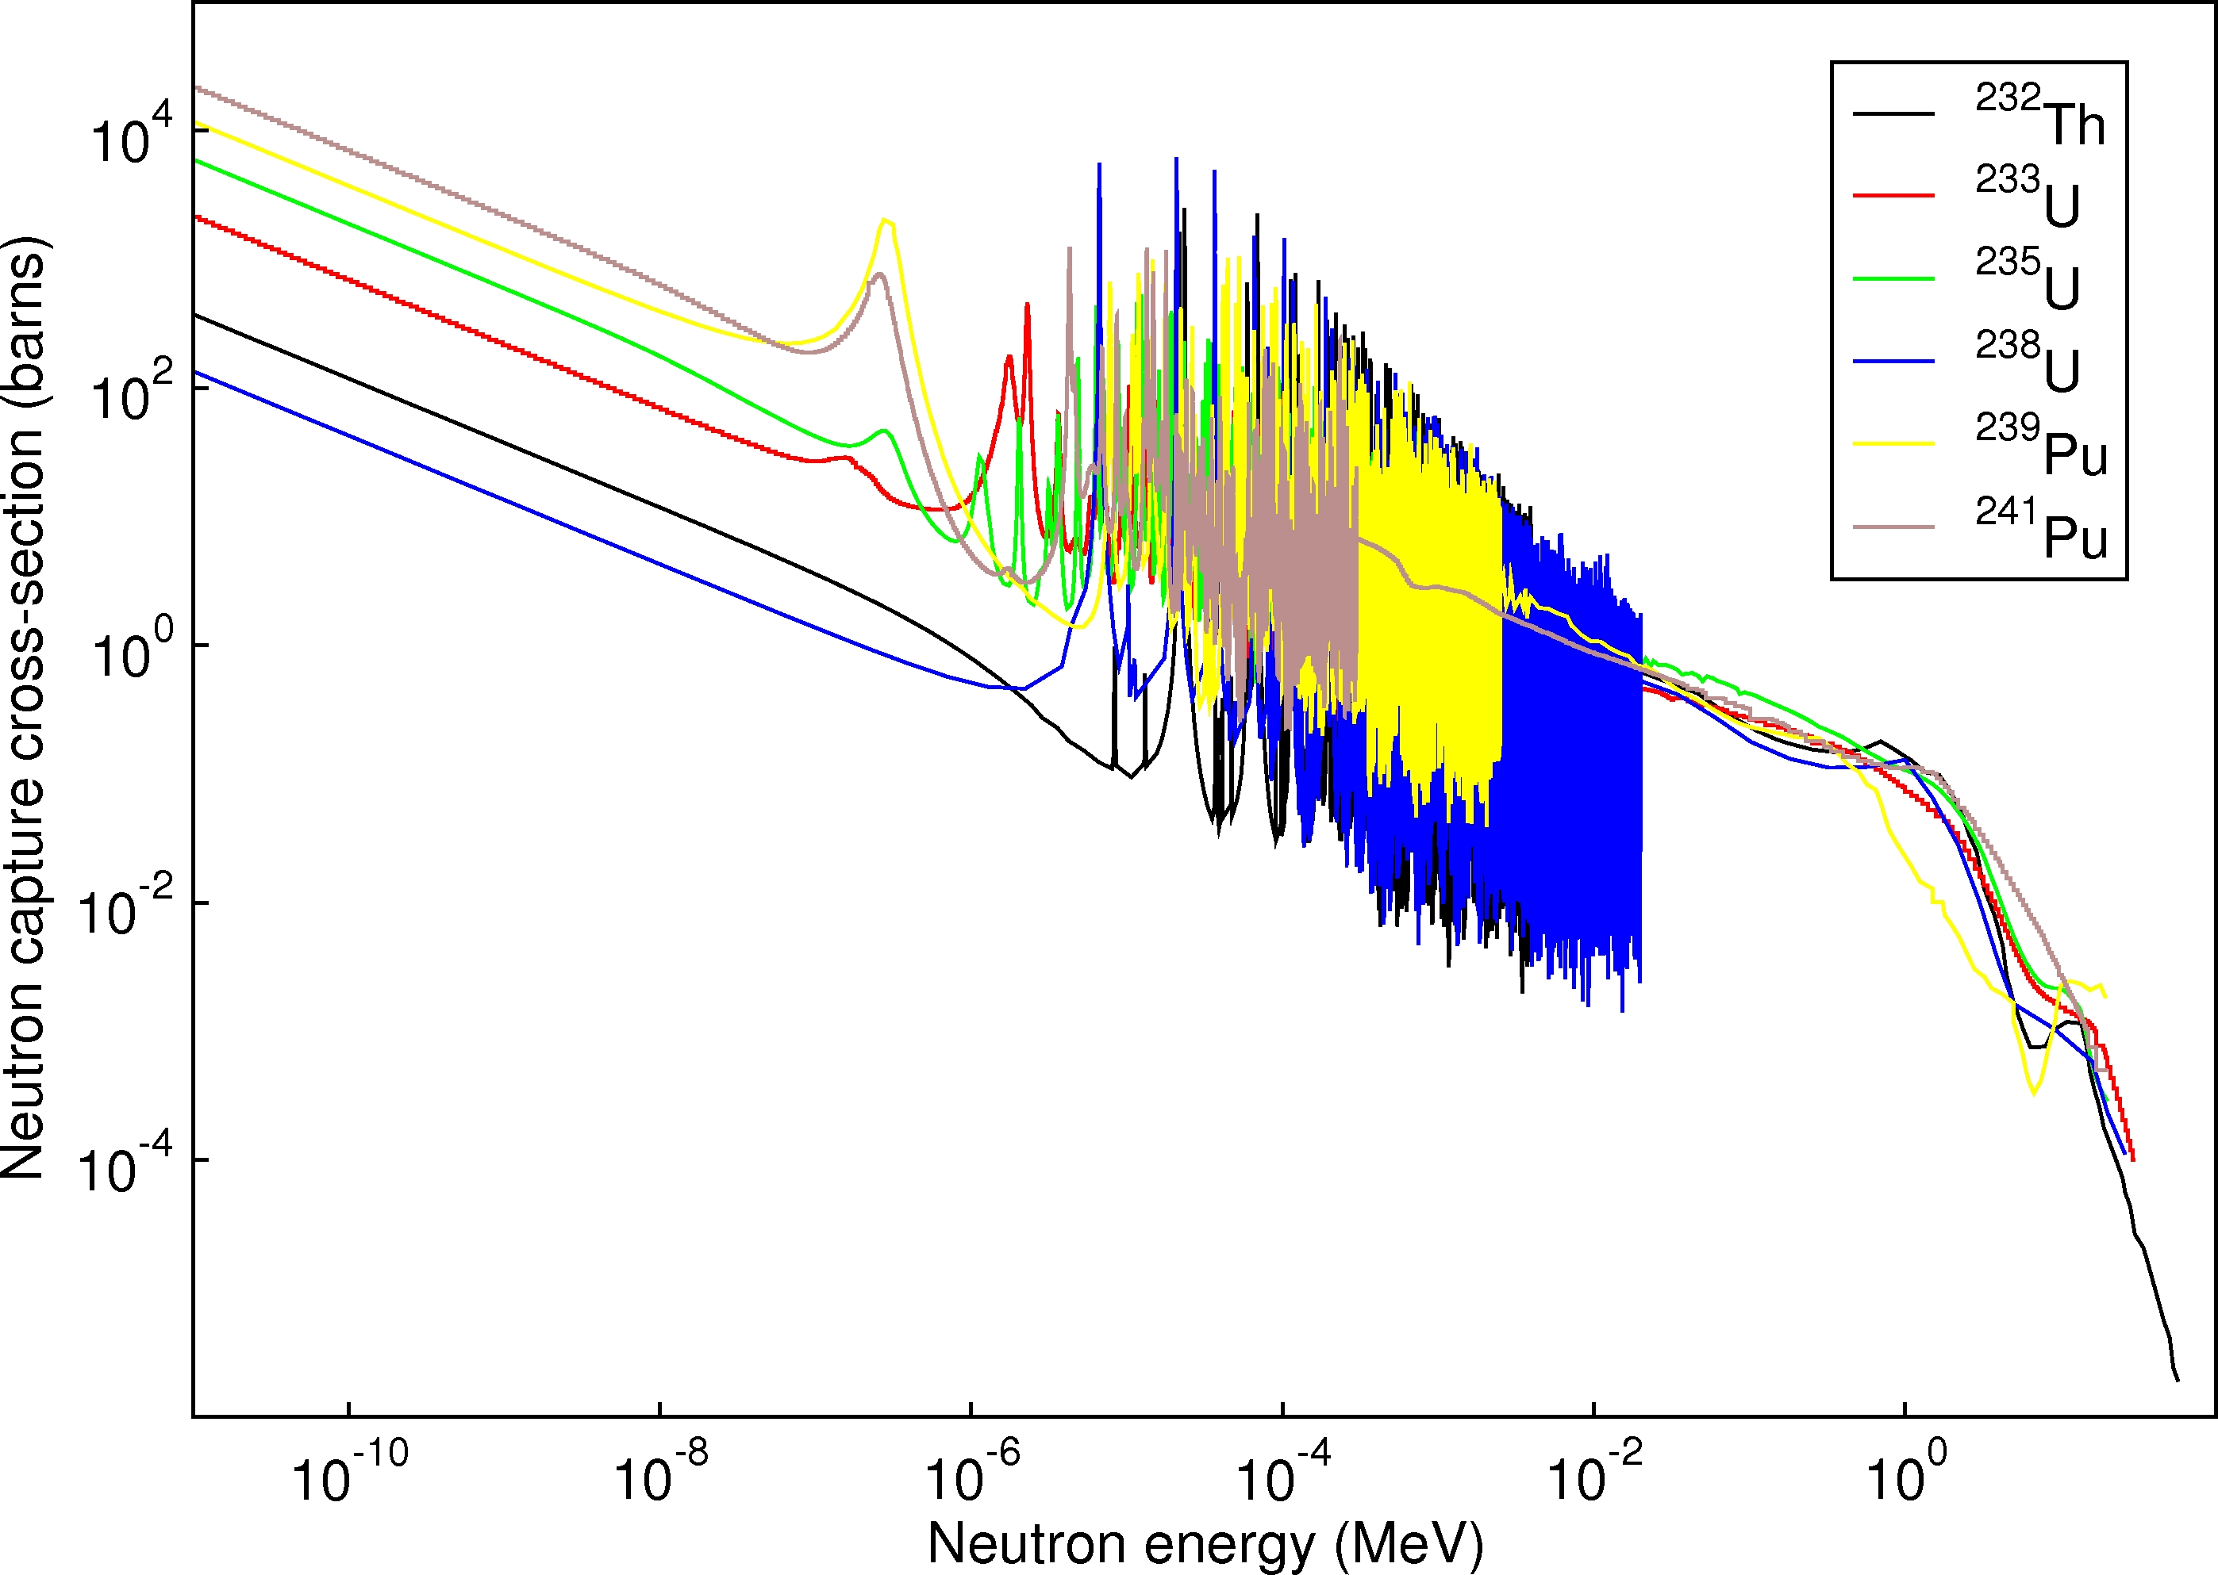
Neutron Capture X-sec

Slide 11
Interaction of Hadrons at High Energies
What are hadrons?
  All particles made of quarks & interact through the strong nuclear force
  Examples?
    Neutrons, protons, pions, kaons, etc
  Protons are easy to obtain and interact with other particles to produce mesons
At low (<2GeV) energies, the cross sections between different particles differ dramatically
  The collision cross sections of any two hadrons vary rapidly with energy
  Nuclear effect is significant
Above 5GeV, the total cross section of hadron-hadron interaction changes slightly as a function of energy
  Typical size of the cross section is 20 – 40 mb at 70 – 100 GeV
  And increases logarithmically as a function of energy

Slide 12
Interaction of Hadrons at High Energies
Hadronic collisions involve very small momentum transfers, small production angles and interaction distance of order 1fm
Typical momentum transfer in hadronic collisions are of the order q² ~ 0.1 (GeV/c)²
Mean number of particles produced in hadronic collisions grows logarithmically as a function of incident energy
  ~3 at 5GeV
  ~12 at 500GeV
When high energy hadrons interact with matter, they break apart nuclei, produce mesons and other hadrons
  These secondary particle then interact through strong forces subsequently in the matter and deposit energy

Slide 13
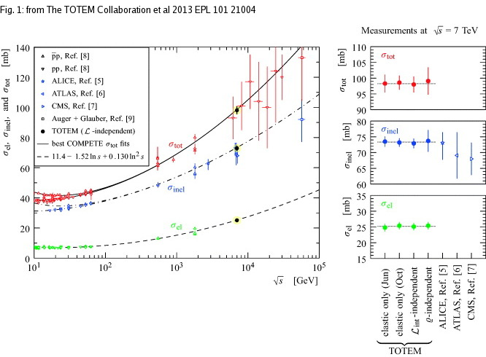
Proton Interaction X-sec

Slide 14
Particle Detectors
Subatomic particles cannot be seen by naked eyes but can be detected through their interactions within matter
What do you think we need to know first to construct a detector?
  What kind of particles do we want to detect?
    Charged particles and neutral particles
  What do we want to measure?
    Their momenta
    Trajectories
    Energies
    Origin of the interaction (interaction vertex)
    Etc
  To what precision do we want to measure?
Depending on the answers to the above questions we use different detection techniques

Slide 15
Particle Detection
Charged Particle Tracks
Energy
Muon Tracks
Scintillating Fiber
Silicon Tracking
Calorimeter (dense)
Interaction
Point
Ä
B
EM
hadronic
Magnet
electron
photon
Wire Chambers
jet
muon
neutrinos -- or any non-interacting particle missing transverse momentum
We know x,y starting momenta is zero, but
along the z axis it is not, so many of our measurements are in the xy plane, or transverse
Notes:
The Run 2 detector. Schematically how it works.
SVX and the like.

