Slide 1
PHYS 3446 – Lecture #15
Monday, Oct. 24, 2016
Dr. Jae Yu
Particle Detection
  Ionization Detectors
  MWPC
  Scintillation Counters
  Time of Flight
  Cerenkov Counter
  Calorimeters

Slide 2
Announcements
Quiz #2
  Beginning of the class this Wednesday, Oct. 26
  Covers: CH4.1 through what we finish today
  Bring your calculators
    No phone or computers allowed
  Bring your own handwritten formula sheet
    Front and back of a letter size sheet
    No word definitions, no derivations, no reaction equations
Homework #7
  Derive Eq. 7.10
  Carry out computations for Eq. 7.14 and 7.17
Due for these assignments is Monday, Oct. 31

Slide 3
Reminder: Research Project Report
Must contain the following at the minimum
  Motivation, including the justification for it
  Current status and some background behind them
  Improvements and bases for such improvements
  Conclusions
  The reference to the original paper must be included!
  Bibliography referring to web site must be minimized (<20%)
Each member of the group writes a 10 (max) page report, including figures
  20% of the total grade
  Can share the theme and facts but you must write your own!
  Text of the report must be your original!
  Due Wed., Dec. 7, 2016

Slide 4
Research Presentations
Each of the 5 research groups makes a 10+3min presentation
  10min presentation + 3min Q&A
  All presentations must be in power point
  I must receive all final presentation files by 8pm, Monday, Dec. 5, 2016
    No changes are allowed afterward
  The representative of the group makes the presentation followed by all group members’ participation in the Q&A session
Date and time:
  In class Wednesday, Dec. 7, 2016
Important metrics
  Contents of the presentation: 60%
    Inclusion of all important points as mentioned in the report
    The quality of the research and making the right points
  Quality of the presentation itself: 15%
  Presentation manner: 10%
  Q&A handling: 10%
  Staying in the allotted presentation time: 5%
  Judging participation and sincerity: 5%

Slide 5
Project Report Template

Slide 6
Ionization Detectors
Measures the ionization produced when an incident particle traverses through a medium
Can be used to
  Trace charged particles through the medium
  Measure the energy loss (dE/dx) of the incident particle
    Must prevent re-combination of an ion and electron pair into an atom after the ionization
    Apply high electric field across medium
      Separates charges and accelerates the electrons

Slide 7
Ionization Detectors – Chamber Structure
Basic ionization detector consists
  A chamber with an easily ionizeable medium
    The medium must be chemically stable and should not absorb ionization electrons
    Should have low ionization potential (‾I ) ➔ To maximize the amount of ionization produced per given energy
  A cathode and an anode held at some large potential difference
  The device is characterized by a capacitance determined by its geometry

Slide 8
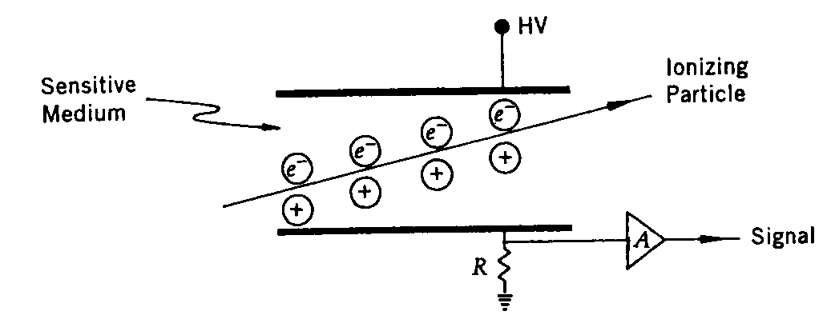
Ionization Detectors – Chamber Structure
Cathode: Negative
Anode: Positive
The ionization electrons and ions drift to their corresponding electrodes, to anode and cathode
  Provide small currents that flow through the resistor
  The current causes voltage drop that can be sensed by the amplifier
  Amplifier signal can be analyzed to obtain pulse height that is related to the total amount of ionization

Slide 9
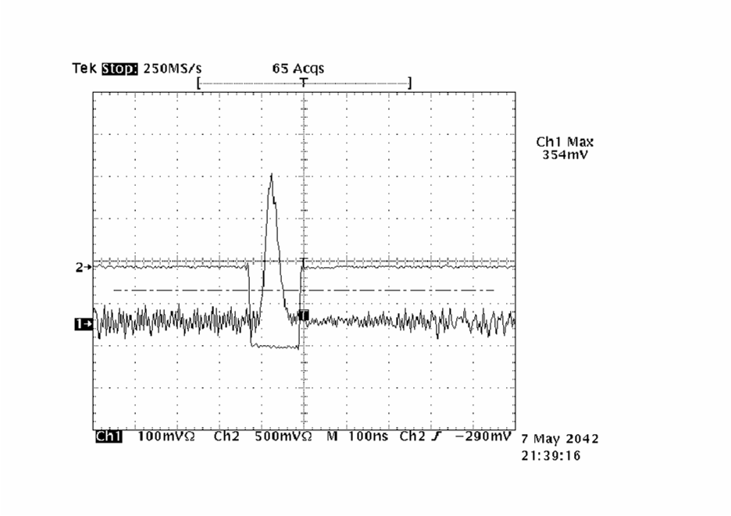
30cmx30cm D-GEM Detector Signal
Signal from Cs¹³⁷ Source

Slide 10
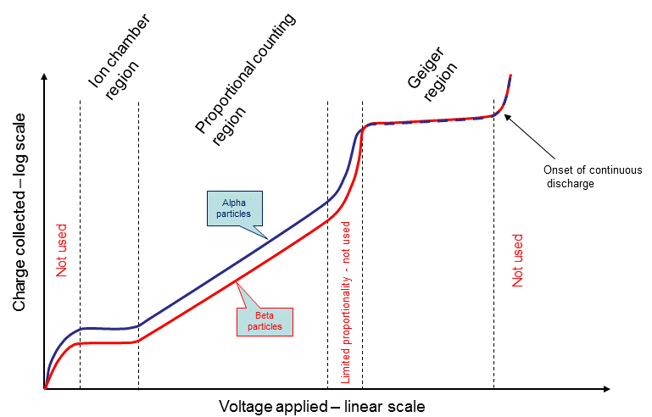
Ionization Detectors – HV
Depending on the magnitude of the electric field across the medium different behaviors are expected
  Recombination region: Low electric field
  Ionization region: Medium voltage that prevents recombination
  Proportional region: large enough HV to cause acceleration of ionization electrons and additional ionization of atoms
  Geiger-operating region: Sufficiently high voltage that can cause large avalanche if electron and ion pair production that leads to a discharge
  Discharge region: HV beyond Geiger operating region, no longer usable
Recombination
Region
Flat!!!
Flat!!!

Slide 11
Ionization Counters
Operate at relatively low voltage (in ionization region of HV)
Generate no amplification of the original signal
Output pulses for minimum ionizing particle is small
Insensitive to voltage variation
Have short recovery time ➔ Used in high interaction rate environment
Response linear to input signal
Excellent energy resolution
Liquid argon ionization chambers used for sampling calorimeters
Gaseous ionization chambers are useful for monitoring high level of radiation, such as alpha decay

Slide 12
Proportional Counters
Gaseous proportional counters operate in high electric fields ~10⁴ V/cm (in the proportional counting region)
Typical amplification of factors of ~10⁵
Use thin wires ( 10 – 50 μm diameter) as anode electrodes in a cylindrical chamber geometry
Multiplication occur near the anode wire where the field is strongest, causing secondary ionization
Sensitive to the voltage variation ➔ not suitable for energy measurement
But used for tracking device

Slide 13
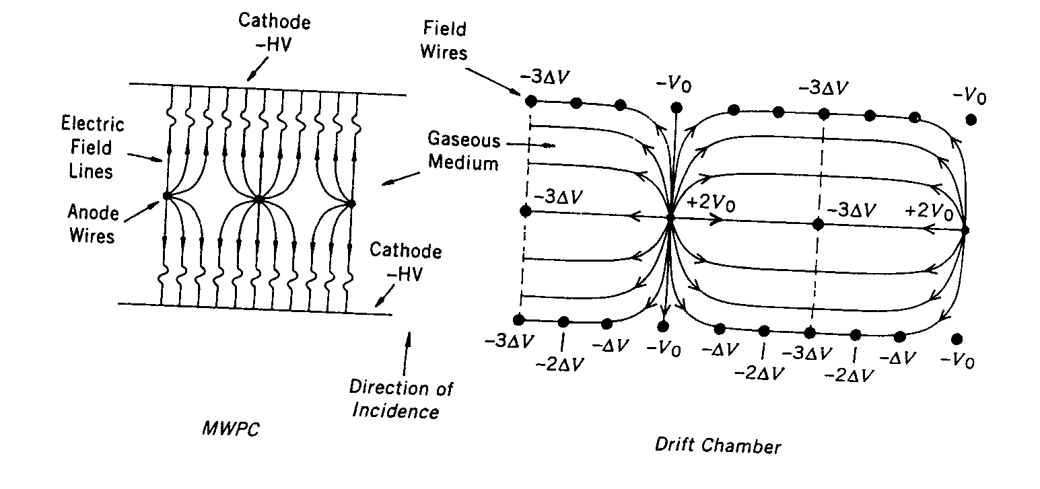
Multi-Wire Proportional Chambers (MWPC)
G. Charpak et al. developed a proportional counter in a multiwire proportional chamber (Nobel prize 1992)
  One of the primary position detectors in HEP
A plane of anode wires positioned precisely w/ about 2 mm spacing
Can be sandwiched in similar cathode planes (in <1cm distance to the anodes) using wires or sheet of aluminum
Cathode planes

Slide 14
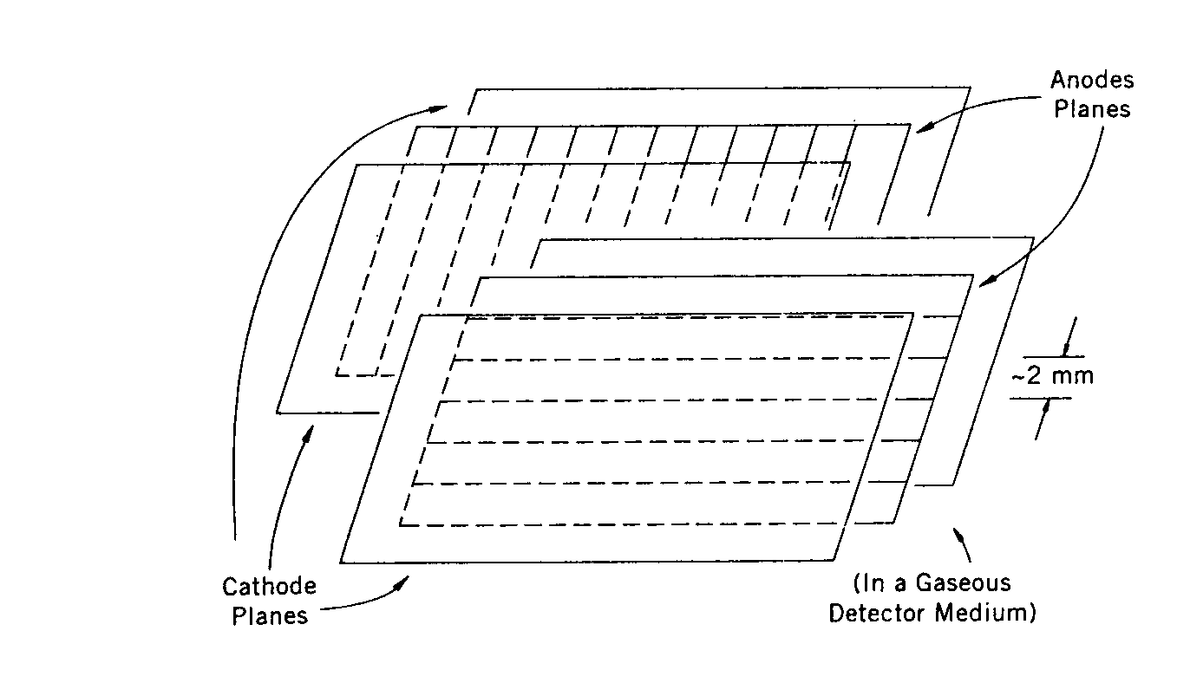
Multi-Wire Proportional Chambers (MWPC)
These structures can be enclosed to form one plane of the detector
Multiple layers can be placed in a succession to provide three dimensional position information

Slide 15
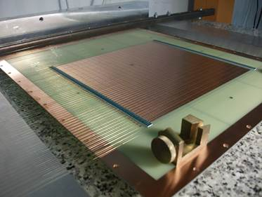
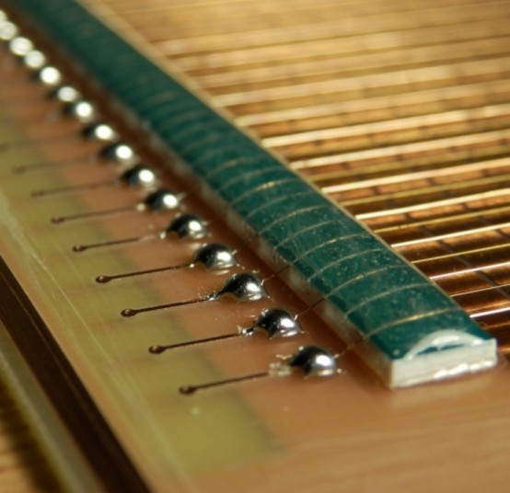
Example PWMC

Slide 16
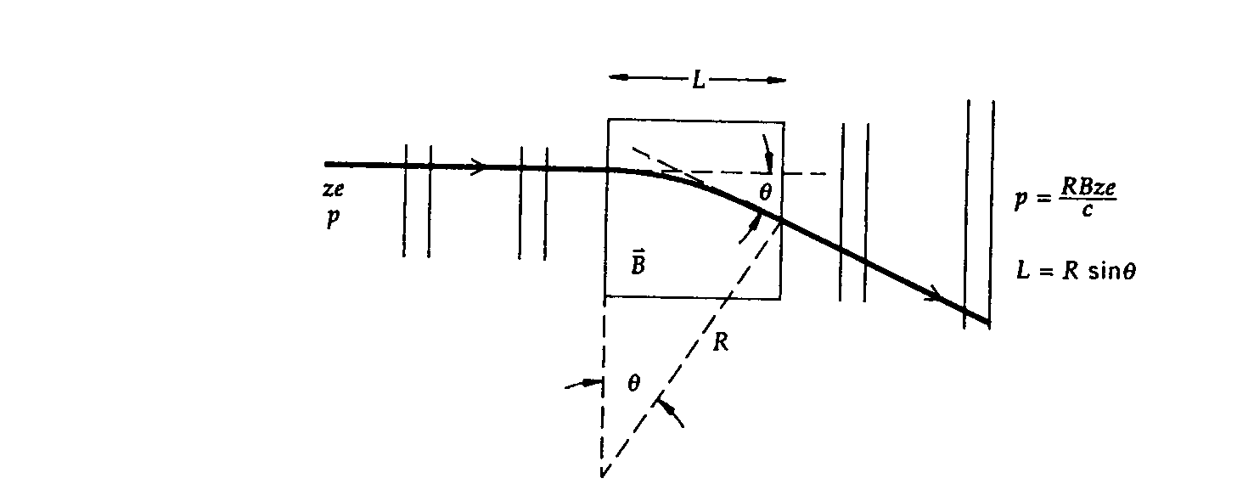
Momentum Measurements
A set of MWPC planes placed before and after a magnetic field can be used to obtain the deflection angle which in turn provides momentum of the particle
Multiple relatively constant electric field can be placed in each cell in a direction transverse to normal incident ➔ Drift chambers
Typical position resolution of proportional chambers are on the order of 200 μm.

Slide 17
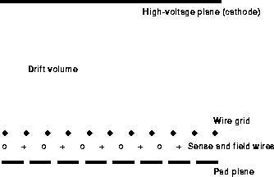
A Schematics of a Drift Chamber
Primary Ionization created
Electrons and ions drift apart
Secondary avalanche occurs

Slide 18
Geiger-Muller Counters
Ionization detector that operates in the Geiger range of voltages
For example, let’s look at an electron with 0.5MeV KE that looses all its energy in the counter
Assume that the gaseous medium is helium with an ionization energy of 42eV.
Number of ionization electron-ion pair in the gas is
If a detector operates as an ionization chamber and has a capacitance of 1 nF, the resulting voltage signal is
In Geiger range, the expected number of electron-ion pair is of the order 10¹⁰ independent of the incoming energy, giving about 1.6V pulse height

Slide 19
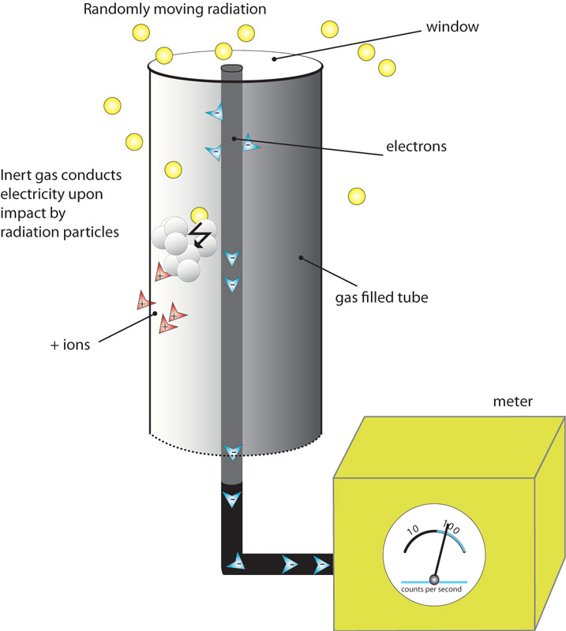
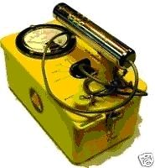
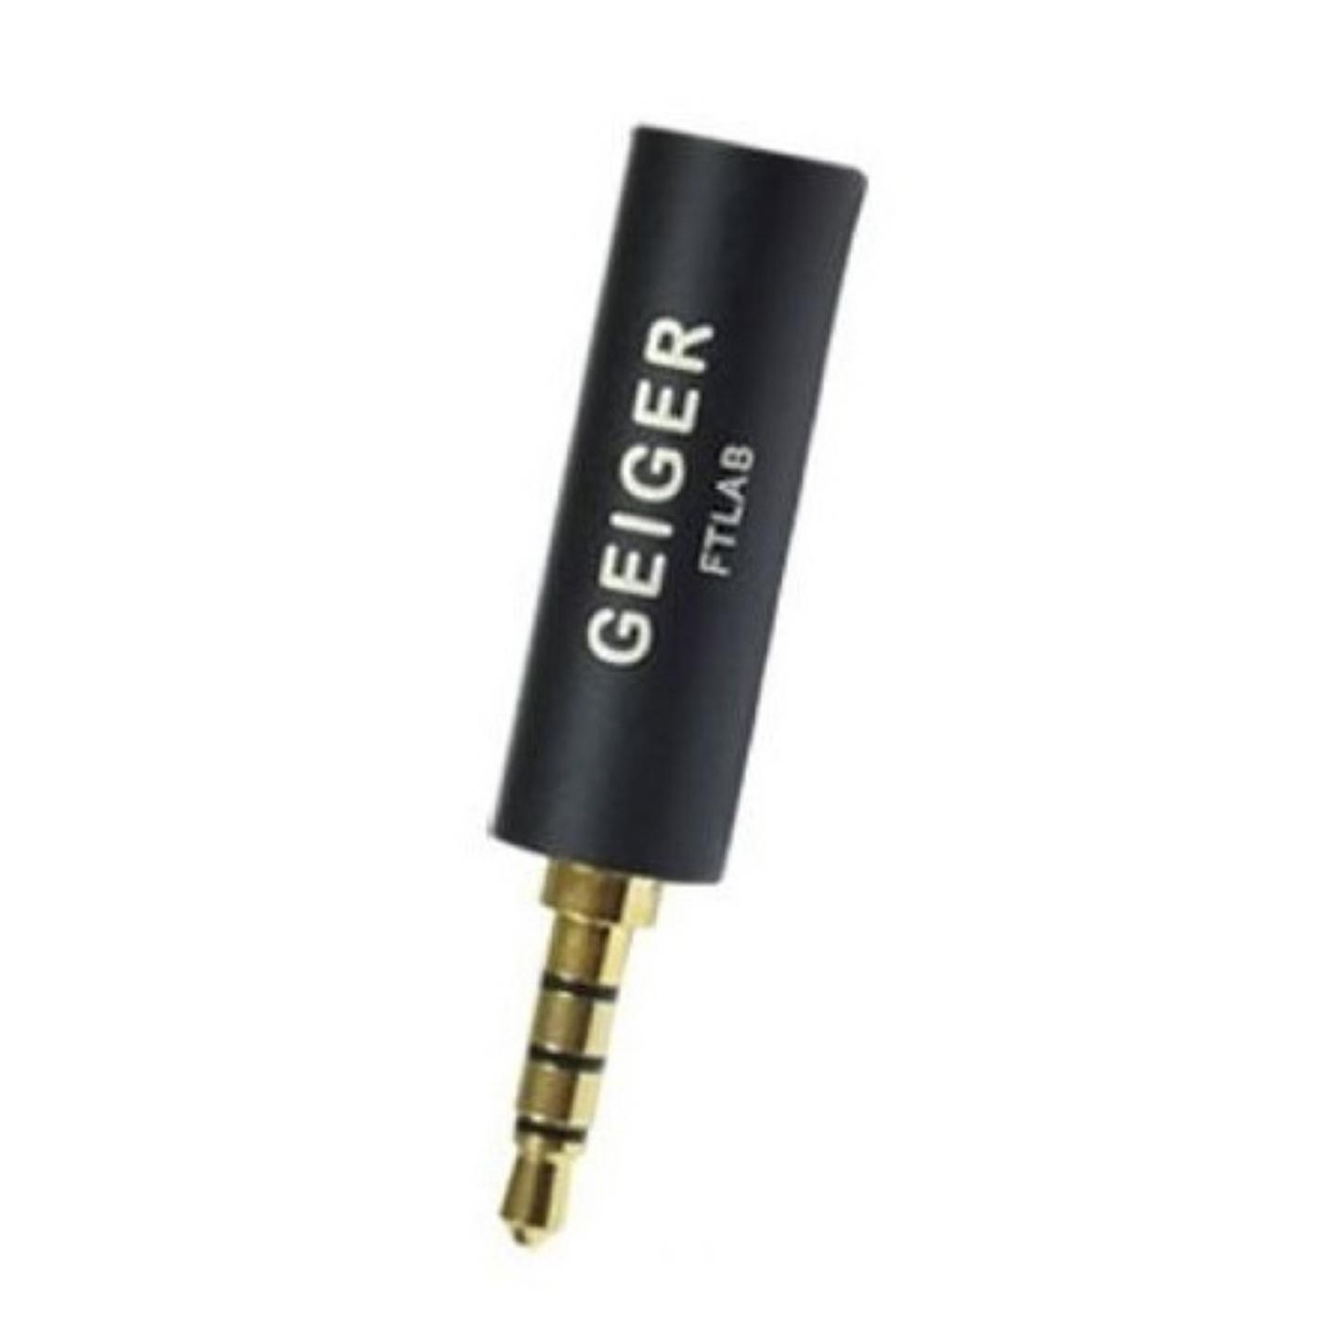
Geiger-Muller Counter

Slide 20
(Dis) Advantage of Geiger-Muller Counters
Simple construction
Insensive to voltage fluctuation
Used in detecting radiation
Disadvantages
  Insensitive to the types of radiation
  Due to the large avalanche, takes long time (~1ms) to recover
    Cannot be used in high rate environment

Slide 21
Scintillation Counters
Ionization produced by charged particles can excite atoms and molecules in the medium to higher energy levels
The subsequent de-excitation process produces lights that can be detected and provide evidence for the traversal of the charged particles
Scintillators are the materials that can produce lights in visible part of the spectrum

Slide 22
Scintillation Counters
Two types of scintillators
  Organic or plastic
    Tend to emit ultra-violate
    Wavelength shifters are needed to reduce attenuation
    Faster decay time (10⁻⁸s)
    More appropriate for high flux environment
  Inorganic or crystalline (NaI or CsI)
    Doped with activators that can be excited by electron-hole pairs produced by charged particles in the crystal lattice
    These dopants can then be de-excited through photon emission
    Decay time of order 10⁻⁶ sec
    Used in low energy detection

Slide 23
Scintillation Counters – Photo-multiplier Tube
The light produced by scintillators are usually too weak to see
  Photon signal needs amplification through photomultiplier tubes
    Gets the light from scintillator directly or through light guide
      Photocathode: Made of material in which valence electrons are loosely bound and are easy to cause photo-electric effect (2 – 50 cm diameter)
      Series of multiple dynodes that are made of material with relatively low work-function
        Operating at an increasing potential difference (100 – 200 V) difference between dynodes

Slide 24
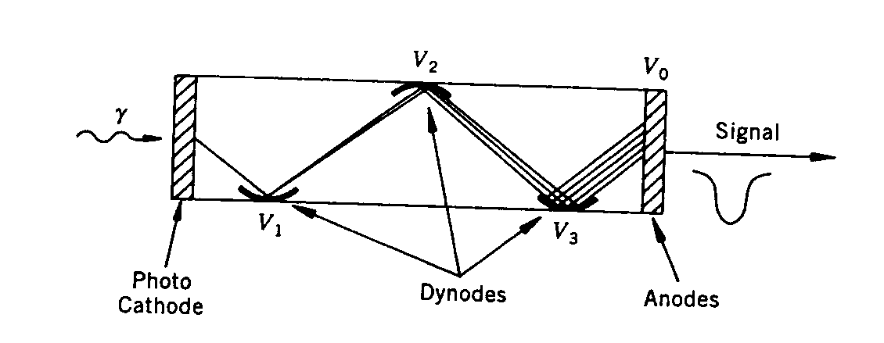
Scintillation Counters – Photo-multiplier Tube
The dynodes accelerate the electrons to the next stage, amplifying the signal to a factor of 10⁴ – 10⁷
Quantum conversion efficiency of photocathode is typically on the order of 0.25
Output signal is proportional to the amount of the incident light except for the statistical fluctuation
Takes only a few nano-seconds for signal processing
Used in as trigger or in an environment that requires fast response
Scintillator+PMT good detector for charged particles or photons or neutrons

Slide 25
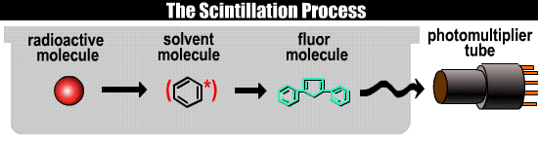
Scintillation Materials
Material | Radiation | Comment
Anthracene | Beta | -
ZnS(Ag) | Alpha | powder
NaI(Tl) | Gamma | crystal
CsI(Na) | X | crystal
p-terphenyl in toluene | Gamma | liquid
p-terphenyl in polystyrene | Gamma | plastic

Slide 26
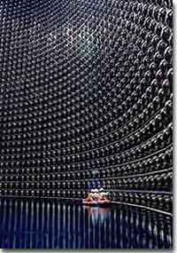
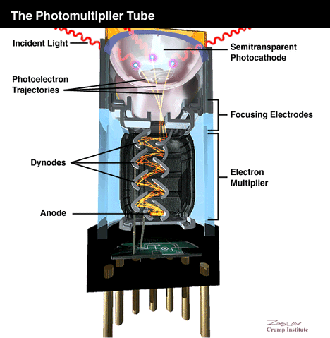
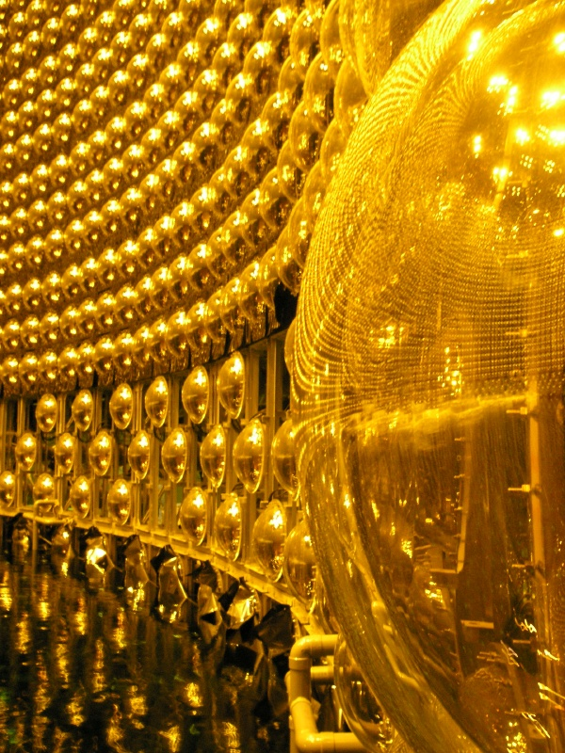
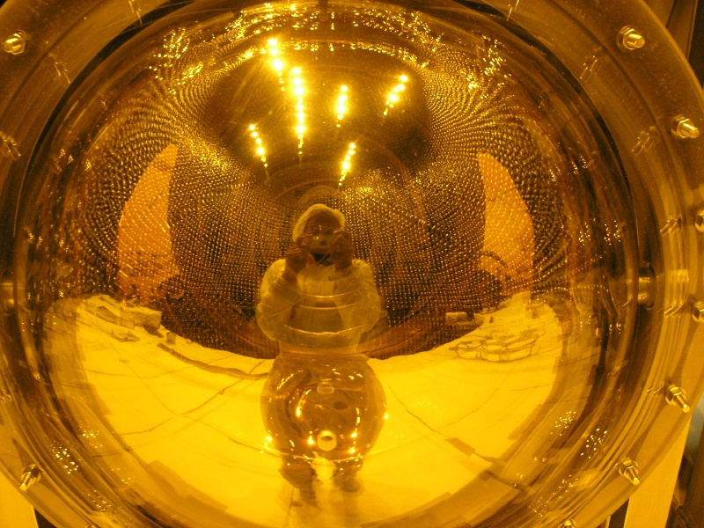
Some PMT’s
Super-Kamiokande detector

