Slide 1
PHYS 3446 – Lecture #16
Wednesday, Oct. 26, 2016
Dr. Jae Yu
Particle Detection
Silicon Photo-Multipliers
Time of Flight
Cerenkov Counter
Calorimeters

Slide 2
Announcements
The MS Word template for project paper has been uploaded to the class web page, under project link
Please use only this template for your project paper.
Mark on your calendar two special colloquia – double extra credit:
Nov. 30: Dr. Steven Sand
Dec. 7: Dr. K.C.Kong

Slide 3
Reminder: Homework #7
Derive Eq. 7.10
Carry out computations for Eq. 7.14 and 7.17
Due for these assignments is Monday, Oct. 31

Slide 4
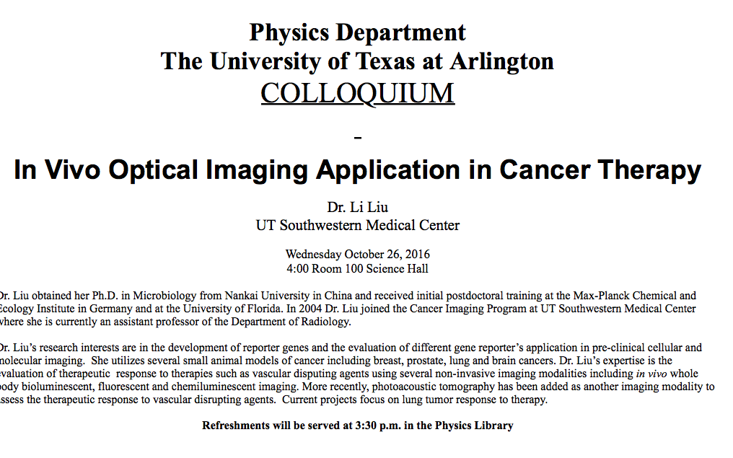

Slide 5
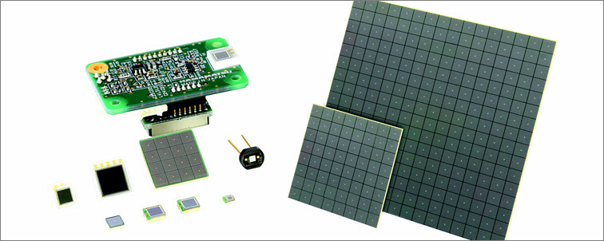
Silicon Photo Multipliers – SiPM
Made of a layer of silicon divided in pixels
Under bias voltage for electron amplifications
Small sizes (1mmx1mm, 3mmx3mm, 6mmx6mm)

Slide 6
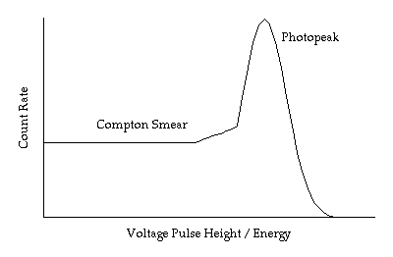
Scintillation Detector Structure
HV PS
Scintillation
Counter
Light Guide/
Wavelength
Shifter
PMT/
SiPM
Readout
Electronics
Scope

Slide 7
Time of Flight Detector
Scintillator + PMT can provide time resolution of 0.1 ns.
What position resolution does this corresponds to?
3cm
Array of scintillation counters can be used to measure the time of flight (TOF) of particles and obtain their velocities
What can this be used for?
Can use this to distinguish particles with about the same momentum but with different mass
How?
Measure
the momentum (p) of a particle in the magnetic field
its time of flight (t) for reaching some scintillation counter at a distance L from the point of origin of the particle
Determine the speed of the particle and its mass

Slide 8
Time of Flight (TOF)
TOF is the distance traveled divided by the speed of the particle, t=L/v.
Thus Δt in flight time of the two particle with m₁ and m₂ is
For a known momentum, p,
Since
In non-relativistic limit,
Mass resolution of ~1% is achievable for low energies
How does this look in a relativistic case?

Slide 9
Cerenkov Detectors
What is the Cerenkov radiation?
Emission of coherent radiation from the excitation of atoms and molecules
When does this occur?
When a charged particle enters a dielectric medium with a speed faster than light in the medium
How is this possible?
Since the speed of light is c/n in a medium with index of refraction n, if the particle’s β>1/n, its speed is greater than the speed of light
Cerenkov light has various frequencies but blue and ultraviolet band are most interesting
Blue can be directly detected w/ standard PMTs
Ultraviolet can be converted to electrons using photosensitive molecules mixed in with some gas in an ionization chamber

Slide 10
Cerenkov Detectors
The angle of emission is given by
The intensity of the produced radiation per unit length of the radiator is proportional to sin²θ_{c}.
For βn>1, light can be emitted while for βn<1, no light can be observed.
Thus, Cerenkov effect provides a means for distinguishing particles with the same momentum
One can use multiple chambers of various indices of refraction to detect the Cerenkov radiation from particles of different mass but with the same momentum

Slide 11
Cerenkov Detectors
Threshold counters
Particles with the same momentum but with different mass will start emitting Cerenkov light when the index of refraction is above a certain threshold
These counters have one type of gas but could vary the pressure in the chamber to change the index of refraction to distinguish particles
Large proton decay experiments use Cerenkov detector to detect the final state particles, such as p → e⁺π⁰
Differential counters
Measure the angle of emission for the given index of refraction since the emission angle for lighter particles will be larger than heavier ones

Slide 12
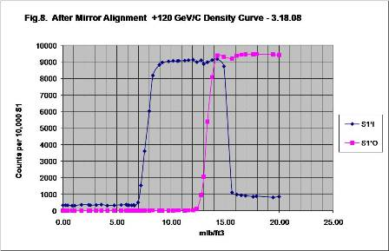
Plot of Threshold Cerenkov Counter
http://ftbf.fnal.gov/cherenkov_pressure-_scans/

Slide 13
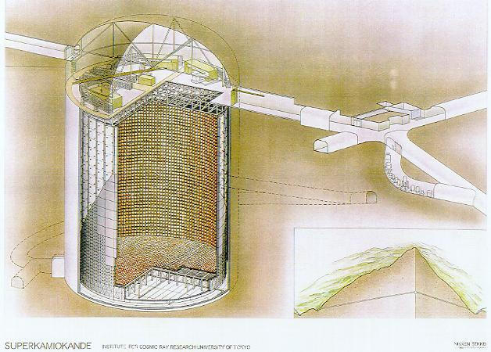
Super Kamiokande A Differential Water Cerenkov Detector
Kamioka zinc mine, Japan
1000m underground
40 m (d) x 40m(h) SS
50,000 tons of ultra pure H₂O
11200(inner)+1800(outer) 50cm PMT’s
Originally for proton decay experiment
Accident in Nov. 2001, destroyed 7000 PMT’s
Dec. 2002 resumed data taking w/ remaining PMT’s

Slide 14
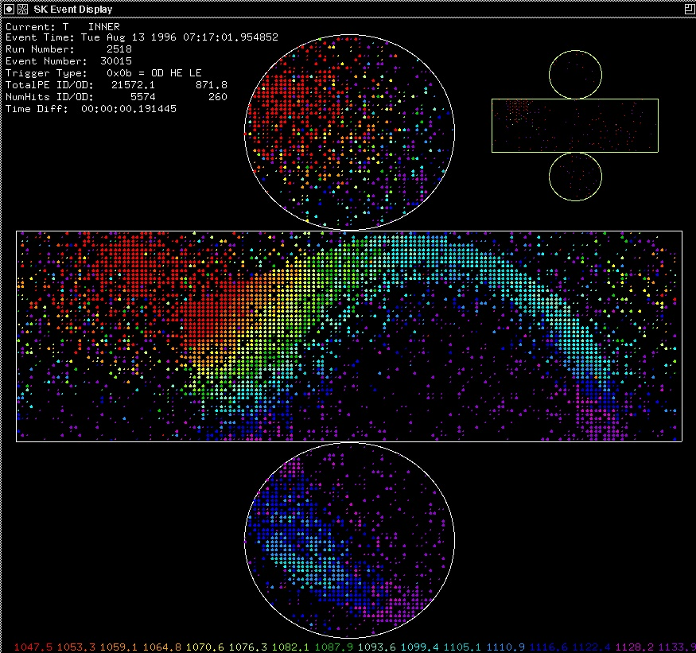
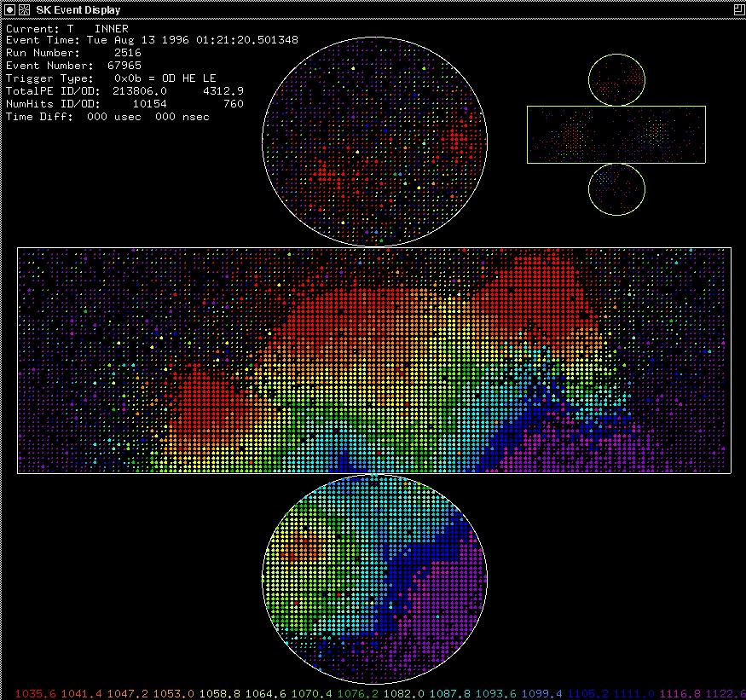
Super-K Event Displays
Stopping μ
3μ

Slide 15
Cerenkov Detectors
Ring-imaging Cerenkov Counters (RICH)
Use UV emissions
An energetic charged particle can produce multiple UV distributed about the direction of the particle
These UV photons can then be put through a photo-sensitive medium creating a ring of electrons
These electrons then can be detected in an ionization chamber forming a ring
Babar experiment at SLAC uses this detector

