Slide 1
PHYS 3446 – Lecture #17
Monday, Oct. 31, 2016
Dr. Jae Yu
Particle Detection
  Semi-Conductor Detectors
  Calorimeters
Particle Accelerators
  Electro-static Accelerators
  Cyclotron Accelerators
  Synchrotron Accelerators

Slide 2
Announcements
Quiz #2 result
  Class average: 28.6/66
    Equivalent to: 43.3/100
    Previous result: 47.1/100
  Top score: 65/66
Mark on your calendar two special colloquia – double extra credit:
  Nov. 30: Dr. Steven Sand
  Dec. 7: Dr. K.C.Kong

Slide 3
Homework #8
Carry out Fourier transformation and derive equations 9.3 and 9.5
Due for these assignments is Monday, Nov. 7

Slide 4
Semiconductor Detectors
Semiconductors can produce large signal (electron-hole pairs) for a relatively small energy deposit (~3eV)
  Advantageous in measuring low energy at high resolution
Silicon strip and pixel detectors are widely used for high precision position measurements
  Due to large electron-hole pair production, thin layers (200 – 300 μm) of wafers are sufficient for measurements
  Output signal proportional to the ionization loss in the semiconductor
  Low bias voltages sufficient to operate
  Can be deposit in thin stripes (20 – 50 μm) on a thin electrode
  High position resolution achievable
  Can be used to distinguish particles in multiple detector configurations
So what is the catch?
  Very expensive ➔ On the order of $30k/m²

Slide 5
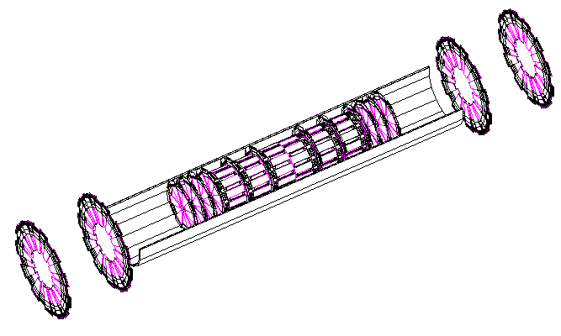
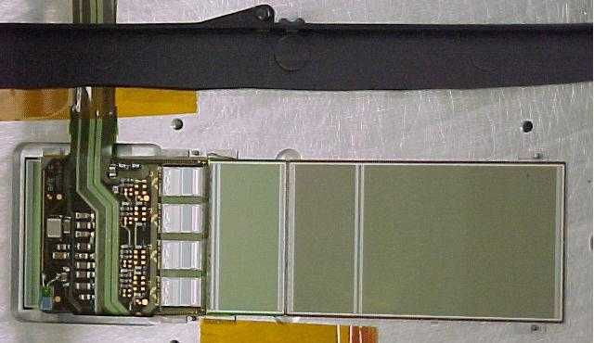
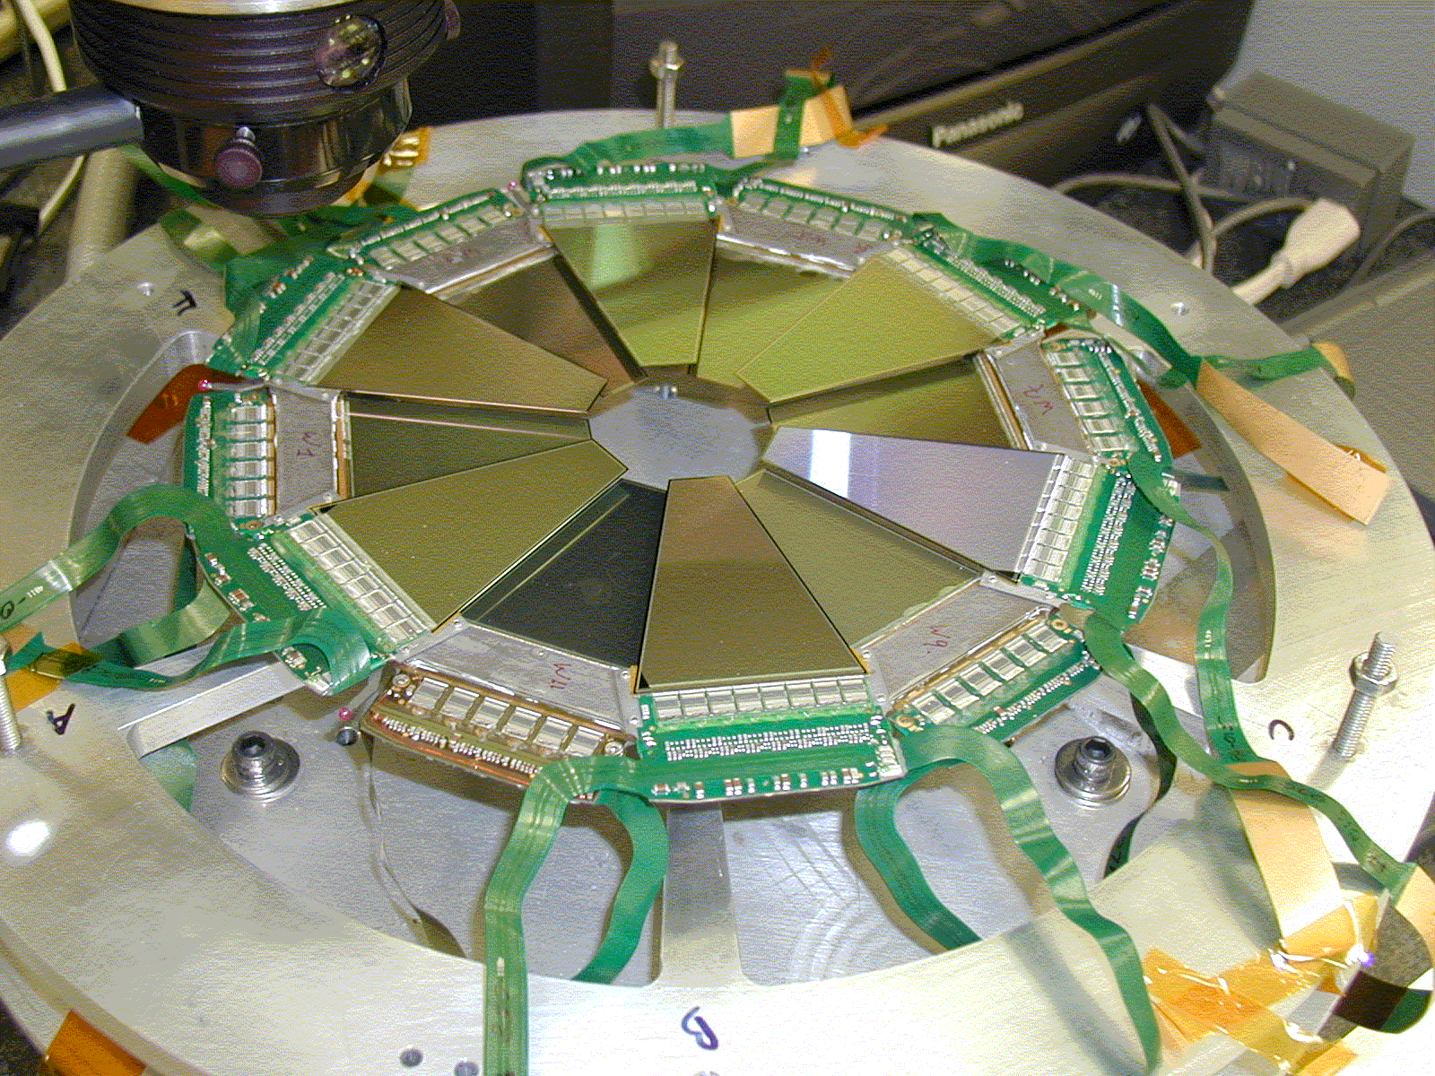
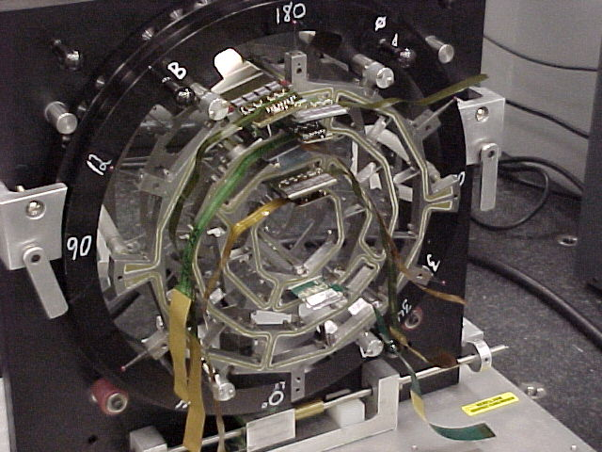
DØ Silicon Vertex Detector
2
1
5
4
3
7
6
9
8
10
11
12
1
…...
1
2
6
One Si detector
3
4
Disk
Barrel

Slide 6
Calorimeters
Magnetic measurement of momentum is not sufficient for physics, why?
  The precision for angular measurements gets worse as particles’ momenta increases
  Increasing the magnetic field or increasing the precision of the tracking device will help but will be expensive
  Cannot measure neutral particle momenta
How do we solve this problem?
  Use a device that measures kinetic energies of the particle
Calorimeter
  A device that absorbs the full kinetic energy of the particle
  Provides signal proportional to deposited energy

Slide 7
Calorimeters
Large scale calorimeter were developed during 1960s
  For energetic cosmic rays
  For particles produced in accelerator experiments
How do high energy EM (photons and electrons) and Hadronic particles deposit their energies?
  Electrons: via bremsstrahlung
  Photons: via electron-positron conversion, followed by bremsstrahlung of electrons and positrons
  These processes continue occurring in the secondary particles causing an electromagnetic shower losing all of its energy

Slide 8
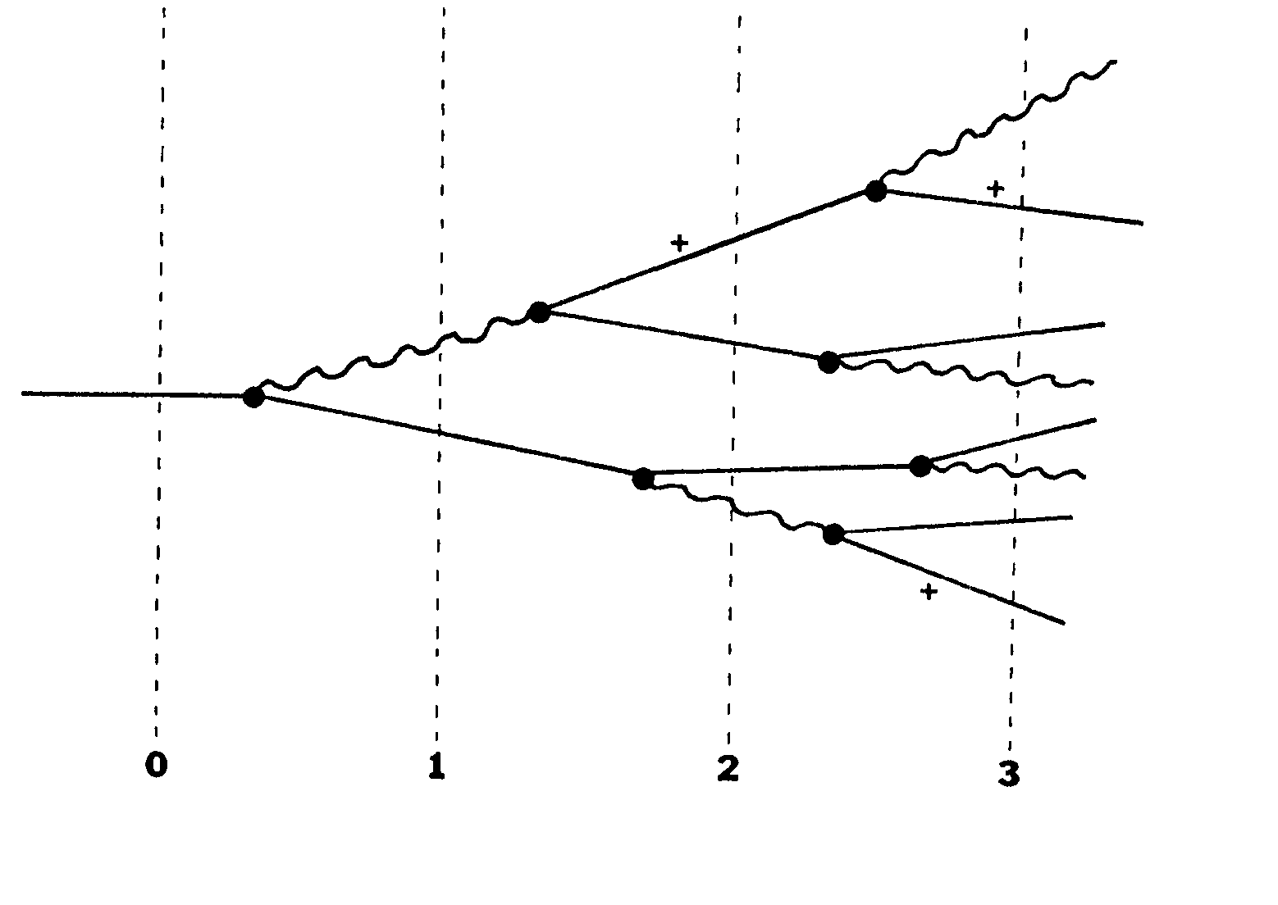
Electron Shower Process
Photon, γ

Slide 9
Calorimeters
Hadrons are massive thus their energy deposit via brem is small
They lose their energies through multiple nuclear collisions
An incident hadron produces multiple pions and other secondary hadrons in the first collision with a nucleus
The secondary hadrons then successively undergo nuclear collisions
Mean free path for nuclear collisions is called nuclear interaction lengths or nuclear absorption length (λ₀^{abs}) and is substantially longer than that of EM particles, radiation length (X₀)
Hadronic shower processes are therefore more erratic than EM shower processes

Slide 10
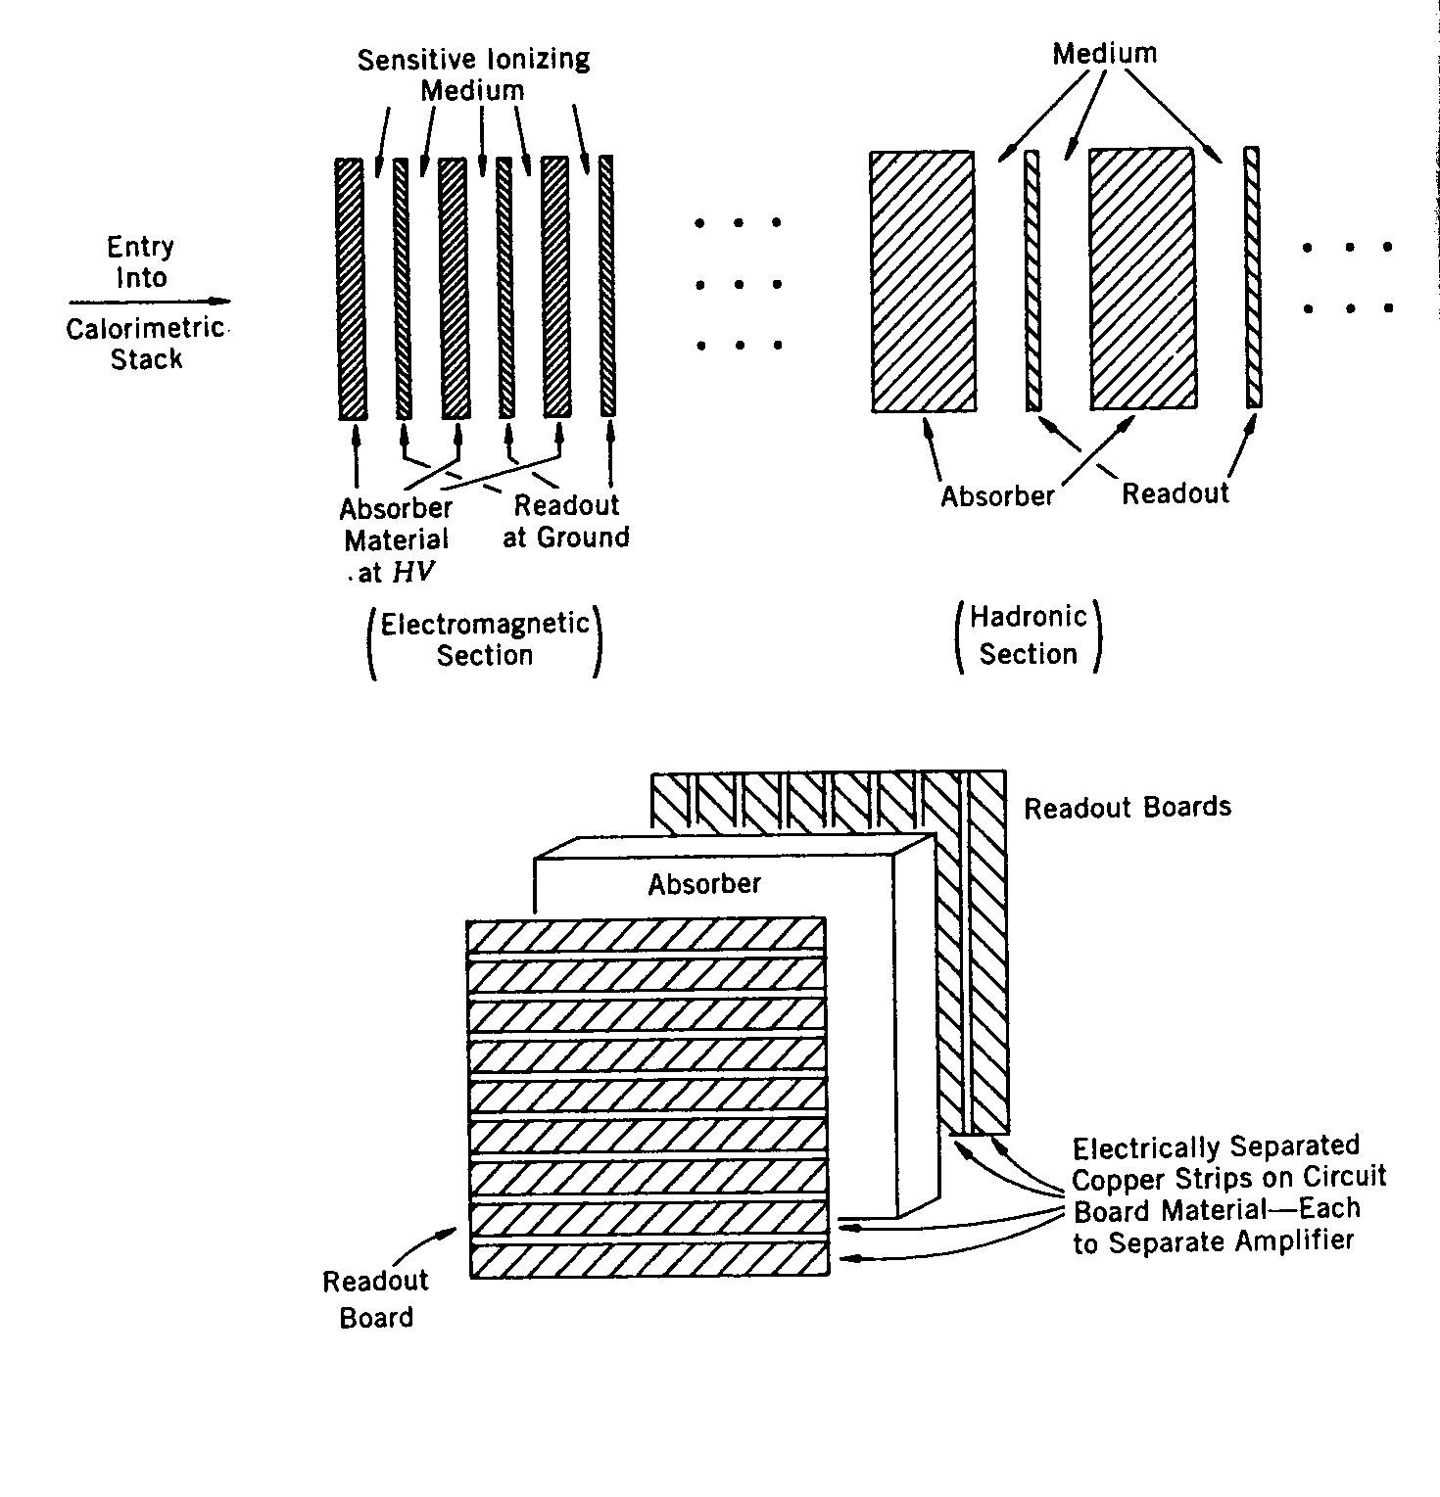
Sampling Calorimeters
High energy particles require large calorimeters to absorb all of their energies and measure them fully in the device (called total absorption calorimeters)
The number of shower particles is directly proportional to the energy of the incident particles
One can deduce the total energy of the particle by measuring only the fraction of their energy, as long as the fraction is known ➔ Called sampling calorimeters
  Most the high energy experiments use sampling calorimeters

Slide 11
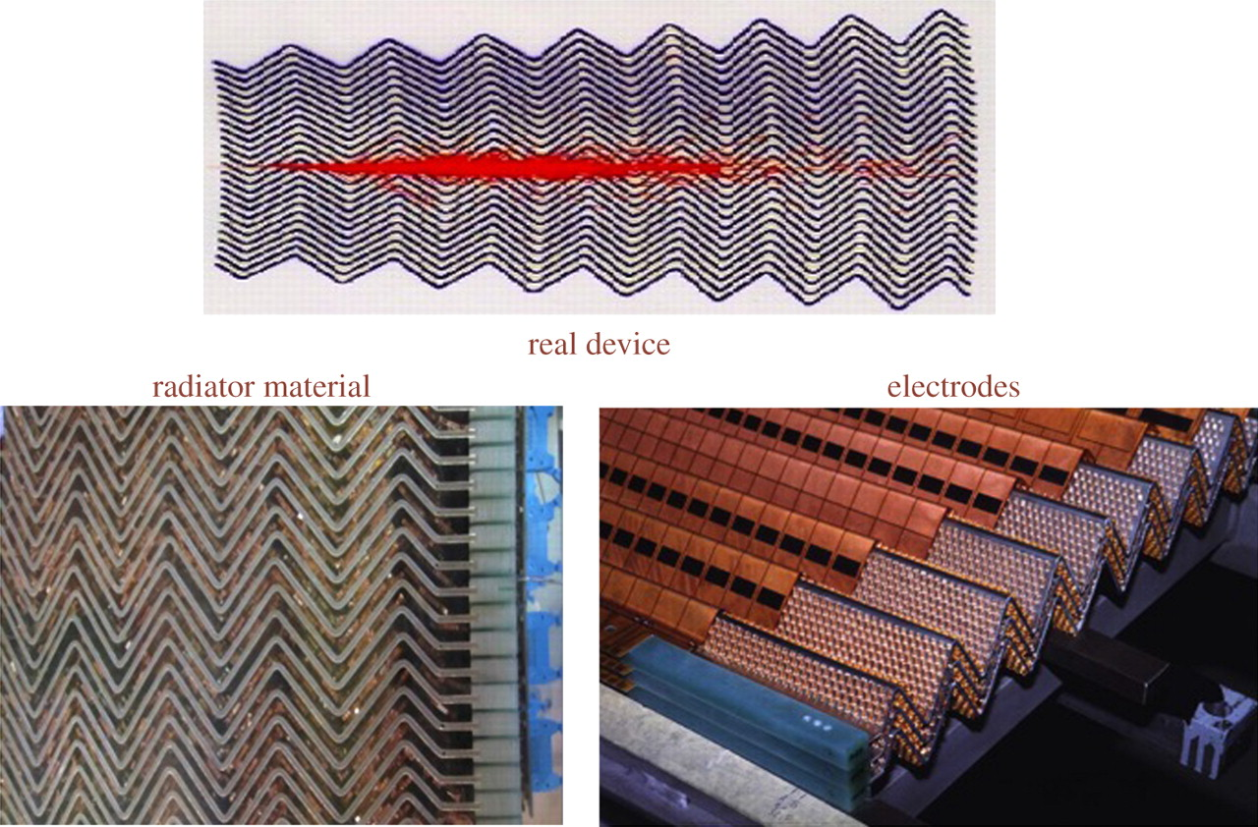
ATLAS LAr EM Calorimeter

Slide 12
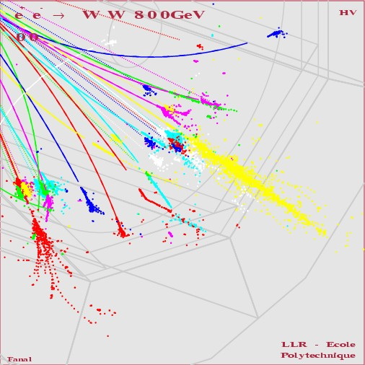
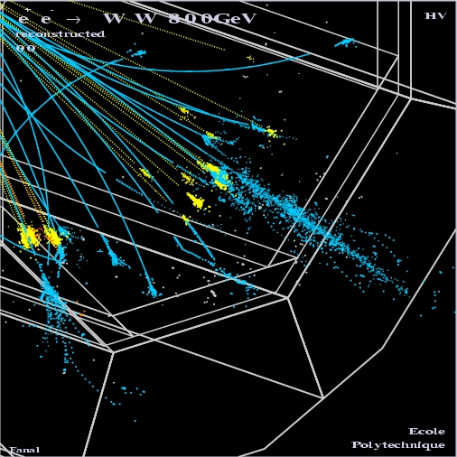
How particle showers look in a detector
Hadron
EM

Slide 13
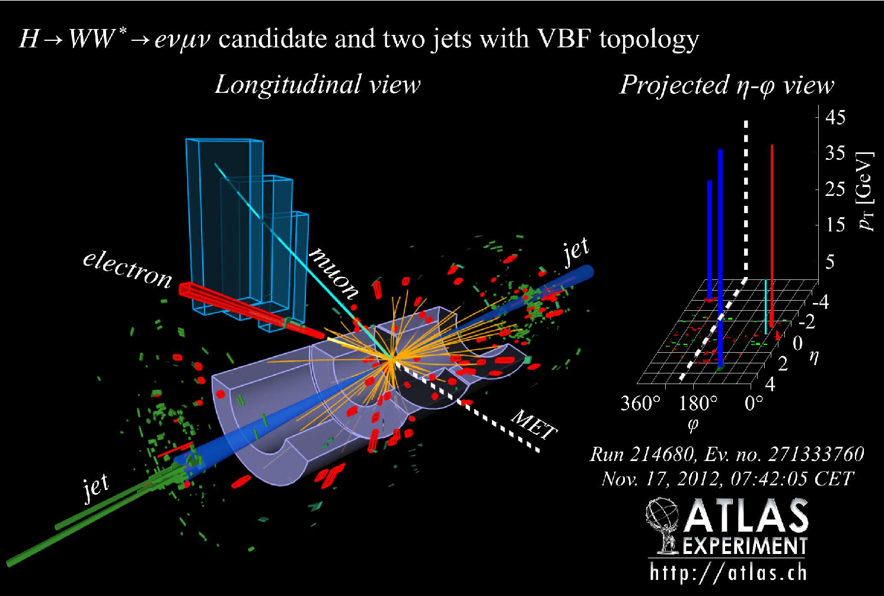
A fresh new event at the ATLAS

Slide 14
Principles of Calorimeters
Total absorption calorimeter: Sees the entire shower energy, all active volume!
Sampling calorimeter: Sees only some fraction of the shower energy
For EM
For HAD
Absorber plates

Slide 15
Example Hadronic Shower (20GeV)

Slide 16
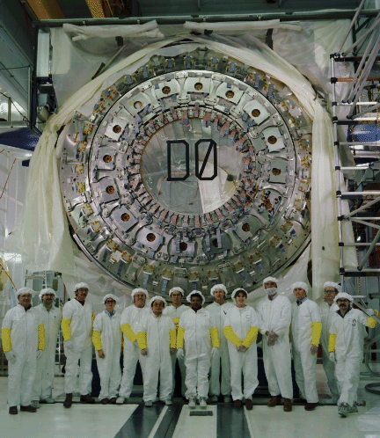
DØ Central Calorimeter 1990

