Slide 1
PHYS 3446 – Lecture #18
Monday, Nov. 7, 2016
Dr. Jae Yu
Particle Accelerators
  Electro-static Accelerators
  Cyclotron Accelerators
  Synchrotron Accelerators
Elementary Particle Properties
  Forces and their relative magnitudes
  Elementary particles

Slide 2
Announcements
Quiz #3
  Beginning of the class Wednesday, Nov. 9
  Covers 6.1 through what we finish today!
  Bring your calculators
    No phone or computers allowed
  Bring your own handwritten formula sheet
    Front and back of a letter size sheet
    No word definitions, no derivations, no reaction equations
Reading assignments: 9.6 and 9.7

Slide 3
Homework #9
End of chapter problems 9.1, 9.2 and 9.3
Due for these assignments is next Monday, Nov. 14

Slide 4
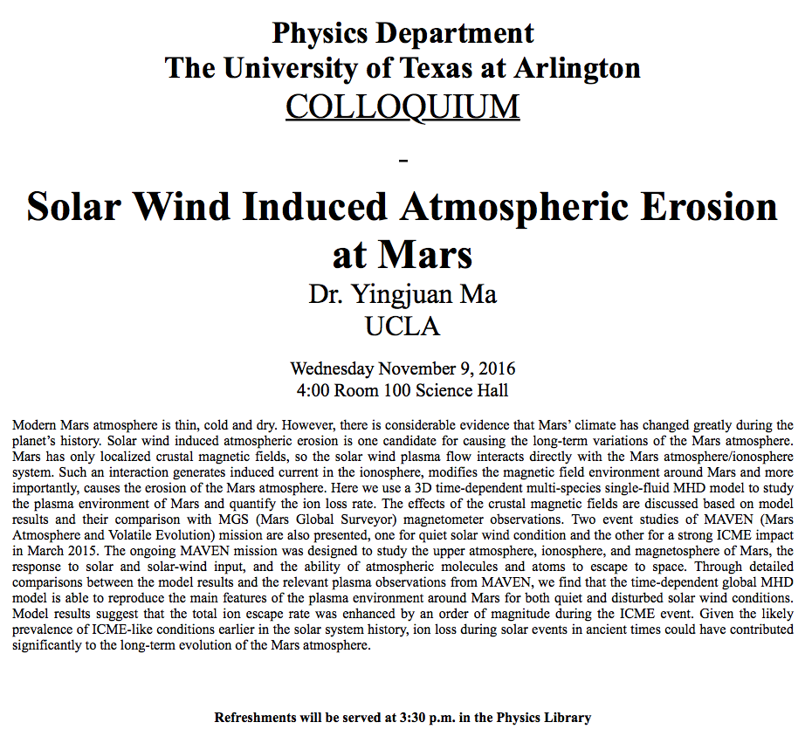

Slide 5
Particle Accelerators
How can one obtain high energy particles?
  Cosmic ray ➔ Sometimes we observe 1000TeV cosmic rays

Slide 6
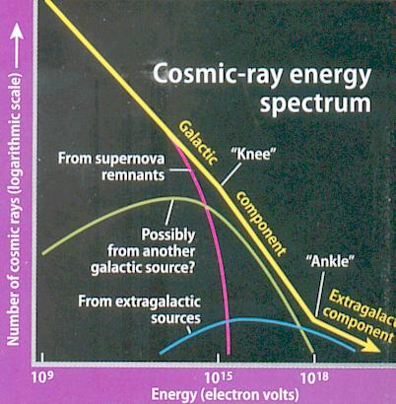

Slide 7
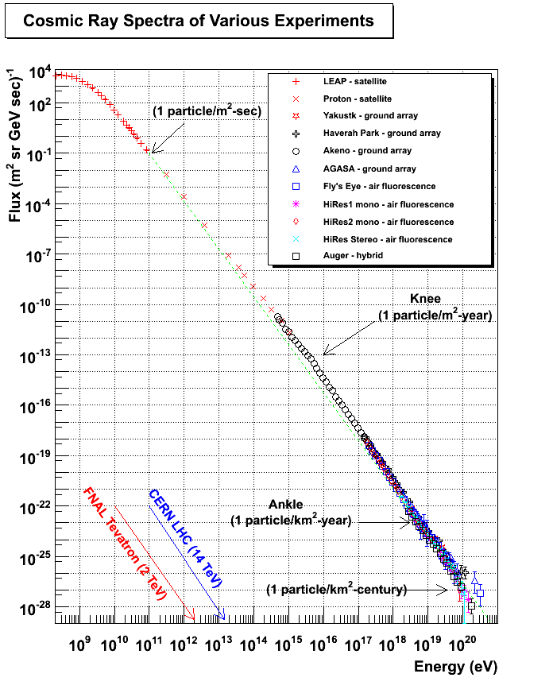

Slide 8
Particle Accelerators
How can one obtain high energy particles?
  Cosmic ray ➔ Sometimes we observe 1000TeV cosmic rays
    Low flux and cannot control the energy too well

Slide 9
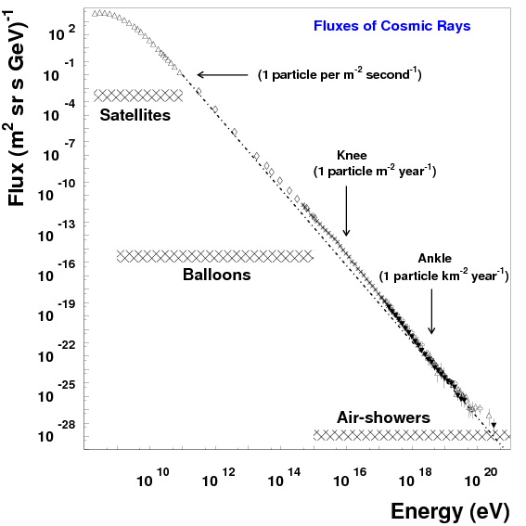

Slide 10
Particle Accelerators
How can one obtain high energy particles?
  Cosmic ray ➔ Sometimes we observe 1000TeV cosmic rays
    Low flux and cannot control the energy too well
Need to look into small distances to probe the fundamental constituents with full control of particle energies and fluxes
  Particle accelerators
Accelerators need not only to accelerate particles but also to
  Track them
  Maneuver them
  Constrain their motions to within the distance of order 1μm
Why?
  Must correct particles’ paths and momenta to increase fluxes and control momenta better

Slide 11
Particle Accelerators
Depending on what the main goals of physics are, one needs different kinds of accelerator experiments
Fixed target experiments: Probe the nature of the nucleons ➔ Structure functions
  Results also can be used for producing secondary particles for further accelerations ➔ Tevatron anti-proton production
Collider experiments: Probe the interactions between fundamental constituents
  Hadron colliders: Wide kinematic range and high discovery potential
    Proton-anti-proton: TeVatron at Fermilab, Sp‾pS at CERN
    Proton-Proton: Large Hadron Collider at CERN (started operating in 2010)
  Lepton colliders: Very narrow kinematic reach, so it is used for precision measurements
    Electron-positron: LEP at CERN, Petra at DESY, PEP at SLAC, Tristan at KEK, ILC in the future
    Muon-anti-muon: Conceptual accelerator in the far future
  Lepton-hadron colliders: HERA at DESY

Slide 12
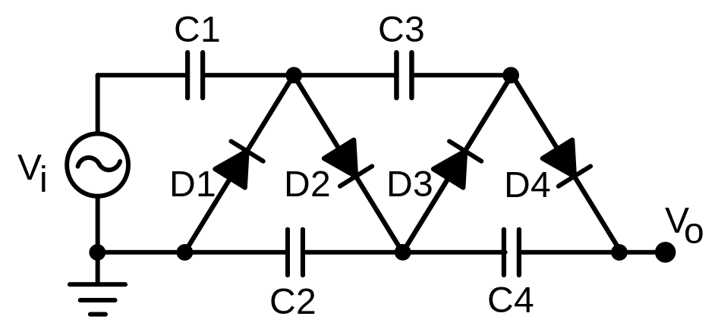
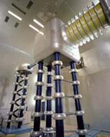
Electrostatic Accelerators: Cockcroft-Walton
Cockcroft-Walton Accelerator – invented in 1932
  Pass ions through sets of aligned DC electrodes consist of arrays of capacitors and diodes at successively increasing fixed potentials
  Consists of ion source (hydrogen gas) and a target with the electrodes arranged in between
  Acceleration Procedure
    Electrons are either added or striped off of an atom
    Ions of charge q then get accelerated through series of electrodes, gaining kinetic energy of T=qV through every set of electrodes
Shut down on Aug. 2012
Limited to about 1MeV acceleration due to voltage breakdown and discharge beyond the voltage of 1MV.
Available commercially and also used as the first step high current injector (to ~1mA).

Slide 13
Electrostatic Accelerators: Van de Graaff
Energies of particles through DC accelerators are proportional to the applied voltage
Robert Van de Graaff invented a clever mechanism to increase HV in 1929
  The charge on any conductor resides on its outermost surface
  If a conductor carrying additional charge touches another conductor that envelops it, all of its charges will transfer to the outer conductor increasing the charge on it and thereby increase the HV

Slide 14
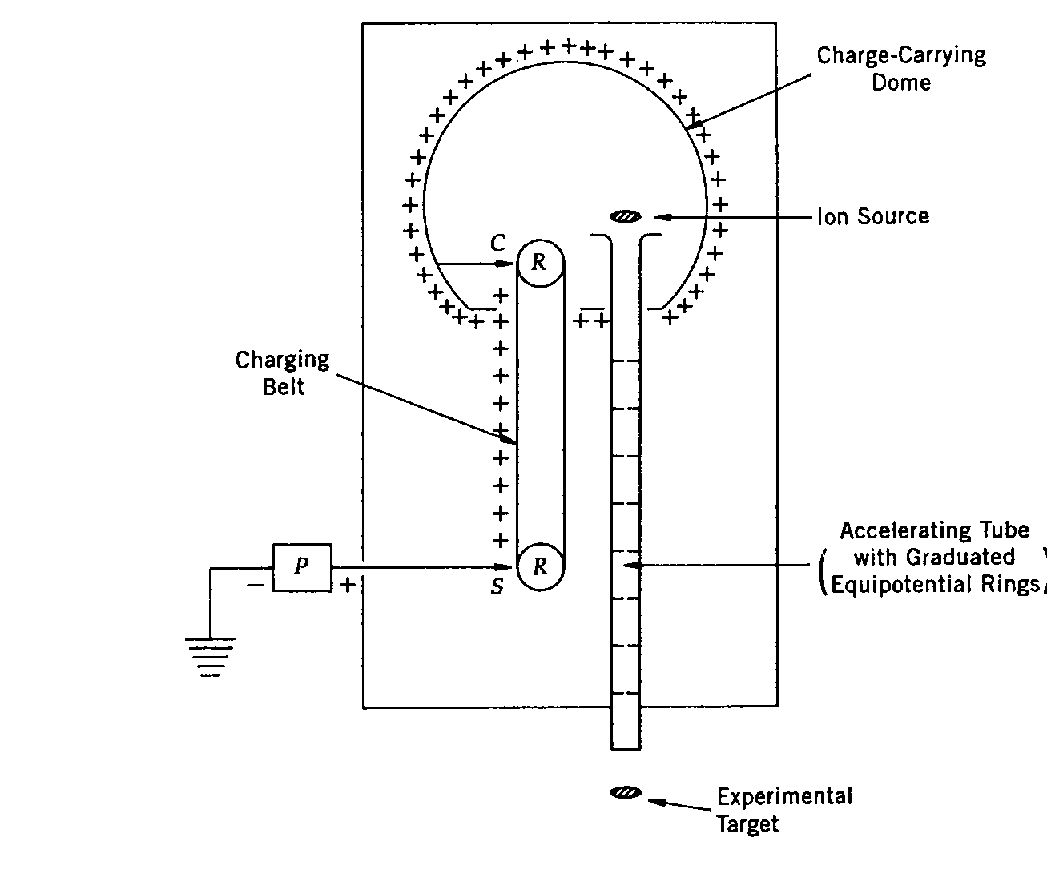
Electrostatic Accelerators: Van de Graaff
Sprayer adds positive charge to the conveyor belt at corona points
The charge is carried on an insulating conveyor belt
The charges get transferred to the dome via the collector
The ions in the source then gets accelerated to about 12MeV
Tandem Van de Graff can accelerate particles up to 25 MeV
This acceleration normally occurs in high pressure gas (~15atm) that has very high breakdown voltage

Slide 15
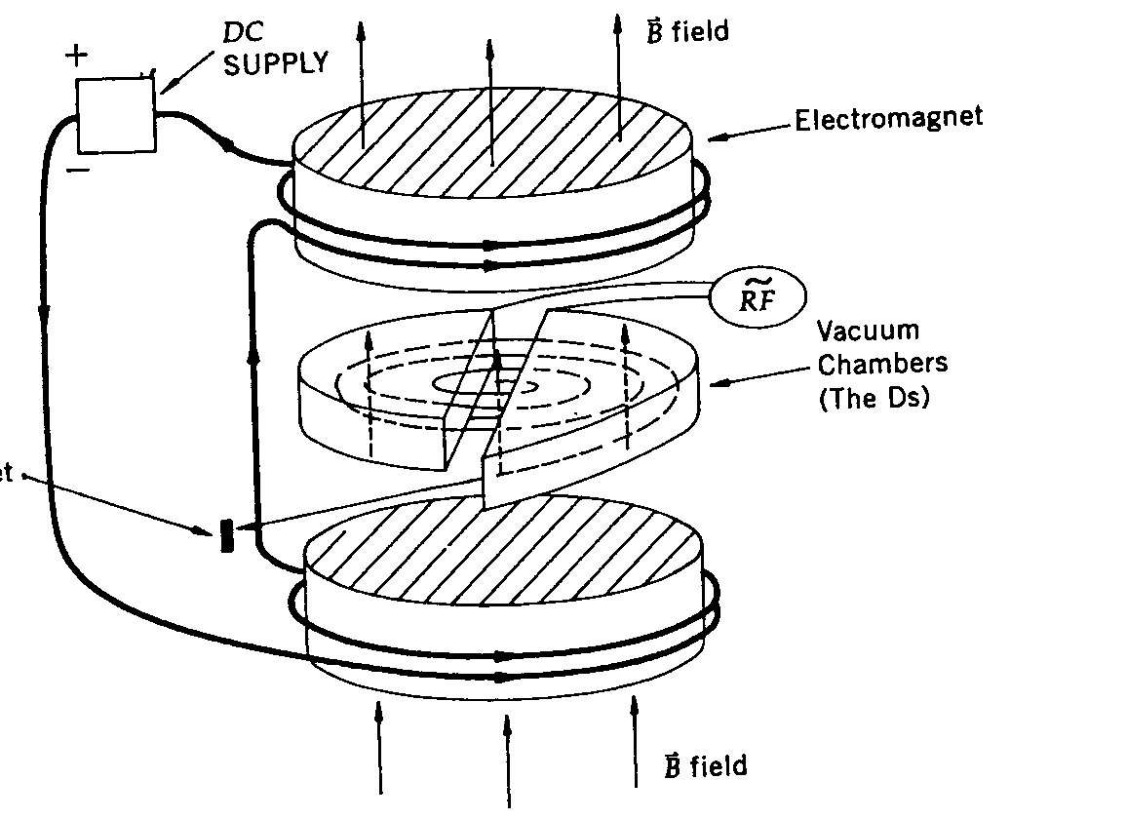
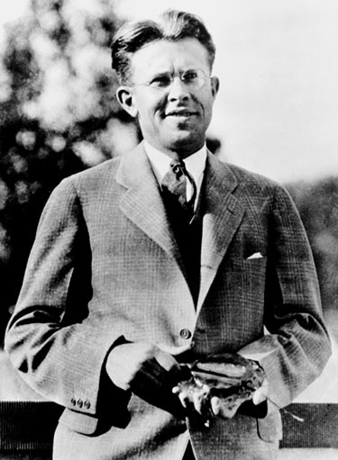
Resonance Accelerators: Cyclotron
Fixed voltage machines have intrinsic limitations in their energy due to breakdown
Machines using resonance principles can accelerate particles in higher energies
Cyclotron invented by Ernest Lawrence 1934 is the simplest one
  Awarded Nobel Prize 1939
Accelerator consists of
  Two hallow D shaped metal chambers connected to alternating HV source
  The entire system is placed under strong magnetic field

Slide 16
Resonance Accelerators: Cyclotron
While the D’s are connected to HV sources, there is no electric field inside the chamber due to Faraday effect
Strong alternating electric field exists only in the gap between the D’s
An ion source is placed in the gap
The path is circular due to the perpendicular magnetic field
Ion does not feel any acceleration inside a D but gets bent due to magnetic field
When the particle exits a D, the direction of voltage can be changed and the ion gets accelerated before entering into the D on the other side
If the frequency of the alternating voltage is just right, the charged particle gets accelerated continuously until it is extracted

Slide 17
Resonance Accelerators: Cyclotron
For a non-relativistic motion, the frequency appropriate for alternating voltage can be calculated from the fact that the magnetic force provides the centripetal acceleration for a circular orbit
In a constant angular speed, ω=v/r. The frequency of the motion is
Thus, to continue accelerate the particle the electric field should alternate in this frequency, cyclotron resonance frequency
The maximum kinetic energy achievable for an cyclotron with radius R is

Slide 18
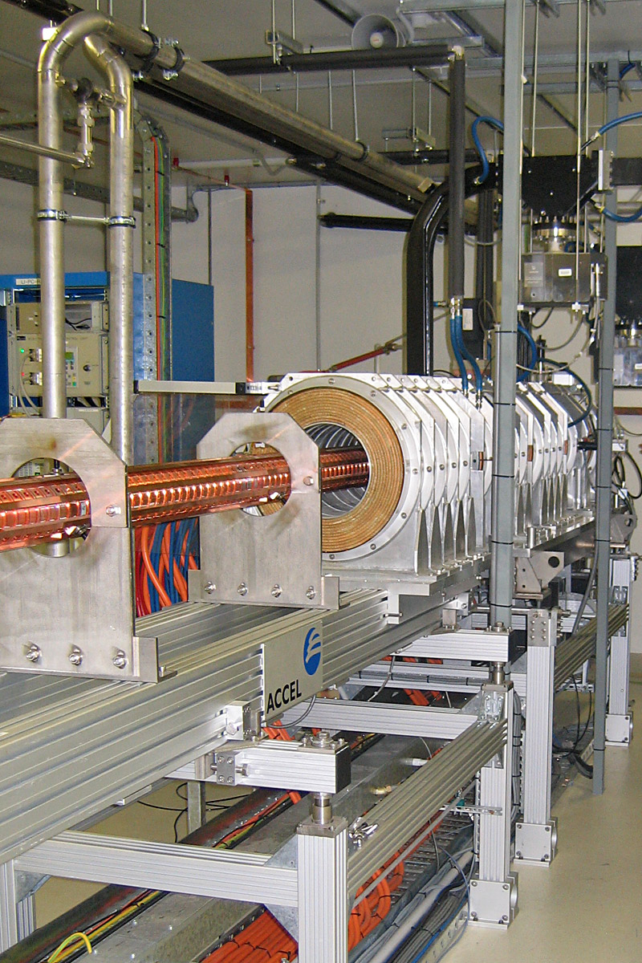
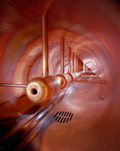
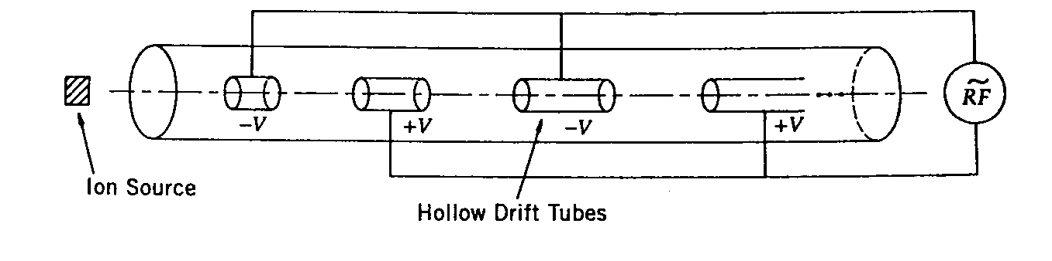
Resonance Accelerators: Linear Accelerator
Accelerates particles along a linear path using the resonance principle
  Method invented by Leo Szilard and patented by Rolf Widerøe in 1929
A series of metal tubes are located in a vacuum vessel and connected successively to alternating terminals of radio frequency oscillator
The directions of the electric fields changes before the particles exits the given tube
The tube length needs to get longer as the particle gets accelerated to keep up with the phase
These accelerators are used for accelerating light particles to very high energies

Slide 19
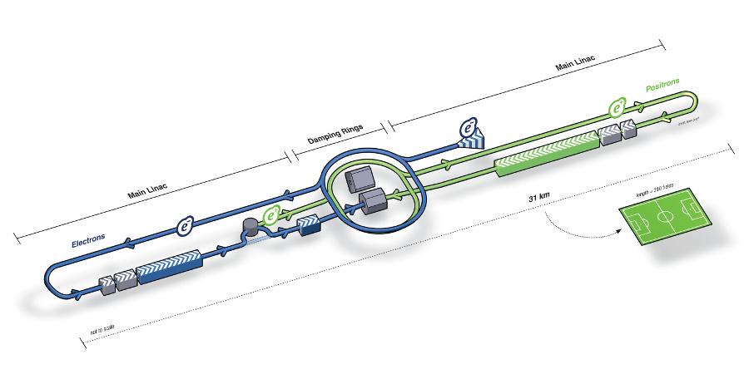
Future Linear Collider
Has been in the works since late 1990’s
An electron-positron collider on a straight line for precision measurements
10~15 years from now (In Dec. 2011, Japanese PM announced that they would bid for a LC in Japan and reaffirmed by the new PM in 2013)
Takes 10 years to build a detector
L~31km (~20 mi)
Circumference ~6.6km
~300 soccer fields

Slide 20
Synchroton Accelerators
For very energetic particles, the relativistic effect must be taken into account
For relativistic energies, the equation of motion of a charge q under magnetic field B is
For v ~ c, the resonance frequency (ν) becomes
Thus for high energies, either B or ν should increase
Machines with constant B but variable ν are called synchro-cyclotrons
Machines with variable B independent of the change of ν is called synchrotrons

Slide 21
Synchroton Accelerators
Electron synchrotrons, B varies while ν is held constant
Proton synchrotrons, both B and ν varies
For v ~ c, the frequency of motion can be expressed
For an electron
For magnetic field strength of 2Tesla, one needs radius of 50m to accelerate an electron to 30GeV/c.

Slide 22
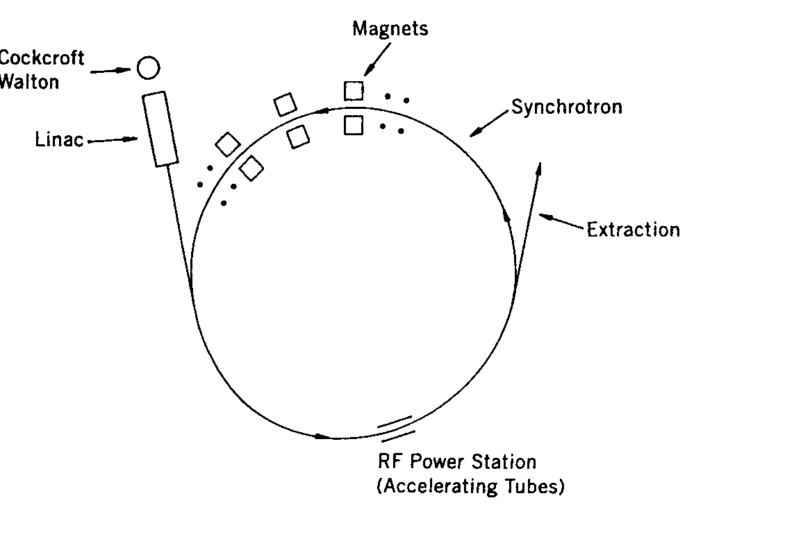
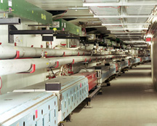
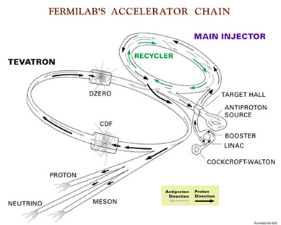
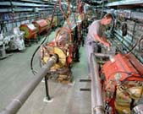
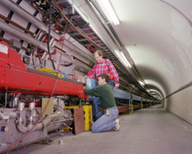
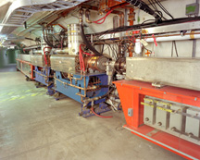
Synchroton Accelerators
Synchrotons use magnets arranged in a ring-like fashion.
Multiple stages of accelerations are needed before reaching over GeV ranges of energies
RF power stations are located through the ring to pump electric energies into the particles

Slide 23
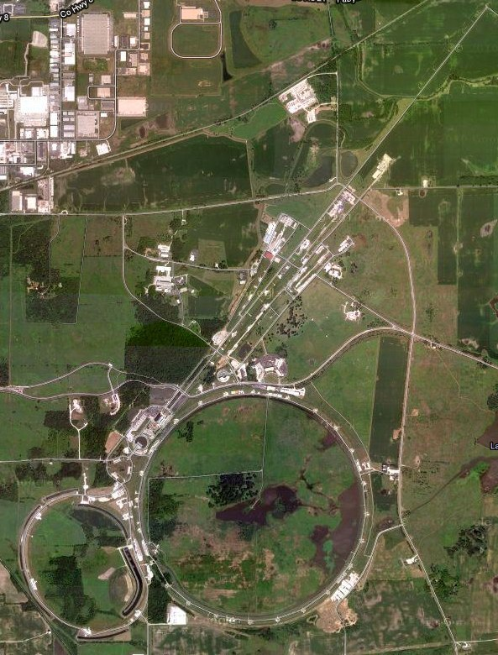
Aerial View of Fermilab Acc. Complex

Slide 24
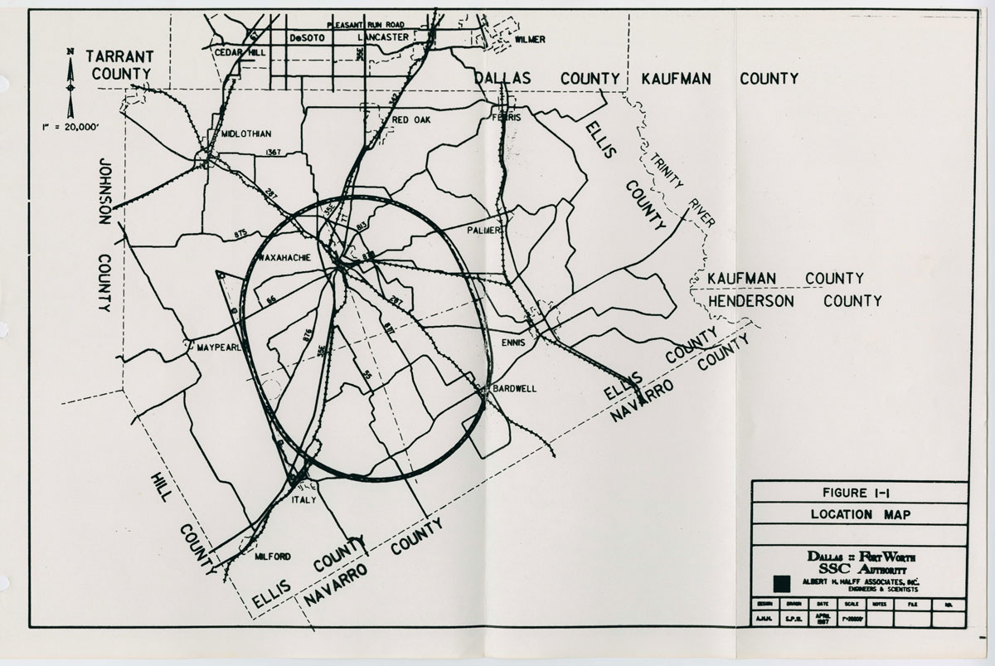
Rough Regional Map of the SSC
54 mile circumference
In Waxahache
⎷S=50TeV

