Slide 1
PHYS 3446 – Lecture #19
Wednesday, Nov. 9, 2016
Dr. Amir Farbin
Elementary Particle Properties
  Forces and their relative magnitudes
  Elementary particles
  Quantum Numbers
    Strangeness
    Isospin
  Gell-Mann-Nishijima Relations
  Production and Decay of Resonances

Slide 2
Announcements
Reading assignments: 9.6 and 9.7

Slide 3
Reminder: Homework #9
End of chapter problems 9.1, 9.2 and 9.3
Due for these assignments is Monday, Nov. 14

Slide 4
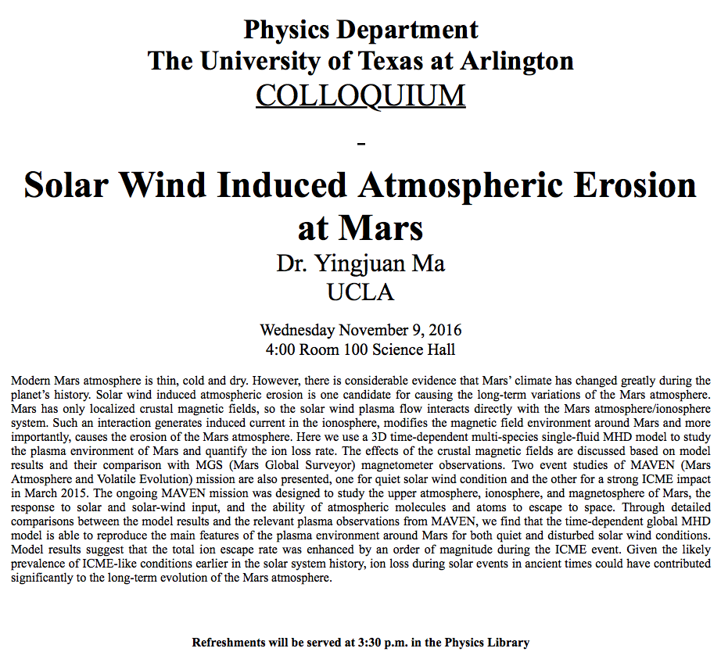

Slide 5
Forewords
What are the elementary particles?
  Particles that make up matter in the universe
What are the requirements for elementary particles?
  Cannot be broken into smaller pieces
  Cannot have sizes
The notion of “elementary particles” have changed from 1930’s through present
  In the past, people thought protons, neutrons, pions, kaons, ρ-mesons, etc, as elementary particles
Why?
  Due to the increasing energies of accelerators that allows us to probe smaller distance scales
What is the energy needed to probe 0.1–fm?
  From de Broglie Wavelength, we obtain

Slide 6
Forces and Their Relative Strengths
Classical forces:
  Gravitational: every particle is subject to this force, including massless ones
    How do you know?
  Electromagnetic: only those with electrical charges
  What are the ranges of these forces?
    Infinite!!
  What does this tell you?
    Their force carriers are massless!!
  What are the force carriers of these forces?
    Gravity: graviton (not seen but just a concept)
    Electromagnetism: Photons

Slide 7
Forces and Their Relative Strengths
What other forces?
  Strong force
    Where did we learn this force?
      From nuclear phenomena
      The interactions are far stronger and extremely short ranged
  Weak force
    How did we learn about this force?
      From nuclear beta decay
  What are their ranges?
    Very short
  What does this tell you?
    Their force carriers are massive!
    Not really for strong forces
All four forces can act at the same time!!!

Slide 8
Forces’ Relative Strengths
The strengths can be obtained through potential, considering two protons separated by a distance r.
Magnitude of Coulomb and gravitational potential are
  q: magnitude of the momentum transfer
What do you observe?
  The absolute values of the potential E decreases quadratically with increasing momentum transfer
  The relative strength is, though independent of momentum transfer
Fourier x-form
Fourier x-form

Slide 9
Forces’ Relative Strengths
Using Yukawa potential form, the magnitudes of strong and weak potential can be written as
  g_{W} and g_{s}: coupling constants or effective charges
  m_{W} and m_{π}: masses of force mediators
The values of the coupling constants can be estimated from experiments
Fourier x-form
Fourier x-form

Slide 10
Forces’ Relative Strengths
We could think of π as the strong force mediator w/
From observations of beta decays,
However there still is an explicit dependence on momentum transfer
  Since we are considering two protons, we can replace the momentum transfer, q, with the mass of protons

Slide 11
Forces’ Relative Strengths
The relative strength between EM and strong potentials is
And that between weak and EM potentials is

Slide 12
Interaction Time
The ranges of forces also affect interaction time
  Typical time for Strong interaction ~10⁻²⁴sec
    What is this?
    A time that takes light to traverse the size of a proton (~1 fm)
  Typical time for EM force ~10⁻²⁰ – 10⁻¹⁶ sec
  Typical time for Weak force ~10⁻¹³ – 10⁻⁶ sec
In GeV ranges, the four forces are different
These are used to classify elementary particles

Slide 13
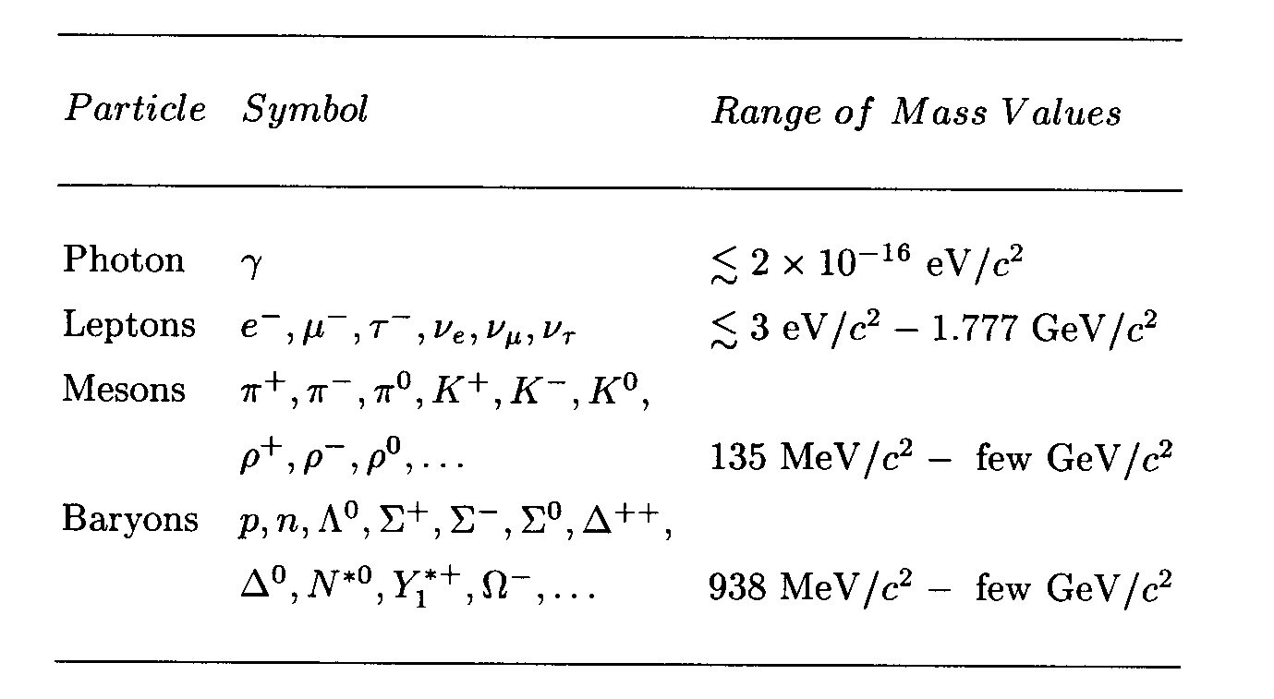
Elementary Particles
Before the quark concepts, all known elementary particles were grouped in four depending on the nature of their interactions

Slide 14
Elementary Particles
How do these particles interact??
  All particles, including photons and neutrinos, participate in gravitational interactions
  Photons can interact electromagnetically with any particles with electric charge
  All charged leptons participate in both EM and weak interactions
  Neutral leptons do not have EM couplings
  All hadrons (Mesons and baryons) responds to the strong force and appears to participate in all the interactions

Slide 15
Elementary Particles: Bosons and Fermions
All particles can be classified as bosons or fermions
  Bosons follow Bose-Einstein statistics
    Quantum mechanical wave function is symmetric under exchange of any pair of bosons
    x_{i}: space-time coordinates and internal quantum numbers of particle i
  Fermions obey Fermi-Dirac statistics
    Quantum mechanical wave function is anti-symmetric under exchange of any pair of Fermions
    Pauli exclusion principle is built into the wave function
      For x_{i}=x_{j},

