Slide 1
PHYS 3446 – Lecture #20
Monday, Nov. 14, 2016
Dr. Jaehoon Yu
Elementary Particle Properties
Elementary particles
Quantum Numbers
Gell-Mann-Nishijima Relations
Production and Decay of Resonances
Symmetries
Why do we care about the symmetry?
Symmetry in Lagrangian formalism
Symmetries in quantum mechanical system

Slide 2
Announcements
Reading assignments: 10.3 and 10.4

Slide 3
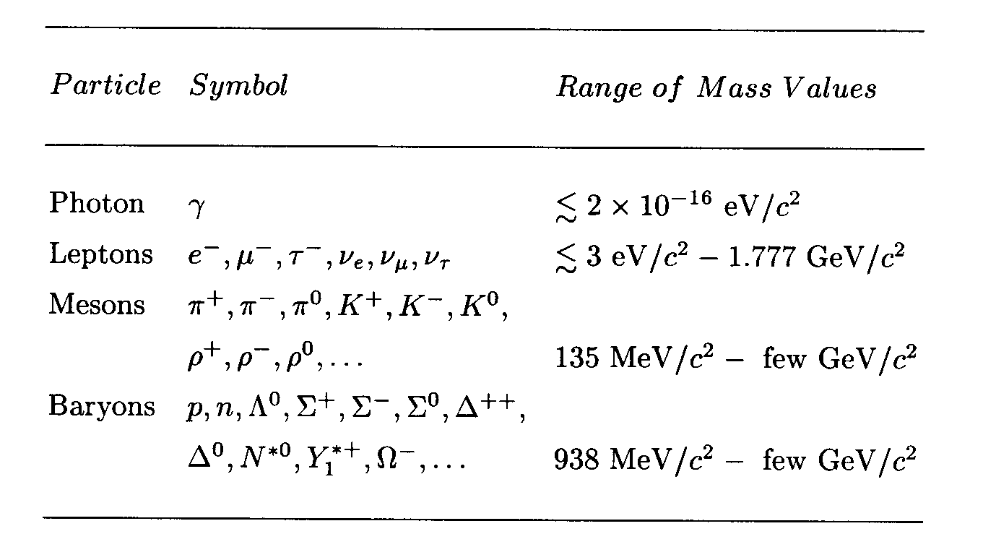
Elementary Particles
Before the quark concepts, all known elementary particles were grouped in four depending on the nature of their interactions

Slide 4
Elementary Particles
How do these particles interact??
All particles, including photons and neutrinos, participate in gravitational interactions
Photons can interact electromagnetically with any particles with electric charge
All charged leptons participate in both EM and weak interactions
Neutral leptons do not have EM couplings
All hadrons (Mesons and baryons) responds to the strong force and appears to participate in all the interactions

Slide 5
Elementary Particles: Bosons and Fermions
All particles can be classified as bosons or fermions
Bosons follow Bose-Einstein statistics
Quantum mechanical wave function is symmetric under exchange of any pair of bosons
x_{i}: space-time coordinates and internal quantum numbers of particle i
Fermions obey Fermi-Dirac statistics
Quantum mechanical wave function is anti-symmetric under exchange of any pair of Fermions
Pauli exclusion principle is built into the wave function
For x_{i}=x_{j},

Slide 6
Bosons, Fermions, Particles and Antiparticles
Bosons
All have integer spin angular momentum
All mesons are bosons
Fermions
All have half integer spin angular momentum
All leptons and baryons are fermions
All particles have anti-particles
What are anti-particles?
Particles that have the same masses as particles but with opposite charges and quantum numbers
What is the anti-particle of
A π⁰?
A neutron?
A K⁰?
A Neutrinos?

Slide 7
Quantum Numbers
When can an interaction occur?
If it is kinematically allowed
If it does not violate any recognized conservation laws
Eg. A reaction that violates charge conservation will not occur
In order to deduce conservation laws, a full theoretical understanding of forces are necessary
Since we do not have a full theory for all the forces
Many of general conservation rules for particles are based on experimental observations
One of the clearest conservation rule is the lepton number conservation
While photon and meson numbers are not conserved

Slide 8
Baryon Numbers
Can the decay occur?
Kinematically??
Yes, proton mass is a lot larger than the sum of the two final state masses
Electrical charge?
Yes, it is conserved
But this decay does not occur (<10⁻⁴⁰/sec)
Why?
Must be a conservation law that prohibits this decay
What could it be?
An additive and conserved quantum number, the Baryon number (B)
All baryons (particles with 3 more quark compositions) have B=1
Anti-baryons? (B=-1)
Photons, leptons and mesons have B=0
Since proton is the lightest baryon, it does not decay.

Slide 9
Lepton Numbers
Quantum number of leptons
All leptons carry L=1 (particles) or L=-1 (antiparticles)
Photons or hadrons carry L=0
Lepton number is a conserved quantity
Total lepton number must be conserved
Lepton numbers by species must also be conserved
This is an empirical law necessitated by experimental observations (or lack thereof)
Consider the decay
Does this decay process conserve energy and charge?
Yes
But it hasn’t been observed, why?
Due to the lepton number conservation law

Slide 10
Lepton Number Assignments
Leptons (anti-leptons) | L_{e} | L_{μ} | L_{τ} | L=L_{e}+L_{μ}+L_{t}
e⁻ (e⁺) | 1 (-1) | 0 | 0 | 1 (-1)
 | 1 (-1) | 0 | 0 | 1 (-1)
 | 0 | 1 (-1) | 0 | 1 (-1)
 | 0 | 1 (-1) | 0 | 1 (-1)
 | 0 | 0 | 1 (-1) | 1 (-1)
 | 0 | 0 | 1 (-1) | 1 (-1)

Slide 11
Lepton Number Conservation
Can the following decays occur?
Case 1: L is conserved but L_{e} and L_{μ} not conserved
Case 2: L is conserved but L_{e} and L_{μ} not conserved
Case 3: L is conserved, and L_{e} and L_{μ} are also conserved
Decays
L_{e}
L_{μ}
L_{τ}
L=L_{e}+L_{μ}+L_{τ}

Slide 12
Quantum Numbers
Baryon Number (B)
The additive and conserved quantum number assigned to baryons
All baryons have B=1
Anti-baryons have B= -1
Photons, leptons and mesons have B=0
Lepton Number
The quantum number assigned to leptons
All leptons carry L=1 (particles) or L=-1 (antiparticles)
Photons or hadrons carry L=0
Total lepton number must be conserved
Lepton numbers by species must be conserved

Slide 13
Strangeness
From cosmic ray shower observations
K-mesons and Σ & Λ⁰ baryons are produced strongly w/ large x-sec’s
But their lifetimes are typical of weak interactions (~10⁻¹⁰ sec)
They are produced in pairs – a K with a Σ or a K with a Λ⁰
Gave an indication of a new quantum number
Consider the reaction
K⁰ and Λ⁰ subsequently decay
and
Observations on Λ⁰
Always produced with a K⁰ never with just a π⁰
Produced with a K⁺ but not with a K⁻

