Slide 1
PHYS 3446 – Lecture #21
Wednesday, Nov. 16, 2016
Dr. Jaehoon Yu
Elementary Particle Properties
  Strangeness Quantum Number
  Isospin Quantum Number
  Gell-Mann-Nishijima Relations
  Summary of Quantum Numbers
Symmetries
  Why do we care about the symmetry?

Slide 2
Announcements
Class on Wednesday, Nov. 23?
  No class Wednesday, Nov. 23
Quiz #4
  Monday, Nov. 28
  Covers up to what we learn coming Monday, Nov. 21
  BYOF
Reading assignments: 10.3 and 10.4

Slide 3
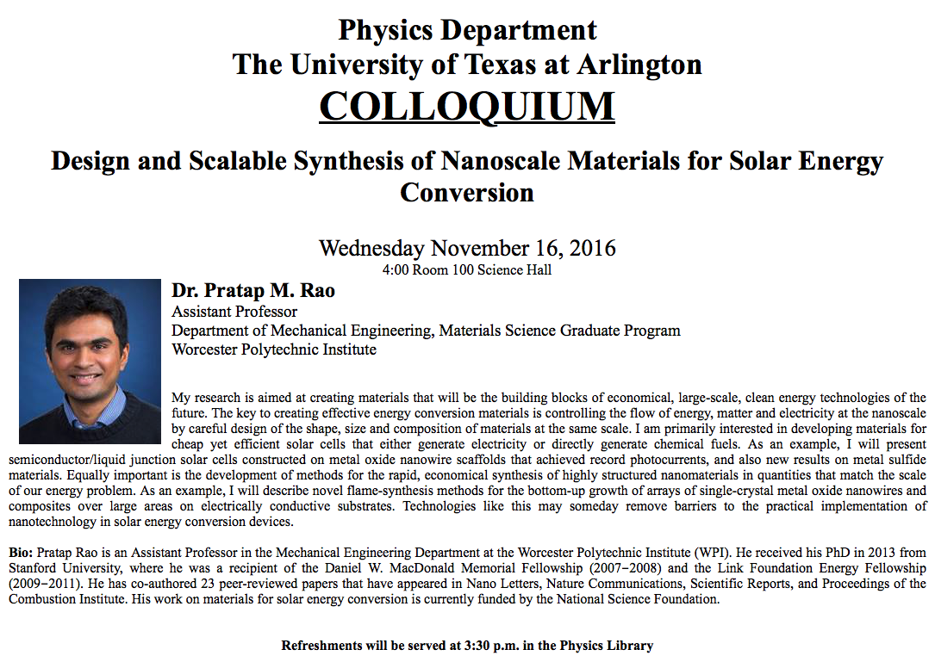

Slide 4
Strangeness
From cosmic ray shower observations
  K-mesons and Σ & Λ⁰ baryons are produced strongly w/ large x-sec’s
    But their lifetimes are typical of weak interactions (~10⁻¹⁰ sec)
    They are produced in pairs – a K with a Σ or a K with a Λ⁰
  Gave an indication of a new quantum number
Consider the reaction
  K⁰ and Λ⁰ subsequently decay
  and
Observations on Λ⁰
  Always produced with a K⁰ never with just a π⁰
  Produced with a K⁺ but not with a K⁻

Slide 5
Strangeness
Consider reactions and
  With the subsequent decays and
Observations from Σ⁺
  Σ⁺ is always produced with a K⁺ never with just a π⁺
  Σ⁺ is also produced with a K⁰ but with an additional π⁺ for charge conservation
Observations from Σ⁻
  Σ⁻ is always produced with a K⁺ never with a K⁻
Thus,
  Observed:
  Not observed:

Slide 6
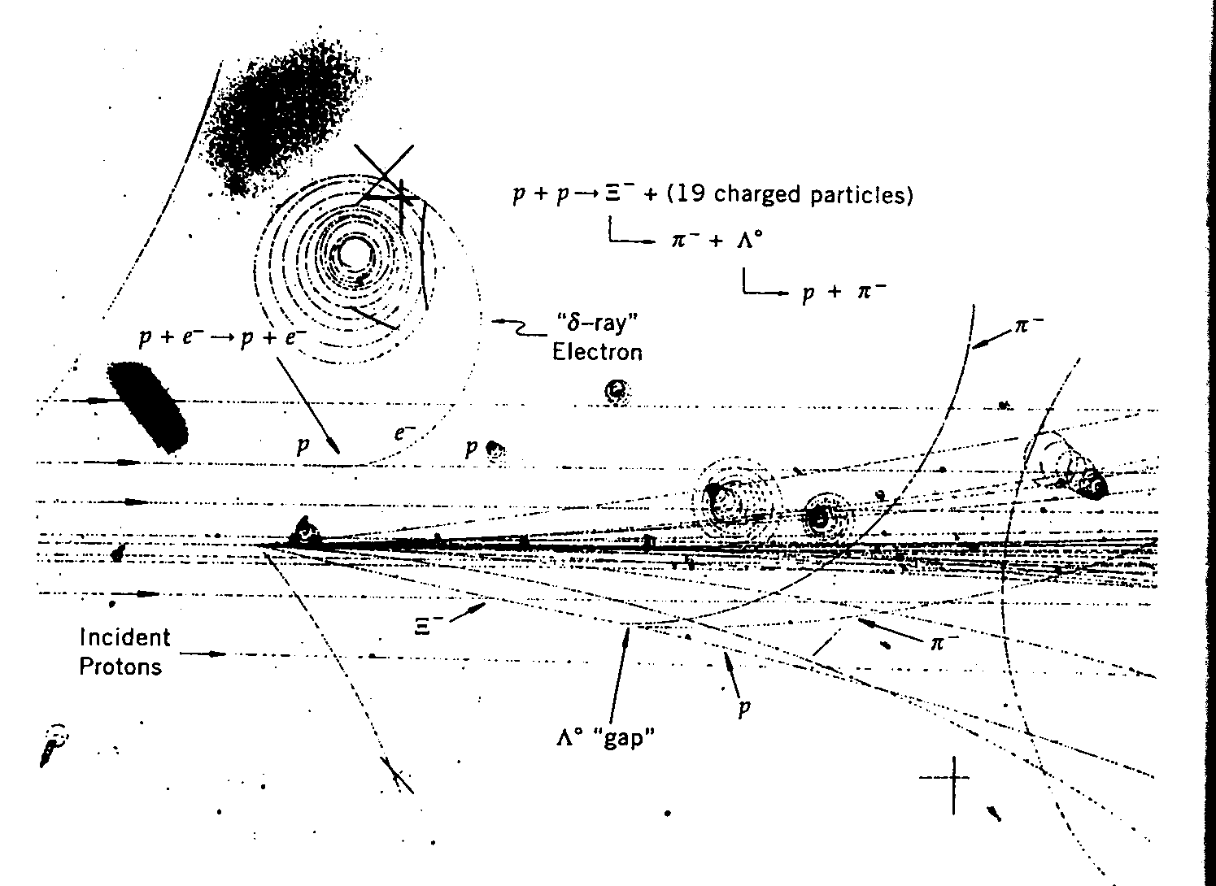
Strangeness
Further observation from cross section measurements
  The cross section for reactions and with 1GeV/c pion momenta are ~ 1mb
    Whereas the total pion-proton scattering cross section is ~ 30mb
    The interactions are strong interactions
  Λ⁰ at v~0.1c decays in about 0.3cm
    Lifetime of Λ⁰ baryon is
    The short lifetime of these strange particles indicate weak decay

Slide 7
Strangeness
Strangeness quantum number
  Murray Gell-Mann and Abraham Pais proposed a new additive quantum number that are carried by these particles in 1950’s
  Conserved in strong and EM interactions
  Violated in weak decays
  S=0 for all ordinary mesons and baryons as well as photons and leptons
  For any strong associated-production reaction with the initial state S=0, the total strangeness of particles in the final state should also add up to 0.

Slide 8
Strangeness
Based on experimental observations of reactions and with an arbitrary choice of S(K⁰)=1, we obtain
  S(K⁺)= S(K⁰)=1 and S(K⁻)= S(‾Κ⁰)= -1
  S(Λ⁰)= S(Σ⁺)= S(Σ⁰)= S(Σ⁻)= -1
  Does this work for the following reactions?
For strong production reactions and
we can determine that
  cascade particles if

Slide 9
More on Strangeness
Let’s look at the reactions again
  This is a strong interaction
    Strangeness must be conserved
    S: 0 + 0 → +1 -1
How about the decays of the final state particles?
  and
  These decays are weak interactions so S is not conserved
  S: -1 → 0 + 0 and +1 → 0 + 0
A not-really-elegant solution
  S is only conserved in Strong and EM interactions ➔ Unique strangeness quantum numbers cannot be assigned to leptons
Leads into the necessity of the strange quark

Slide 10
Isospin Quantum Number
Strong force does not depend on the charge of the particle
  Nuclear properties of protons and neutrons are very similar
  From the studies of mirror nuclei, the strengths of p–p , p–n and n–n strong interactions are essentially the same
  If corrected by the EM interactions, the x-sec between n–n and p–p are the same
Since the strong force is much stronger than any other forces, we could imagine a new quantum number that applies to all particles involved in the strong interaction
  Protons and neutrons are two orthogonal mass eigenstates of the same particle like spin up and down states

Slide 11
Isospin Quantum Number
Protons and neutrons are degenerate in mass because of some symmetry of the strong force
  Isospin symmetry ➔ Under the strong force these two particles appear identical
  Presence of the Electromagnetic or Weak force breaks this symmetry, distinguishing p from n
Isospin works just like the spin
  Protons and neutrons have isospin ½ ➔ Isospin doublet
  Three pions, π+, π- and π⁰, have almost the same masses
  Strong interaction X-sec by these particles are almost the same after correcting for EM effects
  Strong force does not distinguish these particles ➔ Isospin triplet

Slide 12
Isospin Quantum Number
This QN is found to be conserved in strong interactions
But not conserved in EM or Weak interactions
The third component of the isospin QN is assigned to be positive for the particles with larger electric charge
Isospin is not a space-time symmetry
Cannot be assigned uniquely to leptons and photons since they are not involved in strong interactions
  There is something called weak-isospin for weak interactions

Slide 13
Iso-spin Assignments of some hadrons
hadrons | Mass (MeV/c²) | Lifetime τ₀ (sec) | I | I₃
p
n
π⁺,π⁻,π⁰
K⁺,K⁰,K⁰-bar,K⁻
η⁰, Λ⁰
Σ⁺, Σ⁰, Σ⁻
Ω⁻

Slide 14
Gell-Mann-Nishijima Relation
Strangeness assignment is based on Gell-Mann-Nishijima relation
  Electric charge of a hadron can be related to its other quantum numbers
  Where
    Q: hadron electric charge
    I₃: third component of isospin
    Y=B+S, strong hypercharge
  Quantum numbers of several long lived particles follow this rule

Slide 15
Gell-Mann-Nishijima Relation
With the discovery of new flavor quantum numbers, charm and bottom, this relationship was modified to include these new additions (Y=B+S+C+b)
  Since the charge and the isospin are conserved in strong interactions, the strong hypercharge, Y, is also conserved in strong interactions
This relationship holds in all strong interactions

Slide 16
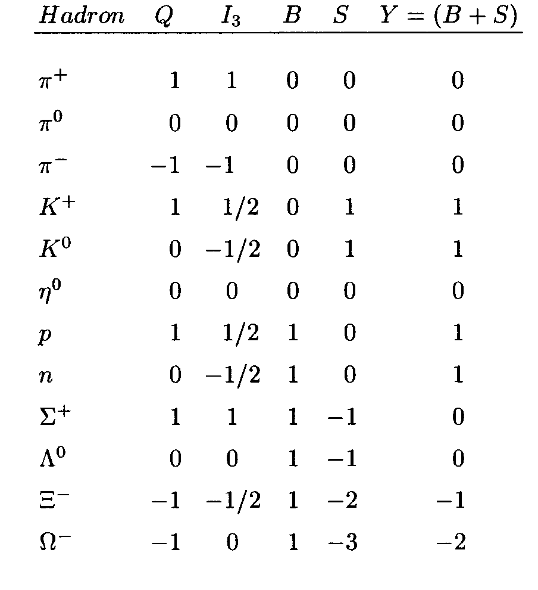
Quantum numbers for a few hadrons

Slide 17
Violation of Quantum Numbers
The QN we learned are conserved in strong interactions are but many of them are violated in EM or weak interactions
Three types of weak interactions
  Hadronic decays: Only hadrons in the final state
  Semi-leptonic decays: both hadrons and leptons are present
  Leptonic decays: only leptons are present

Slide 18
Hadronic Weak Decays
These decays follow selection rules: |ΔI₃|=1/2 and |ΔS|=1
QN | Λ⁰ → | π⁻ | p
I₃ | 0 | -1 | ½
S | -1 | 0 | 0
|Δ|
1/2
1
QN | Σ⁺ → | π⁰ | p
I₃ | 1 | 0 | ½
S | -1 | 0 | 0
1/2
1
QN | Κ⁰ → | π⁺ | π⁻
I₃ | - ½ | 1 | -1
S | 1 | 0 | 0
1/2
1
QN | Ξ⁻ → | Λ⁰ | π⁻
I₃ | - ½ | 0 | -1
S | -2 | -1 | 0
1/2
1

Slide 19
Semi-leptonic Weak Decays
These decays follow selection rules: |ΔI₃|=1 and |ΔS|=0 or |ΔI₃|= ½ and |ΔS|=1
QN | n→ | p | e⁻+‾ν_{e}
I₃ | -1/2 | 1/2
S | 0 | 0
|Δ|
1
0
QN | π⁻ → | μ⁻ | ‾ν_{μ}
I₃ | -1
S | 0
1
0
QN | Κ⁺ → | π⁰ | μ⁺+ν_{μ}
I₃ | ½ | 0
S | 1 | 0
1/2
1
QN | Σ⁻ → | n | e⁻+‾ν_{e}
I₃ | -1 | -1/2
S | -1 | 0
1/2
1

Slide 20
Summary of Weak Decays
Hadronic weak-decays
  Selection rules are |ΔI₃|=1/2 and |ΔS|=1
  |ΔI₃|=3/2 and |ΔS|=2 exists but heavily suppressed
Semi-leptonic weak-decays
  Type 1: Strangeness conserving
    Selection rules are: |ΔS|=0, |ΔI₃|=1 and |ΔI|=1
  Type 2: Strangeness non-conserving
    Selection rules are: |ΔS|=1, |ΔI₃|= ½ and |ΔI|= ½ or 3/2
    ΔI=3/2 and |ΔS|=1 exist but heavily suppressed

Slide 21
EM Processes
|Δ|
QN | π⁰ → | γ | γ
I₃ | 0
S | 0
0
0
QN | η⁰ → | γ | γ
I₃ | 0
S | 0
0
0
QN | Σ⁰ → | Λ⁰ | γ
I₃ | 0 | 0
S | -1 | -1
0
0
Strangeness is conserved but the total isospin is not
  Selection rules are: |ΔS|=0, |ΔI₃|=0 and ΔI= 1or 0

Slide 22
Summary of Quantum Numbers
Baryon Number
  An additive and conserved quantum number, Baryon number (B)
  This number is conserved in general but not absolute
Lepton Number
  Quantum number assigned to leptons
  Lepton numbers by species and the total lepton numbers must be conserved
Strangeness Numbers
  Conserved in strong interactions
  But violated in weak interactions
Isospin Quantum Numbers
  Conserved in strong interactions
  But violated in weak and EM interactions

Slide 23
Quantum Numbers
We’ve learned about various newly introduced quantum numbers as a patch work to explain experimental observations
  Lepton numbers
  Baryon numbers
  Isospin
  Strangeness
Some of these numbers are conserved in certain situation but not in others
  Very frustrating indeed….
These are due to lack of quantitative description by an elegant theory

