Slide 1
PHYS 3446 – Lecture #23
Monday, Nov. 28, 2016
Dr. Jaehoon Yu
  The Standard Model
  Quarks and Leptons
  Gauge Bosons
  Symmetry Breaking and the Higgs particle
    Issues in the Standard Model

Slide 2
Announcements
    Reading Assignments: CH11 and 12
Term Exam #2
  Next Monday, Dec. 5
  Comprehensive: CH1.1 through what we cover today
  BYOF
Please fill out class feedback surveys
  Only 1 has done as of last Saturday!
Remember to submit your report by Wed. Dec. 7!
Reminder the double extra credit opportunities
  Colloquium this Wednesday
    Dr. Steven Sands
  Colloquium next Wednesday
    Dr. K.C.Kong

Slide 3
The Standard Model of Particle Physics
Prior to 70’s, low mass hadrons are thought to be the fundamental constituents of matter, despite some new particles that seemed to have new flavors
  Even the lightest hadrons, protons and neutrons, show some indication of substructure
    Such as magnetic moment of the neutron
  Raised questions whether they really are fundamental particles
In 1964 Gell-Mann and Zweig suggested independently that hadrons can be understood as composite of quark constituents
  Recall that the quantum number assignments, such as strangeness, were only theoretical tools rather than real particle properties

Slide 4
The Standard Model of Particle Physics
In late 60’s, Jerome Friedman, Henry Kendall and Rich Taylor designed an experiment with electron beam scattering off of hadrons and deuterium at SLAC (then Stanford Linear Accelerator Center – now SLAC National Laboratory) (Shared a Nobel in 1990)
  Data could be easily understood if protons and neutrons are composed of point-like objects with charges -1/3e and +2/3e.
  A point-like electrons scattering off of point-like quark partons inside the nucleons and hadrons
    Corresponds to modern day Rutherford scattering
    Higher energies of the incident electrons could break apart the target particles, revealing the internal structure

Slide 5
The Standard Model of Particle Physics
Elastic scatterings at high energies can be described well with the elastic form factors measured at low energies
  Since the interaction is elastic, particles behave as if they are point-like objects
Inelastic scatterings cannot be described well with the elastic form factors since the target is broken apart
  Inelastic scatterings of electrons with large momentum transfer (q²) provide opportunities to probe shorter distances, breaking apart nucleons
  The fact that the form factor for inelastic scattering at large q² is independent of q² shows that there are point-like object in a nucleon

Slide 6
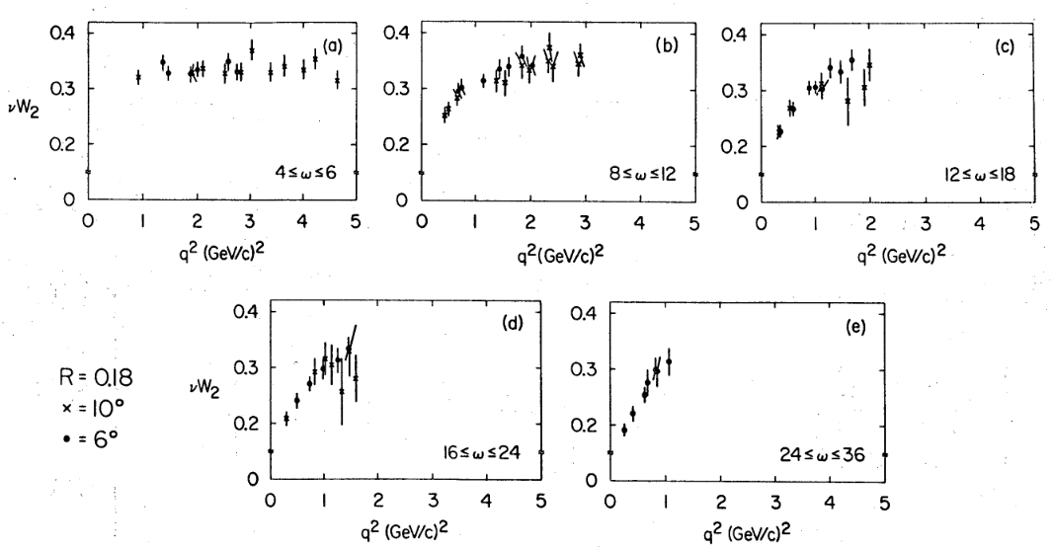
Friedman Experimental Results

Slide 7
The Standard Model of Particle Physics
Elastic scatterings at high energies can be described well with the elastic form factors measured at low energies, why?
  Since the interaction is elastic, particles behave as if they are point-like objects
Inelastic scatterings cannot be described well with the elastic form factors since the target is broken apart
  Inelastic scatterings of electrons with large momentum transfer (q²) provide opportunities to probe shorter distances, breaking apart nucleons
  The fact that the form factor for inelastic scattering at large q² is independent of q² shows that there are point-like object in a nucleon
    Bjorken scaling
Nucleons contain both quarks and glue particles (gluons) both described by individual characteristic momentum distributions (Parton Distribution Functions)

Slide 8
The Standard Model of Particle Physics
By early 70’s, it was clear that hadrons (baryons and mesons) are not fundamental point-like objects
But leptons did not show any evidence of internal structure
  Even at high energies they still do not show any structure
  Can be regarded as elementary particles
The phenomenological understanding along with observation from electron scattering (Deep Inelastic Scattering, DIS) and the quark model
Resulted in the Standard Model that can describe three of the four known forces along with quarks, leptons and gauge bosons as the fundamental particles

Slide 9
Quarks and Leptons
In SM, there are three families of leptons
  ➔ Increasing order of charged lepton mass
  The same convention used in strong isospin symmetry, higher member of multiplet carries higher electrical charge
And three families of quark constituents
All these fundamental particles are fermions w/ spin
Q
0
-1
Q
+2/3
-1/3

Slide 10
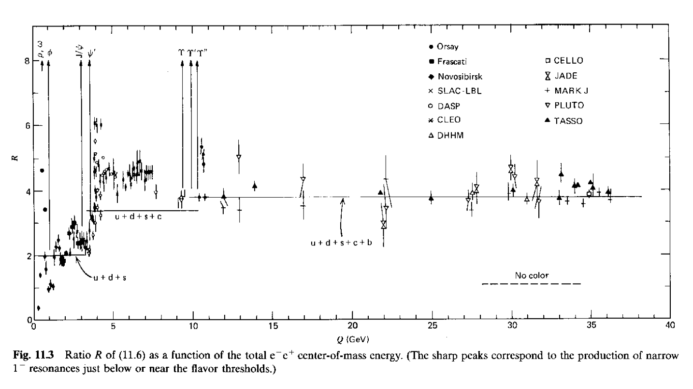
Further Experiments on Quarks

Slide 11
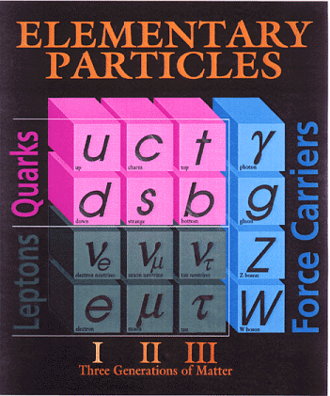
Standard Model Elementary Particle Table
Assumes the following fundamental structure:
Total of 6 quarks, 6 leptons and 12 force mediators form the entire universe

Slide 12
Quark Content of Mesons
Meson spins are measured to be integer.
  They must consist of an even number of quarks
  They can be described as bound states of quarks
Quark compositions of some mesons
  Pions Strange mesons

Slide 13
Quark Content of Baryons
Baryon spins are measured to be ½ integer.
  They must consist of an odd number of quarks
  They can be described as a bound states of three quarks based on the studies of their properties
Quark compositions of some baryons
  Nucleons Strange baryons Other Baryons
  s=1 s=2
Since baryons have B=1, the quarks must have baryon number 1/3

Slide 14
Need for Color Quantum Number
The baryon Δ⁺⁺ has an interesting characteristics
  Its charge is +2, and spin is 3/2
  Can consists of three u quarks ➔ These quarks in the ground state can have parallel spins to give Δ⁺⁺ 3/2 spin
  A trouble!! What is the trouble?
    The three u-quarks are identical fermions and would be symmetric under exchange of any two of them
    This is incompatible to Pauli’s exclusion principle
  What does this mean?
    Quark-parton model cannot describe the Δ⁺⁺ state
    So should we give up?

Slide 15
Need for Color Quantum Number
Since the quark-parton model works so well with other baryons and mesons it is imprudent to give the model up
Give an additional internal quantum number that will allow the identical fermions in different states
A color quantum number can be assigned to the quark
  Red, Green or Blue
  Baryons and Mesons (the observed particles) are color charge neutral
It turns out that the color quantum number works to the strong forces as the electrical charge to EM force
The dynamics is described by the theoretical framework, Quantum Chromodynamics (QCD)
  Wilcek and Gross ➔ The winners of 2004 physics Nobel prize
Gluons are very different from photons since they have non-zero color charges

Slide 16
Formation of the Standard Model
Presence of the global symmetry can be used to classify particle states according to some quantum numbers
Presence of local gauge symmetry requires an introduction of new vector particles as the force mediators
The work of Glashow, Weinberg and Salam through the 1960’s provided the theory of unification of electromagnetic and weak forces (GSW model), incorporating Quantum Electro-Dynamics (QED)
  References:
    L. Glashow, Nucl. Phys. 22, 579 (1961).
    S. Weinberg, Phys. Rev. Lett. 19, 1264 (1967).
    A. Salam, Proceedings of the 8th Nobel Symposium, Editor: N. Svartholm, Almqvist and Wiksells, Stockholm, 367 (1968)
The addition of Quantum Chromodynamics (QCD) for strong forces (Wilcek & Gross) to GSW theory formed the Standard Model in late 70’s
Current SM is U(1)xSU(2)xSU(3) gauge theory

Slide 17
Introduction of Gauge Fields
To maintain a local symmetry, additional fields had to be introduced
  This is in general true even for more complicated symmetries
  A crucial information for modern physics theories
A distinct fundamental force in nature arises from the local invariance of physical theories
The associated gauge fields generate these forces
  These gauge fields are the mediators of the given force
This is referred as the gauge principle, and such theories are gauge theories
  Fundamental interactions are understood through this theoretical framework

Slide 18
Gauge Fields and Mediators
To keep local gauge invariance, new particles had to be introduced in gauge theories
  U(1) gauge introduced a new field (particle) that mediates the electromagnetic force: Photon
  SU(2) gauge introduces three new fields that mediates weak force
    Charged current mediator: W⁺ and W⁻
    Neutral current: Z⁰
  SU(3) gauge introduces 8 mediators (gluons) for the strong force
Unification of electromagnetic and weak force SU(2)xU(1) gauge introduces a total of four mediators
  Neutral current: Photon, Z⁰
  Charged current: W⁺ and W⁻

Slide 19
Gauge Bosons
Through the local gauge symmetry, the Standard Model employs the following vector bosons as force mediators
  Electro-weak: photon, Z⁰, W⁺ and W⁻ bosons
  Strong force: 8 colored gluons
If the theory were to be validated, these additional force carriers must be observed
The electro-weak vector bosons were found at the CERN proton-anti proton collider in 1983 independently by C. Rubbia & collaborators and P. Darriulat & collaborators

Slide 20
Standard Model Elementary Particle Table

Slide 21
Z and W Boson Decays
The weak vector bosons couples quarks and leptons
  Thus they decay to a pair of leptons or a pair of quarks
Since they are heavy, they decay instantly to the following channels and their branching ratios
  Z bosons: M_{Z}=91GeV/c²
  W bosons: M_{W}=80GeV/c²

Slide 22
Z and W Boson Search Strategy
The weak vector bosons have masses of 91 GeV/c² for Z and 80 GeV/c² for W
While the most abundant decay final state is qqbar (2 jets of particles), the multi-jet final states are also the most abundant in collisions
  Background is too large to be able to carry out a meaningful search
The best channels are using leptonic decay channels of the bosons
  Especially the final states containing electrons and muons are the cleanest
So what do we look for as signature of the bosons?
  For Z-bosons: Two isolated electrons or muons with large transverse momenta (P_{T})
  For W bosons: One isolated electron or muon with a large transverse momentum along with a signature of high P_{T} neutrino (Large missing ET).

Slide 23
What do we need for the experiment to search for vector bosons?
We need to be able to identify isolated leptons
  Good electron and muon identification
  Charged particle tracking
We need to be able to measure transverse momentum well
  Good momentum and energy measurement
We need to be able to measure missing transverse energy well
  Good coverage of the energy measurement (hermeticity) to measure transverse momentum imbalance well

Slide 24
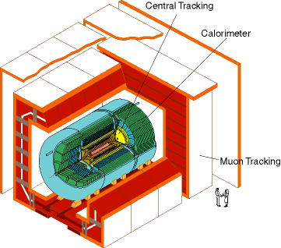
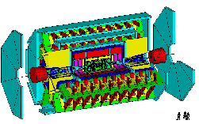
DØ Detector
ATLAS Detector
30’
30’
50’
Weighs 5000 tons
Can inspect 3,000,000 collisions/second
Recordd 50 - 75 collisions/second
Records approximately 10,000,000 bytes/second
Records 0.5x10¹⁵ (500,000,000,000,000) bytes per year (0.5 PetaBytes).
Weighs 10,000 tons
Can inspect 1,000,000,000 collisions/second
Will record 100 collisions/second
Records approximately 300,000,000 bytes/second
Will record 1.5x10¹⁵ (1,500,000,000,000,000) bytes each year (1.5 PetaByte).

Slide 25
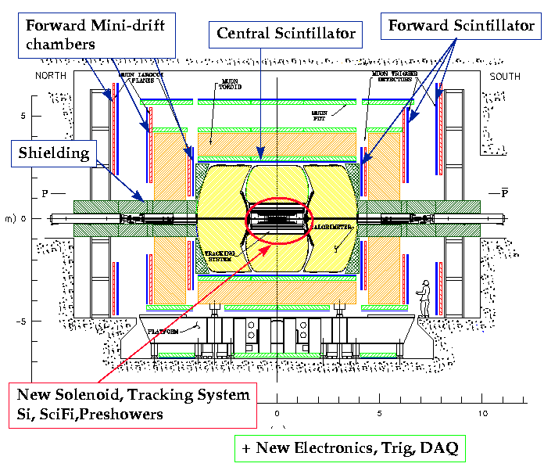
Run II DØ Detector

Slide 26
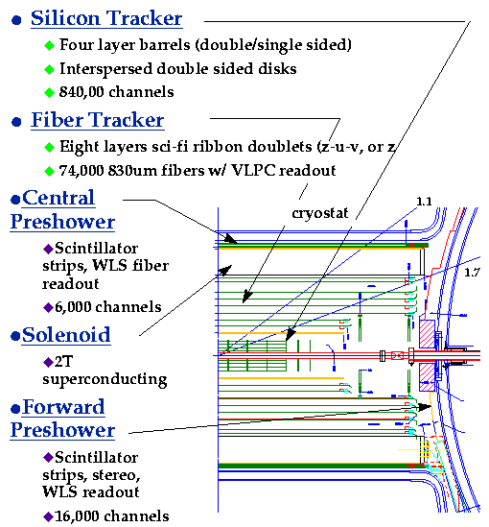
The DØ Upgrade Tracking System
Charged Particle
Momentum Resolution
Δp_{T}/p_{T} ~ 5% @ p_{T} = 10 GeV/c

Slide 27
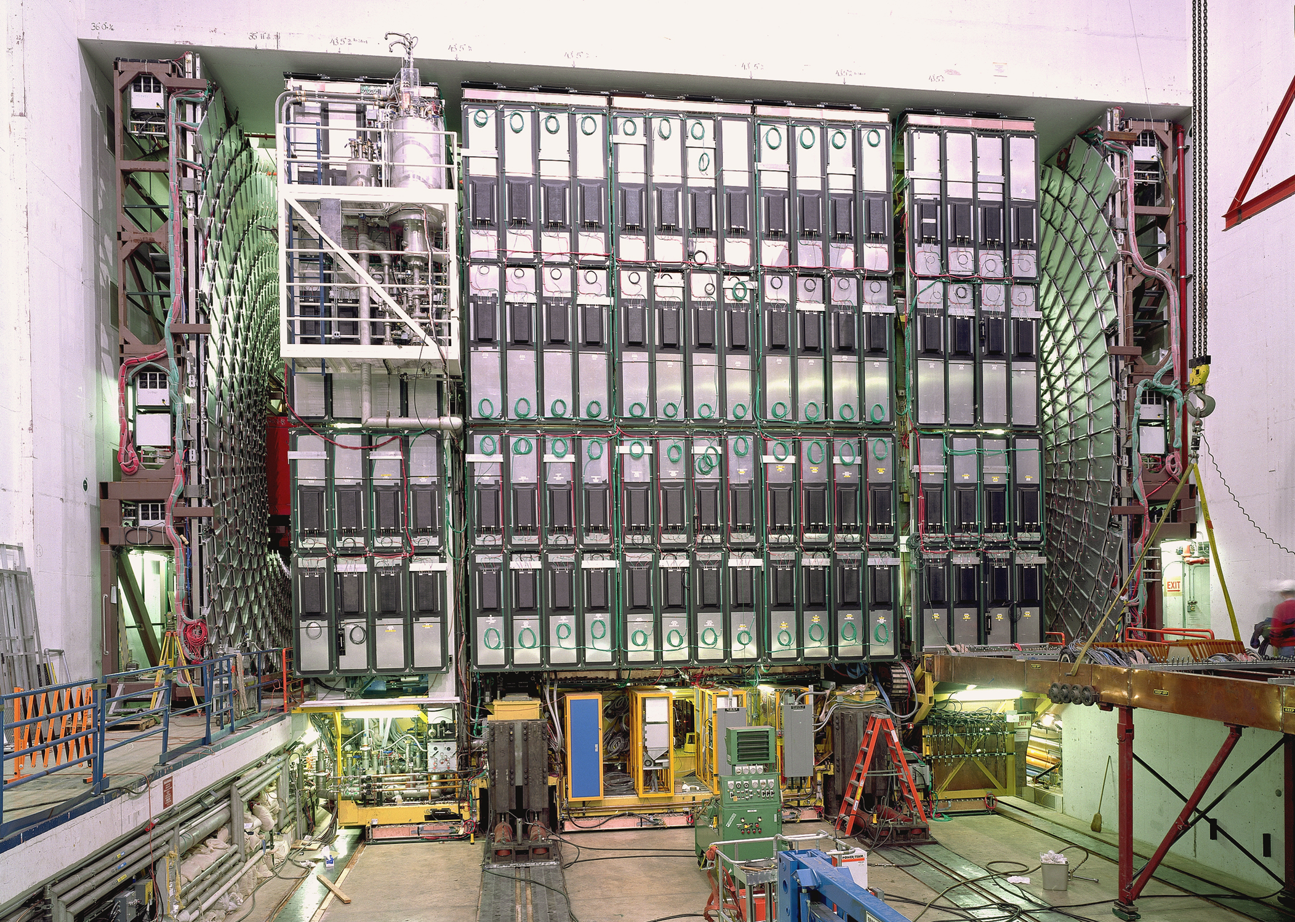
DØ Detector
muon system
shielding
electronics

Slide 28
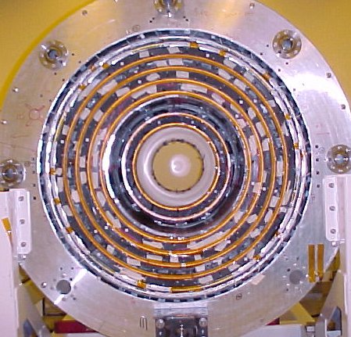
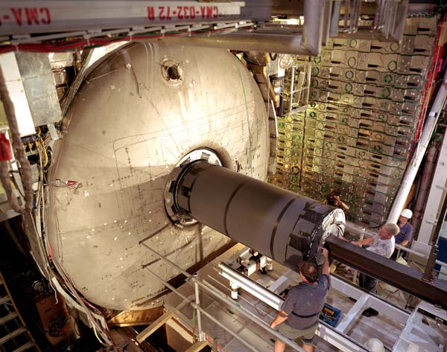
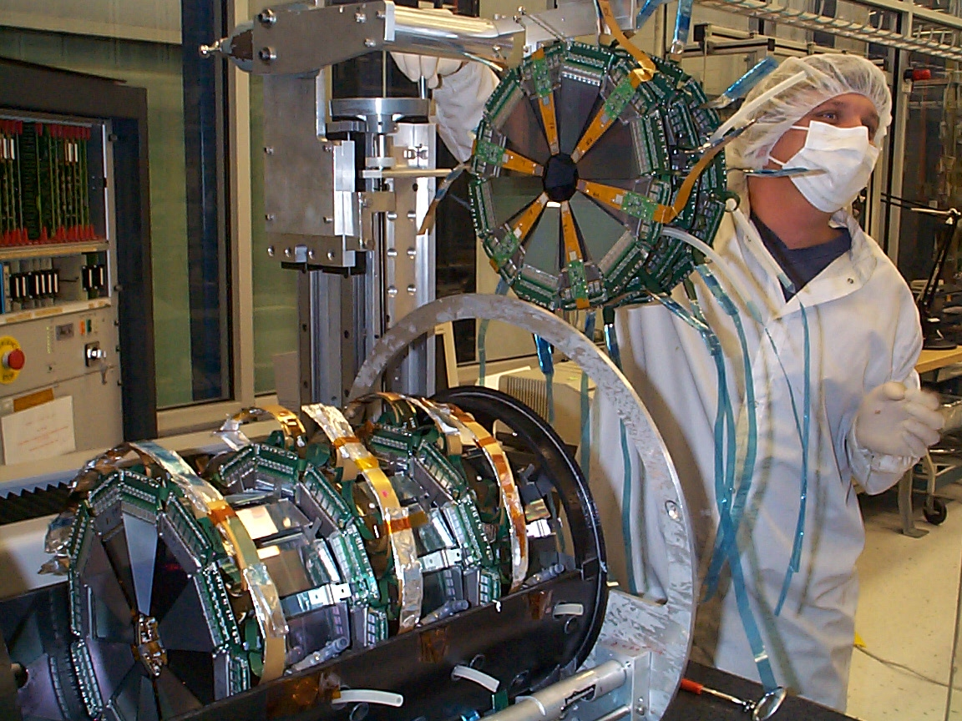
DØ Detector
Fiber Tracker
Solenoid
Central Calorimeter
Silicon

Slide 29
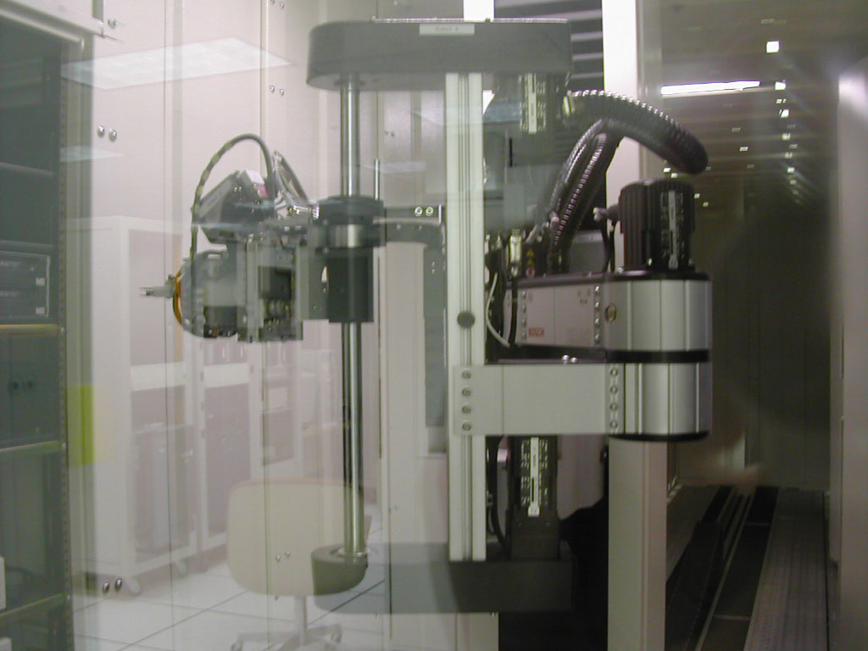
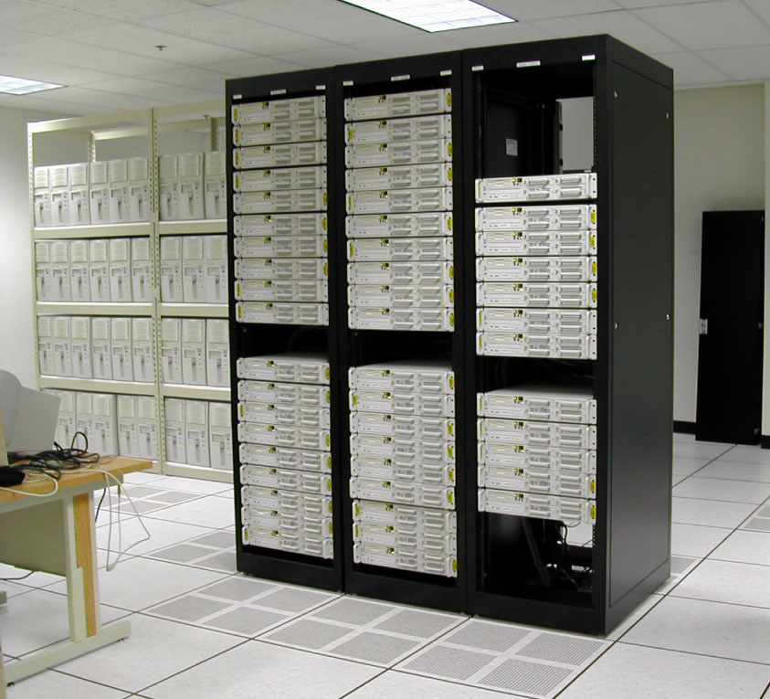
How are computers used in HEP?
Digital Data
p
‾p
Data Reconstruction

Slide 30
How does an Event Look in a HEP Detector?
CH
Highest E_{T} dijet event at DØ
“calorimeter jet”
hadrons
FH
γ
EM
“particle jet”
Time
“parton jet”
Notes:
RECO [Slide 1]
Very briefly mention RECO version used.
Mention that these are fixed-cone jets of R=0.7 found by iterative algorithm, Et is the scalar Et sum of the towers.
List corrections we apply (basically) to RECO. No more is needed for AIDA restoration or Ht-revertexing at this point, but following three slides will be about eta bias -- so just briefly prepare listeners for this!

Slide 31
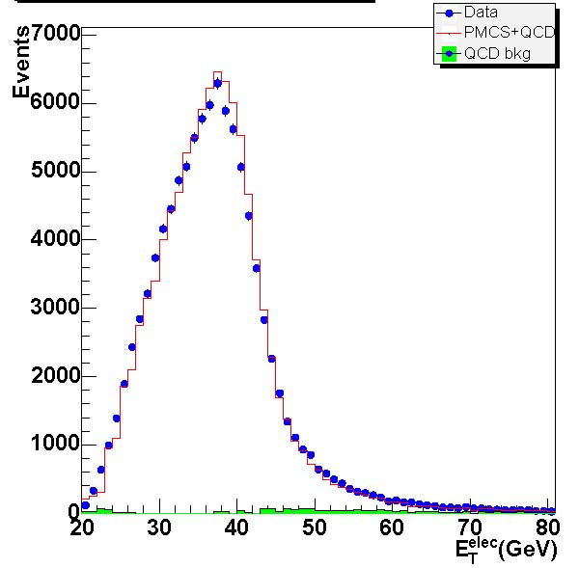
Electron Transverse Momentum W(→eν) +X
Transverse momentum distribution of electrons in W+X events

Slide 32
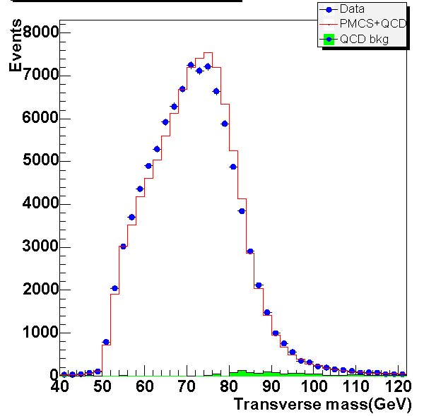
W Transverse Mass W(→eν) +X
Transverse mass distribution of electrons in W+X events

Slide 33
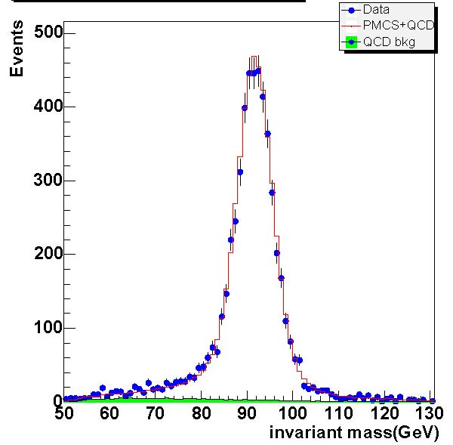
Electron Invariant Mass Z(→ee) +X
Invariant mass distribution of electrons in Z+X events

Slide 34
W and Z event kinematic properties
Z→e⁺e⁻ cross-section
dots: Data
histogram: MC
E_{T}
E_{T}^{e}
M_{T}
p_{T}^{w}
diEM Invariant mass (GeV)

Slide 35
A W → e+ν Event, End view

Slide 36
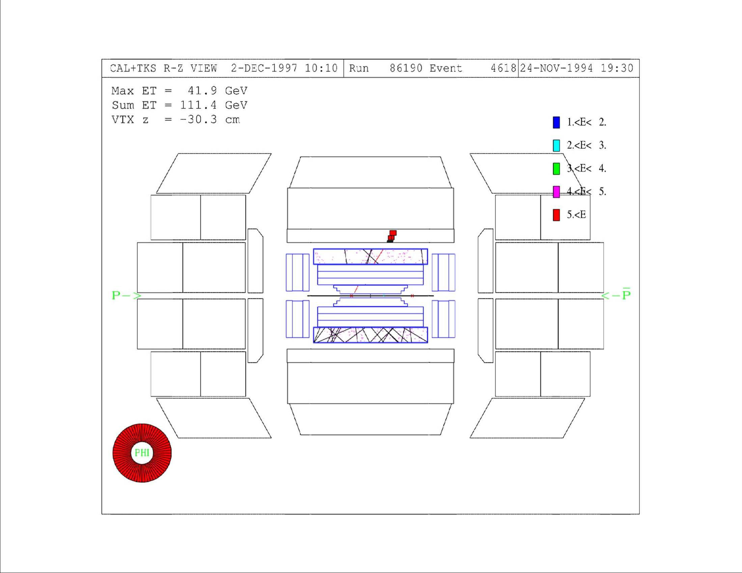
A W → e+ν Event, Side View

Slide 37
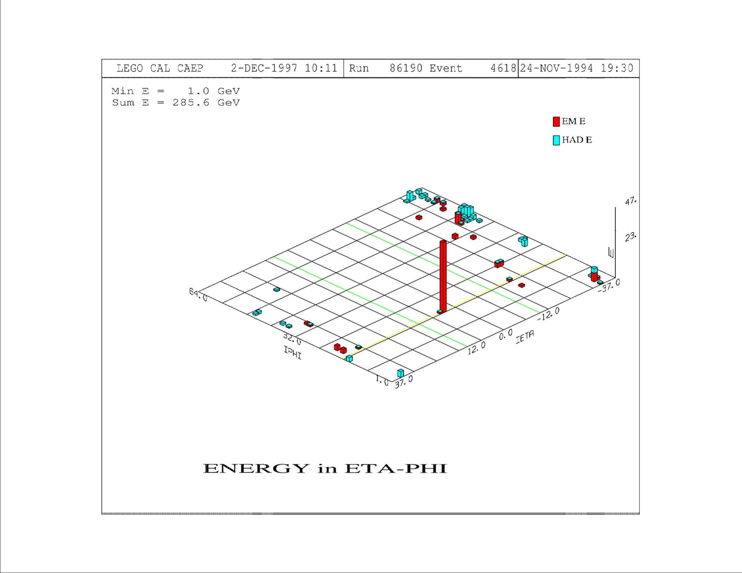
A W → e+ν Event, Lego Plot

Slide 38
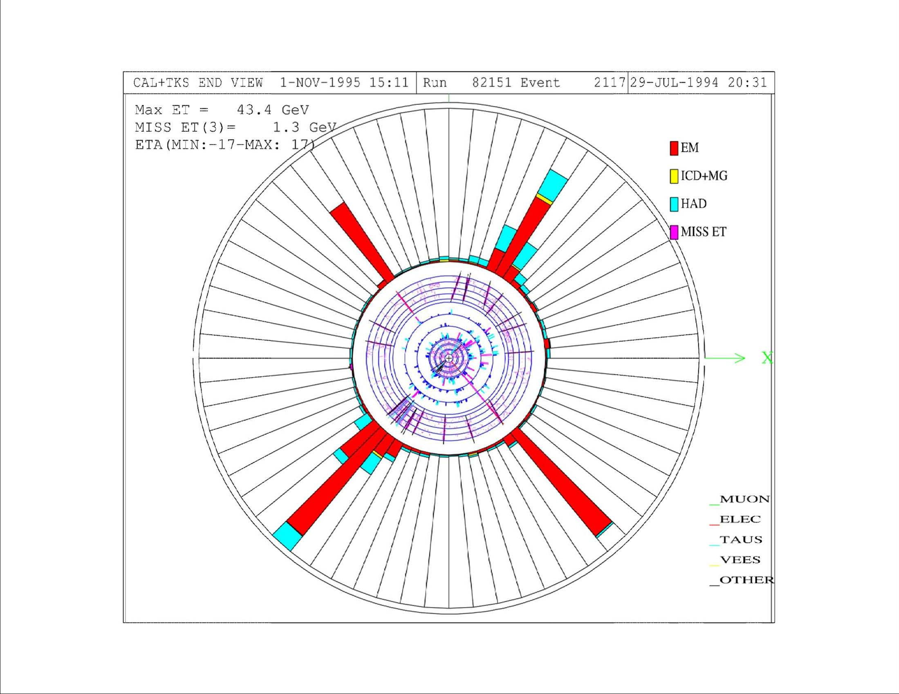
A Z → e⁺e⁻+2jets Event, End view

Slide 39
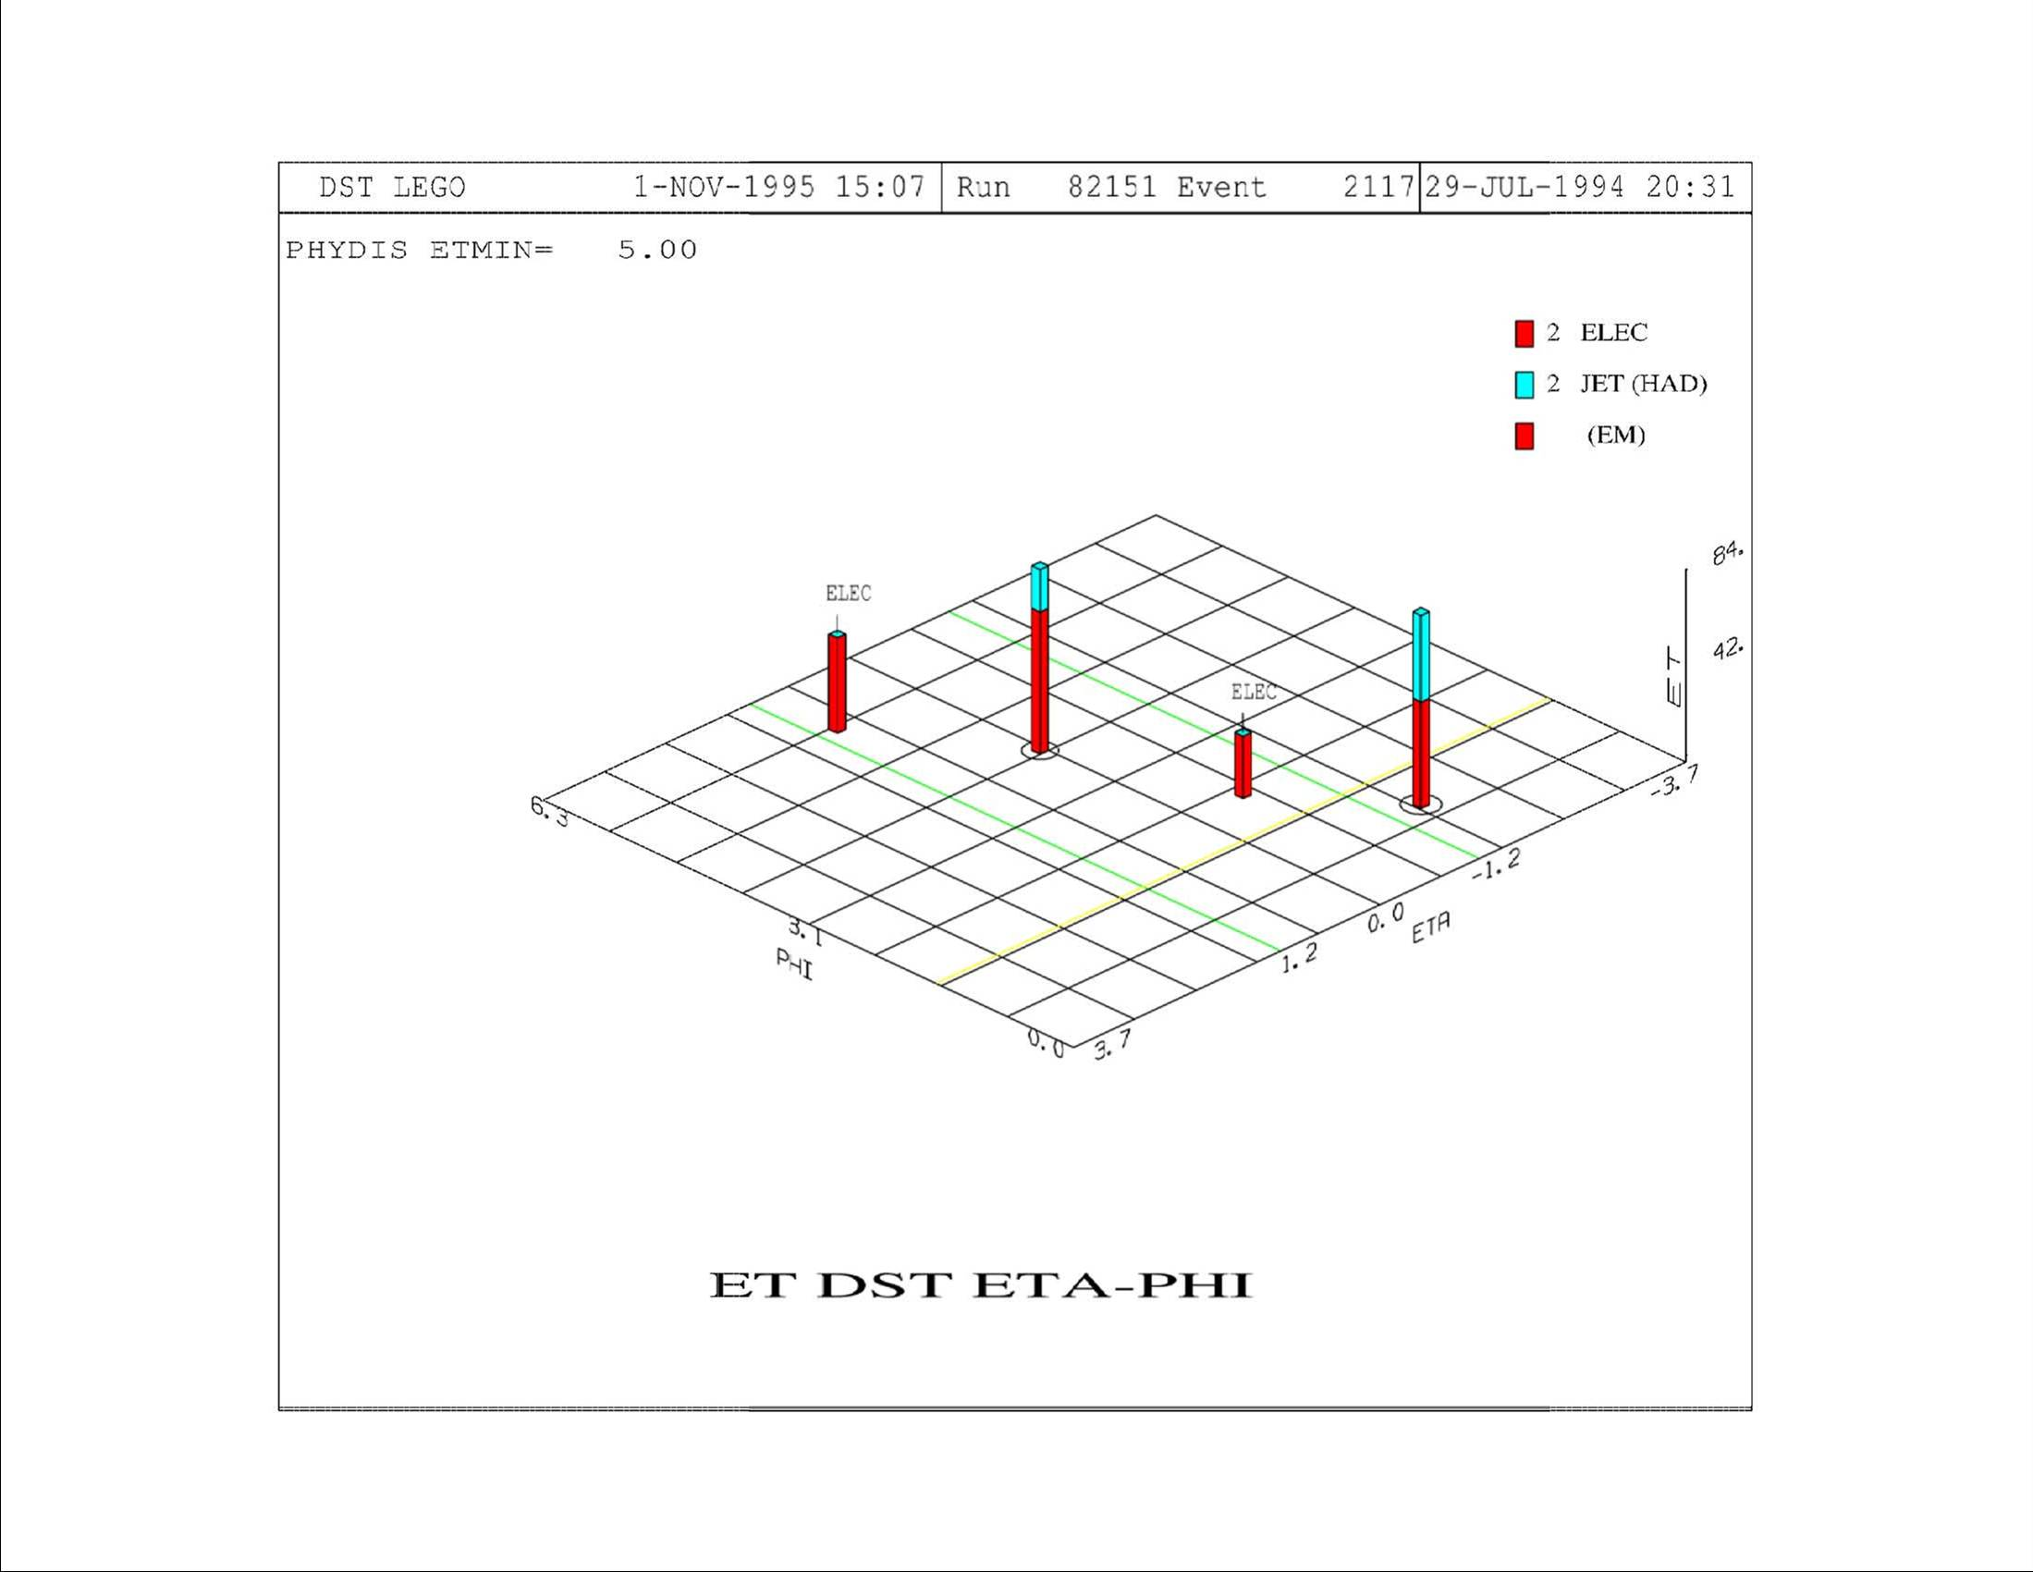
A Z → e⁺e⁻+2jets Event, Lego Plot

Slide 40
Spontaneous Symmetry Breaking
While the collection of ground states does preserve the symmetry in L, the Feynman formalism allows to work with only one of the ground states through the local gauge symmetry ➔ Causes the symmetry to break.
This is called “spontaneous” symmetry breaking, because symmetry breaking is not externally caused.
The true symmetry of the system is hidden by an arbitrary choice of a particular ground state. This is the case of discrete symmetry w/ 2 ground states.

Slide 41
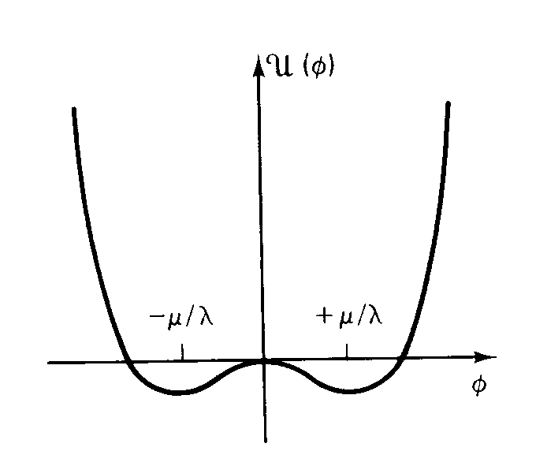
EW Potential and Symmetry Breaking
Not symmetric about this axis
Symmetric about this axis

Slide 42
The Higgs Mechanism
Recovery from a spontaneously broken electroweak symmetry gives masses to gauge fields (W and Z) and produce a massive scalar boson
  The gauge vector bosons become massive (W and Z)
  The massive scalar boson produced through this spontaneous EW symmetry breaking is the Higgs particle
In SM, the Higgs boson is a ramification of the mechanism that gives masses to weak vector bosons, leptons and quarks
The Higgs Mechanism

Slide 43
Issues in SM
We have come a long way on SM to describe how the universe works but we are not done yet! Actually a long way from done!
Why are the masses of quarks, leptons and vector bosons the way they are?
Why are there three families of fundamental particles?
What gives the particle their masses?
Do the neutrinos have mass?
Why is the universe dominated by particles?
  What happened to anti-particles?
What are the dark matter and dark energy?
Are quarks and leptons the “real” fundamental particles?
Other there other particles that we don’t know of?
Why are there only four forces?
How is the universe created?

