Slide 1
PHYS 1441 – Section 002 Lecture #2
Wednesday, Aug. 30, 2017
Dr. Jaehoon Yu
Brief history of physics
Some basics …
Chapter 21
Static Electricity and Charge Conservation
Charges in Atom, Insulators and Conductors & Induced Charge
Coulomb’s Law

Slide 2
Announcements
98/103 of you have registered in the homework system.
79/98 submitted the homework!
Fantastic job!!
You need my enrollment approval… So move quickly…
Remember, the deadline for the first freebee homework is 11pm today, Wednesday, Aug. 30
You MUST submit the homework to obtain 100% credit!
Also please be sure to make the payment in time otherwise your access as well as my access to the site for grading is cut.
Reading assignment: CH21 – 7
Quiz at the beginning of the class, Wed. Sept. 6
Appendix A1 – A8 and what we’ve learned today!
No class Monday, Sept. 4

Slide 3
Extra Credit Special Project #1
Compare the Coulomb force to the Gravitational force in the following cases by expressing Coulomb force (F_{C}) in terms of the gravitational force (F_{G})
Between the two protons separated by an arbitrary distance R
Between the two protons separated by 1m
Between the two electrons separated by an arbitrary distance R
Between the two electrons separated by 1m
Five points each, totaling 20 points
BE SURE to show all the details of your work and MUST list all formulae, the necessary parameters (mass of proton, electron, gravitational constant, Coulomb constant, etc) and compute the numbers as simple as possible
Please staple them before the submission
Due at the beginning of the class Wednesday, Sept. 6

Slide 4
In this course, you will learn…
Concept of electricity and magnetism
Electric charge and magnetic poles
Electric and magnetic Forces
Electric and magnetic potential and energies
Propagation of electric and magnetic fields
Relationship between the electro-magnetic force and light
Behaviors of light and optics, the study of it
Special relativity and quantum theories

Slide 5
How to study for this course?
Keep up with the class for comprehensive understanding of materials
Come to the class and participate actively in the discussions and problems solving sessions
Follow through the lecture notes after each class
Work out example problems in the book yourself without looking at the solution
Have many tons of fun in the class!!!!!
Keep up with the homework to put the last nail in the coffin
One can always input the answers as you solve problems. Do NOT wait till you are done with all the problems.
Form a study group and discuss how to solve problems with your friends, then work the problems out yourselves!
Prepare for upcoming classes
Read the textbook for the material to be covered in the next class
The extra mile
Work out additional end of chapter problems starting the easiest problems to harder ones

Slide 6
Why do Physics?
Exp.{
To understand nature through experimental observations and measurements (Research)
Establish limited number of fundamental laws, usually with mathematical expressions
Predict the nature’s course
Theory and Experiment work hand-in-hand
Discrepancies between experimental measurements and theory are good for improvements
The general principles formulated through theory is used to improve our everyday lives, even though some laws can take a while till we see them amongst us
Theory {
6

Slide 7
Brief History of Physics
AD 18th century:
Newton’s Classical Mechanics: A theory of mechanics based on observations and measurements
AD 19th Century:
Electricity, Magnetism, and Thermodynamics
Late AD 19th and early 20th century (Modern Physics Era)
Einstein’s theory of relativity: Generalized theory of space, time, and energy (mechanics)
Quantum Mechanics: Theory of atomic phenomena
Physics has come very far, very fast, and is still progressing, yet we’ve got a long way to go
What is matter made of?
How do matters get mass?
How and why do matters interact with each other?
How is universe created?
7

Slide 8
Models, Theories and Laws
Models: An analogy or a mental image of a phenomena in terms of something we are familiar with
Thinking light as waves, behaving just like water waves
Often provide insights for new experiments and ideas
Theories: More systematically improved version of models
Can provide quantitative predictions that are testable and more precise
Laws: Certain concise but general statements about how nature behaves
Energy conservation law
The statement must be found experimentally valid to become a law
Principles: Less general statements of how nature behaves
Has some level of arbitrariness
8

Slide 9
Uncertainties
Physical measurements have limited precision, however good they are, due to:
Number of measurements
Quality of instruments (meter stick vs micro-meter)
Experience of the person doing measurements
Etc
In many cases, uncertainties are more important and difficult to estimate than the central (or mean) values
Stat.{
{
Syst.
9

Slide 10
Significant Figures
Denote the precision of the measured values
The number 80 implies precision of +/- 1, between 79 and 81
If you are sure to +/-0.1, the number should be written 80.0
Significant figures: non-zero numbers or zeros that are not place-holders
34, 34.2, 0.001, 34.100
34 has two significant digits
34.2 has 3
0.001 has one because the 0’s before 1 are place holders to position “.”
34.100 has 5, because the 0’s after 1 indicates that the numbers in these digits are indeed 0’s.
When there are many 0’s, use scientific notation for simplicity:
31400000=3.14x10⁷
0.00012=1.2x10⁻⁴
How about 3000?
This book assumes all 0’s are significant but it could be different in other cases!
10

Slide 11
Significant Figures
Operational rules:
Addition or subtraction: Keep the smallest number of decimal place in the result, independent of the number of significant digits: 12.001+ 3.1=
Multiplication or Division: Keep the smallest number of significant digits in the result: 12.001 x 3.1 = , because the smallest significant figures is ?
15.1
37
What does this mean?
The worst precision determines the precision of the overall operation!!
In English?
Can’t get any better results than the worst measurement!
11

Slide 12
SI Base Quantities and Units
Quantity | Unit | Unit Abbrevation
Length | Meter | m
Time | Second | s
Mass | Kilogram | kg
Electric current | Ampere | A
Temperature | Kelvin | k
Amount of substance | Mole | mol
Luminous Intensity | Candela | cd
There are prefixes that scales the units larger or smaller for convenience (see pg. 7)

Slide 13
Prefixes, expressions and their meanings
Larger
Smaller
deca (da): 10¹
hecto (h): 10²
kilo (k): 10³
mega (M): 10⁶
giga (G): 10⁹
tera (T): 10¹²
peta (P): 10¹⁵
exa (E): 10¹⁸
zetta (Z): 10²¹
yotta (Y): 10²⁴
deci (d): 10⁻¹
centi (c): 10⁻²
milli (m): 10⁻³
micro (μ): 10⁻⁶
nano (n): 10⁻⁹
pico (p): 10⁻¹²
femto (f): 10⁻¹⁵
atto (a): 10⁻¹⁸
zepto (z): 10⁻²¹
yocto (y): 10⁻²⁴
13

Slide 14
How do we convert quantities from one unit to another?
Unit 1 =
Conversion factor X
Unit 2
1 inch | 2.54 | cm
1 inch | 0.0254 | m
1 inch | 2.54x10⁻⁵ | km
1 ft | 30.3 | cm
1 ft | 0.303 | m
1 ft | 3.03x10⁻⁴ | km
1 hr | 60 | minutes
1 hr | 3600 | seconds
And many | More | Here….
14

Slide 15
What does the Electric Force do?
Electric force is the bases of modern technology
Virtually everything we use every day uses electric force
Can you give a few examples?
But this force also affects many others
Making up materials with atoms and molecules
Biological metabolic processes
Nerve signals, heart pumping, etc
Virtually all the forces we have learned in Physics I:
Friction, normal force, elastic force and other contact forces are the results of electric forces acting at the atomic level

Slide 16
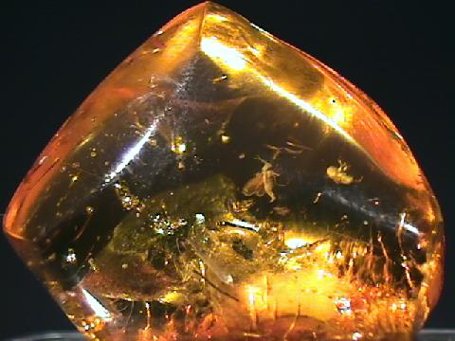
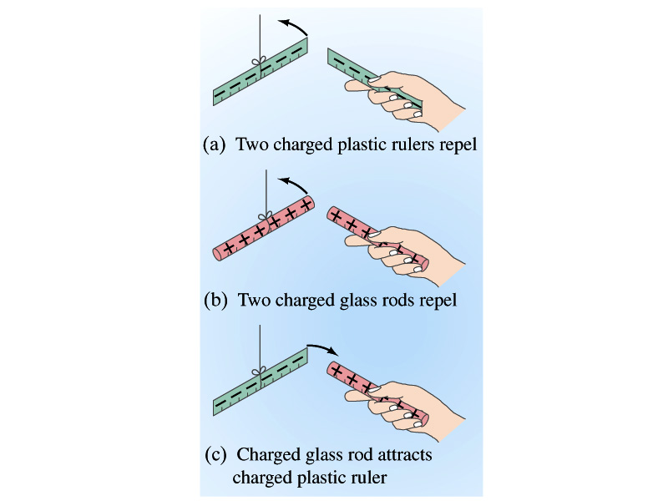
Static Electricity; Electric Charge and Its Conservation
Electricity is from Greek word elecktron=amber, a petrified tree resin that attracts matter if rubbed
Static Electricity: an amber effect
An object becomes charged or “posses a net electric charge” due to rubbing
Can you give some examples?
Two types of electric charge
Like charges repel while unlike charges attract
Benjamin Franklin referred the charge on glass rod as the positive, arbitrarily. Thus the charge that attracts glass rod is negative. ➔ This convention is still used.

Slide 17
Static Electricity; Electric Charge and Its Conservation
Franklin argued that when a certain amount of charge is produced on one body in a process, an equal amount of opposite type of charge is produced on another body.
The positive and negative are treated algebraically so that during any process the net change in the amount of produced charge is 0.
When you comb your hair with a plastic comb, the comb acquires a negative charge and the hair an equal amount of positive charge.
This is the law of conservation of electric charge.
The net amount of electric charge produced in any process is ZERO!!
If one object or one region of space acquires a positive charge, then an equal amount of negative charge will be found in neighboring areas or objects.
No violations have ever been observed.
This conservation law is as firmly established as that of energy or momentum.

