Slide 1
PHYS 1441 – Section 002 Lecture #4
Monday, Sept. 11, 2017
Dr. Jaehoon Yu
Chapter 21
The Electric Field & Field Lines
Electric Fields and Conductors
Motion of a Charged Particle in an Electric Field
Electric Dipoles
Today’s homework is homework #3, due 11pm, Monday, Sept. 18!!

Slide 2
Announcements
1st Term exam
In class, Wednesday, Sept. 20: DO NOT MISS THE EXAM!
CH1.1 to what we learn on Monday, Sept. 18 + Appendices A1 – A8
You can bring your calculator but it must not have any relevant formula pre-input
No phone or computers can be used as a calculator!
BYOF: You may bring one 8.5x11.5 sheet (front and back) of handwritten formulae and values of constants for the exam
No derivations, word definitions, or solutions of ANY problems !
No additional formulae or values of constants will be provided!
Quiz 1 result
Class average: 16.8/35
Equivalent to: 48/100
Top score: 35/35

Slide 3
Special Project #2 – Angels & Demons
Compute the total possible energy released from an annihilation of x-grams of anti-matter and the same quantity of matter, where x is the last two digits of your SS#. (20 points)
Use the famous Einstein’s formula for mass-energy equivalence
Compute the power output of this annihilation when the energy is released in x ns, where x is again the first two digits of your SS#. (10 points)
Compute how many cups of gasoline (8MJ) this energy corresponds to. (5 points)
Compute how many months of world electricity usage (3.6GJ/mo) this energy corresponds to. (5 points)
Due by the beginning of the class Monday, Sept. 25

Slide 4
Coulomb’s Law – The Formula
Formula
Is Coulomb force a scalar quantity or a vector quantity? Unit?
A vector quantity. The unit is Newtons (N)!
The direction of electric (Coulomb) force is always along the line joining the two objects.
If the two charges are the same: forces are directed away from each other.
If the two charges are opposite: forces are directed toward each other.
Coulomb force is precise to 1 part in 10¹⁶.
Unit of charge is called Coulomb, C, in SI.
The value of the proportionality constant, k, in SI unit is
Thus, 1C is the charge that gives F~9x10⁹N of force when placed 1m apart from each other.

Slide 5
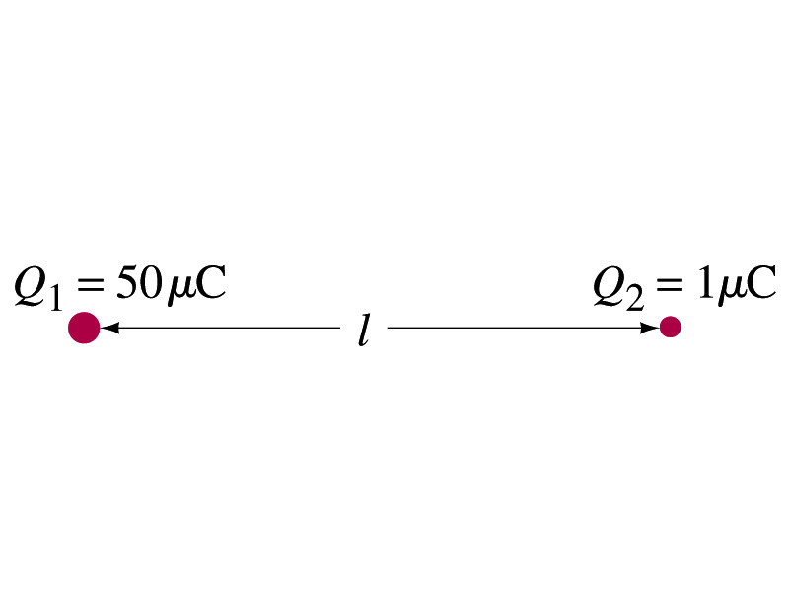
Example 21 – 1
Which charge exerts greater force? Two positive point charges, Q₁=50μC and Q₂=1μC, are separated by a distance L. Which is larger in magnitude, the force that Q₁ exerts on Q₂ or the force that Q₂ exerts on Q₁?
What is the force that Q₁ exerts on Q₂?
What is the force that Q₂ exerts on Q₁?
Therefore the magnitudes of the two forces are identical!!
Well then what is different?
The direction.
Which direction?
Opposite to each other!
What is this law?
Newton’s third law, the law of action and reaction!!

Slide 6
Vector Additions and Subtractions
Addition:
Triangular Method: One can add vectors by connecting the head of one vector to the tail of the other (head-to-tail)
Parallelogram method: Connect the tails of the two vectors and extend
Addition is commutative: Changing order of operation does not affect the results A+B=B+A, A+B+C+D+E=E+C+A+B+D
A+B
A
A+B
B
=
OR
B
A+B
B
A
A
Subtraction:
The same as adding a negative vector:A - B = A + (-B)
A
-B
Since subtraction is the equivalent to adding a negative vector, subtraction is also commutative!!!
A-B
Multiplication by a scalar is increasing the magnitude A, B=2A
A
B=2A

Slide 7
Example for Vector Addition
A force of 20.0N applies to north while another force of 35.0N applies in the direction 60.0º west of north. Find the magnitude and direction of resultant force.
F₂sin60^{ο}
N
F₂
60^{ο}
F₂cos60^{ο}
20
F
θ
F₁
E
Find other ways to solve this problem…

Slide 8
Components and Unit Vectors
Coordinate systems are useful in expressing vectors in their components
y
(+,+)
F_{y}
(F_{x},F_{y})
}Components
F
(-,+)
θ
x
} Magnitude
(-,-)
(+,-)
F_{x}

Slide 9
Unit Vectors
Unit vectors are the ones that tells us the directions of the components
Dimensionless
Magnitudes are exactly 1
Unit vectors are usually expressed in i, j, k or
So the vector F can be re-written as

Slide 10
Examples of Vector Operations
Find the resultant force which is the sum of F1=(2.0i+2.0j)N and F2 =(2.0i-4.0j)N.
Find the resultant force of the sum of three forces: F₁=(15i+30j +12k)N, F₂=(23i+14j -5.0k)N, and F₃=(-13i+15j)N.
Magnitude

Slide 11
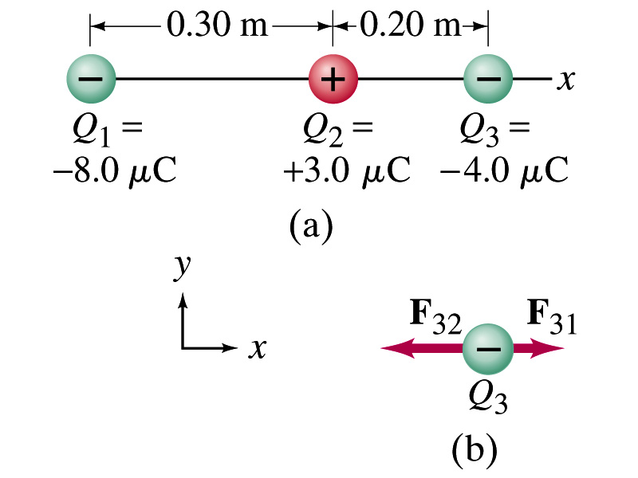
Example 21.2
Three charges on a line. Three charged particles are arranged in a line as shown in the figure. Calculate the net electrostatic force on particle 3 (the -4μC on the right) due to other two charges.
What is the force that Q₁ exerts on Q₃?
What is the force that Q₂ exerts on Q₃?
Using the vector sum of the two forces

Slide 12
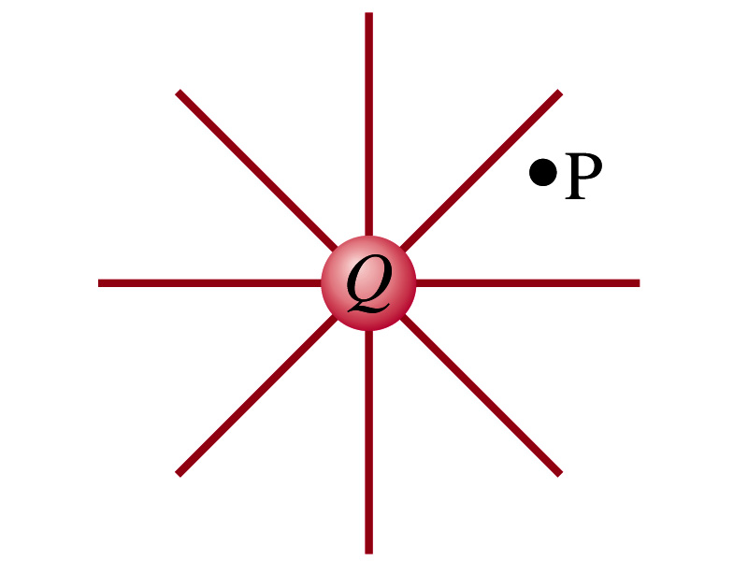
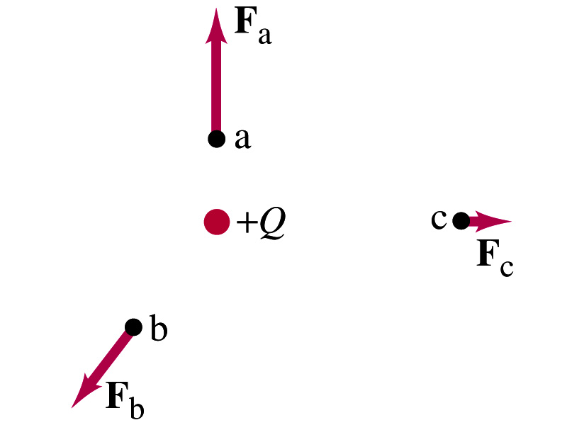
The Electric Field
Both gravitational and electric forces act over a distance without contacting objects ➔ What kind of forces are these?
Field forces
Michael Faraday developed an idea of field.
Faraday (1791 – 1867) argued that the electric field extends outward from every charge and permeates through all of space.
Field by a charge or a group of charges can be inspected by placing a small positive test charge in the vicinity and measuring the force on it.

Slide 13
The Electric Field
The electric field at any point in space is defined as the force exerted on a tiny positive test charge divide by magnitude of the test charge
Electric force per unit charge
What kind of quantity is the electric field?
Vector quantity. Why?
What is the unit of the electric field?
N/C
What is the magnitude of the electric field at a distance r from a single point charge Q?

Slide 14
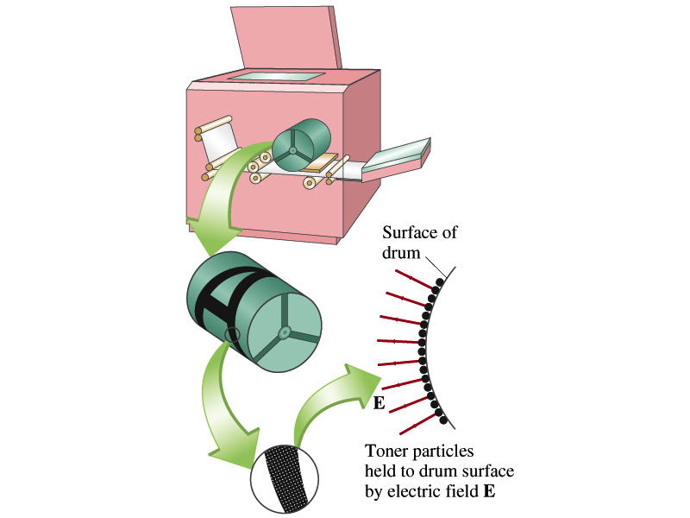
Example 21 – 5
Electrostatic copier. An electrostatic copier works by selectively arranging positive charges (in a pattern to be copied) on the surface of a nonconducting drum, then gently sprinkling negatively charged dry toner (ink) onto the drum. The toner particles temporarily stick to the pattern on the drum and are later transferred to paper and “melted” to produce the copy. Suppose each toner particle has a mass of 9.0x10⁻¹⁶kg and carries the average of 20 extra electrons to provide an electric charge. Assuming that the electric force on a toner particle must exceed twice its weight in order to ensure sufficient attraction, compute the required electric field strength near the surface of the drum.
The electric force must be the same as twice the gravitational force on the toner particle.
So we can write
Thus, the magnitude of the electric field is

