Slide 1
PHYS 1441 – Section 002 Lecture #6
Monday, Sept. 18, 2017
Dr. Jaehoon Yu
Chapter 21
Motion of a Charged Particle in an Electric Field
Electric Dipoles
Chapter 22
Electric Flux
Gauss’ Law with many charges
What is Gauss’ Law good for?
Today’s homework is homework #4, due 11pm, Monday, Sept. 25!!

Slide 2
Announcements
1st Term exam
In class, this Wednesday, Sept. 20: DO NOT MISS THE EXAM!
CH21.1 to what we learn today+ Appendices A1 – A8
You can bring your calculator but it must not have any relevant formula pre-input
No phone or computers can be used as a calculator!
BYOF: You may bring one 8.5x11.5 sheet (front and back) of handwritten formulae and values of constants for the exam
No derivations, word definitions, or solutions of ANY problems !
No additional formulae or values of constants will be provided!
Reading assignments
CH21.11 and CH22.4
Bring out the special project #2

Slide 3
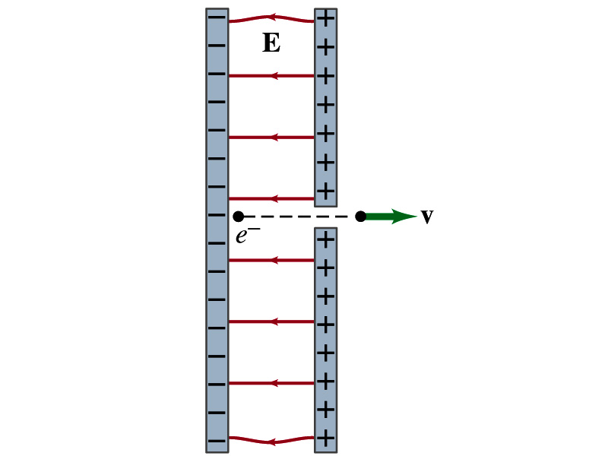
Special Project #3
Particle Accelerator. A charged particle of mass M with charge -Q is accelerated in the uniform field E between two parallel charged plates whose separation is D as shown in the figure on the right. The charged particle is accelerated from an initial speed v₀ near the negative plate and passes through a tiny hole in the positive plate.
Derive the formula for the electric field E to accelerate the charged particle to a fraction f of the speed of light c. Express E in terms of M, Q, D, f, c and v₀.
(a) Using the Coulomb force and kinematic equations. (8 points)
(b) Using the work-kinetic energy theorem. ( 8 points)
(c) Using the formula above, evaluate the strength of the electric field E to accelerate an electron from 0.1% of the speed of light to 90% of the speed of light. You need to look up the relevant constants, such as mass of the electron, charge of the electron and the speed of light. (5 points)
Due beginning of the class Monday, Oct. 2

Slide 4
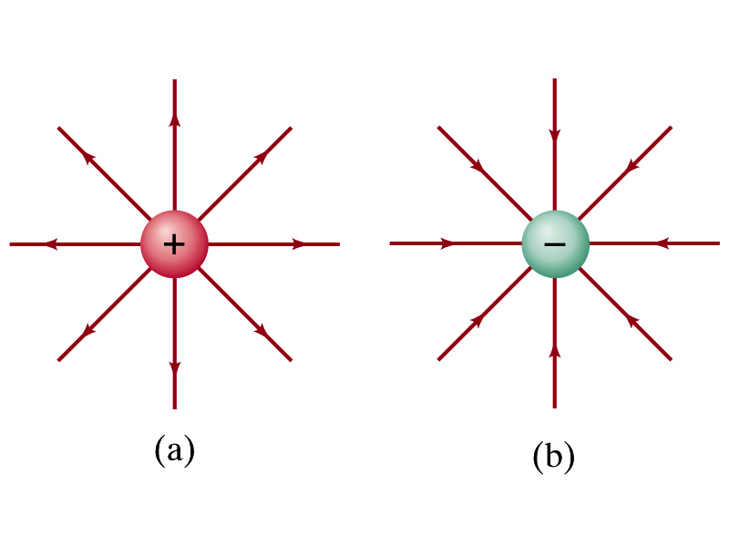
Motion of a Charged Particle in an Electric Field
If an object with an electric charge q is at a point in space where electric field is E, the force exerting on the object is .
What do you think will happen to the charge?
Let’s think about the cases like these on the right.
The object will move along the field line…Which way?
Depends on the sign of the charge
The charge gets accelerated under an electric field.

Slide 5
Example 21 – 14
Electron accelerated by electric field. An electron (mass m = 9.1x10⁻³¹kg) is accelerated in a uniform field E (E=2.0x10⁴N/C) between two parallel charged plates. The separation of the plates is 1.5cm. The electron is accelerated from rest near the negative plate and passes through a tiny hole in the positive plate. (a) With what speed does it leave the hole? (b) Show that the gravitational force can be ignored. Assume the hole is so small that it does not affect the uniform field between the plates.
The magnitude of the force on the electron is F=qE and is directed to the right. The equation to solve this problem is
The magnitude of the electron’s acceleration is
Between the plates the field E is uniform, thus the electron undergoes a uniform acceleration

Slide 6
Example 21 – 14
Since the travel distance is 1.5x10⁻²m, using one of the kinetic eq. of motions,
Since there is no electric field outside the conductor, the electron continues moving with this speed after passing through the hole.
(b) Show that the gravitational force can be ignored. Assume the hole is so small that it does not affect the uniform field between the plates.
The magnitude of the electric force on the electron is
The magnitude of the gravitational force on the electron is
Thus the gravitational force on the electron is negligible compared to the electromagnetic force.

Slide 7
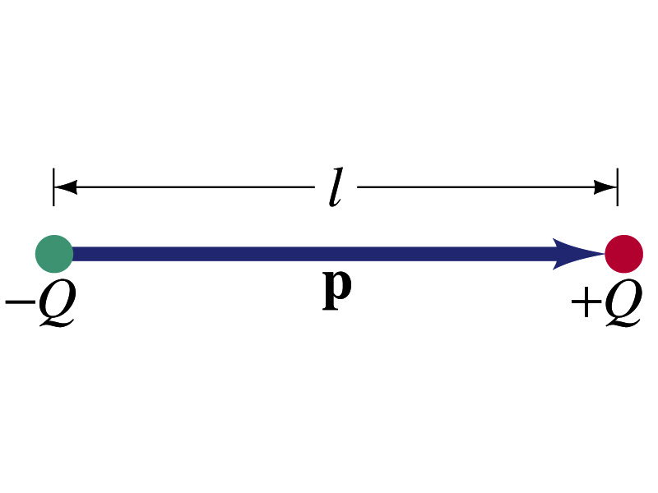
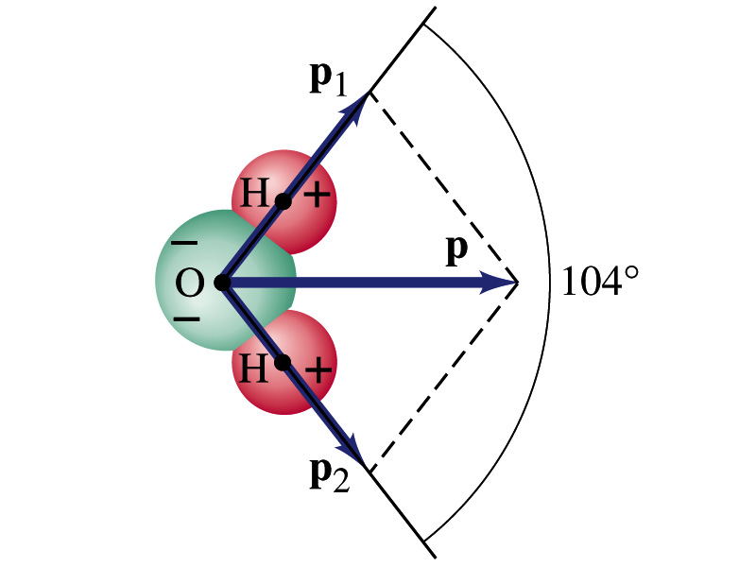
Electric Dipoles
An electric dipole is the combination of two equal charges of opposite signs, +Q and –Q, separated by a distance l, which behaves as one entity.
The quantity Ql is called the electric dipole moment and is represented by the symbol p.
The dipole moment is a vector quantity, p
The magnitude of the dipole moment is Ql. Unit?
Its direction is from the negative to the positive charge.
Many of diatomic molecules like CO have a dipole moment. ➔ These are referred as polar molecules.
Even if the molecule is electrically neutral, their sharing of electron causes separation of charges
Symmetric diatomic molecules, such as O₂, do not have dipole moment.
C-m
The water molecule also has a dipole moment which is the vector sum of two dipole moments between Oxygen and each of Hydrogen atoms.

Slide 8
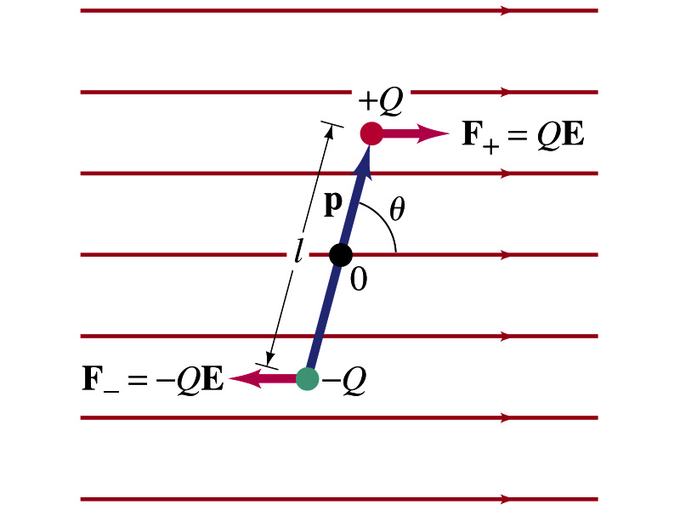
Dipoles in an External Field
Let’s consider a dipole placed in a uniform electric field E.
What do you think will happen to the dipole in the figure?
Forces will be exerted on the charges.
The positive charge will get pushed toward right while the negative charge will get pulled toward left.
What is the net force acting on the dipole?
Zero
So will the dipole not move?
Yes, it will.
Why?
There is a torque applied on the dipole.

Slide 9
Dipoles in an External Field, cnt’d
How much is the torque on the dipole?
Do you remember the formula for torque?
The magnitude of the torque exerting on each of the charges with respect to the rotational axis at the center is
Thus, the total torque is
So the torque on a dipole in vector notation is
The effect of the torque is to try to turn the dipole so that the dipole moment is parallel to E. Which direction?

Slide 10
Potential Energy of a Dipole in an External Field
What is the work done on the dipole by the electric field to change the angle from θ₁ to θ₂?
The torque is .
Thus the work done on the dipole by the field is
What happens to the dipole’s potential energy, U, when a positive work is done on it by the field?
It decreases.
We choose U=0 when θ₁=90 degrees, then the potential energy at θ₂=θ becomes
Why negative?
Because τ and θ are opposite directions to each other.

Slide 11
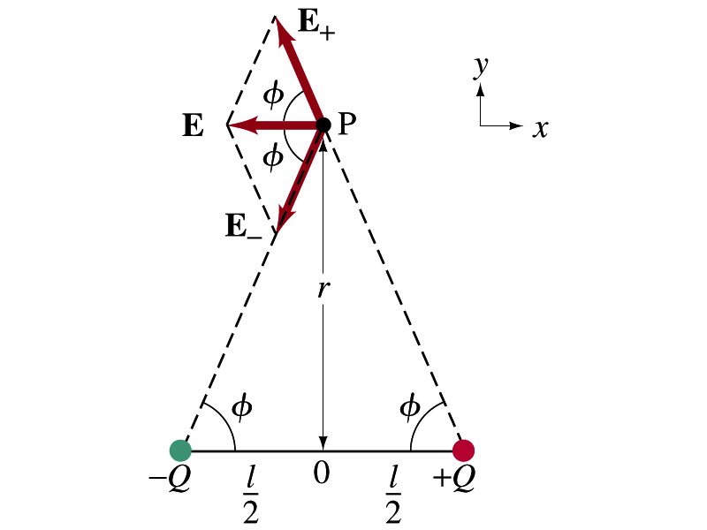
Electric Field by a Dipole
Let’s consider the case in the picture.
There are fields by both the charges. So the total electric field by the dipole is
The magnitudes of the two fields are equal
Now we must work out the x and y components of the total field.
Sum of the two y components is
Zero since they are the same but in opposite direction
So the magnitude of the total field is the same as the sum of the two x-components:

Slide 12
Dipole Electric Field from Afar
What happens when r>>l?.
Why does this make sense?
Since from a long distance, the two charges are very close so that the overall charge gets close to 0!!
This dependence works for the point not on the bisecting line as well

Slide 13
Example 21 – 17
Dipole in a field. The dipole moment of a water molecule is 6.1x10⁻³⁰C-m. A water molecule is placed in a uniform electric field with magnitude 2.0x10⁵N/C. (a) What is the magnitude of the maximum torque that the field can exert on the molecule? (b) What is the potential energy when the torque is at its maximum? (c) In what position will the potential energy take on its greatest value? Why is this different than the position where the torque is maximized?
(a) The torque is maximized when θ=90 degrees. Thus the magnitude of the maximum torque is
What is the distance between a hydrogen atom and the oxygen atom?

Slide 14
Example 21 – 17
(b) What is the potential energy when the torque is at its maximum?
Since the dipole potential energy is
And τ is at its maximum at θ=90 degrees, the potential energy, U, is
Is the potential energy at its minimum at θ=90 degrees?
No
Why not?
Because U will become negative as θ increases.
(c) In what position will the potential energy take on its greatest value?
The potential energy is maximum when cosθ= -1, θ=180 degrees.
Why is this different than the position where the torque is maximized?
The potential energy is maximized when the dipole is oriented so that it has to rotate through the largest angle against the direction of the field, to reach the equilibrium position at θ=0.
Torque is maximized when the field is perpendicular to the dipole, θ=90.

Slide 15
Gauss’ Law
Gauss’ law states the relationship between electric charge and the electric field.
More generalized and elegant form of Coulomb’s law.
The electric field by the distribution of charges can be obtained using Coulomb’s law by summing (or integrating) over the charge distributions.
Gauss’ law, however, gives an additional insight into the nature of electrostatic field and a more general relationship between the charge and the field

Slide 16
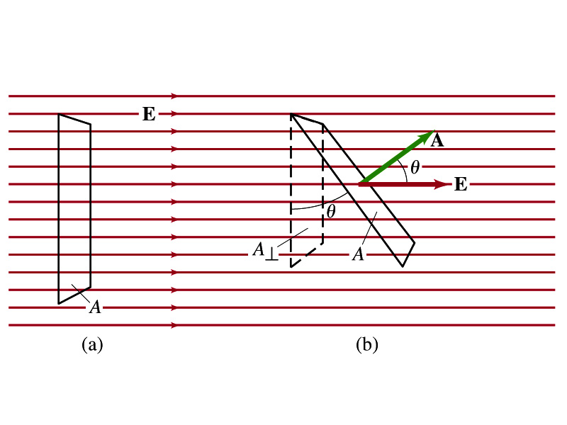
Electric Flux
Let’s imagine a surface of area A through which a uniform electric field E passes
The electric flux Φ_{E} is defined as
Φ_{E}=EA, if the field is perpendicular to the surface
Φ_{E}=EAcosθ, if the field makes an angle θ to the surface
So the electric flux is defined as .
How would you define the electric flux in words?
The total number of field lines passing through the unit area perpendicular to the field.

Slide 17
Example 22 – 1
Electric flux. (a) Calculate the electric flux through the rectangle in the figure (a). The rectangle is 10cm by 20cm and the electric field is uniform with magnitude 200N/C. (b) What is the flux in figure if the angle is 30 degrees?
The electric flux is defined as
So when (a) θ=0, we obtain
And when (b) θ=30 degrees, we obtain

Slide 18
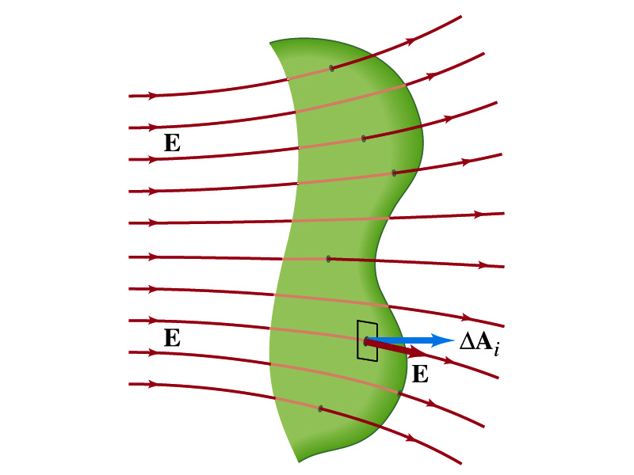
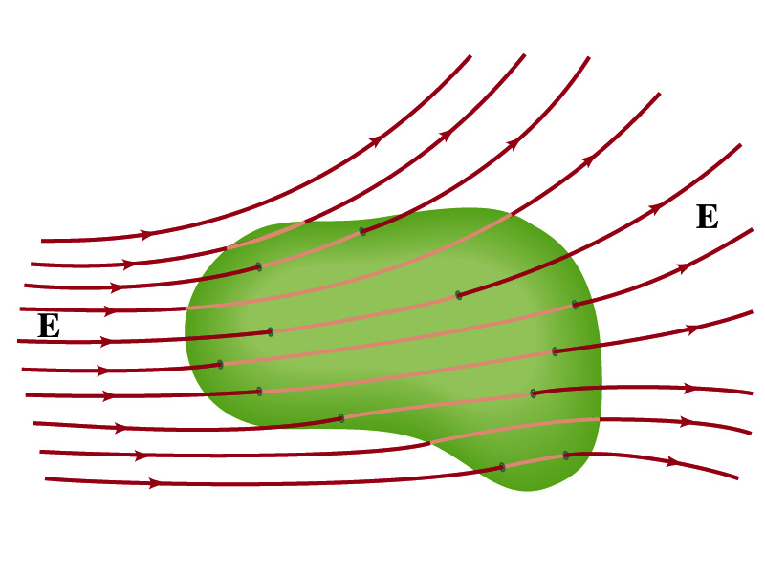
Generalization of the Electric Flux
Let’s consider a surface of area A that is not a square or flat but in some random shape, and that the field is not uniform.
The surface can be divided up into infinitesimally small areas of ΔA_{i} that can be considered flat.
And the electric field through this area can be considered uniform since the area is very small.
Then the electric flux through the entire surface is approximately
In the limit where ΔA_{i} → 0, the discrete summation becomes an integral.
open surface
enclosed surface

Slide 19
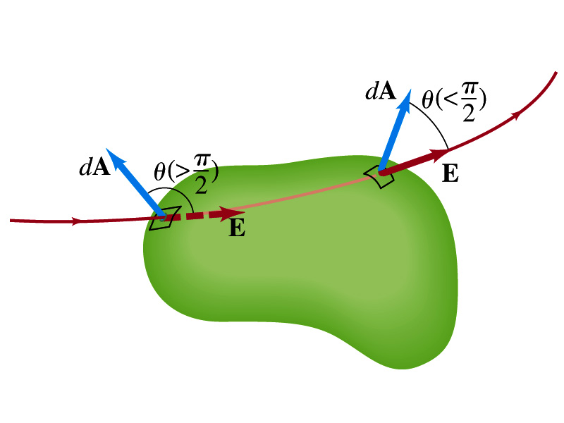
Generalization of the Electric Flux
We arbitrarily define that the area vector points outward from the enclosed volume.
For the line leaving the volume, θ<π/2 and cosθ>0. The flux is positive.
For the line coming into the volume, θ>π/2 and cosθ<0. The flux is negative.
If Φ_{E}>0, there is net flux out of the volume.
If Φ_{E}<0, there is flux into the volume.
In the above figures, each field that enters the volume also leaves the volume, so
The flux is non-zero only if one or more lines start or end inside the surface.

Slide 20
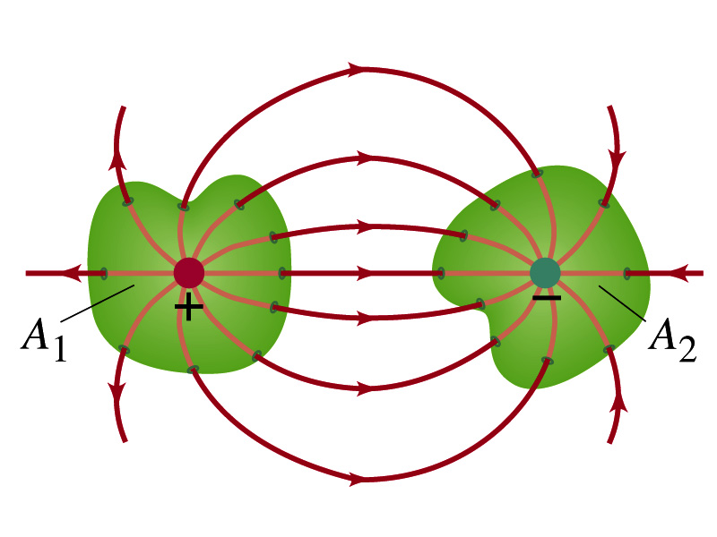
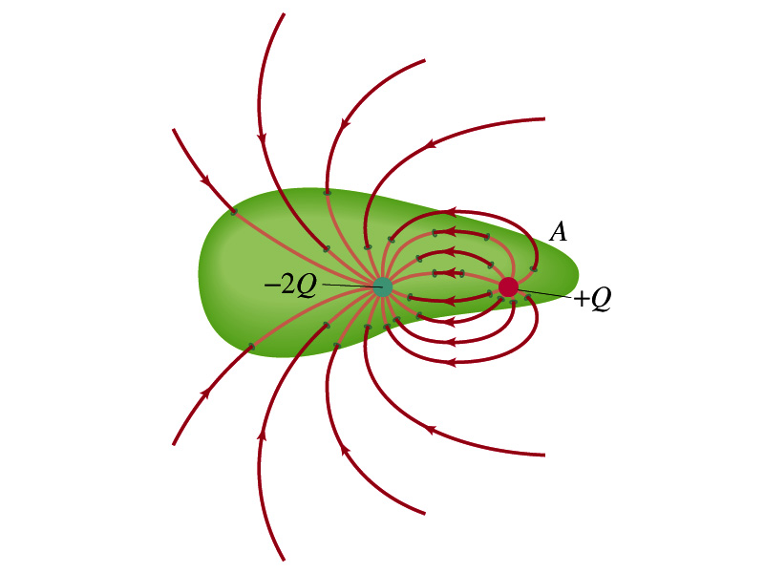
Generalization of the Electric Flux
The field line starts or ends only on a charge.
Sign of the net flux on the surface A₁?
The net outward flux (positive flux)
How about A₂?
Net inward flux (negative flux)
What is the flux in the bottom figure?
There should be a net inward flux (negative flux) since the total charge inside the volume is negative.
The net flux that crosses an enclosed surface is proportional to the total charge inside the surface. ➔ This is the crux of Gauss’ law.

Slide 21
Gauss’ Law
q
q’
Let’s consider the case in the above figure.
What are the results of the closed integral of the Gaussian surfaces A₁ and A₂?
For A₁
For A₂

Slide 22
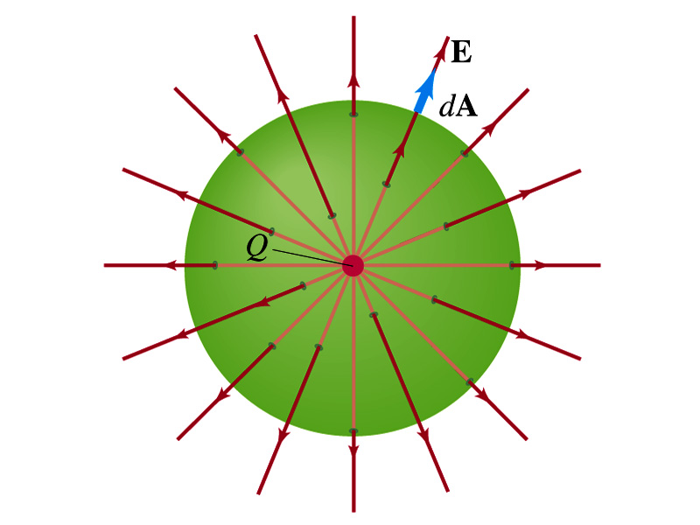
Coulomb’s Law from Gauss’ Law
Let’s consider a charge Q enclosed inside our imaginary Gaussian surface of sphere of radius r.
Since we can choose any surface enclosing the charge, we choose the simplest possible one! ☺
The surface is symmetric about the charge.
What does this tell us about the field E?
Must have the same magnitude (uniform) at any point on the surface
Points radially outward parallel to the surface vector dA.
The Gaussian integral can be written as
Solve
for E
Electric Field of
Coulomb’s Law

Slide 23
Gauss’ Law from Coulomb’s Law
Let’s consider a single static point charge Q surrounded by an imaginary spherical surface.
Coulomb’s law tells us that the electric field at a spherical surface of radius r is
Performing a closed integral over the surface, we obtain
Gauss’ Law

Slide 24
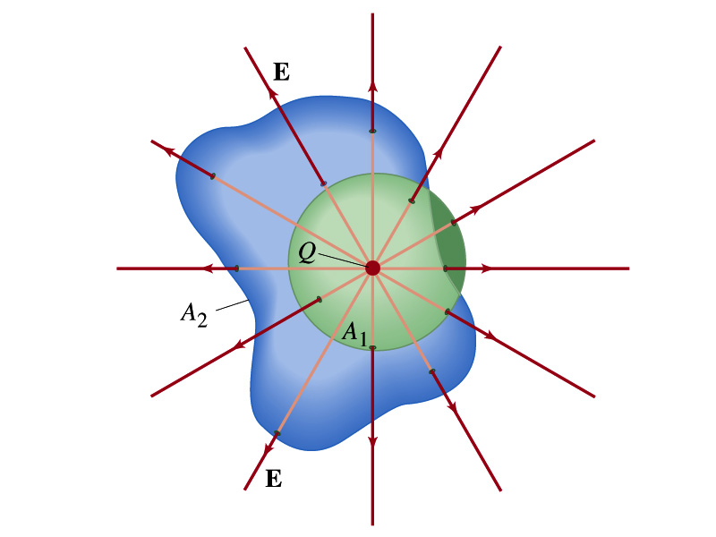
Gauss’ Law from Coulomb’s Law Irregular Surface
Let’s consider the same single static point charge Q surrounded by a symmetric spherical surface A₁ and a randomly shaped surface A₂.
What is the difference in the total number of field lines due to the charge Q, passing through the two surfaces?
None. What does this mean?
The total number of field lines passing through the surface is the same no matter what the shape of the enclosed surface is.
So we can write:
What does this mean?
The flux due to the given enclosed charge is the same no matter what the shape of the surface enclosing it is. ➔ Gauss’ law, , is valid for any surface surrounding a single point charge Q.

Slide 25
Gauss’ Law w/ more than one charge
Let’s consider several charges inside a closed surface.
For each charge, Q_{i} inside the chosen closed surface,
What is ?
The electric field produced by Q_{i} alone!
Since electric fields can be added vectorially, following the superposition principle, the total field E is equal to the sum of the fields due to each charge and any external fields. So
The value of the flux depends only on the charge enclosed in the surface!! ➔ Gauss’ law.
What is Q_{encl}?
The total enclosed charge!

Slide 26
So what is Gauss’ Law good for?
Derivation of Gauss’ law from Coulomb’s law is only valid for static electric charge.
Electric field can also be produced by changing magnetic fields.
Coulomb’s law cannot describe this field while Gauss’ law is still valid
Gauss’ law is more general than Coulomb’s law.
Can be used to obtain electric field, forces or obtain charges
Gauss’ Law: Any differences between the input and output flux of the electric field over any enclosed surface is due to the charge inside that surface!!!

Slide 27
Solving problems with Gauss’ Law
Identify the symmetry of the charge distributions
Draw an appropriate Gaussian surface, making sure it passes through the point you want to know the electric field
Use the symmetry of charge distribution to determine the direction of E at the point of the Gaussian surface
Evaluate the flux
Calculate the enclosed charge by the Gaussian surface
Ignore all the charges outside the Gaussian surface
Equate the flux to the enclosed charge and solve for E

Slide 28
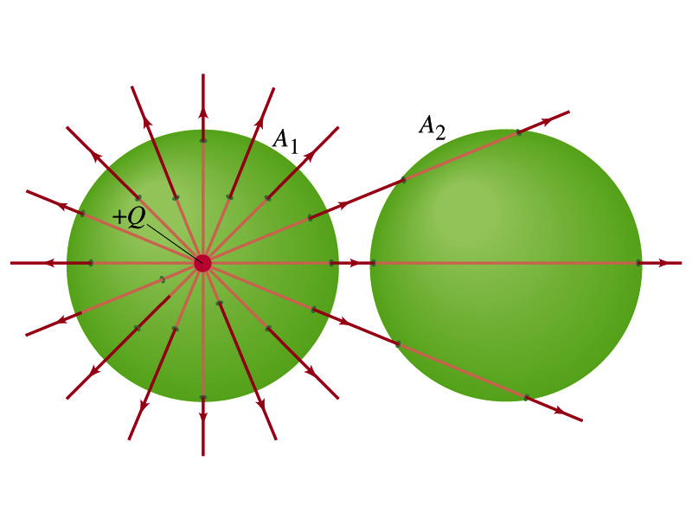
Example 22 – 2
Flux from Gauss’ Law: Consider two Gaussian surfaces, A₁ and A₂, shown in the figure. The only charge present is the charge +Q at the center of surface A₁. What is the net flux through each surface A₁ and A₂?
The surface A₁ encloses the charge +Q, so from Gauss’ law we obtain the total net flux
The surface A₂ the charge, +Q, is outside the surface, so the total net flux is 0.

Slide 29
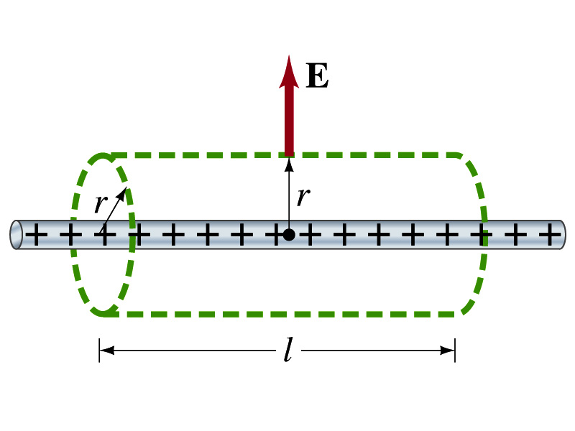
Example 22 – 6
Long uniform line of charge: A very long straight wire possesses a uniform positive charge per unit length, λ. Calculate the electric field at points near but outside the wire, far from the ends.
Which direction do you think the field due to the charge on the wire is?
Radially outward from the wire, the direction of radial vector r.
Due to cylindrical symmetry, the field is the same on the Gaussian surface of a cylinder surrounding the wire.
The end surfaces do not contribute to the flux at all. Why?
Because the field vector E is perpendicular to the surface vector dA.
From Gauss’ law
Solving for E

