Slide 1
PHYS 1441 – Section 002 Lecture #7
Monday, Sept. 25, 2017
Dr. Jaehoon Yu
Chapter 22
One last Gauss’ Law Example
Chapter 23 Electric Potential
Electric Potential Energy
Electric Potential due to Point Charges
Shape of the Electric Potential
Today’s homework is homework #5, due 11pm, Monday, Oct. 2!!

Slide 2
Announcements
Reading assignments
CH23.9
Bring out the special project #2

Slide 3
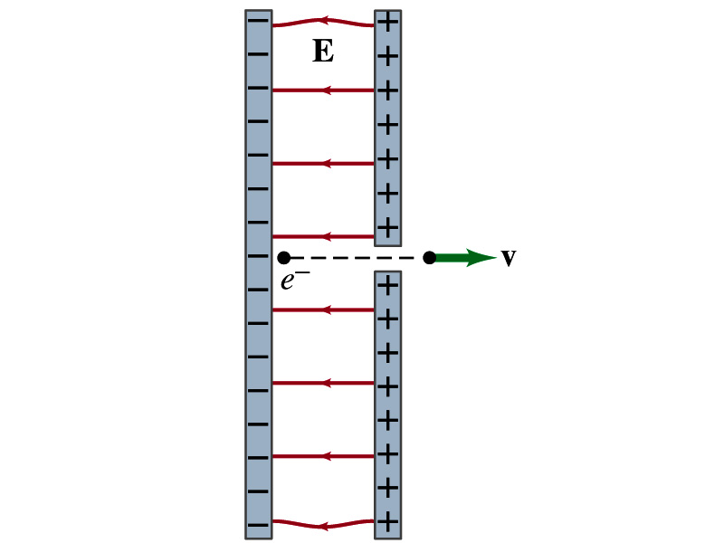
Reminder: Special Project #3
Particle Accelerator. A charged particle of mass M with charge -Q is accelerated in the uniform field E between two parallel charged plates whose separation is D as shown in the figure on the right. The charged particle is accelerated from an initial speed v₀ near the negative plate and passes through a tiny hole in the positive plate.
Derive the formula for the electric field E to accelerate the charged particle to a fraction f of the speed of light c. Express E in terms of M, Q, D, f, c and v₀.
(a) Using the Coulomb force and kinematic equations. (8 points)
(b) Using the work-kinetic energy theorem. ( 8 points)
(c) Using the formula above, evaluate the strength of the electric field E to accelerate an electron from 0.1% of the speed of light to 90% of the speed of light. You need to look up the relevant constants, such as mass of the electron, charge of the electron and the speed of light. (5 points)
Due beginning of the class Monday, Oct. 2

Slide 4
A Brain Teaser of Electric Flux
What would change the electric flux through a circle lying in the xz plane where the electric field is (10N/C)j?
Changing the magnitude of the electric field
Changing the surface area of the circle
Tipping the circle so that it is lying in the xy plane
All of the above
None of the above

Slide 5
Gauss’ Law Summary
The precise relation between flux and the enclosed charge is given by Gauss’ Law
ε₀ is the permittivity of free space in the Coulomb’s law
A few important points on Gauss’ Law
Freedom to choose!!
The integral is performed over the value of E on a closed surface of our choice in any given situation.
Test of existence of electrical charge!!
The charge Q_{encl} is the net charge enclosed by the arbitrary closed surface of our choice.
Universality of the law!
It does NOT matter where or how much charge is distributed inside the surface.
The charge outside the surface does not contribute to Q_{encl}. Why?
The charge outside the surface might impact field lines but not the total number of lines entering or leaving the surface

Slide 6
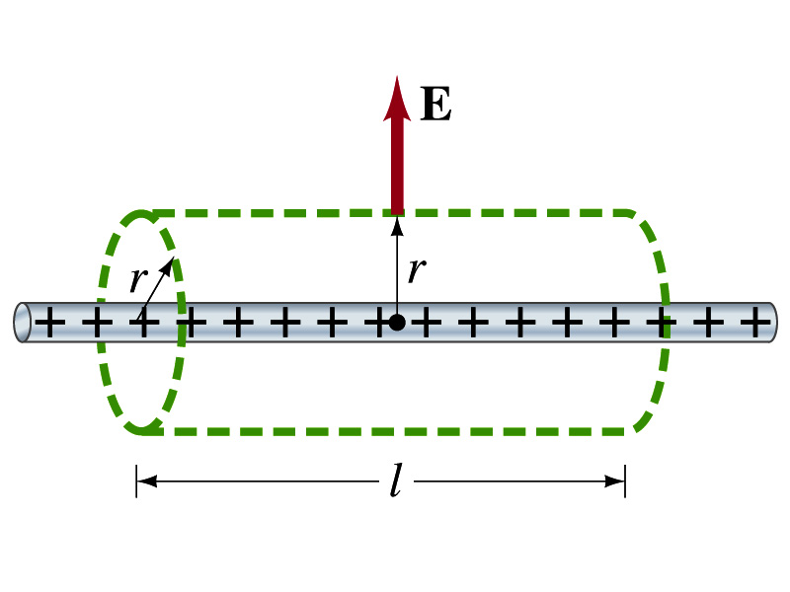
Example 22 – 6
Long uniform line of charge: A very long straight wire possesses a uniform positive charge per unit length, λ. Calculate the electric field at points near but outside the wire, far from the ends.
Which direction do you think the field due to the charge on the wire is?
Radially outward from the wire, the direction of radial vector r.
Due to cylindrical symmetry, the field is the same on the Gaussian surface of a cylinder surrounding the wire.
The end surfaces do not contribute to the flux at all. Why?
Because the field vector E is perpendicular to the surface vector dA.
From Gauss’ law
Solving for E

Slide 7
Electric Potential Energy
Concept of energy is very useful solving mechanical problems
Conservation of energy makes solving complex problems easier.
When can the potential energy be defined?
Only for a conservative force.
The work done by a conservative force is independent of the path. What does it only depend on??
The difference between the initial and final positions
Can you give me an example of a conservative force?
Gravitational force
Is the electrostatic force between two charges a conservative force?
Yes. Why?
The dependence of the force to the distance is identical to that of the gravitational force.
The only thing matters is the direct linear distance between the objects not the path.

Slide 8
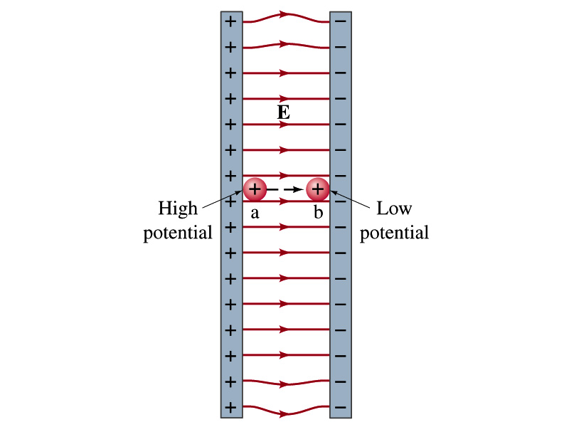
Electric Potential Energy
How would you define the change in electric potential energy U_{b} – U_{a}?
The potential gained by the charge as it moves from point a to point b.
The negative work done on the charge by the electric force to move it from a to b.
Let’s consider an electric field between two parallel plates w/ equal but opposite charges
The field between the plates is uniform since the gap is small and the plates are infinitely long…
What happens when we place a small charge, +q, on a point at the positive plate and let go?
The electric force will accelerate the charge toward negative plate.
What kind of energy does the charged particle gain?
Kinetic energy

Slide 9
Electric Potential Energy
What does this mean in terms of energies?
The electric force is a conservative force.
Thus, the mechanical energy (K+U) is conserved under this force.
The charged object has only the electric potential energy (no KE) at the positive plate.
The electric potential energy decreases and
Turns into kinetic energy as the electric force works on the charged object, and the charged object gains speed.
Point of greatest potential energy for
Positively charged object
Negatively charged object
PE=
U
0
KE=
0
K
ME=
U
K
U+K

Slide 10
Electric Potential
How is the electric field defined?
Electric force per unit charge: F/q
We can define electric potential (potential) as
The electric potential energy per unit charge
This is like the voltage of a battery…
Electric potential is written with a symbol V
If a positive test charge q has potential energy U_{a} at a point a, the electric potential of the charge at that point is

Slide 11
Electric Potential
Since only the difference in potential energy is meaningful, only the potential difference between two points is measurable
What happens when the electric force does “positive work”?
The charge gains kinetic energy
Electric potential energy of the charge decreases
Thus the difference in potential energy is the same as the negative of the work, W_{ba}, done on the charge by the electric field to move the charge from point a to b.
The potential difference V_{ba} is
Electric potential is independent of the test charge!! Unit?

Slide 12
A Few Things about Electric Potential
What does the electric potential depend on?
Other charges that creates the field
What about the test charge?
No, the electric potential is independent of the test charge
Test charge gains potential energy by existing in the potential created by other charges
Which plate is at a higher potential?
Positive plate. Why?
Since positive charge has the greatest potential energy on it.
What happens to the positive charge if it is let go?
It moves from higher potential to lower potential
How about a negative charge?
Its potential energy is higher on the negative plate. Thus, it moves from negative plate to positive. Potential difference is the same.
The unit of the electric potential is Volt (V).
From the definition, 1V = 1J/C.
Zero point of electric potential can be chosen arbitrarily.
Often the ground, a conductor connected to Earth, is zero.

Slide 13
Example 23 – 1
A negative charge: Suppose a negative charge, such as an electron, is placed at point b in the figure. If the electron is free to move, will its electric potential energy increase or decrease? How will the electric potential change?
An electron placed at point b will move toward the positive plate since it was released at its highest potential energy point.
It will gain kinetic energy as it moves toward left, decreasing its potential energy.
The electron, however, moves from the point b at a lower potential to point a at a higher potential. ΔV=V_{a} – V_{b}>0.
This is because the potential is generated by the charges on the plates not by the electron.

Slide 14
Electric Potential and Potential Energy
What is the definition of the electric potential?
The potential energy difference per unit charge
OK, then, how would you express the potential energy that a charge q would obtain when it is moved between point a and b with the potential difference V_{ba}?
In other words, if an object with charge q moves through a potential difference V_{ba}, its potential energy changes by qV_{ba}.
So based on this, how differently would you describe the electric potential in words?
A measure of how much energy an electric charge can acquire in a given situation
A measure of how much work a given charge can do.

Slide 15
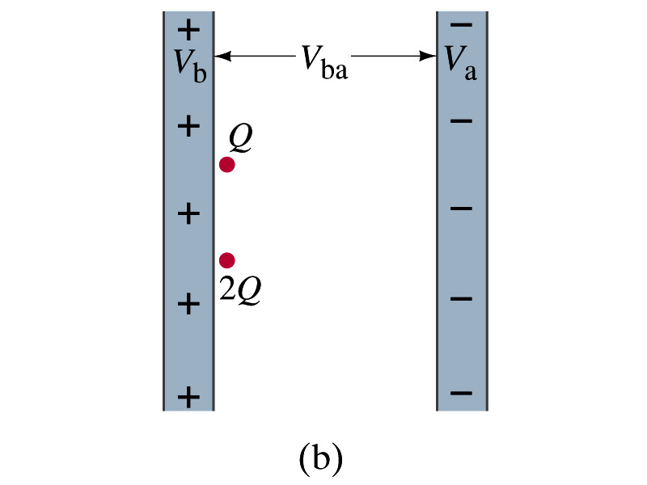
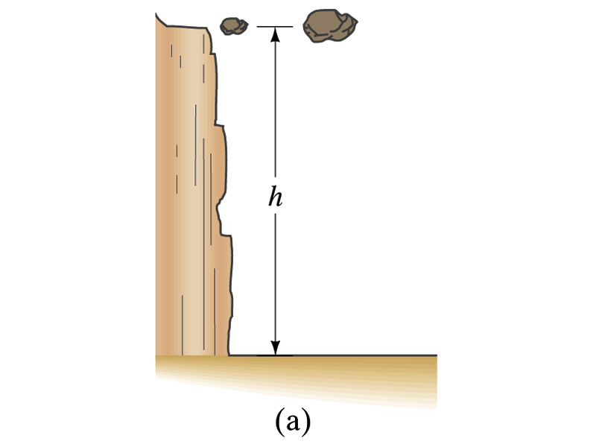
Comparisons of Potential Energies
Let’s compare gravitational and electric potential energies
m
2m
What are the potential energies of the rocks?
mgh and 2mgh
Which rock has a bigger potential energy?
The rock with a larger mass
Why?
It’s got a bigger mass.
What are the potential energies of the charges?
QV_{ba} and 2QV_{ba}
Which object has a bigger potential energy?
The object with a larger charge.
Why?
It’s got a bigger charge.
The potential is the same but the heavier rock or larger charge can do a greater work.

Slide 16
Electric Potential and Potential Energy
The electric potential difference gives potential energy or the possibility to perform work based on the charge of the object.
So what is happening in a battery or a generator?
They maintain a potential difference.
The actual amount of energy used or transformed depends on how much charge flows.
How much is the potential difference maintained by a car’s battery?
12Volts
If for a given period, 5C charge flows through the headlight lamp, what is the total energy transformed?
E_{tot}=5C*12V=60 Umm… What is the unit?
If it is left on twice as long? E_{tot}=10C*12V=120J.
Joules

Slide 17
Some Typical Voltages
Sources | Approximate Voltage
Thundercloud to ground | 10⁸ V
High-Voltage Power Lines | 10⁶ V
Power supply for TV tube | 10⁴ V
Automobile ignition | 10⁴ V
Household outlet | 10² V
Automobile battery | 12 V
Flashlight battery | 1.5 V
Resting potential across nerve membrane | 10⁻¹ V
Potential changes on skin (EKG and EEG) | 10⁻⁴ V
In a typical lightening strike, 15C of electrons are released in 500μs. What is the total kinetic energy of these electrons when they strike ground? What is the power released during this strike? What do you think will happen to a tree hit by this lightening?

Slide 18
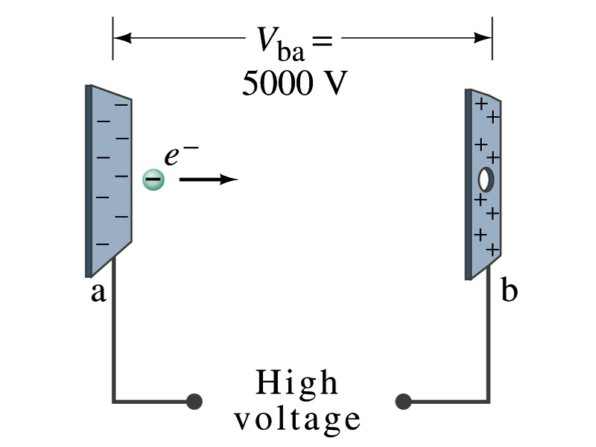
Example 23 – 2
Electrons in TV tube: Suppose an electron in the picture tube of a television set is accelerated from rest through a potential difference V_{ba}=+5000V. (a) What is the change in potential energy of the electron? (b) What is the speed of the electron (m=9.1x10⁻³¹kg) as a result of this acceleration? (c) Repeat for a proton (m=1.67x10⁻²⁷kg) that accelerates through a potential difference of V_{ba}=-5000V.
(a) What is the charge of an electron?
So what is the change of its potential energy?

Slide 19
Example 23 – 2
(b) Speed of the electron?
The entire potential energy of the electron turns to its kinetic energy. Thus the equation is
(C) Speed of a proton?

