Slide 1
PHYS 1444 – Section 002 Lecture #8
Wednesday, Sept. 27, 2017
Dr. Jaehoon Yu
Chapter 23 Electric Potential
Electric Potential due to Point Charges
Shape of the Electric Potential
V due to Charge Distributions Equi-potential Lines and Surfaces
Electric Potential Due to Electric Dipole
Electrostatic Potential Energy

Slide 2
Announcements
Quiz #2
Coming Monday, Oct. 2, at the beginning of the class (CH23.8?)
Covers CH22.1 through what we cover in class today
Bring your calculator but DO NOT input formula into it!
Cell phones or any types of computers cannot replace a calculator!
BYOF: You may bring a one 8.5x11.5 sheet (front and back) of handwritten formulae and values of constants for the quiz
No derivations, word definitions or solutions of any problems!
No additional formulae or values of constants will be provided!
Mid-term results
Class average: 48.1/95
Equivalent to 50.6/`00
Top score: 86/95
Colloquium today
Dr. Mustapha Ishak of UTD

Slide 3
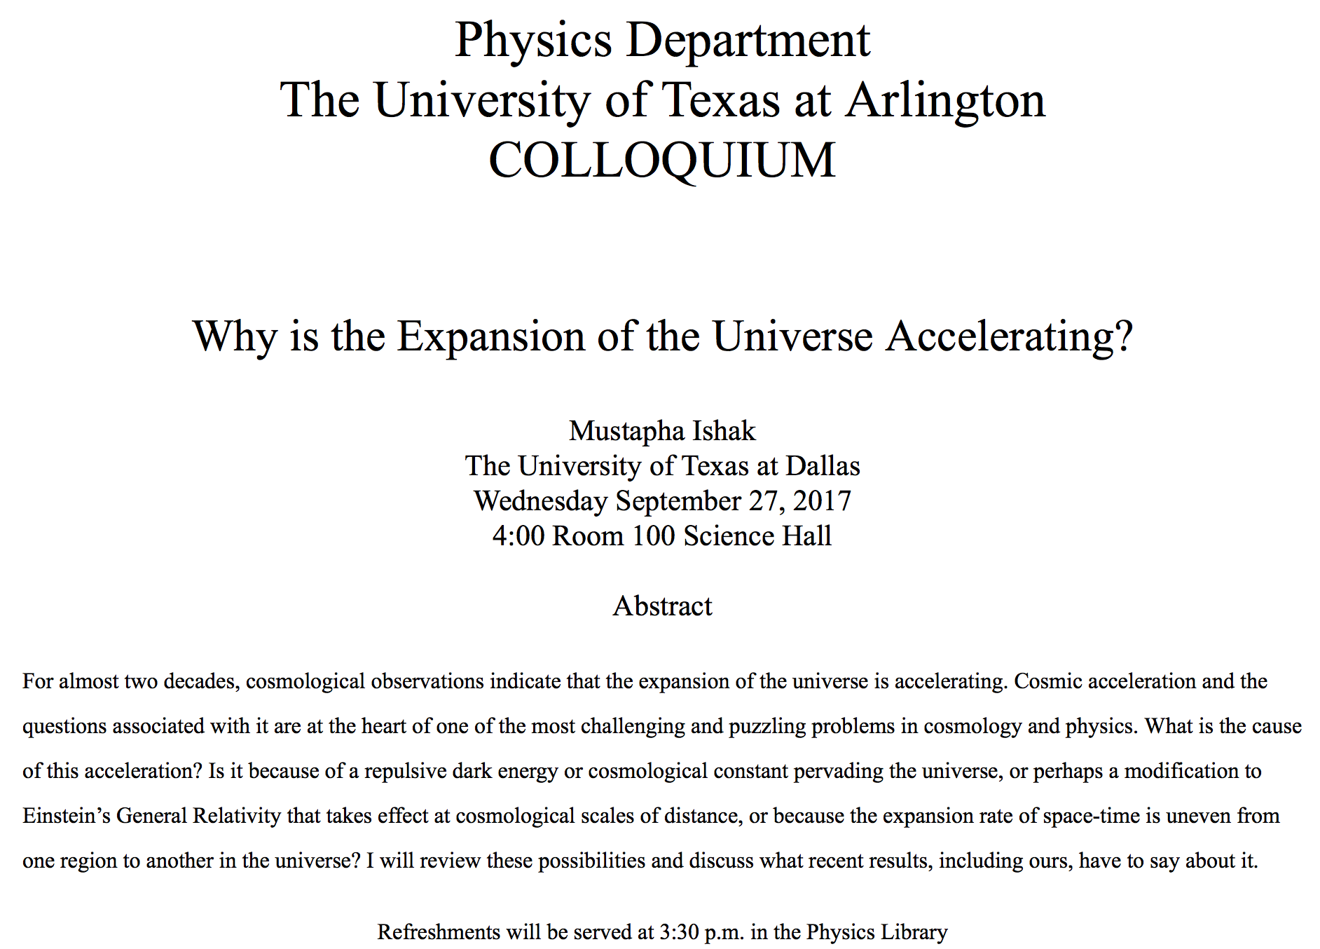

Slide 4
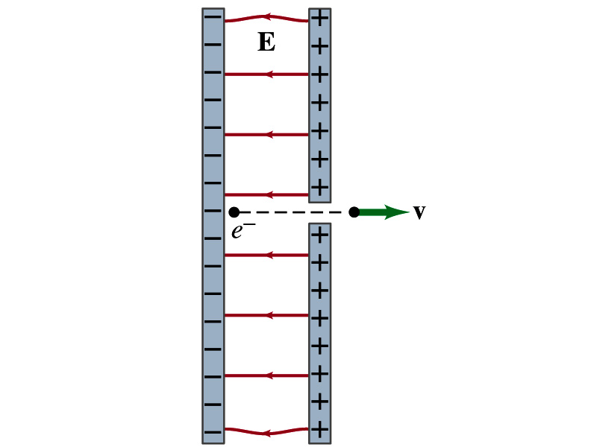
Reminder: Special Project #3
Particle Accelerator. A charged particle of mass M with charge -Q is accelerated in the uniform field E between two parallel charged plates whose separation is D as shown in the figure on the right. The charged particle is accelerated from an initial speed v₀ near the negative plate and passes through a tiny hole in the positive plate.
Derive the formula for the electric field E to accelerate the charged particle to a fraction f of the speed of light c. Express E in terms of M, Q, D, f, c and v₀.
(a) Using the Coulomb force and kinematic equations. (8 points)
(b) Using the work-kinetic energy theorem. ( 8 points)
(c) Using the formula above, evaluate the strength of the electric field E to accelerate an electron from 0.1% of the speed of light to 90% of the speed of light. You need to look up the relevant constants, such as mass of the electron, charge of the electron and the speed of light. (5 points)
Due beginning of the class Monday, Oct. 2

Slide 5
Electric Potential and Electric Field
The effect of a charge distribution can be described in terms of electric field or electric potential.
What kind of quantities are the electric field and the electric potential?
Electric Field:
Electric Potential:
Since electric potential is a scalar quantity, it is often easier to handle.
Well other than the above, how are these two quantities related?
Vector
Scalar

Slide 6
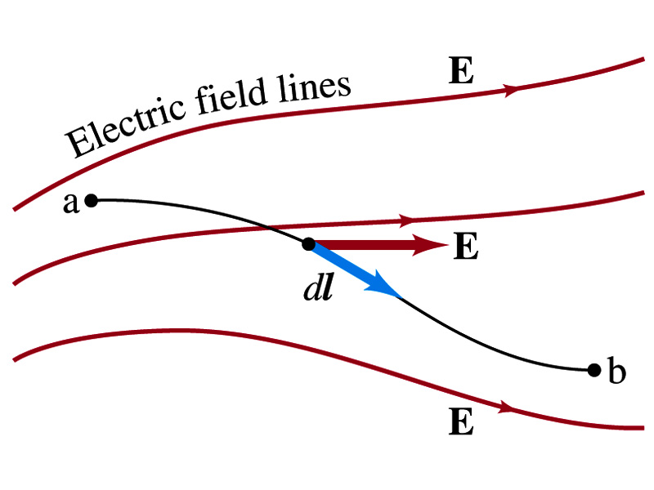
Electric Potential and Electric Field
Potential energy change is expressed in terms of a conservative force (point a at a higher potential)
For the electrical case, we are more interested in the potential difference:
This formula can be used to determine V_{ba} when the electric field is given.
When the field is uniform
so
What does “-”sign mean?
The direction of E is along that of decreasing potential.
Unit of the electric field in terms of potential?
V/m
Can you derive this from N/C?

Slide 7
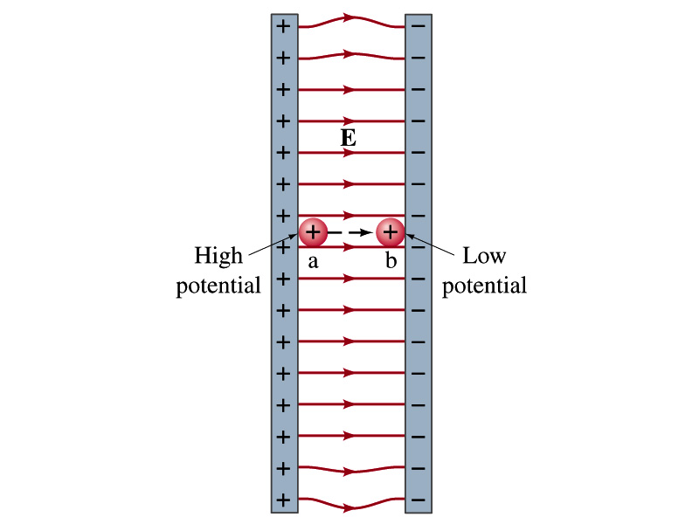
Example
Uniform electric field obtained from voltage: Two parallel plates are charged to a voltage of 50V. If the separation between the plates is 5.0cm, calculate the magnitude of the electric field between them, ignoring any fringe effect.
5cm
50V
What is the relationship between electric field and the potential for a uniform field?
Solving for E
Which direction is the field?
Direction of decreasing potential!

Slide 8
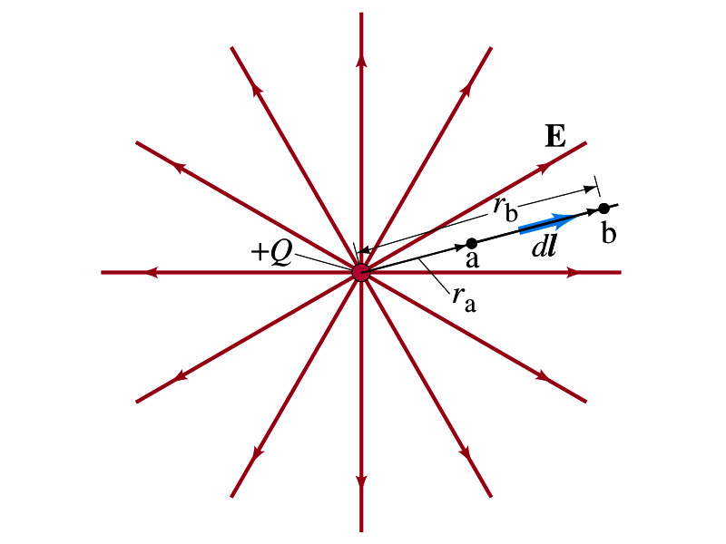
Electric Potential due to Point Charges
What is the electric field by a single point charge Q at a distance r?
Electric potential due to the field E for moving from point r_{a} to r_{b} in radial direction away from the charge Q is

Slide 9
Electric Potential due to Point Charges
Since only the differences in potential have physical meaning, we can choose at .
The electrical potential V at a distance r from a single point charge Q is
So the absolute potential by a single point charge can be thought of the potential difference by a single point charge between r and infinity

Slide 10
Properties of the Electric Potential
What are the differences between the electric potential and the electric field?
Electric potential
Electric potential energy per unit charge
Inversely proportional to the distance
Simply add the potential by each of the source charges to obtain the total potential from multiple charges, since potential is a scalar quantity
Electric field
Electric force per unit charge
Inversely proportional to the square of the distance
Need vector sums to obtain the total field from multiple source charges
Potential due to a positive charge is a large positive near the charge and decreases towards 0 at the large distance.
Potential due to a negative charge is a large negative near the charge and increases towards 0 at a large distance.

Slide 11
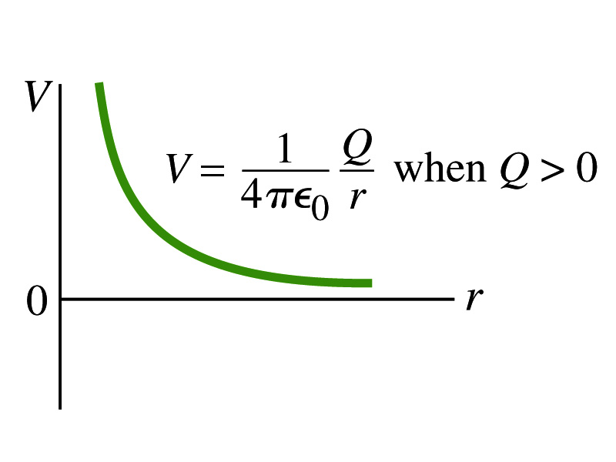
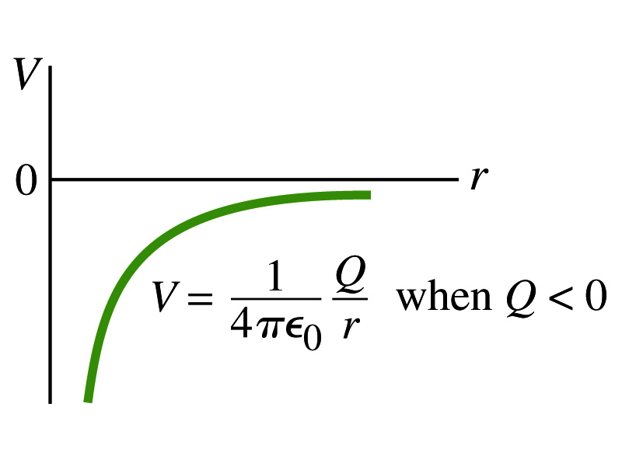
Shape of the Electric Potential
So, how does the electric potential look like as a function of distance?
What is the formula for the potential by a single charge?
Positive Charge
Negative Charge
Uniformly charged sphere would have the potential the same as a single point charge.
What does this mean?
Uniformly charged sphere behaves like all the charge is on the single point in the center.

Slide 12
Example 23 – 6
Work to bring two positive charges close together: What is minimum work required by an external force to bring the charge q=3.00μC from a great distance away (r=∞) to a point 0.500m from a charge Q=20.0 μC?
What is the work done by the electric field in terms of potential energy and potential?
Since we obtain
Electric force does negative work. In other words, the external force must work +1.08J to bring the charge 3.00μC from infinity to 0.500m to the charge 20.0μC.

